Slide 1
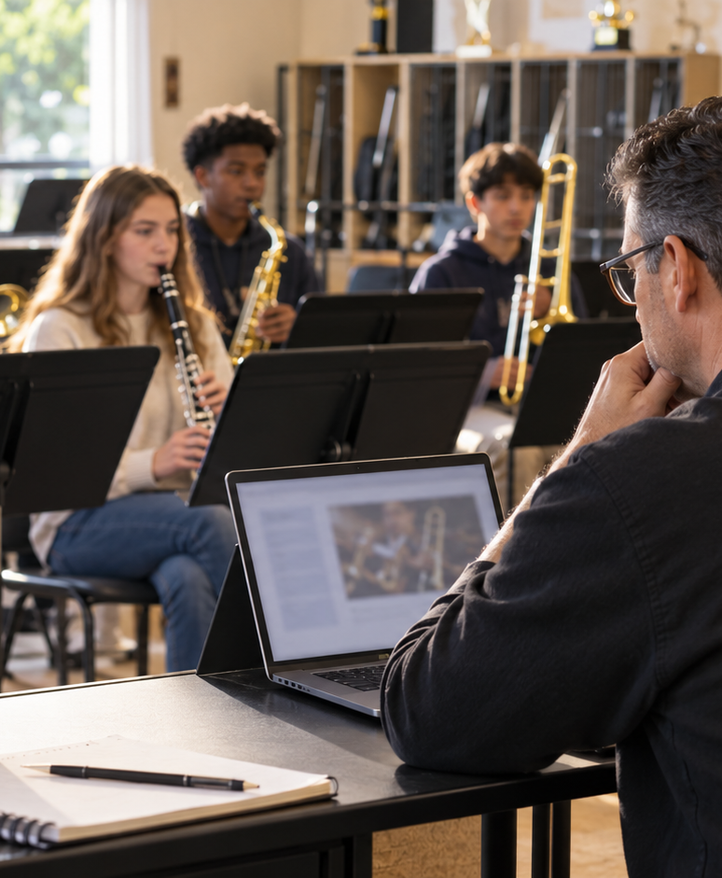
YIHA TEMPLATE SERIES
Band Director Lesson Plan PPT Template
Ms. Rivera maps a 45-minute rehearsal for the brass section before the spring concert.
11 EDITABLE SLIDES
VIOLET POP
Notes:
Cover template. Replace the title, subtitle and hero image. All text remains editable.

Slide 2
YIHA / EDITABLE PPTX
OVERVIEW
02
START HERE
band director lesson plan template in four chapters
01
Warm-Up
02
Technique
Warm up brass
Set tempo goals
03
Rehearsal
04
Wrap-Up
Rehearse tricky bars
Give section feedback
Notes:
Agenda layout. Rename the four chapters to match your narrative.

Slide 3
YIHA / EDITABLE PPTX
BIG IDEA
03
ONE IDEA
Focused rehearsal plan for a middle school band
Use this page for the core message, campaign promise, or thesis that frames the rest of the deck.
Notes:
Statement slide. Keep the headline short and make it the single idea people should remember.

Slide 4
YIHA / EDITABLE PPTX
SNAPSHOT
04
AT A GLANCE
Three lenses on band director lesson plan template
01
02
03
PRIMARY TOPIC
CONTENT ANGLE
NEXT ACTION
band director lesson plan template
Focused rehearsal plan for a middle schoo…
Education: Close with run-through
EXAMPLE — REPLACE
EXAMPLE — REPLACE
EXAMPLE — REPLACE
Notes:
Metric-card template. Every value is a clearly marked placeholder; replace it with sourced project data.

Slide 5
YIHA / EDITABLE PPTX
ROADMAP
05
FROM IDEA TO IMPACT
A five-stage Education workflow
1
2
3
4
5
Warm up brass
Set tempo goals
Rehearse tricky bars
Give section feedback
Close with run-through
DISCOVER
FRAME
CREATE
LAUNCH
LEARN
Notes:
Roadmap layout. Replace each stage label and description while preserving the left-to-right story.

Slide 6
YIHA / EDITABLE PPTX
COMPARISON
06
CHOOSE THE STRONGER PATH
band director lesson plan template: before and after
BEFORE
AFTER
Students start without a clear warm-up routine.
Each part of rehearsal has a clear purpose.
The brass section rushes through difficult measures.
Students revisit the hardest passage with guidance.
Feedback gets scattered during rehearsal.
The lesson ends with a confident full run-through.
Notes:
Comparison layout. Use for current/future state, option A/B, or problem/solution.

Slide 7
YIHA / EDITABLE PPTX
AUDIENCE
07
DESIGN FOR REAL PEOPLE
Three audience lenses
01
02
03
BAND DIRECTOR
MUSIC TEACHER
SCHOOL ADMIN
Needs a clear lesson flow for a focused rehearsal and section-specific coaching.
Needs a simple plan to guide students through warm-up, practice, and review.
Needs a clean overview of the rehearsal purpose and student activities.
Notes:
Persona-card template. Replace roles, motivations and friction points with audience research.

Slide 8
YIHA / EDITABLE PPTX
STORYBOARD
08
BUILD THE STORY BEAT BY BEAT
Four scenes, one coherent arc
01
02
03
04
[ DROP VISUAL HERE ]
[ DROP VISUAL HERE ]
[ DROP VISUAL HERE ]
[ DROP VISUAL HERE ]
HOOK
TENSION
REVEAL
ACTION
Warm up brass
Set tempo goals
Rehearse tricky bars
Give section feedback
Notes:
Storyboard template. Add one visual and one narrative beat per card.

Slide 9
YIHA / EDITABLE PPTX
CASE STUDY
09
TURN THE IDEA INTO A PROOF POINT
band director lesson plan template: a compact case-study structure
01
Insight
THE CHALLENGE
Set tempo goals
How can Ms. Rivera structure one rehearsal so the brass section stays focused and prepared?
02
Move
Rehearse tricky bars
03
Result
Add the real constraint, audience and baseline here.
Close with run-through
Notes:
Case-study template. Replace the example prompt with an actual challenge, action and sourced outcome.

Slide 10
YIHA / EDITABLE PPTX
ACTION PLAN
10
MOVE IN FOUR FOCUSED SPRINTS
band director lesson plan template: a practical action plan
WEEK 01
WEEK 02
WEEK 03
WEEK 04
ALIGN
BUILD
SHIP
LEARN
Warm up brass
Set tempo goals
Rehearse tricky bars
Close with run-through
OWNER [ NAME ]
OWNER [ NAME ]
OWNER [ NAME ]
OWNER [ NAME ]
Notes:
Action-plan template. Replace sprint labels, deliverables and owners.

Slide 11
MAKE THE NEXT SLIDE COUNT
A clear plan keeps rehearsal steady and productive.
Replace this closing message with a decision, invitation, or single next step.
ADD YOUR CALL TO ACTION →
yiha.ai/slides
Notes:
Closing template. End with one clear decision or call to action.

