Slide 1
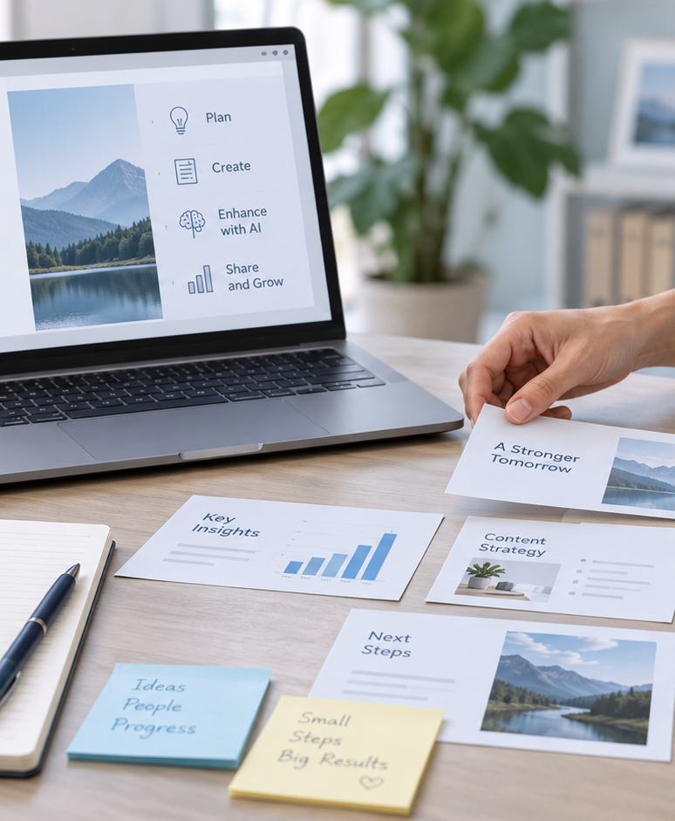
YIHA TEMPLATE SERIES
Chatgpt Prompt For Creating Presentation PPT Template
A startup team turns a rough product idea into a clear investor story.
11 EDITABLE SLIDES
COBALT TYPE
Notes:
Cover template. Replace the title, subtitle and hero image. All text remains editable.

Slide 2
YIHA / EDITABLE PPTX
OVERVIEW
02
START HERE
chatgpt prompt for creating presentation in four chapters
01
Project Brief
02
Prompt Setup
Define the goal
List key inputs
03
Slide Flow
04
Final Polish
Draft slide prompts
Refine the tone
Notes:
Agenda layout. Rename the four chapters to match your narrative.

Slide 3
YIHA / EDITABLE PPTX
BIG IDEA
03
ONE IDEA
Prompt-driven deck for a launch-ready pitch
Use this page for the core message, campaign promise, or thesis that frames the rest of the deck.
Notes:
Statement slide. Keep the headline short and make it the single idea people should remember.

Slide 4
YIHA / EDITABLE PPTX
SNAPSHOT
04
AT A GLANCE
Three lenses on chatgpt prompt for creating presentation
01
02
03
PRIMARY TOPIC
CONTENT ANGLE
NEXT ACTION
chatgpt prompt for creating presentation
Prompt-driven deck for a launch-ready pit…
Business: Export the deck
EXAMPLE — REPLACE
EXAMPLE — REPLACE
EXAMPLE — REPLACE
Notes:
Metric-card template. Every value is a clearly marked placeholder; replace it with sourced project data.

Slide 5
YIHA / EDITABLE PPTX
ROADMAP
05
FROM IDEA TO IMPACT
A five-stage Business workflow
1
2
3
4
5
Define the goal
List key inputs
Draft slide prompts
Refine the tone
Export the deck
DISCOVER
FRAME
CREATE
LAUNCH
LEARN
Notes:
Roadmap layout. Replace each stage label and description while preserving the left-to-right story.

Slide 6
YIHA / EDITABLE PPTX
COMPARISON
06
CHOOSE THE STRONGER PATH
chatgpt prompt for creating presentation: before and after
BEFORE
AFTER
Ideas are scattered across emails and notes.
The story is organized into a clear slide flow.
Slides feel generic and hard to follow.
Each slide has focused, usable prompt guidance.
The team spends too long rewriting copy.
The team can review and refine faster.
Notes:
Comparison layout. Use for current/future state, option A/B, or problem/solution.

Slide 7
YIHA / EDITABLE PPTX
AUDIENCE
07
DESIGN FOR REAL PEOPLE
Three audience lenses
01
02
03
STARTUP FOUNDER
PRODUCT MANAGER
AGENCY DESIGNER
Needs a fast way to turn scattered notes into a sharp pitch deck.
Needs a repeatable structure for presenting a new feature or roadmap.
Needs a clear prompt to speed up first-draft presentation copy.
Notes:
Persona-card template. Replace roles, motivations and friction points with audience research.

Slide 8
YIHA / EDITABLE PPTX
STORYBOARD
08
BUILD THE STORY BEAT BY BEAT
Four scenes, one coherent arc
01
02
03
04
[ DROP VISUAL HERE ]
[ DROP VISUAL HERE ]
[ DROP VISUAL HERE ]
[ DROP VISUAL HERE ]
HOOK
TENSION
REVEAL
ACTION
Define the goal
List key inputs
Draft slide prompts
Refine the tone
Notes:
Storyboard template. Add one visual and one narrative beat per card.

Slide 9
YIHA / EDITABLE PPTX
CASE STUDY
09
TURN THE IDEA INTO A PROOF POINT
chatgpt prompt for creating presentation: a compact case-study structure
01
Insight
THE CHALLENGE
List key inputs
How can a small team turn a rough launch idea into a polished presentation outline?
02
Move
Draft slide prompts
03
Result
Add the real constraint, audience and baseline here.
Export the deck
Notes:
Case-study template. Replace the example prompt with an actual challenge, action and sourced outcome.

Slide 10
YIHA / EDITABLE PPTX
ACTION PLAN
10
MOVE IN FOUR FOCUSED SPRINTS
chatgpt prompt for creating presentation: a practical action plan
WEEK 01
WEEK 02
WEEK 03
WEEK 04
ALIGN
BUILD
SHIP
LEARN
Define the goal
List key inputs
Draft slide prompts
Export the deck
OWNER [ NAME ]
OWNER [ NAME ]
OWNER [ NAME ]
OWNER [ NAME ]
Notes:
Action-plan template. Replace sprint labels, deliverables and owners.

Slide 11
MAKE THE NEXT SLIDE COUNT
Use prompts to shape a cleaner first draft.
Replace this closing message with a decision, invitation, or single next step.
ADD YOUR CALL TO ACTION →
yiha.ai/slides
Notes:
Closing template. End with one clear decision or call to action.

