Slide 1
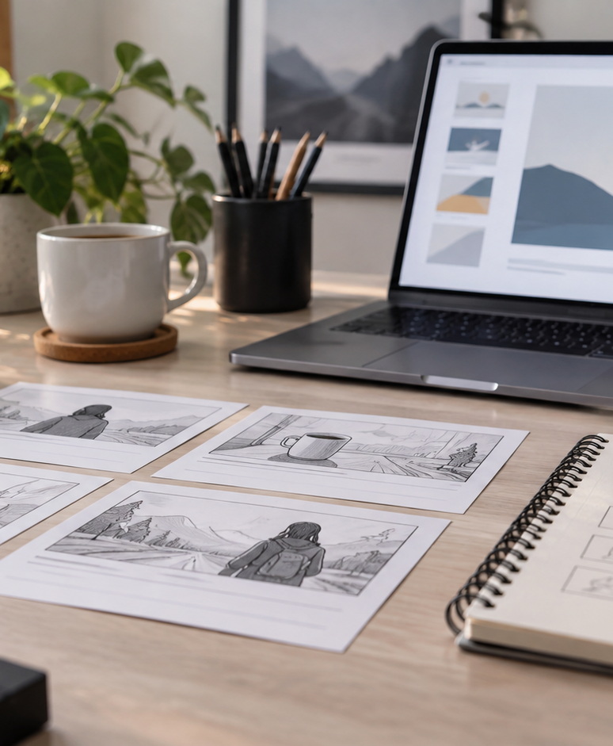
YIHA TEMPLATE SERIES
Cinematography Storyboard PPT Template
A noir short follows a detective through rain-soaked streets to a final reveal.
11 EDITABLE SLIDES
COBALT TYPE
Notes:
Cover template. Replace the title, subtitle and hero image. All text remains editable.

Slide 2
YIHA / EDITABLE PPTX
OVERVIEW
02
START HERE
cinematography storyboard in four chapters
01
Opening Scene
02
Visual Beats
Set the opening mood
Block key character moves
03
Camera Plan
04
Final Reveal
Plan shot transitions
Refine light and color
Notes:
Agenda layout. Rename the four chapters to match your narrative.

Slide 3
YIHA / EDITABLE PPTX
BIG IDEA
03
ONE IDEA
Map each shot to build tension and guide the reveal.
Use this page for the core message, campaign promise, or thesis that frames the rest of the deck.
Notes:
Statement slide. Keep the headline short and make it the single idea people should remember.

Slide 4
YIHA / EDITABLE PPTX
SNAPSHOT
04
AT A GLANCE
Three lenses on cinematography storyboard
01
02
03
PRIMARY TOPIC
CONTENT ANGLE
NEXT ACTION
cinematography storyboard
Map each shot to build tension and guide…
Video & Film: Review the final cut
EXAMPLE — REPLACE
EXAMPLE — REPLACE
EXAMPLE — REPLACE
Notes:
Metric-card template. Every value is a clearly marked placeholder; replace it with sourced project data.

Slide 5
YIHA / EDITABLE PPTX
ROADMAP
05
FROM IDEA TO IMPACT
A five-stage Video & Film workflow
1
2
3
4
5
Set the opening mood
Block key character moves
Plan shot transitions
Refine light and color
Review the final cut
DISCOVER
FRAME
CREATE
LAUNCH
LEARN
Notes:
Roadmap layout. Replace each stage label and description while preserving the left-to-right story.

Slide 6
YIHA / EDITABLE PPTX
COMPARISON
06
CHOOSE THE STRONGER PATH
cinematography storyboard: before and after
BEFORE
AFTER
Scenes feel disconnected
Each shot supports the mood
Camera moves are unclear
Transitions feel intentional
The ending lacks buildup
The reveal lands with impact
Notes:
Comparison layout. Use for current/future state, option A/B, or problem/solution.

Slide 7
YIHA / EDITABLE PPTX
AUDIENCE
07
DESIGN FOR REAL PEOPLE
Three audience lenses
01
02
03
FILM STUDENTS
DIRECTORS
STORYBOARD ARTISTS
Need a clear way to organize scenes, framing, and pacing for a short film.
Need a quick visual plan to align the crew on tone, movement, and sequence.
Need a clean structure for sketching shots and tracking story progression.
Notes:
Persona-card template. Replace roles, motivations and friction points with audience research.

Slide 8
YIHA / EDITABLE PPTX
STORYBOARD
08
BUILD THE STORY BEAT BY BEAT
Four scenes, one coherent arc
01
02
03
04
[ DROP VISUAL HERE ]
[ DROP VISUAL HERE ]
[ DROP VISUAL HERE ]
[ DROP VISUAL HERE ]
HOOK
TENSION
REVEAL
ACTION
Set the opening mood
Block key character moves
Plan shot transitions
Refine light and color
Notes:
Storyboard template. Add one visual and one narrative beat per card.

Slide 9
YIHA / EDITABLE PPTX
CASE STUDY
09
TURN THE IDEA INTO A PROOF POINT
cinematography storyboard: a compact case-study structure
01
Insight
THE CHALLENGE
Block key character moves
How does Lena turn a rainy alley chase into a clear, suspenseful sequence?
02
Move
Plan shot transitions
03
Result
Add the real constraint, audience and baseline here.
Review the final cut
Notes:
Case-study template. Replace the example prompt with an actual challenge, action and sourced outcome.

Slide 10
YIHA / EDITABLE PPTX
ACTION PLAN
10
MOVE IN FOUR FOCUSED SPRINTS
cinematography storyboard: a practical action plan
WEEK 01
WEEK 02
WEEK 03
WEEK 04
ALIGN
BUILD
SHIP
LEARN
Set the opening mood
Block key character moves
Plan shot transitions
Review the final cut
OWNER [ NAME ]
OWNER [ NAME ]
OWNER [ NAME ]
OWNER [ NAME ]
Notes:
Action-plan template. Replace sprint labels, deliverables and owners.

Slide 11
MAKE THE NEXT SLIDE COUNT
Frame the story before the camera rolls.
Replace this closing message with a decision, invitation, or single next step.
ADD YOUR CALL TO ACTION →
yiha.ai/slides
Notes:
Closing template. End with one clear decision or call to action.

