Slide 1
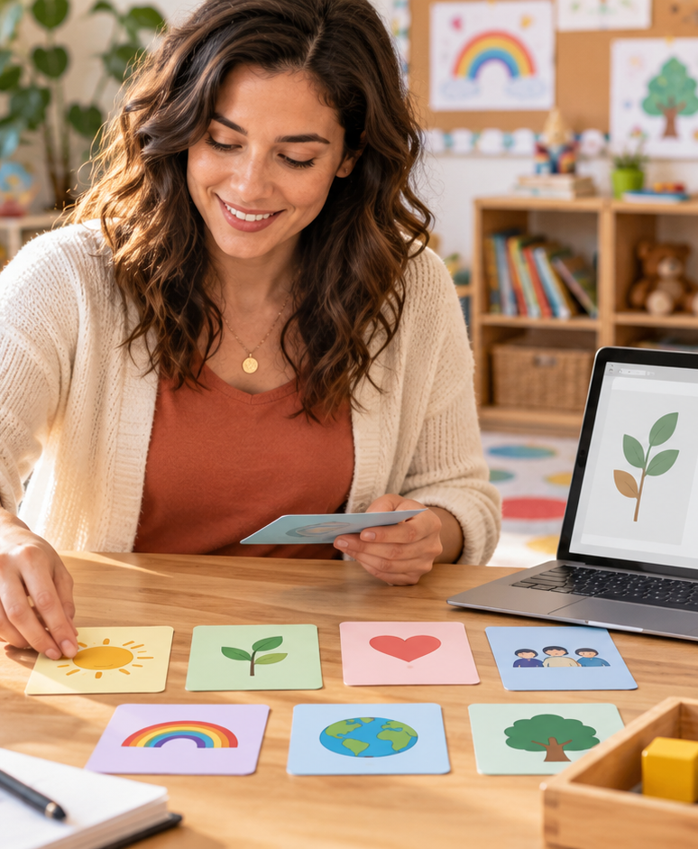
YIHA TEMPLATE SERIES
Early Childhood Education Lesson Plans PPT Template
Ms. Rivera guides preschoolers through a rainy-day lesson on colors, shapes, and sharing.
11 EDITABLE SLIDES
LIME STUDIO
Notes:
Cover template. Replace the title, subtitle and hero image. All text remains editable.

Slide 2
YIHA / EDITABLE PPTX
OVERVIEW
02
START HERE
early childhood education lesson plans in four chapters
01
Welcome Routine
02
Hands-On Centers
Warm-up circle time
Sort by color
03
Guided Practice
04
Wrap-Up Talk
Trace and name shapes
Partner counting game
Notes:
Agenda layout. Rename the four chapters to match your narrative.

Slide 3
YIHA / EDITABLE PPTX
BIG IDEA
03
ONE IDEA
Simple play-based learning for a mixed-age preschool class
Use this page for the core message, campaign promise, or thesis that frames the rest of the deck.
Notes:
Statement slide. Keep the headline short and make it the single idea people should remember.

Slide 4
YIHA / EDITABLE PPTX
SNAPSHOT
04
AT A GLANCE
Three lenses on early childhood education lesson plans
01
02
03
PRIMARY TOPIC
CONTENT ANGLE
NEXT ACTION
early childhood education lesson plans
Simple play-based learning for a mixed-ag…
Education: Reflect with cleanup
EXAMPLE — REPLACE
EXAMPLE — REPLACE
EXAMPLE — REPLACE
Notes:
Metric-card template. Every value is a clearly marked placeholder; replace it with sourced project data.

Slide 5
YIHA / EDITABLE PPTX
ROADMAP
05
FROM IDEA TO IMPACT
A five-stage Education workflow
1
2
3
4
5
Warm-up circle time
Sort by color
Trace and name shapes
Partner counting game
Reflect with cleanup
DISCOVER
FRAME
CREATE
LAUNCH
LEARN
Notes:
Roadmap layout. Replace each stage label and description while preserving the left-to-right story.

Slide 6
YIHA / EDITABLE PPTX
COMPARISON
06
CHOOSE THE STRONGER PATH
early childhood education lesson plans: before and after
BEFORE
AFTER
Children lose focus during transitions
Each activity has a clear purpose
Activities feel scattered and too long
Children move smoothly from one task to the next
Cleanup turns into a noisy struggle
The class ends calmly with a shared review
Notes:
Comparison layout. Use for current/future state, option A/B, or problem/solution.

Slide 7
YIHA / EDITABLE PPTX
AUDIENCE
07
DESIGN FOR REAL PEOPLE
Three audience lenses
01
02
03
PRESCHOOL TEACHERS
DAYCARE LEADERS
EARLY TUTORS
A clear lesson flow that keeps young children engaged and on task.
An easy plan for small-group activities, transitions, and cleanup.
A ready example for teaching colors, shapes, and social skills.
Notes:
Persona-card template. Replace roles, motivations and friction points with audience research.

Slide 8
YIHA / EDITABLE PPTX
STORYBOARD
08
BUILD THE STORY BEAT BY BEAT
Four scenes, one coherent arc
01
02
03
04
[ DROP VISUAL HERE ]
[ DROP VISUAL HERE ]
[ DROP VISUAL HERE ]
[ DROP VISUAL HERE ]
HOOK
TENSION
REVEAL
ACTION
Warm-up circle time
Sort by color
Trace and name shapes
Partner counting game
Notes:
Storyboard template. Add one visual and one narrative beat per card.

Slide 9
YIHA / EDITABLE PPTX
CASE STUDY
09
TURN THE IDEA INTO A PROOF POINT
early childhood education lesson plans: a compact case-study structure
01
Insight
THE CHALLENGE
Sort by color
How can Ms. Rivera keep preschoolers learning, moving, and calm in one morning?
02
Move
Trace and name shapes
03
Result
Add the real constraint, audience and baseline here.
Reflect with cleanup
Notes:
Case-study template. Replace the example prompt with an actual challenge, action and sourced outcome.

Slide 10
YIHA / EDITABLE PPTX
ACTION PLAN
10
MOVE IN FOUR FOCUSED SPRINTS
early childhood education lesson plans: a practical action plan
WEEK 01
WEEK 02
WEEK 03
WEEK 04
ALIGN
BUILD
SHIP
LEARN
Warm-up circle time
Sort by color
Trace and name shapes
Reflect with cleanup
OWNER [ NAME ]
OWNER [ NAME ]
OWNER [ NAME ]
OWNER [ NAME ]
Notes:
Action-plan template. Replace sprint labels, deliverables and owners.

Slide 11
MAKE THE NEXT SLIDE COUNT
A calm class day with playful learning
Replace this closing message with a decision, invitation, or single next step.
ADD YOUR CALL TO ACTION →
yiha.ai/slides
Notes:
Closing template. End with one clear decision or call to action.

