Slide 1
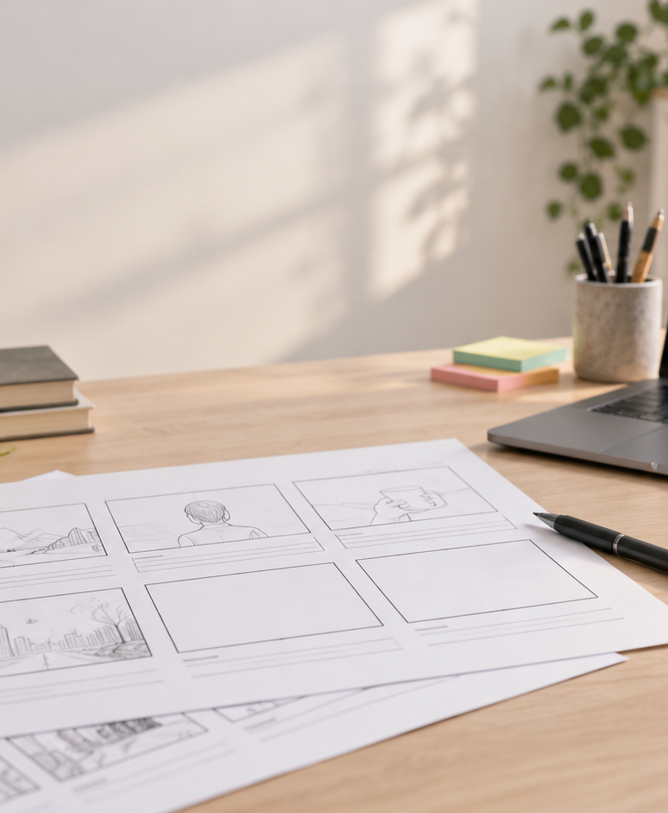
YIHA TEMPLATE SERIES
Free Storyboard Creator PPT Template
A student filmmaker maps a short sci-fi scene before the first shoot day.
11 EDITABLE SLIDES
LIME STUDIO
Notes:
Cover template. Replace the title, subtitle and hero image. All text remains editable.

Slide 2
YIHA / EDITABLE PPTX
OVERVIEW
02
START HERE
free storyboard creator in four chapters
01
Scene Setup
02
Frame Order
Define the scene
Sketch key frames
03
Dialogue Beats
04
Final Review
Add dialogue notes
Review shot flow
Notes:
Agenda layout. Rename the four chapters to match your narrative.

Slide 3
YIHA / EDITABLE PPTX
BIG IDEA
03
ONE IDEA
Plan each shot before filming begins.
Use this page for the core message, campaign promise, or thesis that frames the rest of the deck.
Notes:
Statement slide. Keep the headline short and make it the single idea people should remember.

Slide 4
YIHA / EDITABLE PPTX
SNAPSHOT
04
AT A GLANCE
Three lenses on free storyboard creator
01
02
03
PRIMARY TOPIC
CONTENT ANGLE
NEXT ACTION
free storyboard creator
Plan each shot before filming begins.
Video & Film: Share with crew
EXAMPLE — REPLACE
EXAMPLE — REPLACE
EXAMPLE — REPLACE
Notes:
Metric-card template. Every value is a clearly marked placeholder; replace it with sourced project data.

Slide 5
YIHA / EDITABLE PPTX
ROADMAP
05
FROM IDEA TO IMPACT
A five-stage Video & Film workflow
1
2
3
4
5
Define the scene
Sketch key frames
Add dialogue notes
Review shot flow
Share with crew
DISCOVER
FRAME
CREATE
LAUNCH
LEARN
Notes:
Roadmap layout. Replace each stage label and description while preserving the left-to-right story.

Slide 6
YIHA / EDITABLE PPTX
COMPARISON
06
CHOOSE THE STRONGER PATH
free storyboard creator: before and after
BEFORE
AFTER
Scenes feel scattered and hard to follow.
Each shot has a clear place in the sequence.
The crew keeps guessing what comes next.
The team can follow the scene with less confusion.
Important moments get missed during planning.
Key beats are planned before the camera rolls.
Notes:
Comparison layout. Use for current/future state, option A/B, or problem/solution.

Slide 7
YIHA / EDITABLE PPTX
AUDIENCE
07
DESIGN FOR REAL PEOPLE
Three audience lenses
01
02
03
FILM STUDENTS
INDIE CREATORS
TEACHERS
Need a simple way to organize scenes for class projects.
Need a clear visual plan before filming with a small crew.
Need an easy template for explaining story structure.
Notes:
Persona-card template. Replace roles, motivations and friction points with audience research.

Slide 8
YIHA / EDITABLE PPTX
STORYBOARD
08
BUILD THE STORY BEAT BY BEAT
Four scenes, one coherent arc
01
02
03
04
[ DROP VISUAL HERE ]
[ DROP VISUAL HERE ]
[ DROP VISUAL HERE ]
[ DROP VISUAL HERE ]
HOOK
TENSION
REVEAL
ACTION
Define the scene
Sketch key frames
Add dialogue notes
Review shot flow
Notes:
Storyboard template. Add one visual and one narrative beat per card.

Slide 9
YIHA / EDITABLE PPTX
CASE STUDY
09
TURN THE IDEA INTO A PROOF POINT
free storyboard creator: a compact case-study structure
01
Insight
THE CHALLENGE
Sketch key frames
How can Maya turn a rough sci-fi idea into a clear scene plan?
02
Move
Add dialogue notes
03
Result
Add the real constraint, audience and baseline here.
Share with crew
Notes:
Case-study template. Replace the example prompt with an actual challenge, action and sourced outcome.

Slide 10
YIHA / EDITABLE PPTX
ACTION PLAN
10
MOVE IN FOUR FOCUSED SPRINTS
free storyboard creator: a practical action plan
WEEK 01
WEEK 02
WEEK 03
WEEK 04
ALIGN
BUILD
SHIP
LEARN
Define the scene
Sketch key frames
Add dialogue notes
Share with crew
OWNER [ NAME ]
OWNER [ NAME ]
OWNER [ NAME ]
OWNER [ NAME ]
Notes:
Action-plan template. Replace sprint labels, deliverables and owners.

Slide 11
MAKE THE NEXT SLIDE COUNT
Turn rough ideas into a shoot-ready sequence.
Replace this closing message with a decision, invitation, or single next step.
ADD YOUR CALL TO ACTION →
yiha.ai/slides
Notes:
Closing template. End with one clear decision or call to action.

