Slide 1
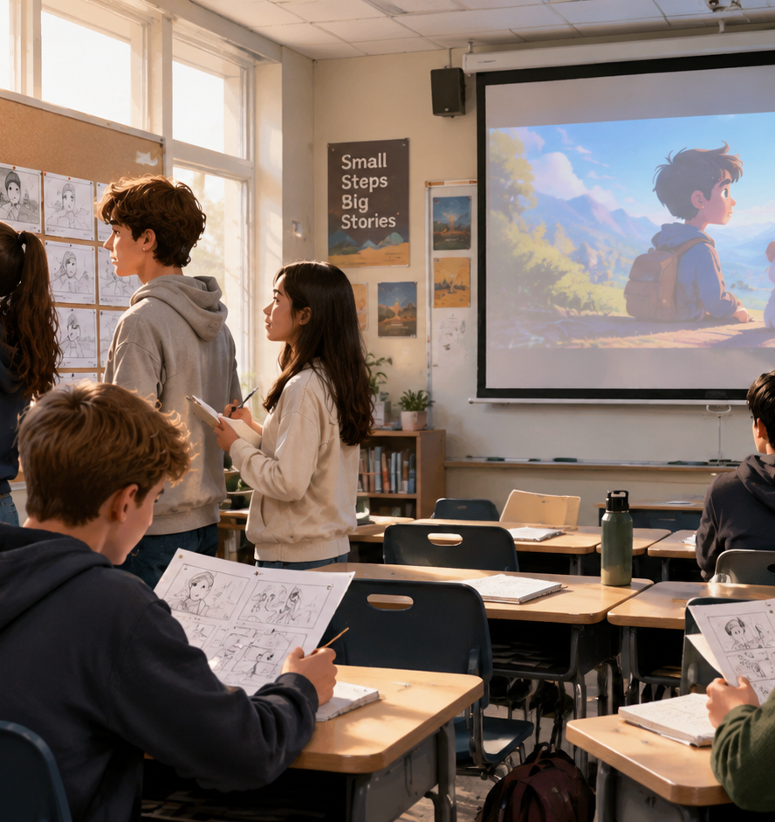
01 / 11
EDUCATION
Animated Short Film Lesson Plan
A Framework for Visual Literacy and Narrative Analysis
YIHA
Notes:
Welcome colleagues. Today we explore how animated short films can serve as rigorous literary texts in the English language arts classroom. Rather than treating animation as an occasional reward or passive entertainment, we will examine how short-form animation functions as dense visual and auditory literature. By looking closely at shot composition, narrative economy, sound design, and character beats, students can master literary analysis in an accessible and engaging format. Over the next ten slides, we will review the pedagogical foundations, step-by-step instructional phases, storyboarding transitions, cognitive management strategies, and rubric assessments required to execute an effective animated short film unit. Through structured viewing routines and creative production tasks, we can empower students to become discerning critical thinkers.
Sources:

Slide 2
02 / 11
Pedagogical Value of Short Animation
Moving images utilize a formal visual grammar that mirrors and reinforces prose reading strategies.
Film grammar relies on the continuous shot as its fundamental building block
Decoding strategies for moving images directly reinforce print text analysis
Adopting film crew roles transforms traditional literature circles into collaborative inquiry
YIHA
Notes:
Animated short films belong in the literacy classroom because they share deep structural parallels with written prose. As detailed by ReadWriteThink in their moving-image curriculum, film and animation have a distinct visual grammar where images and sounds are sequenced to convey connected meaning. A continuous camera shot functions much like a sentence, acting as the basic building block of visual narrative. Furthermore, educator John Golden points out that the cognitive skills students use to decode visual scenes are the same skills they use for written text. Reframing literature circles into film crew roles like director or set designer captures natural student interest and turns it into serious literary analysis. (Sources: ReadWriteThink Reading Movies and TV; ReadWriteThink Literature Circle Roles Reframed).
Sources:
https://www.readwritethink.org/classroom-resources/lesson-plans/reading-movies-learning-language
https://www.readwritethink.org/classroom-resources/lesson-plans/literature-circle-roles-reframed

Slide 3
03 / 11
Deconstructing Narrative Structure and Beats
Short animated films demonstrate tight narrative economy through visual character arcs and plot milestones.
01
Short narrative structures prioritize conciseness where every visual detail matters
02
Core plot milestones map clearly from exposition to climax and resolution
03
Example: A 3 to 7 minute animation compresses rising action into rapid visual beats
YIHA
Notes:
Deconstructing plot in an animated short allows students to see classic story architecture in minutes. As outlined in ReadWriteThink materials on plot structure, stories move through exposition, rising action, climax, falling action, and resolution. Short stories and animated shorts share a common characteristic of conciseness, as described by MyEnglishPages, where every single detail must directly advance the central narrative. In a three-to-seven-minute animated short, characters cannot rely on lengthy verbal exposition. They must reveal intentions and stakes through immediate physical actions. Mapping these visual beats onto a graphic organizer trains students to identify causal relationships before tackling longer, more complex written texts. (Sources: ReadWriteThink Teaching Plot Structure; MyEnglishPages Short Story Lesson Plan).
Sources:
https://www.readwritethink.org/classroom-resources/lesson-plans/teaching-plot-structure-through
https://www.myenglishpages.com/the-elements-of-a-short-story-lesson-plan/

Slide 4
04 / 11
Analyzing Visual Language, Framing, and Color
Camera angles, intentional framing, and color palettes provide critical textual evidence for student inferences.
Close-up shots highlight internal emotions while long shots establish setting
Worm eye and bird eye angles alter status, vulnerability, and spatial perspective
Color palettes signal psychological shifts and thematic changes across scenes
YIHA
Notes:
Teaching visual literacy requires giving students the precise vocabulary of cinematography. In his visual storytelling course, artist Mike Hawthorne explains how intentional camera placement directs the viewer's eye and paces the narrative. Close-ups convey intense emotional reactions, long shots anchor setting, and extreme angles like worm's-eye or bird's-eye views shift perspective dramatically. Hawthorne also stresses using extreme close-ups sparingly for maximum impact. Director Martin Scorsese emphasizes in Edutopia that students must learn to interpret camera movement, lighting, and visual grammar critically. When students analyze why an animator changes color saturation or framing, they learn to justify their literary inferences with concrete visual evidence. (Sources: Proko Mastering Visual Storytelling; Edutopia Martin Scorsese Teaching Visual Literacy).
Sources:
https://www.proko.com/course-lesson/mastering-visual-storytelling-angles-shots-and-camerawork-for-comics
https://www.edutopia.org/martin-scorsese-teaching-visual-literacy

Slide 5
05 / 11
Decoding Sound Design, Foley, and Music
Audio in animation is entirely fabricated, revealing how layered soundscapes create mood and character realism.
Foley effects add human weight through performed footsteps, cloth rustles, and props
Ambient sound beds define atmospheric environment, location, and psychological mood
Deliberate silence and musical cues guide audience tension without spoken dialogue
YIHA
Notes:
Animation starts in complete silence, which makes sound design an exceptionally clear teaching topic. According to the EmojiFaces sound design guide, effective cinematic audio relies on distinct, purposeful layers: clear dialogue, human Foley sounds, ambient backgrounds, sound effects, and music. Lightworks documentation also highlights that while ambient beds build continuous atmosphere, Foley effects provide physical presence and weight to on-screen objects and character movement. A powerful classroom strategy is to play an animated sequence with the display blacked out. Students listen strictly for ambient hums, footsteps, and musical shifts, deducing character emotion and narrative suspense before seeing a single visual frame. (Sources: EmojiFaces Sound Design Guide; Lightworks Sound Effects 101).
Sources:
https://emojifaces.org/blog/2026/09/05/sound-design-guide-a-complete-sound-design-guide-for-dialogue-foley-sound-effects-ambience-music-mixing-and-storytelling/
https://lwks.com/blog/sound-effects-101-ambient-vs.-foley

Slide 6
06 / 11
The Three-Stage Active Viewing Sequence
Scaffolding film analysis across pre-viewing, during-viewing, and post-viewing stages prevents passive consumption.
01
Stage 1 Pre-Viewing: Predict conflicts using title stills and character designs
02
Stage 2 During-Viewing: Log visual grammar and auditory cues during paused replays
03
Stage 3 Post-Viewing: Conduct small-group critique connecting technique to theme
YIHA
Notes:
Without structured instructional scaffolding, students easily fall into passive television habits. Following reading models from ReadWriteThink, lessons should be organized into three distinct phases. In pre-viewing, students examine title cards or initial sketches to make evidence-based predictions about character goals. During the first viewing, students watch uninterrupted to absorb story flow. Then, during a guided second screening, teachers pause at pivotal moments so students can record camera angles, Foley shifts, and character reactions into graphic organizers. Finally, in post-viewing discussions, students collaborate in small teams to evaluate how those deliberate storytelling choices support the overarching theme. (Sources: ReadWriteThink Teaching About Story Structure; ReadWriteThink Teaching Plot Structure).
Sources:
https://www.readwritethink.org/classroom-resources/lesson-plans/teaching-about-story-structure
https://www.readwritethink.org/classroom-resources/lesson-plans/teaching-plot-structure-through

Slide 7
07 / 11
Transitioning to Student Storyboarding
Students apply literary and cinematic principles by composing concise pitch sheets and six-frame storyboards.
Storyboards function as visual blueprints that plan narrative pacing and transitions
Pitch decks establish visual tone, color philosophy, and thematic direction
Recommendation: Assign a 6-frame storyboard challenge with written audio notes
YIHA
Notes:
Analyzing short animation naturally prepares students to create their own visual narratives. Advids notes that storyboards serve as visual blueprints, allowing creators to map narrative flow, scene transitions, and pacing before animation begins. Furthermore, industry guides from Shore Scripts and Presentations Template highlight that pitch decks and mood boards translate abstract story concepts into concrete visual plans, defining color palettes and emotional tone. In the classroom, a six-frame storyboard assignment challenges students to construct a complete micro-narrative. Each frame requires a sketch, a designated shot type, and accompanying notes on sound and character motivation. (Sources: Advids 3D Animated Ad Video; Shore Scripts Pitch Deck Guide; Presentations Template Pitch Deck).
Sources:
https://advids.co/blog/3d-animated-ad-video
https://www.shorescripts.com/creating-a-successful-pitch-deck-for-your-short-film/
https://presentationstemplate.com/blog/short-film-pitch-deck-visual-storytelling-for-funding

Slide 8
08 / 11
Tradeoffs Between Animation and Print Texts
Animation accelerates structural understanding but must be paired with print to develop deep reading stamina.
Short animation provides high-speed access to literary concepts for all abilities
Print texts remain irreplaceable for teaching syntax, vocabulary, and written stamina
Recommendation: Pair animated shorts as visual anchors before reading complex prose
YIHA
Notes:
While short animation offers tremendous instructional benefits, teachers must evaluate its educational tradeoffs against traditional literature. Curriculum guidelines on ReadWriteThink emphasize that students need exposure to both print and nonprint media to develop robust analytical skills. Animation accelerates the understanding of abstract concepts such as foreshadowing, dramatic irony, and character development, especially for English learners and striving readers. However, short films do not develop orthographic decoding, sustained print stamina, or exposure to complex sentence syntax. The most effective instructional strategy uses animated shorts as conceptual bridges, grounding students in narrative mechanics before challenging them with paired written texts. (Sources: ReadWriteThink Reading Movies and TV; ReadWriteThink Literature Circle Roles Reframed).
Sources:
https://www.readwritethink.org/classroom-resources/lesson-plans/reading-movies-learning-language
https://www.readwritethink.org/classroom-resources/lesson-plans/literature-circle-roles-reframed

Slide 9
09 / 11
Managing Pacing, Equipment, and Cognitive Load
Controlling cognitive load and optimizing classroom equipment ensures visual analysis remains focused and accessible.
01
Working memory holds around seven new chunks and actively processes roughly four
02
Avoid dual-task overload by pre-teaching terminology rather than talking over playback
03
Screening moving media for educational media literacy meets fair use principles
YIHA
Notes:
Practical classroom logistics require careful management of cognitive load and equipment. Research published by the New South Wales Centre for Education Statistics and Evaluation indicates that human working memory holds only around seven chunks of new information, actively processing about four at a time. Presenting complex text on screen while lecturing creates split-attention redundancy that overwhelms working memory. Teachers should introduce vocabulary before screening rather than narrating over the film. In addition, ReadWriteThink notes that fair use principles allow educators to screen moving-image media for media literacy instruction without copyright infringement concerns. Ensuring proper classroom audio projection and screen sightlines prevents technical obstacles from derailing the lesson. (Sources: CESE Managing Cognitive Load; ReadWriteThink Reading Movies and TV).
Sources:
https://education.nsw.gov.au/about-us/education-data-and-research/cese/publications/practical-guides-for-educators/managing-cognitive-load-through-effective-presentations
https://www.readwritethink.org/classroom-resources/lesson-plans/reading-movies-learning-language

Slide 10
10 / 11
Assessing Multimodal Literacy and Rubrics
Assessment rubrics must separate basic plot summary from high-order analysis of visual and auditory storytelling.
Multimodal methodology integrates viewing and representing with reading and writing
Rubrics evaluate narrative comprehension alongside precise cinematic terminology
Evidence must be cited directly from camera shots, color shifts, and audio tracks
YIHA
Notes:
Evaluating student progress in visual literacy demands rubrics that look beyond superficial plot recall. Lesson frameworks from Film English, including units on Pip and Soar, demonstrate how a multimodal methodology integrates viewing and representing with traditional reading, writing, and speaking. Assessment rubrics should score students on four core criteria: identifying narrative turning points, using accurate technical vocabulary such as tracking shot or ambient noise, citing specific visual and auditory evidence, and writing evaluative commentary that links techniques to thematic meaning. This structured evaluation ensures that students demonstrate genuine critical literacy rather than informal impressions. (Sources: Film English ESL Lesson Plan Pip; Film English Lesson Plan Soar).
Sources:
https://film-english.com/esl-lesson-plan-pip/
https://film-english.com/lesson-plan-soar/

Slide 11
11 / 11
Conclusion and Next Steps for Educators
Integrating animated shorts establishes a rigorous foundation for lifelong critical viewing and analytical literacy.
Animated shorts provide compact, equitable platforms for rigorous textual analysis
Students transfer visual decoding skills directly to complex written literature
Next step: Pilot a single short-film viewing lesson before launching storyboard units
YIHA
Notes:
In conclusion, animated short films offer secondary English educators a potent, research-grounded instructional tool. By engaging with moving-image texts through structured active viewing, students learn that camera framing, lighting, Foley sound effects, and narrative pacing are deliberate rhetorical choices. These visual decoding habits build immediate bridges back to traditional print literature, enhancing reading comprehension and analytical writing. As a recommended next step, begin with a single three-to-five-minute animated short using a guided three-stage viewing organizer. Once students master cinematic vocabulary and structural analysis, advance to creative storyboarding and comparative literature projects. (Source: ReadWriteThink Reading Movies and TV).
Sources:
https://www.readwritethink.org/classroom-resources/lesson-plans/reading-movies-learning-language

