Slide 1
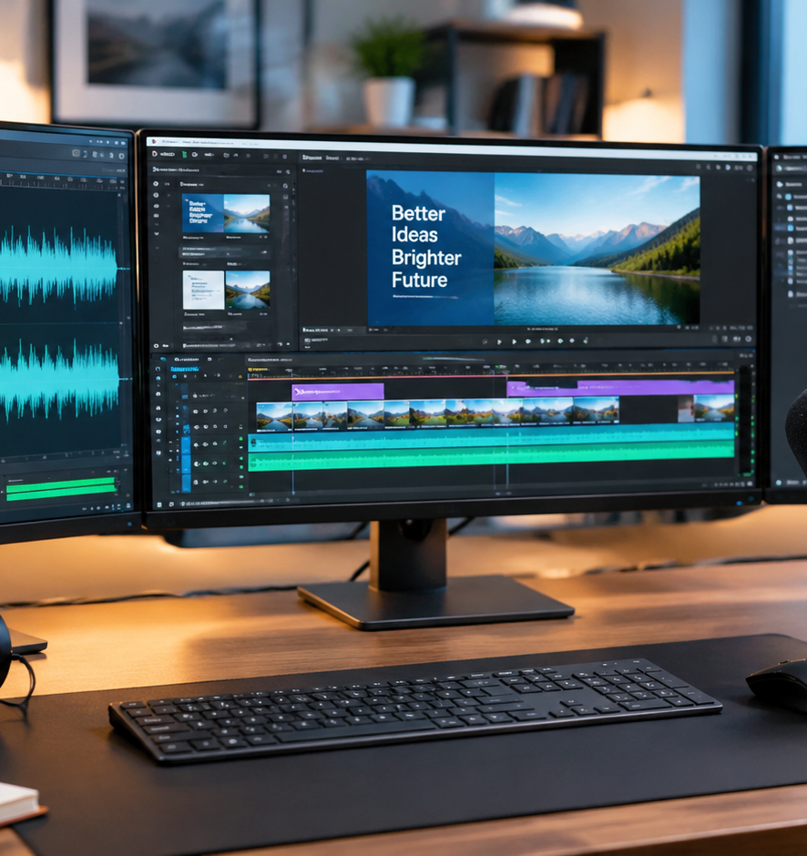
01 / 11
VIDEO PRODUCTION
Video Presentation Editing Software
Technical Architecture, Production Workflows, and Enterprise Distribution
YIHA
Notes:
Welcome to this technical presentation on video presentation editing software workflows. Across this session, we will examine how modern digital platforms transform static slide decks into fully synchronized multimedia deliverables. As organizations shift toward distributed asynchronous communication, presentation authors face practical technical requirements that extend far beyond traditional slide deck design. In this deck, we evaluate the core mechanics of non-linear editing, transcript-driven workflows, multi-stream screen capture, and post-production audio optimization. Furthermore, we analyze accessibility standards like WebVTT captions and enterprise packaging specifications like SCORM and xAPI. By understanding these production pipelines, technical teams can produce scalable, maintainable presentations without experiencing timeline bottlenecks, audio synchronization drift, or costly rework during final media exports.
Sources:

Slide 2
02 / 11
Transitioning from Slide Decks to Video Output
Video presentations require tight audiovisual synchronization to replace live presenter pacing.
Static slides become continuous media streams with locked timing
Slide-to-video rendering automates transitions and audio matching
Narration overlay ties spoken explanations to visual sequence steps
YIHA
Notes:
When moving from live slideshows to standalone video files, the author loses the ability to respond dynamically to audience questions. In a live setting, a presenter can pause or clarify points on demand. In recorded media, every pause and transition must be intentionally designed to prevent viewer disengagement. As evaluated in the 2026 WorldMetrics comparative review of video slide presentation software, dedicated slide-to-video engines convert standardized decks into timed MP4 files with synchronized voiceover. Narration overlay ensures that on-screen build steps match vocal delivery. Authors must treat each slide as a timed multimedia asset rather than an open-ended visual note, ensuring smooth pacing throughout the recorded presentation.
Sources:
https://worldmetrics.org/best/video-slide-presentation-software/

Slide 3
03 / 11
Comparing Multi-Track NLEs and Text-Based Editors
Track NLEs offer precision compositing while text editors accelerate rough dialogue cuts.
01
Traditional NLEs structure media along multi-track timecode sequences
02
Transcript editors delete video clips by deleting words in the text
03
Hybrid editing combines rapid text trimming with detailed track finishing
YIHA
Notes:
Video presentation authoring platforms generally fall into two distinct structural models. Traditional non-linear editors like Adobe Premiere Pro and DaVinci Resolve Studio rely on horizontal timecode tracks. They provide exact frame trimming, fine keyframing, and multi-channel audio mixing. In contrast, tools like Descript introduce text-based editing, where deleting a sentence in the transcript automatically cuts the corresponding video frames on the underlying timeline. As Tone Production observed in their 2026 workflow guide, text-based workflows can dramatically shorten the rough cut phase on dialogue-heavy footage. However, polishing still requires timeline tools to smooth edit points, insert cutaway visuals, and balance background audio levels across tracks.
Sources:
https://toneproduction.net/ai-tools-video-editing-workflow-2026/

Slide 4
04 / 11
Multi-Stream Screen Capture Ingestion Pipelines
Isolating display feeds, webcam, and system audio prevents technical editing dead ends.
Independent tracks for system audio, microphone, screen, and camera
Fixed frame rates prevent synchronization drift during long recordings
Lightweight recorders prioritize speed while suites support deep edits
YIHA
Notes:
High-quality software demonstrations require multi-stream capture architectures. Flattening screen activity, camera footage, and audio into a single recorded track creates severe editing limitations during post-production. Dedicated recording tools like Camtasia capture independent tracks for microphone audio, desktop system audio, screen video, and webcam feeds. As Vidpros noted in their 2026 training software comparison, quick screen capture tools like Loom excel at rapid asynchronous updates, but full capture suites are necessary when editors need to reframe video, isolate audio channels, or animate cursor movements. Maintaining standardized display capture resolutions and fixed frame rates also prevents gradual audio drift across extended technical demonstration sequences.
Sources:
https://vidpros.com/training-video-software/

Slide 5
05 / 11
Structured Storyboarding and Two-Column Scripting
Mapping visual assets and shot durations before editing prevents timeline bottlenecks.
Two-column scripts match exact spoken dialogue with visual requirements
Shot-level tracking categorizes assets as available, needed, or replaced
Target frame durations establish pacing before touching the timeline
YIHA
Notes:
Pre-production planning protects editing teams from timeline bloat and costly post-production reshoots. A standard two-column audio-visual script places visual directions in the left column and spoken narration in the right column. As detailed in the Nemo Video storyboard guide, establishing target duration estimates for each frame and tracking asset availability prevents unexpected gaps. Labeling assets as available, needed, or requiring replacement ensures that missing screen recordings are identified before timeline assembly begins. WorldMetrics reviews of video storyboard software confirm that reviewing visual beats early prevents narrative mismatch. This pre-production discipline ensures that vocal explanations and on-screen software steps remain tightly aligned without extensive re-cutting later.
Sources:
https://www.nemovideo.com/blog/ai-video-editing/short-form-video-storyboard-template

Slide 6
06 / 11
Audio Optimization and Dialogue Enhancement
Clear vocal quality requires dynamic equalization, noise suppression, and speech leveling.
01
Digital noise removal clears background hum without distorting voice
02
Automated audio ducking balances narration over background audio
03
Integrated transcript tools allow one-click filler word removal
YIHA
Notes:
Clear dialogue is essential for instructional presentations because poor sound quality causes immediate viewer fatigue and cognitive strain. Dedicated audio editing tools like Camtasia Audiate combine digital signal processing with transcript-driven editing. Narration tracks can be cleaned with one-click background noise removal and automated speech leveling directly inside the text interface. Modern video production suites also provide automated audio ducking to attenuate musical beds whenever dialogue begins. Tone Production noted in their 2026 editing guide that AI-assisted trim tools automatically detect and remove verbal pauses and filler words. Creators must still exercise caution, as excessive noise gating or aggressive spectral repair can leave vocal tracks sounding thin and artificial.
Sources:
https://www.techsmith.com/camtasia/audiate/

Slide 7
07 / 11
Guiding Attention with Annotations and Overlays
Dynamic zooms, callout shapes, and picture-in-picture masks guide visual focus.
Keyframed zooms direct viewer eyes to specific user interface areas
Callouts and lower thirds provide structured contextual information
Webcam overlays integrate human presenter presence without clutter
YIHA
Notes:
Complex application screens and dense presentation slides can overwhelm viewers with competing visual data. Presentation editing software solves this challenge using dedicated visual hierarchy tools. Editors apply keyframed zoom-and-pan animations to direct viewer focus toward specific navigation menus or detailed data charts. Vector callouts, shape highlights, and lower-third graphic titles supply contextual definitions as concepts are introduced. Comparative reviews from WorldMetrics indicate that tools like Visme and VEED support multi-track layering for graphics, webcam masks, and timed scene transitions. Editors should use smooth easing on all zooms and avoid excessive visual callouts that create visual fatigue or distract from the spoken instruction.
Sources:
https://worldmetrics.org/best/video-and-presentation-software/

Slide 8
08 / 11
Packaging for Platforms, WebVTT, and LMS Delivery
Enterprise deployment requires standard MP4 files, WebVTT tracks, or SCORM packages.
H.264 video within MP4 containers ensures universal browser playback
WebVTT files deliver accessible timed captions and chapter markers
SCORM and xAPI packaging enable completion tracking in learning systems
YIHA
Notes:
Exporting a completed presentation requires matching container formats to organizational delivery requirements. Universal web distribution relies on standard H.264 or HEVC video streams packaged inside an MP4 container. For accessibility compliance, the official W3C WebVTT specification provides time-aligned text tracks for closed captions and navigational chapter markers. For formal corporate training, Vidpros emphasized in their 2026 comparison that learning management systems require SCORM or xAPI packages. Specialized tools like iSpring Suite export compliant course modules that log learner completion and assessment scores, whereas standard video editors produce raw media files that require external packaging workflows for LMS tracking.
Sources:
https://www.w3.org/TR/webvtt1/

Slide 9
09 / 11
Evaluating Human Recording Versus Synthetic Avatars
AI avatars provide rapid multilingual scaling while human footage offers warmth.
01
Script-driven avatars eliminate physical cameras and studio setups
02
Automated translation enables fast global localization across languages
03
Human recording remains critical for nuanced or high-stakes messages
YIHA
Notes:
Organizations often weigh conventional human recording against synthetic AI generation when planning production pipelines. Tools like Synthesia allow teams to generate presenter-led training videos directly from text scripts without operating physical cameras or studio lighting. As Synthesia and Vidpros documented in their 2026 evaluations, synthetic generation excels at rapid localization, translating modules into dozens of languages within minutes. However, synthetic avatars can sound flat when delivering emotionally sensitive or culturally nuanced company updates. For standard compliance refreshers, synthetic avatars lower production overhead significantly, but human presenters remain superior when establishing genuine warmth and personal connection with audiences.
Sources:
https://www.synthesia.io/post/training-video-software

Slide 10
10 / 11
Scalable Review Cycles and Project Maintenance
Modular project files and frame-based review loops streamline ongoing revisions.
Cloud review platforms allow timestamped feedback on specific frames
Modular timeline architecture enables swapping outdated screen assets
Brand kits ensure consistent typography and styling across revisions
YIHA
Notes:
Enterprise presentations require continuous maintenance as software products, corporate policies, and digital interfaces evolve over time. Establishing a scalable maintenance workflow prevents teams from having to re-record presentations from scratch whenever details change. WorldMetrics reviews of storyboard and video tools highlight that cloud-based review links with frame-accurate annotations keep stakeholder feedback organized across revisions. Production teams should construct modular timelines, placing slide intros, software recordings, and vocal tracks on separate project layers. When a software menu updates, editors can replace that isolated screen capture without re-recording the entire narration track. Enforcing centralized brand kit rules keeps visual styling consistent across contributors.
Sources:
https://worldmetrics.org/best/video-storyboard-software/

Slide 11
11 / 11
Summary: Building an Enterprise Video Workflow
Combining pre-edit planning, modern editing, and standard packaging ensures success.
Plan visual pacing with two-column scripts before recording footage
Use transcript tools for rough cuts and track NLEs for finishing
Standardize delivery with WebVTT captions and LMS-compliant exports
YIHA
Notes:
To summarize the principles analyzed across the WorldMetrics software benchmarks, producing effective video presentations requires a structured technical pipeline. Start by planning visual beats and shot durations using two-column scripts before recording footage. Capture screen and audio inputs across isolated streams to preserve post-production editing flexibility. Leverage text-based transcript editing for rapid dialogue trimming, then refine visual pacing and hierarchical overlays using timeline-based non-linear editors. Finally, containerize deliverables to match organizational standards, providing WebVTT tracks for accessibility compliance and SCORM packages for corporate tracking. By adhering to these guidelines, media production teams can build scalable, maintainable presentations.
Sources:
https://worldmetrics.org/best/video-and-presentation-software/

