Slide 1
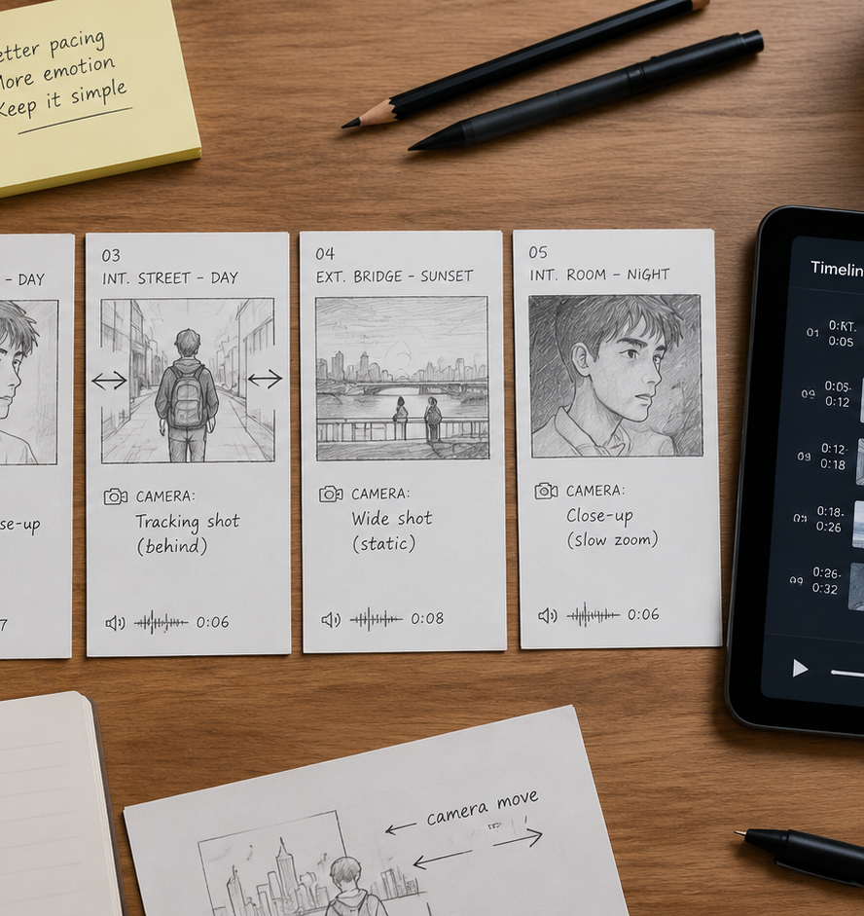
01 / 11
VIDEO PRODUCTION
How To Storyboard A Short Video
Engineering Visual Rhythm and Precision in Short-Form Video Pre-Production
YIHA
Notes:
Welcome to this pre-production masterclass on how to storyboard a short video. In short-form video production, every second determines whether a viewer stays engaged or scrolls away. Creators often face severe bottlenecks when attempting to shoot or edit directly from unformatted scripts. Without shot-level planning, directors guess camera compositions, editors struggle to assemble mismatched b-roll, and essential graphics get hidden beneath mobile app user interface elements. This presentation outlines an actionable, systematic approach to storyboarding short videos. We examine vertical aspect ratio framing, core storyboard data fields, audio rhythm synchronization, screen direction rules, camera movement notation, asset status tracking, and animatic testing. Adopting these structured methods will eliminate confusion, reduce production expenses, and ensure every visual cut lands with purpose.
Sources:

Slide 2
02 / 11
Why Short Videos Require Shot-Level Planning
Shot-level storyboards bridge script intent and visual execution while identifying pacing flaws before production starts.
Translate abstract script lines into concrete screen actions
Expose structural pacing flaws prior to camera setup
Prevent asset misalignment across directing and editing teams
YIHA
Notes:
Short-form video production leaves no room for ambiguous storytelling. A written script specifies dialogue and spoken concepts, but it cannot establish camera angles, shot scales, or visual pacing on its own. As highlighted by Video Production Agency at https://www.videoproductionagency.com/what-is-a-storyboard-and-how-is-it-used-in-filmmaking/ , a storyboard functions as an essential visual roadmap. It enables filmmakers to plan camera angles, organize scenes, and establish narrative pacing before spending production resources on set. For short-form projects, shot-level planning ensures that every frame advances the story directly. Advance planning prevents costly misunderstandings between directors and editors by locking compositions in pre-production. In addition, reviewing the sequence as a continuous series of frame cards highlights pacing issues early, confirming that each visual beat holds viewer attention without unnecessary delay.
Sources:
https://www.videoproductionagency.com/what-is-a-storyboard-and-how-is-it-used-in-filmmaking/

Slide 3
03 / 11
The Core Data Fields of a Functional Storyboard
Standardizing operational card fields ensures clear handoff between camera operators, editors, and sound teams.
01
Framing descriptor defines camera angle and shot scale
02
Action notes detail physical subject movement and state changes
03
Audio rails and time durations lock down temporal pacing
YIHA
Notes:
An effective storyboard is a practical technical guide rather than an informal sketchpad. Each card must record specific production metadata to direct shooting and post-production workflows accurately. This approach mirrors standards such as W3C WebVTT at https://www.w3.org/TR/webvtt1/ , which structure time-aligned text, captions, and descriptions into strict data streams. On a functional storyboard card, five core fields are required. First, write the framing descriptor to define the camera angle and shot scale. Second, describe the subject action to clarify physical movement. Third, document the exact voiceover line or ambient audio cue. Fourth, list all required on-screen graphic text and interface labels. Finally, state the planned duration in seconds. Recording these precise fields eliminates confusion and ensures seamless handoff across creative team members.
Sources:
https://www.w3.org/TR/webvtt1/

Slide 4
04 / 11
Framing for Vertical Ratios and UI Overlays
Vertical mobile video requires center-weighted framing to keep key visuals clear of platform interface dead zones.
Maintain critical subjects inside the center safe corridor
Avoid bottom and right edge interface graphic dead zones
Use transparent guide overlays during storyboard composition
YIHA
Notes:
Vertical video production uses a 9:16 aspect ratio, typically 1080 by 1920 pixels, which introduces distinct framing requirements. As documented by Vidpros at https://vidpros.com/vertical-video-safe-zone/ , social platforms display extensive interface overlays across vertical content. Interactive elements such as account names, engagement buttons, and caption boxes occupy the right margin and lower screen area. If you position logos or focal points in the bottom right corner, platform icons will obscure them. When drafting vertical storyboard cards, keep critical subjects, demonstrations, and text inside the central safe zone corridor. As a practical recommendation, using transparent safe area guides during the sketching stage prevents visual interference and protects graphic readability across all mobile display screens.
Sources:
https://vidpros.com/vertical-video-safe-zone/

Slide 5
05 / 11
Assigning Exactly One Visual Objective per Shot
Eliminate visual clutter by dedicating each short-form cut to a single distinct narrative or mechanical purpose.
Isolate visual roles into hook, proof, mechanism, and action
Prevent cognitive overload by removing competing focal points
Split multifaceted panels into sequential focused frames
YIHA
Notes:
Short videos become confusing when a single shot tries to convey multiple messages at once. Applying clear visual constraints keeps each moment effective. As outlined in the Google Cloud Video Generation Prompt Guide at https://docs.cloud.google.com/gemini-enterprise-agent-platform/models/video/video-gen-prompt-guide , explicitly defining the subject, perspective, and verb for each shot shapes the pacing and action of the final sequence. Creators should apply a strict single-job rule to every storyboard card. For example, assign Shot 1 exclusively to visual engagement, Shot 2 to demonstration evidence, Shot 3 to the operating mechanism, and Shot 4 to viewer action. If a single panel attempts to show a complex product feature while simultaneously presenting pricing terms, split it into two sequential shots. This disciplined division prevents viewer fatigue and ensures clarity.
Sources:
https://docs.cloud.google.com/gemini-enterprise-agent-platform/models/video/video-gen-prompt-guide

Slide 6
06 / 11
Aligning Audio Rhythm with Visual Cut Timing
Visual cut points must synchronize with speech pauses, music downbeats, and sound design markers.
01
Map storyboard frame transitions to natural speech pauses
02
Lock key visual reveals to background audio downbeats
03
Document sound effects directly onto the visual duration rail
YIHA
Notes:
Visual timing in short-form editing must synchronize closely with audio tracks. Cutting images without considering voiceover pauses or musical beats creates an uncomfortable viewing experience. Technical audio captioning concepts described by Microsoft Learn at https://learn.microsoft.com/en-us/azure/ai-services/speech-service/captioning-concepts demonstrate that spoken audio relies on exact offsets and durations to align words with visual output. Apply this timing precision directly to your storyboard by mapping speech pauses to frame transitions. Cutting visuals mid-word sounds abrupt, while lingering through silence causes viewers to lose interest. When utilizing musical tracks, note the downbeats on the duration rail and place key visual reveals directly on those auditory markers. Documenting sound cues on the board ensures that picture and sound reinforce each other seamlessly.
Sources:
https://learn.microsoft.com/en-us/azure/ai-services/speech-service/captioning-concepts

Slide 7
07 / 11
Preserving Screen Direction and Spatial Continuity
Maintain the 180-degree axis and eyeline matches so rapid cuts remain clear and intuitive for viewers.
Maintain the 180-degree axis of action across all camera setups
Match exit and entry vectors between sequential shots
Align eye-trace locations to reduce visual search fatigue
YIHA
Notes:
Rapid shot transitions disorient audiences quickly if spatial continuity is broken. Viewers instinctively construct a mental layout of the scene based on screen position and subject movement. StoryboardArt explains at https://storyboardart.org/storyboard-tutorials/180-degree-rule-film/ that following the 180-degree rule maintains consistent screen position and direction by placing camera angles on one side of an imaginary line of action. In narrow vertical frames, maintaining this axis is critical. If a character exits toward screen right in Shot 1, they must enter from screen left in Shot 2. Violating this rule makes it appear as though the subject turned around unexpectedly. In addition, plan eye-trace between adjacent cuts by aligning the incoming subject where the viewer looked in the outgoing frame to reduce viewing fatigue.
Sources:
https://storyboardart.org/storyboard-tutorials/180-degree-rule-film/

Slide 8
08 / 11
Indicating Camera Movement and Action Landmarks
Standardized directional arrows and framing boxes clarify camera motion and subject movement instantly.
Use thick arrows for camera motion and thin arrows for actors
Draw interior bounding boxes to indicate pushes and zooms
Label start and end positions to avoid ambiguity during shoots
YIHA
Notes:
Because storyboard drawings are static panels, camera and subject motion must be indicated clearly through standardized symbols. Filmmaker Genius notes at https://filmmakergenius.com/academy/how-to-storyboard-a-film/storyboard-arrows-and-symbols that using established arrows and symbols allows a creator to pack a moving shot into a single frame so any crew member understands the visual plan. Distinguish camera motion from subject action by drawing bold outlined arrows for pans or tilts, and thin arrows for walking actors or moving objects. For pushes or zooms, sketch an interior framing box with directional arrows pointing inward. Explicitly labeling start and end landmarks on cards removes ambiguity during filming. When the entire crew understands planned movements before arriving on set, filming proceeds efficiently and without costly delays.
Sources:
https://filmmakergenius.com/academy/how-to-storyboard-a-film/storyboard-arrows-and-symbols

Slide 9
09 / 11
Tracking Production Asset Status and Footage Gaps
Integrating asset inventory tags into storyboards identifies missing clips before filming begins.
01
Classify every card as Available, Need, or Replace
02
Group all Need shots by camera setup to streamline shoot days
03
Prevent project delays by verifying existing b-roll upfront
YIHA
Notes:
A working storyboard serves as an inventory checklist for production assets rather than just an artistic drawing. As NemoVideo demonstrates at https://www.nemovideo.com/blog/ai-video-editing/short-form-video-storyboard-template , tracking footage status directly on storyboard cards is vital for aligning creators, clients, and editors. By classifying each card as Available, Need, or Replace, the production team immediately identifies missing media. Mark Available when existing footage meets quality criteria. Mark Need when new footage or motion graphics must be captured. Mark Replace when placeholder assets must be upgraded. Auditing these tags before production allows teams to group required shots by physical setup or camera angle rather than shooting in script sequence. This tracking method prevents missing footage and ensures smooth handoff to the editing bay.
Sources:
https://www.nemovideo.com/blog/ai-video-editing/short-form-video-storyboard-template

Slide 10
10 / 11
Testing Timing with an Animatic Before Final Export
Assembling low-fidelity sketches with scratch audio tests pacing and validates visual flow before final production.
String static storyboard drawings into a real-time edit timeline
Sync scratch voiceover and audio tracks to test hold times
Identify and fix dragging or rushed moments before rendering
YIHA
Notes:
The final validation stage before shooting or final export is building an animatic. DrawStory emphasizes at https://www.drawstory.ai/blog/how-to-turn-storyboard-to-video that an animatic strings timed storyboard frames together with scratch audio, serving as the first moving draft and exposing pacing flaws before full production begins. Place the static drawings into your video editing software and assign each panel its planned duration in seconds. Pair the timeline with rough scratch voiceover and temporary music. Playing the animatic at full speed quickly reveals whether certain shots hold too long or pass before graphics can be read. Adjusting second counts on static panels costs nothing and protects your production schedule, ensuring the final edit flows logically from start to finish.
Sources:
https://www.drawstory.ai/blog/how-to-turn-storyboard-to-video

Slide 11
11 / 11
Key Takeaways for Disciplined Storyboarding
Disciplined storyboard workflows reduce production costs, clarify creative vision, and ensure consistent video quality.
Anchor composition within vertical safe zones for mobile clarity
Enforce single-objective shot rules and strict audio synchronization
Validate all edit pacing with animatics before camera call time
YIHA
Notes:
To conclude, high-quality short-form video production depends on disciplined pre-visualization rather than improvisation. By establishing shot-level objectives, designing for vertical interface safe zones, enforcing the 180-degree rule, tracking asset inventory status, and assembling animatics, you build an efficient and reliable production pipeline. As Video Production Agency outlines at https://www.videoproductionagency.com/what-is-a-storyboard-and-how-is-it-used-in-filmmaking/ , structured storyboards organize camera angles and visual rhythm before committing resources to filming. When every card defines its framing, subject action, audio timing, and duration, team members execute their roles without confusion. Incorporate these standard storyboarding principles into your pre-production workflow to create sharp, coherent, and visually compelling short videos. Adopting this pre-visualization method saves critical post-production time and elevates overall creative execution across platforms.
Sources:
https://www.videoproductionagency.com/what-is-a-storyboard-and-how-is-it-used-in-filmmaking/

