Slide 1
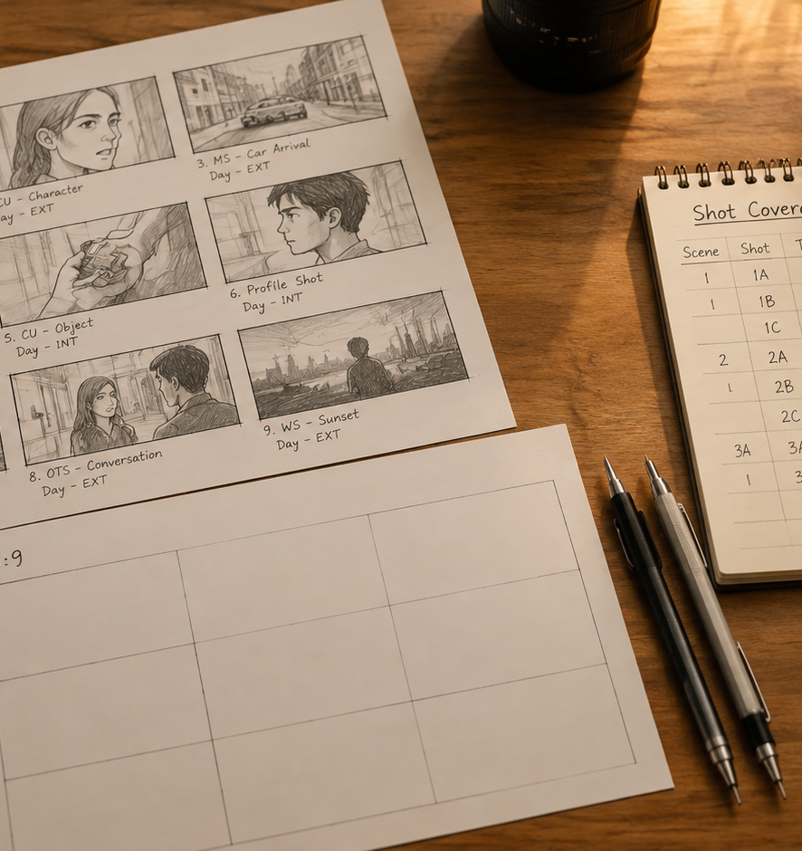
01 / 11
FILMMAKING & VIDEO PRODUCTION
How To Create A Storyboard For A Short Film
A Step-by-Step Pre-Production Visual Planning Guide
YIHA
Notes:
Welcome everyone. Today we are examining how to create an actionable storyboard for a short film. Storyboarding is not merely an artistic exercise or a decorative pre-production step. It is the central visual blueprint that bridges your written screenplay and physical production on set. For short films operating under tight budgets and brief shooting schedules, clear visual planning determines whether your shoot wraps on time with the coverage you need. Over the next nine sections, we will walk through every stage of the process, including script breakdown, aspect ratios, composition, motion arrows, technical metadata, software workflows, crew feedback, and animatic assembly. By the end of this session, you will possess a structured workflow for visualizing any narrative scene.
Sources:

Slide 2
02 / 11
The Purpose of Visual Pre-Planning
Storyboards make abstract directorial vision concrete enough to evaluate and budget accurately.
Transforms script lines into deliberate visual choices and perspectives
Aligns directors, cinematographers, and crew on creative vision
Identifies shooting location constraints, lighting needs, and gear costs
YIHA
Notes:
Our first section establishes why storyboarding is indispensable in short film pre-production. As documented by the Vancouver Film School at vfs.edu, the core purpose of a storyboard is to make visual ideas concrete enough to evaluate, communicate, and revise before production progresses too far. A written script might simply say a character enters a room and pauses, but the storyboard establishes whether the audience experiences that moment through a wide establishing frame or an intimate close-up. Furthermore, Shoots.video emphasizes that storyboards serve as a technical roadmap that accounts for location space, lighting conditions, and crew requirements. By visualizing every setup on paper, directors and producers can estimate equipment, props, and personnel accurately, protecting modest short film budgets from expensive on-set reshoots.
Sources:
https://vfs.edu/news/what-is-storyboarding
https://www.shoots.video/post/the-role-of-storyboarding-in-pre-production-enhancing-visual-narrative/

Slide 3
03 / 11
Breaking Down Scripts into Shot Units
Narrative pacing and dramatic turning points dictate camera cut points and scene coverage.
01
Isolate emotional beats and narrative shifts within every scene
02
Decompose scripts into characters, locations, props, and shot lists
03
Pair script breakdowns directly with shot coverage sequences
YIHA
Notes:
Moving to section two, we look at breaking down written screenplay scenes into distinct shot units. Script breakdowns represent the bridge between literary storytelling and cinematic grammar. Open-source development projects such as Sam Wasserman's scriptbreak on GitHub show that structured pre-production begins by breaking scripts down into scenes, characters, locations, props, and starter shot lists. When planning coverage, you must look for dramatic turning points where character dominance shifts or vital information is revealed. Additionally, resources like CinemaDrop emphasize that camera prompts and shot lists should always be story-first rather than disconnected visuals. Instead of designing random cool shots, build coverage sequences where wide masters, medium reaction angles, and tight inserts serve the emotional pacing of the written beat.
Sources:
https://github.com/wassermanproductions/scriptbreak
https://www.cinemadrop.com/camera-prompt-generator-for-film

Slide 4
04 / 11
Configuring Aspect Ratios and Panels
Standardize panel dimensions to 16:9 widescreen and avoid visual crowding on the page.
Recommendation: standard 16:9 widescreen frame aspect ratio
Recommendation: 3 to 6 storyboard frames per printed page
Establish safe framing zones to accommodate multi-format cut-downs
YIHA
Notes:
In section three, we configure template technical parameters. Modern filmmaking relies overwhelmingly on widescreen formats. As StudioBinder explains in their film storyboarding guide, 16:9 is the current standard film aspect ratio, making 16:9 the natural standard for storyboard panels. StudioBinder explicitly recommends keeping panel density to between three and six frames per page. Exceeding six frames crowds the visual composition and restricts the space needed for dialogue and staging descriptions. Furthermore, curriculum materials from Tertiary Courses on frame formats highlight the importance of establishing blocking boundaries, such as keeping critical subjects within the center third of a 16:9 frame to protect vertical 9:16 or square social cut-downs. Consistent frame dimensions keep your entire production team aligned across every department.
Sources:
https://www.studiobinder.com/guides/storyboards/how-to-create-a-film-storyboard/
https://github.com/tertiarycourses/TGS-2020505925-Create-Short-Video-Film-using-AI/tree/main/labs/lab-02-frames-formats-aspect-ratios

Slide 5
05 / 11
Blocking, Framing, and Composition
Communicative clarity and depth layering matter far more than polished illustration skills.
Simple stick figures and geometric shapes effectively block scene action
Apply rule of thirds, leading lines, and negative space to guide eyes
Use depth planes to position foreground and background characters
YIHA
Notes:
Section four addresses composition and staging. A common misconception among emerging filmmakers is that storyboards require master illustrations. That is incorrect. As the Garden of Edits short film guide explains, directors can sketch scenes using simple stick figures and basic shapes to block action, focusing on cinematography fundamentals like the rule of thirds, leading lines, and framing. As wikiHow details in their storyboarding guide, spatial depth is achieved by placing foreground characters lower and larger on the page while background characters appear smaller and higher up. Storyboards must prioritize communicative clarity over artistic perfection. When each panel clearly indicates character orientation, eyelines, and framing boundaries, your camera team will instantly understand how to stage the live camera setup.
Sources:
https://www.gardenofedits.com/a-guide-on-how-to-create-a-storyboard-for-your-short-film/
https://www.wikihow.com/Create-a-Storyboard

Slide 6
06 / 11
Directing Motion with Visual Arrows
Standardized arrow vectors prevent confusion between camera moves and actor movement.
01
Distinguish bold camera move arrows from thin subject motion arrows
02
Draw push-ins, pans, tilts, and tracks directly on the frame
03
Add quick written labels to eliminate any on-set staging ambiguity
YIHA
Notes:
Section five covers directing motion with graphic vectors and arrows. Storyboards are static images representing a dynamic, moving medium. Filmmaker Genius notes that filmmakers must use standardized arrows to show movement inside still panels, stressing that camera movement indicators must look visually distinct from actor blocking paths. One common convention is using bold arrows for camera moves and thin lines for character tracks. ImagineArt reinforces that movement belongs directly on the frame because camera maneuvers fundamentally alter the composition over time. If a frame shows a zoom or push-in, telescoping boxes or corner arrows communicate the transition clearly. Will Roberts emphasizes on Filmmaker Genius that adding a five-second written label like 'Push In' saves a five-minute argument on set.
Sources:
https://filmmakergenius.com/academy/how-to-storyboard-a-film/storyboard-arrows-and-symbols
https://www.imagine.art/insights/how-to-create-a-film-storyboard

Slide 7
07 / 11
Technical Metadata and Audio Cues
Complete storyboard panels pair visual framing with lens specs, dialogue, and audio cues.
Index each panel with scene numbers, shot letters, and lens choices
Transcribe synchronized dialogue excerpts directly below each cell
Note pivotal sound design effects and musical hits in panel notes
YIHA
Notes:
Section six covers technical metadata and audio annotations. Visuals tell only half the story. As documented by the Video Production Agency, shooting boards developed for camera crews include precise technical information such as lens selections, camera movements, and lighting plans. Below each visual cell, specify the scene number, shot letter, focal length, and camera support type, such as tripod, handheld, or gimbal. Furthermore, StudioBinder highlights that the description space beneath panels should include synchronized dialogue and iconic sound cues. Noting when off-screen sounds, musical swells, or footsteps occur allows the director and editor to evaluate dramatic timing. Adding technical notes ensures that your storyboard operates as a rigorous production guide rather than a simple picture collection.
Sources:
https://www.videoproductionagency.com/what-is-a-storyboard-and-how-is-it-used-in-filmmaking/
https://www.studiobinder.com/guides/storyboards/how-to-create-a-film-storyboard/

Slide 8
08 / 11
Balancing Analog and Digital Tools
Choose tactile paper sketching or cloud software based on team collaboration needs.
Physical paper boards and index cards offer tactile sketching speed
Digital platforms enable script tagging, asset libraries, and resizing
Cloud tools support threaded comments and multi-user permission controls
YIHA
Notes:
Section seven explores workflow tooling, comparing analog sketching with digital platforms. Traditional paper templates and sticky notes allow for tactile speed, making it easy to rearrange scenes physically on a production office corkboard. However, physical boards make remote sharing and revisions tedious. StudioBinder's guides highlight that digital templates provide script tagging tools that convert screenplay text directly into panel descriptions, alongside image upload and cropping features. Software evaluations published by Zipdo note that digital platforms like Miro, Boords, and Panels support frame-level threaded comments, reusable templates, and rapid re-ordering. Independent filmmakers should select the medium that best fits their team, whether sketching physical thumbnails during initial brainstorming or utilizing cloud software for distributed production crews.
Sources:
https://www.studiobinder.com/guides/storyboards/how-to-create-a-storyboard-for-a-short-film/
https://zipdo.co/best/digital-storyboard-software/

Slide 9
09 / 11
Crew Collaboration and PDF Exports
Incorporate department feedback early and distribute locked PDF packets to crew.
01
Stress-test camera coverage with cinematographers, designers, and editors
02
Address set constraints and lighting feasibility in pre-production
03
Export watermarked, locked PDF packets to prevent version confusion
YIHA
Notes:
Section eight covers department collaboration and production distribution. A storyboard is a collaborative communication tool, not a static monument. StudioBinder emphasizes that processing and incorporating crew feedback is just as critical as creating the original storyboard. Conducting a visual read-through with your cinematographer, production designer, and editor uncovers hidden logistical obstacles, such as impossible lighting turnarounds or tight interior set restrictions. Once all department adjustments are finalized, StudioBinder recommends converting the project into a locked PDF document. Distributing watermarked, formatted PDF packets ensures that font sizes remain readable on set, layout borders remain intact, and crew members do not accidentally alter shot sequences during production.
Sources:
https://www.studiobinder.com/guides/storyboards/how-to-create-a-storyboard-for-a-short-film/
https://www.studiobinder.com/templates/storyboards/16x9-storyboard-template/

Slide 10
10 / 11
Set Execution and Timed Animatics
Assemble panels into timed animatics to test scene pacing before stepping on set.
Import numbered panels into video timelines with temporary audio
Identify rushed cuts and lingering beats before shooting starts
Use storyboards on set to organize daily shooting setups efficiently
YIHA
Notes:
Our ninth section focuses on set execution and animatic construction. StoryboardArt defines an animatic as a timed video edit of storyboard panels paired with scratch dialogue, sound, or music. While a printed storyboard PDF can mask pacing issues, a timed animatic exposes cutting rhythm and dramatic pauses immediately. As StoryboardArt notes in their step-by-step short film tutorial, you can drop numbered panels onto a video editing timeline, assign approximate shot durations, and include scratch audio to test whether beats land properly. Identifying an awkward pause or confusing cut in an animatic is virtually free, whereas discovering it on set burns precious daylight and budget. On set, boards guide the daily call sheet and shooting schedule.
Sources:
https://storyboardart.org/storyboard-tutorials/animatic-meaning/
https://storyboardart.org/storyboard-tutorials/how-to-make-storyboard-short-film/

Slide 11
11 / 11
Summary of Short Film Storyboarding
Thorough visual pre-planning safeguards budgets, schedules, and artistic intent.
Deconstruct scripts into coverage units before drawing frames
Maintain standard 16:9 framing with clear motion arrow notations
Test pacing via animatics to execute efficient shooting days on set
YIHA
Notes:
To conclude our presentation, creating an effective storyboard for a short film is the single most practical investment a director and production team can make during pre-production. As Story2Board highlights in their short film guide, short films have limited screen time, requiring filmmakers to know exactly what every shot accomplishes before stepping on set. Making creative and logistical decisions on paper where revisions are free preserves your financial budget and keeps your cast and crew working in total alignment. By following these nine steps, deconstructing scripts, framing in 16:9, drawing clear motion arrows, soliciting crew feedback, and testing rhythm in animatics, you set your short film up for a smooth and focused shoot.
Sources:
https://story2board.com/how-to-storyboard/short-film

