Slide 1
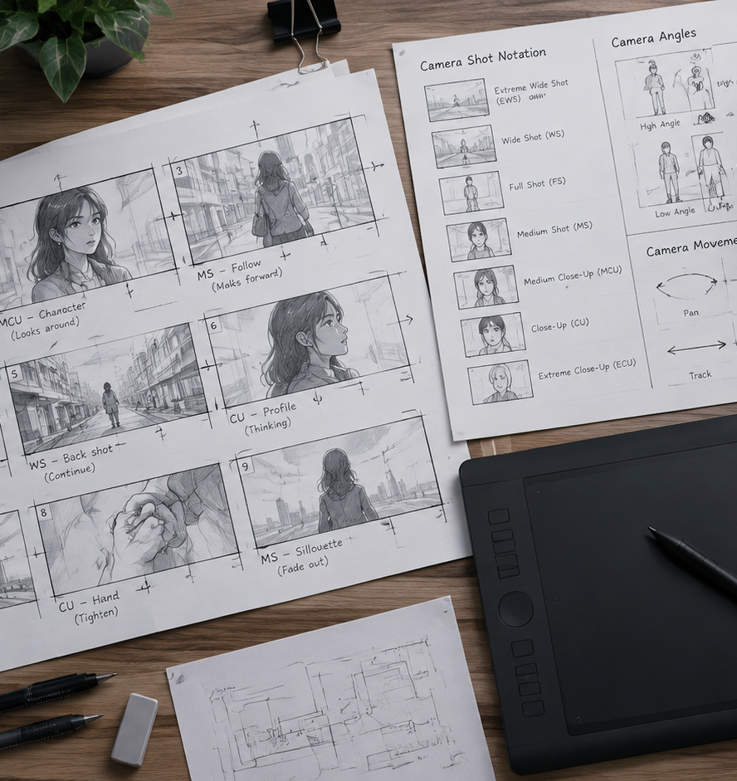
01 / 11
VIDEO PRODUCTION
Create Product Video Storyboard
Pre-Visualization, Narrative Structure, and Production Frameworks
YIHA
Notes:
Welcome to our presentation on creating an effective product video storyboard. Before a single camera rolls or animation software begins rendering, pre-production planning determines project success. Storyboarding is not just drawing sketches. It functions as an architectural blueprint for visual communication. It forces cross-functional stakeholders across product management, engineering, and creative marketing to agree on narrative pacing, technical feature priority, and customer value propositions. In this session, we examine how to build a storyboard that serves as an actionable bridge to live production. We will cover narrative framing, camera grammar, audio synchronization, accessibility considerations, and modern generative workflows to help your production team deliver compelling product stories.
Sources:

Slide 2
02 / 11
The Role of Storyboards in Pre-Production
Visual blueprints establish clarity and prevent costly mid-production revisions.
Map narrative flow and camera angles before production begins
Identify on-set logistical bottlenecks and location constraints early
Lock stakeholder consensus on core product benefits and tone
YIHA
Notes:
Pre-production planning forms the operational bedrock of video production. As documented by Shoots.video in their pre-production guide, storyboarding provides a visual roadmap that guides the director, cinematographer, and production crew through the planned visual narrative. Laying out scenes panel by panel reveals potential creative conflicts and physical shooting constraints before crews arrive on set. The Storyboard Artists Guide notes that this early foresight minimizes costly on-set changes, reduces the need for reshoots, and optimizes budget management. Modern production teams also use animatics and three-dimensional pre-visualization alongside traditional panels, as Shootsta highlights in their pre-production research. Locking visual decisions early protects your project schedule and guarantees that team resources are invested efficiently.
Sources:
https://www.shoots.video/post/the-role-of-storyboarding-in-pre-production-enhancing-visual-narrative/
https://storyboardartists.com/why-using-storyboards-are-essential-for-pre-production/
https://shootsta.com/blog/alternatives-to-storyboards-modern-video-pre-production

Slide 3
03 / 11
Structuring the Core Product Narrative Arc
Structure narrative sequences around real user friction and tangible outcomes.
01
Ground the opening panels in authentic user pain points
02
Demonstrate the product as the direct resolution mechanism
03
Sequence complex information to manage audience cognitive load
YIHA
Notes:
An effective product video tells a story that resonates with real user needs. As emphasized by the Nielsen Norman Group in their research on persuasive storytelling, compelling business narratives bring user pain points to the forefront rather than relying on dry product feature lists. The story must speak the vocabulary of the intended audience and remain rooted in verifiable data. Furthermore, UX researcher Timothy Graf explains that structured chronological visualization sequences act as cognitive scaffolding, guiding viewers through curated analytical insights while managing mental load. Illustrative Example: opening with two panels showing workflow bottlenecks helps viewers immediately appreciate the streamlined dashboard demonstrated in subsequent frames. This structure ensures that product capabilities directly address the friction shown earlier.
Sources:
https://www.nngroup.com/articles/persuasive-storytelling/
https://timgraf.com/ux-design/navigation-that-thinks-applying-cognitive-load-theory-to-website-information-architecture-the-cognitive-scaffolding-of-data-storytelling-how-narrative-guided-visualization-sequences-and-pr/

Slide 4
04 / 11
Visual Framing and Camera Shot Selection
Contrast shot sizes to direct viewer attention toward critical product details.
Wide shots establish operational context and user surroundings
Medium shots frame direct human interaction with the product
Close-ups isolate critical hardware textures and software UI controls
YIHA
Notes:
Choosing the appropriate camera shot size establishes visual grammar and hierarchy. StudioBinder explains in their cinematography guide that shot size contrast signals narrative importance to viewers. An establishing wide shot sets the physical environment, such as an active office floor or industrial facility. A medium shot highlights user interaction, showing ergonomics and context. Close-ups and extreme close-ups isolate small UI elements, button clicks, or hardware ports. Google Cloud video prompt documentation also categorizes shots into extreme close-ups, points of view, and static angles to influence viewer focus. Intentional framing prevents visual clutter and keeps product capabilities front and center throughout the narrative, guiding viewer attention directly to what matters most.
Sources:
https://www.studiobinder.com/blog/types-of-camera-shots-sizes-in-film/
https://docs.cloud.google.com/gemini-enterprise-agent-platform/models/video/video-gen-prompt-guide

Slide 5
05 / 11
Camera Movement and Motion Vector Annotations
Annotate camera motion clearly to communicate dynamic action in static frames.
Use directional arrows to separate camera moves from subject motion
Apply push-in framing to emphasize pivotal product discoveries
Maintain static locked frames when stability and clarity are required
YIHA
Notes:
Static drawings cannot communicate dynamic camera motion without clear visual notation. Story2Board explains in their guide to storyboard camera movement that every camera move must fulfill a specific storytelling purpose. For instance, a push-in creates intimacy and focus, whereas a static shot provides objective clarity. The guide reminds creators that locked shots are deliberate choices that prevent visual chaos. In modern generative workflows, Luma Dream Machine documentation highlights that camera trajectories such as orbit, pan, and zoom can be defined programmatically. Annotate panels using standard framing boxes and exterior motion arrows to ensure animators and camera operators interpret your intentions accurately, avoiding costly misunderstandings during production.
Sources:
https://story2board.com/blog/camera-movement-storyboard-guide
https://docs.lumalabs.ai/docs/video-generation

Slide 6
06 / 11
Voiceover Scripting and Audio Cue Mapping
Budget speech pacing and synchronize sound cues with visual transitions.
01
Recommendation: Budget spoken voiceovers at 130 to 150 words per minute
02
Map audio offsets directly beneath corresponding visual panels
03
Plan sound design early to avoid complex editing revisions
YIHA
Notes:
A polished product video balances visuals with spoken voiceover and sound effects. Microsoft Learn documentation on speech captioning illustrates how audio streams rely on discrete offsets and duration timestamps to align spoken words with visual content. Video Editing Company benchmarks indicate that multi-track audio mixing and sound design can significantly expand post-production editing hours per finished minute. As a practical recommendation, script voiceovers between 130 and 150 words per minute to allow visuals room to breathe. Dedicate separate rows in your storyboard for dialogue and sound effects so the editing team knows exactly when key auditory cues trigger. Planning audio timing prevents unexpected pacing bottlenecks.
Sources:
https://learn.microsoft.com/en-us/azure/ai-services/speech-service/captioning-concepts
https://videoeditingcompany.com/video-editing-cost-per-minute/

Slide 7
07 / 11
Designing for Accessibility and Caption Placement
Preserve lower third screen zones to prevent captions from obscuring product UI.
Comply with WCAG 2.2 synchronized media accessibility standards
Reserve safe margins in the lower third of each panel for subtitles
Shift software interface actions away from caption display areas
YIHA
Notes:
Accessibility planning must occur during the storyboard phase rather than after rendering. W3C Web Accessibility Initiative guidelines emphasize that captions provide essential dialogue and non-speech audio information for people who are deaf or hard of hearing. The WCAG 2.2 standard requires testable media accommodations to serve diverse user needs across multiple viewing devices. When sketching panels, mark a clear safe zone across the bottom of the screen. If critical software controls or notification banners sit along the lower edge of the display, subtitles will block them. Adjust panel framing to ensure uninterrupted readability for both captions and interface elements, creating an inclusive experience for every viewer.
Sources:
https://www.w3.org/WAI/media/av/captions/
https://www.w3.org/TR/WCAG22/

Slide 8
08 / 11
Building Timed Animatics to Test Pacing
Assemble sequential panels into moving reels to validate timing before filming.
Test pacing and narrative flow by combining panels with scratch audio
Identify awkward transitions and boring beats before final production
Recommendation: Build quick browser-based reels to test scene rhythm
YIHA
Notes:
Static panels represent frozen moments, but videos live in time. Kasra Design notes that a storyboard acts like an architectural floorplan, allowing teams to move walls on paper before physical construction starts. Vain New York explains that animatics string storyboard panels together with temporary audio to test pacing, composition, and cut logic before production begins. Tools like Storyboard Express demonstrate how browser-based slideshows and animatic workflows let teams preview pacing and export video reels quickly. Building an animatic allows creative directors to spot narrative drag, refine dialogue cadence, and eliminate redundant shots before incurring studio expenses, ensuring the final video maintains audience interest.
Sources:
https://www.kasradesign.com/what-is-a-storyboard-and-how-to-read-it/
https://www.vainnewyork.com/post/storyboard-vs-shot-list
https://www.storyboard-express.com/

Slide 9
09 / 11
Translating Boards into Technical Shot Lists
Convert visual storyboard panels into structured camera manifests for the crew.
01
Bridge the interpretation gap between visual art and camera physics
02
Group shots by camera angle and lighting setup to save production time
03
Specify lens focal lengths, camera mounting, and capture formats
YIHA
Notes:
A storyboard conveys visual emotion, but on-set crews need logistical facts. Studiovity points out that relying solely on storyboards forces camera crews to guess technical parameters, creating a risky interpretation gap. Converting panels into a technical shot list provides a concrete construction blueprint that details lenses, lights, and schedules. Video Production Agency highlights that shooting boards explicitly inform camera crews about lens choices and lighting schemes. Grouping shots by lighting setup and camera orientation rather than script order saves hours on set. Cross-reference every shot list row back to its storyboard panel number to maintain creative alignment and keep the entire crew focused on efficient execution.
Sources:
https://blog.studiovity.com/streamline-video-production-master-storyboard-shot-list/
https://www.videoproductionagency.com/what-is-a-storyboard-and-how-is-it-used-in-filmmaking/

Slide 10
10 / 11
Integrating Generative Tools and Modern Pipelines
Augment visual pre-production with generative models while recognizing limits.
Explore visual concepts and lighting using diffusion transformer pipelines
Orchestrate script, image, and video nodes in unified workspaces
Capture high fidelity UI natively to avoid generative rendering flaws
YIHA
Notes:
Generative video platforms are becoming active tools in modern pre-production pipelines. Hugging Face Diffusers documentation shows how diffusion transformer architectures generate sequential video frames using explicit parameters for frame count and spatial coherence. Open-source workspaces like mjj-ai-studio illustrate how modern creators connect script generation, visual storyboards, and image-to-video tools within integrated canvas environments. However, video producers must recognize operational boundaries. AI models often struggle with consistent text rendering and precise interface micro-interactions. Use generative pipelines for rapid visual exploration and animatic drafts, but capture final software interfaces through lossless digital screen recorders to guarantee fidelity, legibility, and exact brand presentation.
Sources:
https://huggingface.co/docs/diffusers/en/using-diffusers/text-img2vid
https://github.com/pkp666/mjj-ai-studio

Slide 11
11 / 11
Summary and Production Checklist
Disciplined visual planning ensures on-time delivery and persuasive product videos.
Lock narrative friction, framing choices, and camera motion in advance
Validate pacing with animatics and verify WCAG caption margins
Convert final boards into technical shot manifests before filming
YIHA
Notes:
Creating a product video storyboard is an indispensable investment that protects budgets and elevates creative execution. By methodically establishing visual narrative arcs, defining deliberate camera shot sizes, annotating motion paths, and checking caption accessibility, teams eliminate ambiguity before capital is spent. As emphasized across production research from Kasra Design and Studiovity, changes made on paper or in animatic reels cost a fraction of post-production reshoots. Apply this systematic framework to your next product video to ensure aligned stakeholders, smooth production days, and clear product messaging that drives real customer engagement. Thorough preparation remains the single most reliable strategy for producing high quality product media.
Sources:
https://www.kasradesign.com/what-is-a-storyboard-and-how-to-read-it/
https://blog.studiovity.com/streamline-video-production-master-storyboard-shot-list/

