Slide 1
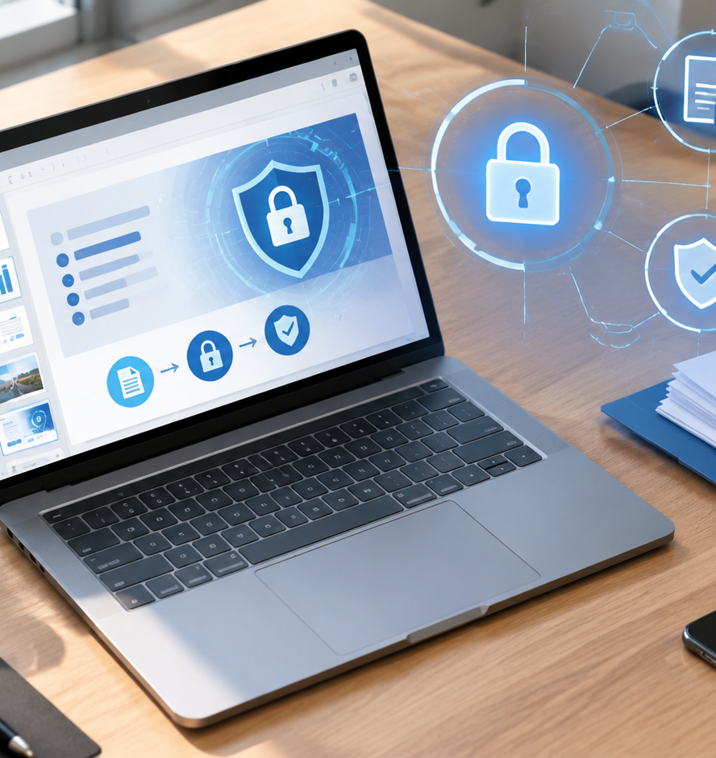
01 / 11
PRESENTATION MANAGEMENT
Protect Presentation From Editing
Technical Controls, Cryptographic Boundaries, and Practical Governance
YIHA
Notes:
Welcome to this technical overview on protecting presentation decks from unauthorized editing and distribution. Throughout this session, we examine how Microsoft PowerPoint handles document protection across multiple tiers. Organizations frequently share decks containing strategic plans, financial data, and branded templates. When these documents move across organizations, uncontrolled editing can lead to lost data or compromised version histories. Our objective today is to understand the exact mechanisms available in modern presentation software, evaluate how client-side locks differ from real cryptographic encryption, and establish a clear implementation framework. By understanding the capabilities and limitations of each method, you can ensure document integrity without adding unnecessary friction to standard business operations.
Sources:

Slide 2
02 / 11
The Need for Presentation Integrity
Uncontrolled slide circulation risks unauthorized edits, data exposure, and brand layout corruption.
Sensitive figures and strategic roadmaps require editing barriers
Unmanaged collaboration leads to version conflict and formula loss
Document inspection removes hidden personal data before sharing
YIHA
Notes:
Slide decks are among the most frequently exchanged files in business, yet they often receive less security scrutiny than formal spreadsheets or databases. Presentations routinely house corporate balance sheets, merger discussions, and proprietary product roadmaps. When distributed as unrestricted files, recipients can accidentally change numbers, overwrite disclaimers, or modify brand assets. As explained in the iSpring Solutions guide, How to Lock a PowerPoint from Editing on Any Device, document inspection under File Info helps clean hidden properties and metadata before distribution. Furthermore, Tool Hunter's guide, Lock PowerPoint from Editing: Complete Protection Guide, highlights that restricting editing capabilities keeps external feedback separate from master source content while securing confidential business information against inadvertent changes.
Sources:
https://www.ispringsolutions.com/blog/protect-your-powerpoint-slides
https://tool-hunt.com/en/how-to-lock-powerpoint-from-editing-guide/

Slide 3
03 / 11
Soft Deterrence via Mark as Final
Mark as Final signals document completion to collaborators but provides no cryptographic restriction.
01
Accessible via File Info Protect Presentation in Backstage view
02
Disables ribbon editing commands and typing tools upon file launch
03
Recipients can bypass the restriction by clicking Edit Anyway
YIHA
Notes:
The Mark as Final command provides an intentional visual indicator that a presentation represents a completed draft. When enabled, PowerPoint disables the standard ribbon commands, typing tools, and proofing markers. A yellow notification banner informs readers that the deck is finalized. However, as noted in SlideGenius's guide, How to Lock a PowerPoint Presentation: Step-by-Step Guide, this feature is strictly a soft lock. Any user can click the Edit Anyway button on the alert bar to restore full write access immediately. Mark as Final works well for internal teams following disciplined document workflows, but it provides no real defense against unauthorized modifications or determined editors who choose to override the setting.
Sources:
https://www.slidegenius.com/cm-faq-question/how-do-i-lock-a-powerpoint-presentation-from-editing

Slide 4
04 / 11
Restricting Revisions with Modify Passwords
A password to modify enforces read-only viewing while requiring credentials to overwrite original files.
Configured via Save As Tools General Options in desktop PowerPoint
Unauthenticated users can view slides by selecting Read Only mode
Recipients cannot overwrite original files but can save separate copies
YIHA
Notes:
When you want recipients to review presentation content without altering the master file, PowerPoint supports setting a password to modify. Configured through Save As under Tools General Options, this setting separates read access from write permissions. As outlined in Tool Hunter's publication, Lock PowerPoint from Editing: Complete Protection Guide, users opening the file must supply the modification password to save edits back to the file. Users without the credential can still read the deck in read-only mode. While this stops accidental overwriting of shared files, users can still save a duplicate copy using Save As to produce an unmanaged version. SlideGenius also notes that modify passwords protect the original file but allow local duplication.
Sources:
https://tool-hunt.com/en/how-to-lock-powerpoint-from-editing-guide/
https://www.slidegenius.com/cm-faq-question/how-do-i-lock-a-powerpoint-presentation-from-editing

Slide 5
05 / 11
Full Encryption with File Passwords
Whole-file encryption with AES-256 blocks unauthorized viewing and stops content extraction entirely.
Configured via File Info Protect Presentation Encrypt with Password
Office 2013 and newer use AES-256 encryption with SHA-512 hashing
Lost passwords cannot be recovered through native Office utilities
YIHA
Notes:
For confidential files requiring genuine security, Encrypt with Password provides robust protection. This feature scrambles the underlying document archive, preventing access to slides, notes, or media without the passkey. As detailed in the Peony security analysis, How to Password Protect a PowerPoint in 2026, modern PowerPoint implementations use AES-256 encryption with SHA-512 hashing and key stretching iterations. Standards for these algorithms are documented in NIST Special Publication 800-175B Revision 1, Guideline for Using Cryptographic Standards in the Federal Government. Without the key, the archive cannot be parsed by external tools. Authors must store passwords securely, because lost passwords cannot be recovered natively through Office utilities or administrative resets.
Sources:
https://www.peony.ink/blog/how-to-password-protect-powerpoint
https://csrc.nist.gov/pubs/sp/800/175/b/r1/final

Slide 6
06 / 11
Enterprise Control via Information Rights
Microsoft Purview sensitivity labels bind document permissions to authenticated user identities.
01
Replaces static file passwords with identity-based corporate controls
02
Defines granular permissions for viewing, editing, and copying content
03
EXTRACT right controls whether users or AI agents can copy data
YIHA
Notes:
Shared file passwords suffer from credential sharing. Enterprise security addresses this by deploying Information Rights Management through Microsoft Purview sensitivity labels. As documented in Microsoft Learn's articles, Manage Sensitivity Labels in Office Apps and Microsoft Purview Information Protection, sensitivity labels apply encryption policies tied to user identities rather than static strings. Administrators configure rights for viewing, editing, printing, and data extraction. When encrypted labels are used, Purview checks the EXTRACT permission before allowing users or automated agents to copy slide content. This identity-bound protection stays with the file across networks, prevents unauthorized duplication, and enables real-time access revocation when sharing across diverse enterprise environments.
Sources:
https://learn.microsoft.com/en-us/purview/sensitivity-labels-office-apps
https://learn.microsoft.com/en-us/purview/information-protection

Slide 7
07 / 11
Locking Slide Master Layout Elements
Moving foundational design assets to Slide Master layouts prevents accidental changes during editing.
Place corporate logos, headers, and disclaimers on master layouts
Normal view editors cannot select or shift background master elements
Preserves template consistency across collaborative drafting cycles
YIHA
Notes:
In collaborative environments, multiple authors must contribute slide text while keeping branding, disclaimers, and layouts intact. Positioning branding assets on the active slide canvas leaves them vulnerable to accidental clicks and shifts. As explained in SlideGenius's guide, How to Lock a PowerPoint Presentation: Step-by-Step Guide, using Slide Master view provides effective structural protection. Changes made within the Slide Master propagate downward to child slides, but standard slide editors working in Normal view cannot select or modify master-level objects. This practice ensures brand consistency and layout stability across complex decks without hindering text authoring or requiring administrative permissions on the file itself.
Sources:
https://www.slidegenius.com/cm-faq-question/how-do-i-lock-a-powerpoint-presentation-from-editing

Slide 8
08 / 11
Read-Only Formats and Static Exports
Exporting to PDF, PPSX, or MP4 formats freezes slide formatting and eliminates editing interfaces.
PDF export locks visual geometry, fonts, and layout across platforms
PowerPoint Show launches slides directly into presentation view
MP4 video render flattens slides into an immutable playback file
YIHA
Notes:
When collaboration concludes, converting decks into static formats prevents formatting drift and deters casual edits. In the iSpring Solutions analysis, How to Lock a PowerPoint from Editing on Any Device, converting presentations to PDF is recommended for sharing reports and event materials. PDF export flattens interactive objects and guarantees consistent rendering across devices. Saving files as PowerPoint Show (.ppsx) formats launches slides directly in full-screen presentation mode, preventing accidental edits during meetings. For digital kiosks or public display boards, exporting slides to an MP4 video file creates an uneditable media stream that plays automatically without exposing presentation assets to interactive modifications.
Sources:
https://www.ispringsolutions.com/blog/protect-your-powerpoint-slides

Slide 9
09 / 11
Technical Limitations of Client-Side Locks
Modify passwords do not encrypt file archives and can be bypassed using Open XML editing tools.
01
Open XML packages store unencrypted text data under modify protection
02
Third-party tools can strip modify password tags in seconds
03
Client-side controls cannot stop screen captures or password sharing
YIHA
Notes:
Understanding security limitations prevents a false sense of security. As detailed in Peony's 2026 report, How to Password Protect a PowerPoint, open passwords provide genuine AES-256 encryption, but modify passwords provide zero cryptographic security. Because modern PPTX files are Open XML ZIP archives, non-encrypted files store slide content in clear text. Free utility scripts can remove the modify password restriction element in seconds without cracking keys. Furthermore, once an authorized recipient decrypts a file, client-side controls cannot prevent screen captures, external photography, or credential forwarding. High-security workflows require identity-bound IRM, dynamic watermarking, and active monitoring to mitigate recipient redistribution risks.
Sources:
https://www.peony.ink/blog/how-to-password-protect-powerpoint

Slide 10
10 / 11
Tiered Strategy for Presentation Security
Match protection tiers to document sensitivity while maintaining secure unencrypted master backups.
Recommendation: low-risk decks use Slide Master locking and Mark as Final
Recommendation: external decks use view-only links or static PDF exports
Recommendation: sensitive decks use AES-256 or Purview sensitivity labels
YIHA
Notes:
An effective presentation security policy aligns protection controls with information sensitivity. Rather than applying heavy encryption everywhere, organizations should follow a structured tiered framework aligned with NIST Special Publication 800-53 Revision 5 and Microsoft Purview sensitivity labeling guidelines. For low-sensitivity internal decks, Slide Master locking and Mark as Final prevent accidental layout drift. For external client deliveries, view-only links or static PDF exports protect formatting. For high-value strategic presentations, AES-256 encryption or Purview labels enforce authenticated access. As Tool Hunter emphasizes in Lock PowerPoint from Editing, always maintain unencrypted source backups in secure storage before locking production files to prevent irreversible data loss.
Sources:
https://csrc.nist.gov/pubs/sp/800/53/r5/upd1/final
https://learn.microsoft.com/en-us/purview/get-started-with-sensitivity-labels
https://tool-hunt.com/en/how-to-lock-powerpoint-from-editing-guide/

Slide 11
11 / 11
Implementation Summary and Best Practices
Balancing document controls with user access ensures presentation integrity without hindering workflows.
Distinguish visual advisory locks from genuine cryptographic controls
Implement Slide Master structure early in the template authoring lifecycle
Retain secure master backups prior to deploying file-level restrictions
YIHA
Notes:
In summary, protecting presentations from editing requires matching the right technical tool to the specific risk scenario. Soft locks like Mark as Final establish clear workflow boundaries for internal teams, while modify passwords protect master copies against accidental overwriting. However, neither provides true cryptographic security. When protecting confidential business intelligence, organizations must rely on AES-256 file encryption or Microsoft Purview sensitivity labels, as documented in NIST SP 800-175B and Microsoft Purview technical guidance. By pairing structural template discipline in the Slide Master with static PDF exports and rigorous backup hygiene, teams safeguard their content across every stage of the distribution lifecycle.
Sources:
https://csrc.nist.gov/pubs/sp/800/175/b/r1/final
https://learn.microsoft.com/en-us/purview/get-started-with-sensitivity-labels

