Slide 1
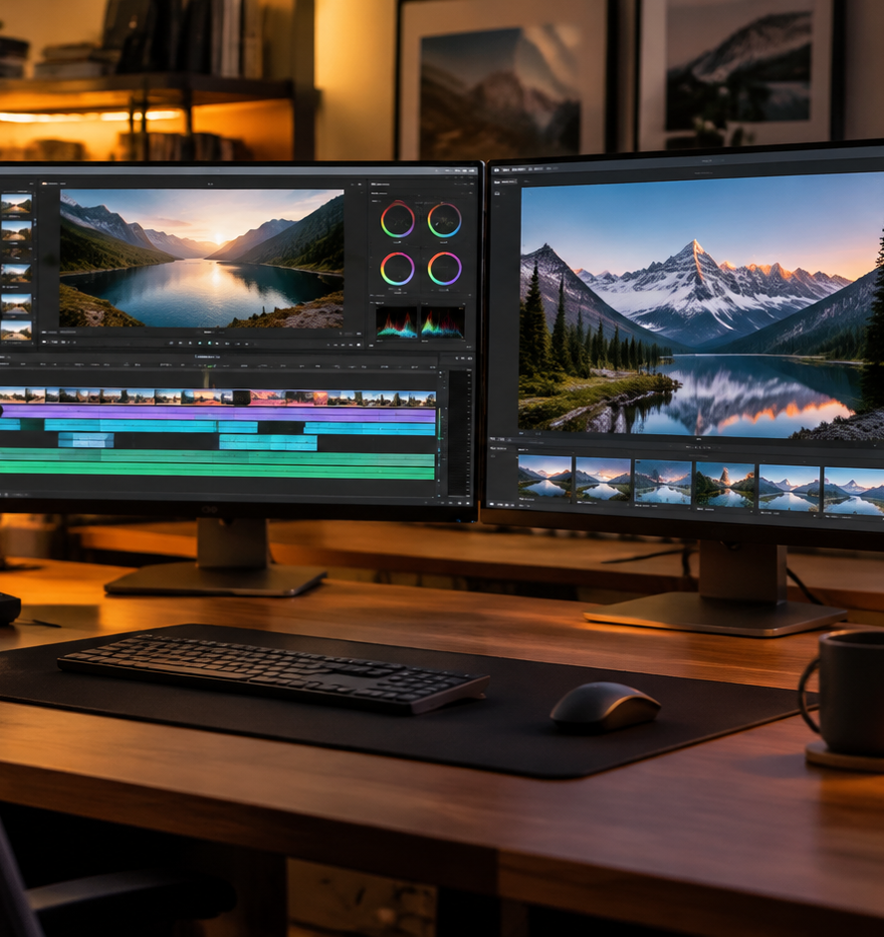
01 / 11
MULTIMEDIA PRODUCTION
How To Make A Picture Presentation With Music
Technical Workflows for Audiovisual Alignment and Playback
YIHA
Notes:
Welcome everyone. Today we examine how to design and execute a picture presentation synchronized with background music. Adding music to a visual slide deck is often treated as an afterthought, leading to cognitive fatigue, licensing issues, or hardware failures during delivery. In this session, we explore the end to end production workflow. We begin with dual-channel cognitive foundations to understand how viewers process sound and imagery simultaneously. Next, we cover pre-production storyboarding, copyright frameworks, and aspect ratio standards. Finally, we examine native software settings in PowerPoint and Keynote, beat-matched timeline editing, live venue gain staging, and long-term video archiving. By approaching audiovisual presentations with intentional design, presenters can reinforce narrative emotion without compromising information clarity or technical reliability.
Sources:

Slide 2
02 / 11
Cognitive Foundations of Audio-Visual Balance
Background music must act as a subtle affective cue rather than competing for working memory capacity.
Dual-channel processing separates visual and auditory bandwidth in working memory
Calm instrumental tracks support focus while lyrical songs cause cognitive overload
Fast tempos risk disrupting slide comprehension and visual processing speeds
YIHA
Notes:
Richard Mayer's Cognitive Theory of Multimedia Learning demonstrates that working memory processes visual and auditory information through independent channels with strict capacity limits. A 2025 thematic study in Frontiers in Psychology observed that calm, low-tempo instrumental background music acts as an affective cue that stabilizes student focus and improves presentation atmosphere without overwhelming cognitive capacity. In contrast, fast or loud music and songs with vocal lyrics act as seductive details that pull attention away from slide content. Salamé and Baddeley demonstrated that vocal tracks disrupt phonological memory, while Cheah and colleagues noted interference during memory-intensive tasks. Presenters must therefore select purely instrumental tracks that reinforce tone without competing for language processing resources. Citing Frontiers in Psychology (https://www.frontiersin.org/journals/psychology/articles/10.3389/fpsyg.2025.1637073/full), thoughtful music integration prevents split attention.
Sources:
https://www.frontiersin.org/journals/psychology/articles/10.3389/fpsyg.2025.1637073/full

Slide 3
03 / 11
Pre-Production Planning and Narrative Storyboarding
A two-column audiovisual script aligns photographic progression with musical movement before editing begins.
01
Visual blueprints pre-visualize scene sequence, framing, and narrative flow
02
Two-column AV scripting pairs specific image numbers with exact audio cues
03
Recommendation: establish structured pre-production checklists to lock runtime assets
YIHA
Notes:
Before arranging assets in editing software, production teams benefit from building an audiovisual storyboard. As analyzed by Filmustage Blog, storyboards serve as visual blueprints that pre-visualize narrative flow, shot angles, and transitions, a practice refined in historic cinema from Gone with the Wind to A Hard Day's Night, where Richard Lester storyboarded musical sequences. Furthermore, structured pre-production checklists documented by Team Unity Media confirm that locking asset ownership, runtime limits, and licensing permissions early avoids costly re-edits during later production stages. Establishing a two-column script maps specific slide numbers and framing cues directly against musical bars and tempo changes. This structured preparation guarantees that slide durations match the natural rhythmic phrasing of the audio. Citing Filmustage Blog (https://filmustage.com/blog/the-art-of-storyboarding-enhancing-script-breakdown-and-pre-production-in-filmmaking/) and Team Unity Media (https://www.teamunitymedia.com/blogs/behind-the-scenes-pre-production-checklist), pre-production establishes creative alignment.
Sources:
https://filmustage.com/blog/the-art-of-storyboarding-enhancing-script-breakdown-and-pre-production-in-filmmaking/
https://www.teamunitymedia.com/blogs/behind-the-scenes-pre-production-checklist

Slide 4
04 / 11
Audio Selection, Licensing, and Synchronization
Synchronizing recorded audio to visual media requires specific sync licensing or royalty-free commercial terms.
Sync rights cover combining musical compositions with sequential visual imagery
Personal streaming subscriptions do not grant commercial presentation rights
Business presentations require explicit commercial royalty-free clearance
YIHA
Notes:
Legal clearance is essential when synchronizing music with visual presentations. According to the comprehensive Music Licensing Study released by the U.S. Copyright Office, synchronizing sound recordings with visual media creates a derivative work that requires distinct licenses for both the underlying musical composition and the master sound recording. Personal streaming subscriptions and retail music purchases do not grant synchronization rights. In addition, platform licensing analyses from Velveteen show that commercial accounts and business organizations face stricter licensing terms than personal users, requiring dedicated commercial libraries like the Meta Sound Collection. Presenters building public or corporate slideshows must license royalty-free commercial tracks or verify explicit Creative Commons derivative terms to prevent copyright infringement and takedown penalties. Citing the U.S. Copyright Office (https://www.copyright.gov/policy/musiclicensingstudy/) and Velveteen (https://www.velveteen.fm/guides/instagram-for-musicians/music-on-instagram-licensing), licensing compliance protects organizations from severe legal liabilities.
Sources:
https://www.copyright.gov/policy/musiclicensingstudy/
https://www.velveteen.fm/guides/instagram-for-musicians/music-on-instagram-licensing

Slide 5
05 / 11
Image Curation, Aspect Ratios, and Framing
Standardizing image assets to a uniform widescreen aspect ratio prevents distortion and viewer fatigue.
Standardize graphics to 16:9 widescreen to prevent download pillarboxes
Recommendation: maintain uniform resolution standards like 1080p across all slides
Establish clear focal hierarchy and negative space to guide viewer eye paths
YIHA
Notes:
Visual consistency preserves narrative coherence and protects viewers from visual fatigue. Production guidelines from VisionStory emphasize that source photographs should match the target aspect ratio, such as 16:9 widescreen, to prevent automatic cropping, distortion, or distracting black pillarbox bars. When preparing image assets, creators must also establish clear spatial hierarchy and focal balance. Framing analyses published by GensGPT demonstrate that identifying a primary subject and utilizing negative space guides viewer eye movement across transitions, preventing chaotic or flat slide compositions. Alternating wide environmental shots with intimate close-up details introduces visual rhythm that complements the progression of the musical soundtrack. Curating high-resolution photographs with uniform lighting and framing builds a professional aesthetic that supports the presentation narrative. Citing VisionStory (https://www.visionstory.ai/tutorials/how-to-turn-an-image-into-a-video) and GensGPT (https://www.gensgpt.com/blog/camera-angles-composition-ai-image-generation-2026-guide), standardized framing maintains visual flow.
Sources:
https://www.visionstory.ai/tutorials/how-to-turn-an-image-into-a-video
https://www.gensgpt.com/blog/camera-angles-composition-ai-image-generation-2026-guide

Slide 6
06 / 11
Native Audio Playback Across Slides in PowerPoint
PowerPoint background playback options enable uninterrupted music across slide transitions.
01
Select Play in Background to automatically enable Play Across Slides and looping
02
Configure the Animation Pane to stop soundtrack playback after a specific slide
03
Recommendation: use standard MP3 files under 100MB to preserve system stability
YIHA
Notes:
Microsoft PowerPoint includes native playback controls that allow audio to run continuously across multiple slides without interruption. According to official Microsoft Support documentation, selecting Play in Background on the Audio Playback ribbon automatically configures three critical options: Play Across Slides, Loop Until Stopped, and Hide During Show. SlideSpeak workflows recommend utilizing standard MP3 audio files under 100 megabytes to prevent playback stutter and preserve device stability. When a soundtrack must conclude on a specific slide rather than repeating indefinitely, presenters can open the Animation Pane, access Effect Options, and designate the exact slide number where playback halts. This technical configuration allows speakers to control whether music acts as an introductory bridge or runs across the entire deck. Citing Microsoft Support (https://support.microsoft.com/en-us/powerpoint/training/add-or-delete-audio-in-your-powerpoint-presentation) and SlideSpeak (https://slidespeak.co/blog/how-to-make-a-picture-slideshow-with-music), proper audio settings prevent accidental restarts.
Sources:
https://support.microsoft.com/en-us/powerpoint/training/add-or-delete-audio-in-your-powerpoint-presentation
https://slidespeak.co/blog/how-to-make-a-picture-slideshow-with-music

Slide 7
07 / 11
Apple Keynote and macOS Native Soundtrack Workflows
Keynote uses document-level soundtracks and accessibility controls for continuous audio presentation.
Document Soundtrack inspector plays continuous audio across all slide builds
Native AAC and M4A audio containers optimize macOS and iOS presentation playback
Recommendation: provide manual volume controls if audio auto-plays beyond 3 seconds
YIHA
Notes:
Apple Keynote organizes continuous presentation audio through its Document Soundtrack inspector rather than slide-level media elements. Assigning an audio track to the document soundtrack ensures that music plays seamlessly across slide transitions and animations, independent of manual slide navigation. SlideSpeak guidelines emphasize that cross-platform presentations must account for Mac-specific format conventions, where native AAC and M4A containers optimize hardware decoding. Furthermore, accessibility standards established by the W3C Web Accessibility Initiative dictate that any audio playing automatically for more than three seconds must provide accessible mechanisms to pause playback or adjust volume. Presenters using Keynote must balance automated background audio with audience control requirements to ensure an inclusive viewing experience. Citing SlideSpeak (https://slidespeak.co/blog/how-to-make-a-picture-slideshow-with-music) and W3C WAI (https://www.w3.org/WAI/media/av/planning/), native soundtrack routing combined with accessibility controls guarantees polished macOS delivery.
Sources:
https://slidespeak.co/blog/how-to-make-a-picture-slideshow-with-music
https://www.w3.org/WAI/media/av/planning/

Slide 8
08 / 11
Beat Synchronization and Advanced Timeline Editing
Timeline editors align photo cuts with musical beats and transient waveforms for cinematic rhythm.
Identify audio transient spikes to place image cuts exactly on rhythmic beats
Apply gentle pan and zoom motion to add dynamic life to static photographs
Utilize audio crossfades and normalization curves to smooth volume transitions
YIHA
Notes:
When presentations require exact alignment between visual transitions and musical tempo, dedicated timeline editing tools provide superior control over standard slide decks. As described in workflow guides by Unanswered, timeline editors allow creators to inspect audio waveforms, identify transient peaks, and place photo cuts directly on rhythmic beats. Incorporating subtle Ken Burns panning and zooming transforms static imagery into dynamic cinematic sequences. In addition, audio filtering techniques documented in FFmpeg Filters show that applying crossfade curves and dynamic volume normalization smooths transitions between distinct audio tracks, preventing jarring volume spikes or harsh cuts. Combining beat-matched slide changes with gentle visual movement creates an engaging rhythm that enhances storytelling. Citing Unanswered (https://unanswered.io/guide/how-to-combine-photos-and-add-music) and FFmpeg Filters (https://ffmpeg.org/ffmpeg-filters.html), timeline synchronization elevates basic slide decks into cohesive video presentations.
Sources:
https://unanswered.io/guide/how-to-combine-photos-and-add-music
https://ffmpeg.org/ffmpeg-filters.html

Slide 9
09 / 11
Hardware Routing, Audio Gain, and Delivery Risks
Calibrated audio gain staging and accessibility captions prevent venue failures during live delivery.
01
Apply peak dynamic audio normalization to prevent clipping and low-volume dropouts
02
Example: balance background tracks at secondary levels beneath spoken narration
03
Incorporate visual captions to preserve messaging for hearing-impaired audiences
YIHA
Notes:
Live presentations introduce hardware vulnerabilities that can disrupt an otherwise polished audiovisual delivery. Documentation from FFmpeg Filters explains that dynamic audio normalization algorithms adjust gain across quiet and loud passages, preventing distortion and room acoustic clipping when connecting to venue sound systems. Presenters should establish proper gain staging during technical rehearsals, setting background music to a secondary level beneath spoken remarks. In addition, the W3C Web Accessibility Initiative standards for synchronized media emphasize providing live text captions or transcripts for hearing-impaired audiences. Captions ensure that spoken narrative and non-speech audio cues remain fully accessible even if venue sound systems experience feedback or speaker dropouts. Citing FFmpeg Filters (https://ffmpeg.org/ffmpeg-filters.html) and W3C WAI (https://www.w3.org/WAI/media/av/captions/), calibrating audio levels and providing captions mitigates live delivery failures.
Sources:
https://ffmpeg.org/ffmpeg-filters.html
https://www.w3.org/WAI/media/av/captions/

Slide 10
10 / 11
Export Encodings, Container Formats, and Archiving
Exporting presentation slides into self-contained MP4 video files guarantees cross-platform reliability.
Multiplex H.264 video and AAC audio into universal MP4 container formats
Synchronize Presentation Time Stamps to prevent progressive audio drift
Self-contained video files eliminate missing asset links and font dependencies
YIHA
Notes:
Distributing presentation files in native slide formats frequently results in broken audio links, missing codecs, and font discrepancies on external venue computers. As detailed in the official FFmpeg Formats and FFmpeg engine documentation, multiplexing visual and audio streams into a standardized MP4 container using H.264 video encoding and AAC audio guarantees universal cross-platform compatibility. Proper stream interleaving aligns Presentation Time Stamps across audio and video packets, preventing the cumulative synchronization drift that often develops during extended slideshow playbacks. Exporting a self-contained MP4 video locks slide timings, transition effects, and audio mixing into a single reliable file suitable for digital distribution and long-term archiving. Citing FFmpeg Formats (https://ffmpeg.org/ffmpeg-formats.html) and FFmpeg Documentation (https://ffmpeg.org/ffmpeg.html), consolidated video exports eliminate external software dependencies.
Sources:
https://ffmpeg.org/ffmpeg-formats.html
https://ffmpeg.org/ffmpeg.html

Slide 11
11 / 11
Summary: Building Reliable Audiovisual Presentations
Mastering cognitive pacing, legal clearance, and consolidated video exports guarantees presentation success.
Respect working memory limits by pairing calm instrumental music with clear imagery
Pre-visualize pacing through two-column AV storyboards and locked checklists
Export finished picture decks to H.264 and AAC MP4 video files for reliable delivery
YIHA
Notes:
In summary, producing a picture presentation with music requires coordinating cognitive principles, legal clearance, and technical encoding. By respecting dual-channel working memory limits identified in Frontiers in Psychology, presenters ensure that calm instrumental music supports rather than distracts from visual messages. Pre-production storyboards, commercial licensing compliance, aspect ratio consistency, and proper playback settings in PowerPoint or Keynote establish a solid foundation. For maximum reliability, exporting the final deck into an MP4 video container preserves timing, audio levels, and visual fidelity across all display hardware. Thank you for your time and engagement. Citing Frontiers in Psychology (https://www.frontiersin.org/journals/psychology/articles/10.3389/fpsyg.2025.1637073/full), thoughtful multimedia design ensures your message connects effectively with every audience.
Sources:
https://www.frontiersin.org/journals/psychology/articles/10.3389/fpsyg.2025.1637073/full

