Slide 1
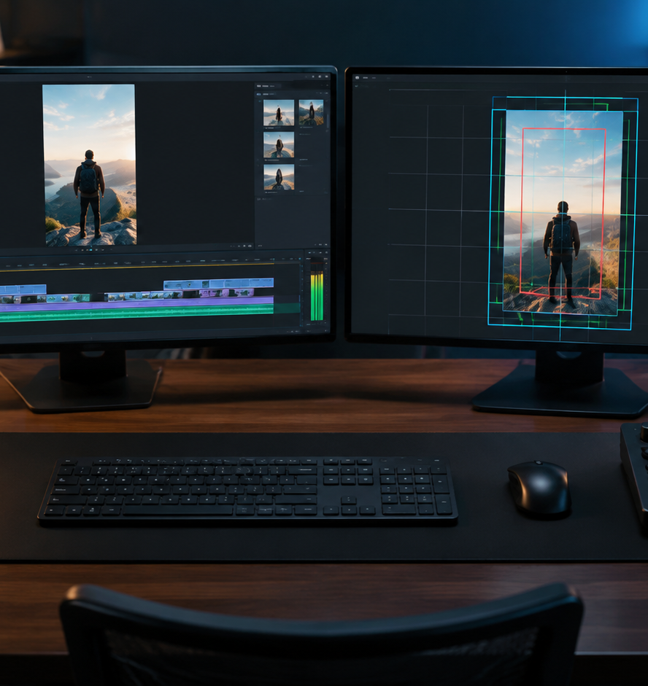
01 / 11
VIDEO PRODUCTION
TikTok Overlay
Safe Zone Architectures and Interface Compliance for 9:16 Video
YIHA
Notes:
Welcome to this technical masterclass on vertical video design and interface safe zones. When creating content for mobile channels like TikTok, working at the standard resolution of 1080 by 1920 pixels gives you a crisp display canvas, but the application interface introduces controls directly on top of your visual narrative. Platform headers, engagement buttons, caption blocks, and interactive tags all compete for screen space. Without structured overlay guides during the editing process, critical storytelling elements, brand marks, and calls to action often end up concealed beneath native interface icons. In this presentation, we will break down the exact pixel margins across the frame, explore dynamic metadata shifts, evaluate cross-platform syndication across Reels and Shorts, and establish dependable quality assurance workflows inside professional editing timelines. By mastering these safe zone principles, your creative work communicates clearly across every mobile device.
Sources:

Slide 2
02 / 11
The Vertical Canvas and Native UI Encroachment
Platform interface graphics consume valuable screen real estate across the standard 9:16 canvas.
Standard export frame is 1080 by 1920 pixels
Right-rail interaction column occupies active edge real estate
Top headers and bottom metadata bars truncate visible space
YIHA
Notes:
As documented in The Vertical Video Guide by Smooth Clip, vertical video renders natively at 1080 by 1920 pixels in a 9:16 aspect ratio. Exporting at this resolution prevents black bars and unnecessary scaling on mobile screens. However, short-form video platforms place extensive user interface graphics directly over the video canvas. The right rail features a vertical stack of buttons for likes, comments, shares, and bookmarks. Meanwhile, the bottom area holds account handles, audio attribution, and multi-line captions. When editors compose scenes as if the entire 1080 by 1920 canvas is usable creative space, essential visual punchlines and logos inevitably end up covered by platform buttons. Editorial teams must design with UI boundaries in mind from the start. Source: https://www.smoothclip.com/vertical-video-guide
Sources:
https://www.smoothclip.com/vertical-video-guide

Slide 3
03 / 11
Anatomy of the Safe Zone: Pixel Margins
Strict pixel boundaries isolate creative assets from overlapping platform controls.
01
Maintain a top buffer of at least 240 pixels
02
Preserve 440 to 660 pixels of bottom clearance
03
Keep right-side buffer between 120 and 164 pixels
YIHA
Notes:
According to technical reference specifications published by AdMakeAI, the usable clear space on a standard TikTok frame contracts to roughly 886 by 1432 pixels. The top 240 pixels house search icons, navigation controls, and account headers that can obstruct elevated elements. The bottom 440 to 660 pixels contain usernames, song titles, descriptions, and interactive buttons, creating a dense lower barrier. Furthermore, the right edge requires a buffer of at least 120 to 164 pixels to prevent the vertical engagement column from covering focal points, while the left margin needs about 60 pixels of padding. Editors who place branding, text, or primary subjects outside these boundary margins face immediate visual obstruction from platform graphics. Source: https://admakeai.com/blog/vertical-video-dimensions-2026
Sources:
https://admakeai.com/blog/vertical-video-dimensions-2026

Slide 4
04 / 11
Dynamic Safe Zones: Metadata Expansion
Variable caption lengths and interface tags dynamically contract usable video space.
Captions expanding to multiple lines raise the lower boundary
Sound tags and interactive anchors stack into the frame
Playlist buttons expand right-side dead zones
YIHA
Notes:
Vidpros reports that platform interface updates continuously alter safe zone calculations. In January 2026, TikTok introduced an Add to Playlist button on the lower right corner, expanding the right-side dead zone by approximately 20 pixels. Furthermore, dynamic captions that extend beyond a single line automatically expand upward into the viewing area, cutting deeper into the canvas. When combined with commerce tags, sound attributions, and location anchors, the lower UI footprint grows considerably. Editorial teams cannot treat the safe zone as a static box. They must anticipate dynamic UI expansion by centering primary narrative elements and keeping key graphic assets well above expanding metadata drawers. Source: https://vidpros.com/vertical-video-safe-zone/
Sources:
https://vidpros.com/vertical-video-safe-zone/

Slide 5
05 / 11
Positioning On-Screen Typography and Captions
Place headlines and burned-in subtitles within the central height band to guarantee visibility.
Recommendation: Position captions in the center third of the frame
Place brand logos in the top-center or top-left safe margins
Apply solid contrast boxes or drop shadows over complex footage
YIHA
Notes:
Vidpros emphasizes that standard subtitle placement in the lower third of the frame inevitably causes overlap with native captions and platform icons. Positioning text in the center third of the screen preserves legibility across mobile devices and prevents collision with native automated captions or interface trays. In addition, Vidpros notes that brand logos placed in the bottom-right corner land directly where engagement buttons and caption rows converge. Logos should instead reside in the top-center or top-left safe margins. Furthermore, typography requires sufficient background contrast to remain readable against complex footage. Adding high-contrast bounding boxes, subtle outlines, or drop shadows ensures that typography remains sharp and legible regardless of underlying video lighting conditions. Source: https://vidpros.com/vertical-video-safe-zone/
Sources:
https://vidpros.com/vertical-video-safe-zone/

Slide 6
06 / 11
Accommodating Interactive Add-Ons and Cards
Commercial advertising formats add prominent interactive layers that require custom spacing.
01
Paid interactive buttons consume an additional 50 to 80 pixels
02
Download cards and display badges overlay the lower viewport
03
Recommendation: Separate organic edits from commercial ad files
YIHA
Notes:
Vidpros points out that paid advertising placements introduce interface elements not found in organic videos. Sponsored posts feature dedicated Learn More buttons, app installation banners, and interactive display cards that occupy an extra 50 to 80 pixels along the bottom boundary. When editors repurpose organic video files for paid campaigns without adjusting for these commercial components, on-screen text and critical calls to action frequently end up covered. Vidpros recommends creating two distinct asset versions during production: one optimized for organic feeds and one tailored to the stricter dimensions of paid distribution. Developing separate ad cuts prevents conversion-critical graphics from being hidden on live campaigns. Source: https://vidpros.com/vertical-video-safe-zone/
Sources:
https://vidpros.com/vertical-video-safe-zone/

Slide 7
07 / 11
Interface Mirroring for Right-to-Left Layouts
Localized campaigns in Right-to-Left regions invert UI elements across the screen.
Right-to-Left regions mirror the vertical interaction rail
Engagement buttons relocate from the right edge to the left edge
Recommendation: Use flipped overlay templates for Arabic campaigns
YIHA
Notes:
Adship notes that TikTok distributes distinct safe zone templates for Left-to-Right and Right-to-Left languages such as Arabic. Technical validation data from Upload-Post confirms that in Right-to-Left mode, the entire button stack moves to the left edge of the display. If a marketing team deploys a standard Left-to-Right layout template for an Arabic campaign, graphics positioned along the left rail will be blocked by native interaction controls. Campaign teams distributing vertical assets into global markets must maintain mirrored safe zone guides to ensure visual clarity across localized user interfaces. Testing localized layouts before distribution prevents awkward visual collisions. Sources: https://www.adship.ai/blog/tiktok-ad-specs-2026 and https://www.upload-post.com/tools/safe-zone-checker/
Sources:
https://www.adship.ai/blog/tiktok-ad-specs-2026
https://www.upload-post.com/tools/safe-zone-checker/

Slide 8
08 / 11
Cross-Platform Conflicts: Reels, Shorts, and TikTok
Harmonize competing platform margins into a single conservative multi-channel safe zone.
Interface elements vary across TikTok, Instagram Reels, and Shorts
YouTube Shorts expands interface elements at the top and bottom
Recommendation: Center critical content within a 900 by 1400 pixel box
YIHA
Notes:
Vidpros analysis demonstrates that cross-platform syndication demands a unified safe zone strategy. While TikTok encroaches heavily on the right rail and bottom caption areas, Instagram Reels and YouTube Shorts impose their own distinct interface footprints. Furthermore, YouTube Shorts claims substantial vertical space across both the top and bottom margins. Vidpros recommends establishing a universal safe area of 900 by 1400 pixels to keep focal subjects, typography, and logos unobstructed across all three major platforms simultaneously. Designing within these conservative boundaries eliminates the need to re-render unique edits for every social network while preventing critical messaging from being covered by native interface components. Source: https://vidpros.com/vertical-video-safe-zone/
Sources:
https://vidpros.com/vertical-video-safe-zone/

Slide 9
09 / 11
Integrating Overlay Guides into Post-Production NLEs
Incorporate timeline reference graphics and structured review checkpoints during editing.
01
Import guide overlays directly into the video editing timeline
02
Organize media assets and graphic elements within the media pool
03
Recommendation: Establish structured post-production review steps
YIHA
Notes:
Professional video editing software like DaVinci Resolve provides an intuitive media pool and timeline architecture where editors organize footage, titles, and graphic overlays. As detailed in the DaVinci Resolve documentation, editors can import reference assets and arrange tracks to monitor visual alignment throughout the cut. Furthermore, as Ziflow outlines in their video production workflow framework, post-production requires clear milestones and review checkpoints before final distribution. By establishing standardized review steps where editors verify graphic placement against platform boundary guides, production teams catch layout errors early. This structured approach prevents delivery delays and ensures polished results across every sequence. Sources: https://www.blackmagicdesign.com/products/davinciresolve/edit and https://www.ziflow.com/blog/video-production-workflow
Sources:
https://www.blackmagicdesign.com/products/davinciresolve/edit
https://www.ziflow.com/blog/video-production-workflow

Slide 10
10 / 11
Pre-Flight Verification and Compliance Auditing
Execute systematic QA checks using platform preview tools prior to public distribution.
Recommendation: Implement pre-flight audits to catch layout errors
Test finished exports against native mobile display conditions
Lock template boundaries to prevent brand standard drift
YIHA
Notes:
Brand Kit OS emphasizes that template governance and automated pre-flight checks are essential to maintain visual integrity across distributed production teams. When assets move through multiple editors and marketing managers, layout drift and margin violations frequently occur without strict quality controls. Creative teams should establish formal compliance checkpoints, verifying every video export against native platform preview tools and mobile draft environments before launch. Testing files under live interface conditions confirms that hardware bezels, automated captions, and platform buttons do not obstruct key messaging or brand identifiers. Standardizing pre-flight audits ensures consistent visual excellence across high-volume publishing schedules. Source: https://www.brandkitos.com/blogs/brand-compliance-automation-guide-2026/template-brand-compliance-enforcement-tools-2026
Sources:
https://www.brandkitos.com/blogs/brand-compliance-automation-guide-2026/template-brand-compliance-enforcement-tools-2026

Slide 11
11 / 11
Architecting Resilient Short-Form Layouts
Safe zone discipline ensures creative ideas communicate clearly without interface obstruction.
Design vertical content with interface encroachment in mind
Separate commercial ad assets from organic content edits
Validate every master export with systematic pre-flight testing
YIHA
Notes:
In conclusion, respecting safe zone boundaries is an essential technical requirement for modern short-form video production. Mobile platforms will continue to update their user interfaces, but adopting proactive guide workflows inside your editing software prevents visual clashes and protects narrative clarity. By adhering to conservative pixel boundaries, accommodating dynamic metadata and paid commercial overlays, and testing layouts thoroughly before public release, your team delivers polished video that captures audience attention without distraction. Safe zone compliance ensures that your visual hooks, branding, and conversion calls remain fully visible on every screen. Source: https://vidpros.com/vertical-video-safe-zone/
Sources:
https://vidpros.com/vertical-video-safe-zone/

