Slide 1
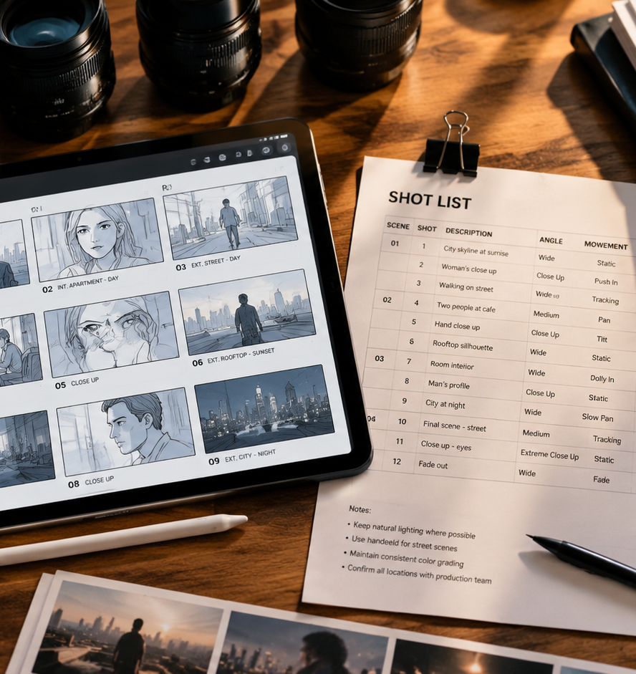
01 / 11
VIDEO PRODUCTION
Video Production Storyboard Tool
Bridging Creative Vision and On-Set Execution
YIHA
Notes:
Welcome to this comprehensive overview of video production storyboard tools and visual planning workflows. In professional film, commercial, and animation pipelines, pre-production planning determines whether a shoot succeeds within budget or collapses under unexpected schedule overruns. Throughout this session, we will examine how visual panels translate written screenplays into actionable instructions for directors, camera operators, and production designers. We will cover the mechanical structure of storyboard panels, the progression from physical index cards to cloud-native platforms, and methods for integrating scripts directly with production shot lists. Furthermore, we will analyze how timed animatics and browser cut detection engines test editorial rhythm before filming begins, and how production crews leverage locked boards on shoot day.
Sources:

Slide 2
02 / 11
Pre-Production Bottlenecks and Visual Planning
Storyboards serve as early defect detection tools that resolve staging errors before expensive crews assemble.
Scripts describe dialogue but omit spatial framing and lens choices
Paper rehearsals reveal screen direction flaws at virtually zero cost
Producers calculate required setups and shooting schedules accurately
YIHA
Notes:
Pre-production sits between early concept writing and physical filming. As explained by asmr.education, a screenplay communicates narrative action and spoken lines, but it cannot convey exact camera placements, focal depth, or editorial cut timing. Every unresolved visual decision left for the shoot day compounds costs in crew wages, location fees, and equipment rentals. According to Video Production Agency, storyboards function as visual blueprints that allow directors and cinematographers to rehearse scene progression and identify logistical hurdles in advance. For example, redrawing a few panels on paper to fix an accidental screen direction crossing costs almost nothing. In contrast, discovering that same continuity error during physical production forces costly reshoots and schedule delays.
Sources:
https://asmr.education/faq/video-production/storyboard-purpose-pre-production
https://www.videoproductionagency.com/what-is-a-storyboard-and-how-is-it-used-in-filmmaking/

Slide 3
03 / 11
Technical Anatomy of a Storyboard Panel
A functional panel pairs simple compositional sketches with precise camera movement and shot metadata.
01
Stick figures and basic shapes clearly establish character staging
02
Directional arrows signal camera pans, tilts, and zoom pushes
03
Panel metadata connects scene numbers to dialogue and audio cues
YIHA
Notes:
A production storyboard panel is a technical specification rather than fine art. As noted by Studiovity, stick figures and simple bounding boxes are completely effective as long as they communicate subject position, framing boundaries, and camera distance. Directional notations provide critical guidance for the camera department. Inward-pointing arrows inside a secondary frame box indicate a camera push-in or zoom, while directional vectors indicate actor paths across the frame. Furthermore, asmr.education notes that pairing sketches with camera angles, character movements, and transition notes prevents misunderstandings among crew members. When operators see scene numbers, shot identifiers, dialogue lines, and audio cues directly below each panel, they immediately understand what to capture without verbal speculation.
Sources:
https://blog.studiovity.com/streamline-video-production-master-storyboard-shot-list/
https://asmr.education/faq/video-production/storyboard-purpose-pre-production

Slide 4
04 / 11
Evolution from Physical Cards to Cloud Software
Pre-production has evolved from 1930s pinned corkboards to browser-based collaborative canvases.
Walt Disney Studios pioneered hand-pinned panel boards in the 1930s
Live-action directors adopted storyboards to previsualize setups
Cloud tools enable drag and drop references and crew synchronization
YIHA
Notes:
The practice of visual storyboarding began in the animation industry. As detailed by asmr.education, Walt Disney Studios developed the technique during the 1930s by pinning illustrated story cards onto studio corkboards to plan animated shorts. Prominent live-action directors quickly recognized that mapping camera angles on paper eliminated guesswork during principal photography. In modern workflows, physical paper has largely transitioned to cloud-native software. According to Studiovity, cloud-based storyboard tools allow filmmakers to drag and drop visual references, collaborate with remote editors, and reorder panels dynamically without redrawing entire sequences. Browser access provides an accessible single source of truth where distributed team members can review camera positions and provide instant feedback from any location.
Sources:
https://asmr.education/faq/video-production/storyboard-purpose-pre-production
https://blog.studiovity.com/streamline-video-production-master-storyboard-shot-list/

Slide 5
05 / 11
Connecting Scripts to Dynamic Shot Lists
Software bridges scripts and shot lists by parsing scene text into structured shot sequences and camera setups.
Script parsers extract scene headings, action beats, and dialogue
Cinematic rules map written script events to camera proposals
Grouping parsed shots by camera angle avoids reset delays on set
YIHA
Notes:
Connecting screenplays directly to shot lists bridges literary narrative and physical production logistics. As analyzed by Shai Creative, pre-production software parses formatted screenplays to extract scene headings, action descriptions, and character dialogue into sequential beats. Researchers on arXiv demonstrate that pairing formatted story scripts with camera parameters allows automated systems to generate camera movement and character staging proposals following cinematic rules. This bidirectional connection ensures that when script revisions occur, shot lists update without forcing production teams to re-enter technical metadata. Organizing parsed script beats into camera setup groups allows crews to film all matching angles simultaneously, cutting unnecessary repositioning and keeping the production schedule intact.
Sources:
https://shaicreative.ai/how-to-use-adobe-storyboard-ai-for-video-pre-production/
https://arxiv.org/abs/2301.12688

Slide 6
06 / 11
Building Timed Animatics to Test Rhythm
Converting static frames into timed animatics tests scene pacing, cut points, and audio sync before filming.
01
Static panels often hide editing duration and pacing bottlenecks
02
Browser animatic engines pair panels with scratch audio and timing
03
Pre-visualizing transitions prevents awkward cuts in final edits
YIHA
Notes:
Static storyboard drawings can conceal significant pacing flaws. As Veo3 AI explains, creating a silent storyboard that lacks audio cues, shot durations, and transition details provides only half of a production plan. A scene might appear balanced across five panels, yet feel dragging or abrupt when filmed. Converting static panels into an animatic solves this blind spot. According to StoryBoard Express, creators can assemble illustrated panels into timed slideshows or animatic videos directly in their browser tab. Adding temporary scratch voiceover, sound effects, and transitions such as cuts or dissolves allows editors and directors to test scene rhythm and verify shot coverage long before production starts.
Sources:
https://www.storyboard-express.com/
https://www.veo3ai.io/blog/how-to-storyboard-a-video

Slide 7
07 / 11
Automated Cut Detection and Reverse Boards
Computer vision cut detection splits reference footage into panels for reverse storyboarding and analysis.
Browser-based cut detectors convert video footage into frame panels
Color scripts reveal sequence lighting and palette progression
Panel slicing tools automatically digitize hand-drawn paper sheets
YIHA
Notes:
Reverse storyboarding is an essential planning technique for commercial and narrative filmmakers. StoryBoard Express provides automated shot detection engines that run directly within the browser, analyzing existing video files or streaming links without uploading private data to remote servers. The software detects cuts across footage and automatically outputs keyframes into organized storyboard layouts. Documentary editors use this capability to review edit pacing across rough assemblies, while commercial directors dissect visual references into color scripts. By scaling thumbnail rows, teams can evaluate lighting changes, color palettes, and shot distributions across complete sequences. The tool also extracts panels from scanned physical sheets, bridging traditional paper sketching with digital boards.
Sources:
https://www.storyboard-express.com/
https://asmr.education/faq/video-production/storyboard-purpose-pre-production

Slide 8
08 / 11
Generative AI and Consistent Visual Mockups
Node-based canvas systems connect script prompts to generative models while maintaining character consistency.
Canvas nodes feed character and lighting references into every frame
Generic image generators struggle with film grammar and progression
Compositing nodes let creators refine framing without canvas exit
YIHA
Notes:
Generative artificial intelligence has introduced automated visualization into pre-production pipelines. As shown by Figma Weave, node-based canvas architectures allow creative teams to link script beats directly to image generation models while maintaining shared character reference nodes and lighting guidelines across sequential panels. However, Shai Creative points out that standard text-to-image engines often lack cinematic domain awareness, struggling to maintain consistent camera lenses, spatial logic, and narrative progression between shots. To overcome these limitations, modern pre-production pipelines combine automated generation with manual canvas adjustments, compositing nodes, and character style guides, ensuring that generated mockups serve as reliable technical blueprints rather than disconnected artistic concepts.
Sources:
https://www.figma.com/solutions/ai-storyboard-generator/
https://shaicreative.ai/how-to-use-adobe-storyboard-ai-for-video-pre-production/

Slide 9
09 / 11
Review Platforms Versus Full Production Suites
Choose between lightweight review tools and all-in-one planning suites based on team size and scope.
01
Lightweight browser tools provide fast local cut detection and export
02
Full pre-production suites unify scripting, boards, and shot plans
03
Client-facing approval portals lock creative direction before shooting
YIHA
Notes:
Video production teams must choose their software based on specific operational needs. According to StoryBoard Express, lightweight browser tools allow rapid cut detection, local storage, and instant exports without server dependencies, making them ideal for agile creators. In contrast, platforms highlighted by Lumina Studio combine automated script breakdowns, shot lists, and visual mockups into an integrated schedule designed to reduce pre-production turnaround times. Meanwhile, Tone Production highlights that for commercial client workflows, dedicated review portals allow stakeholders, directors of photography, and editors to review boards and sign off on frame-level details. This client approval step ensures that all parties align on creative expectations before filming begins.
Sources:
https://www.lumina-os.com/blog/ai-video-scripting-storyboard-workflow/
https://toneproduction.net/how-to-storyboard-a-promo-video/

Slide 10
10 / 11
Executing Storyboards from Review to Shoot Day
A locked storyboard functions as a floor plan and on-set checklist that keeps physical shoots on schedule.
Locked shot numbers prevent communication errors across camera teams
Keep panel annotations concise to enable rapid crew comprehension
Cross-reference digital boards or printed decks to track filmed takes
YIHA
Notes:
On shoot day, the storyboard transitions from a creative ideation document into an operational checklist. Kasra Design compares a storyboard to an architectural floor plan, noting that moving walls on paper is straightforward, whereas altering structures after filming or animation begins is extremely costly. Tone Production recommends transferring approved storyboard panels into a numbered operational shot list sorted by location, required equipment, and cast presence. Maintaining consistent, locked shot numbering prevents miscommunication between camera teams, script supervisors, and assistant directors. Crew members can reference printed production decks or mobile screens on set, checking off completed setups and ensuring that all necessary coverage is captured before wrapping.
Sources:
https://toneproduction.net/how-to-storyboard-a-promo-video/
https://www.kasradesign.com/what-is-a-storyboard-and-how-to-read-it/

Slide 11
11 / 11
Conclusion: Integrated Pre-Production Flow
Rigorous visual planning aligns clients and crews, protects budgets, and accelerates editorial assembly.
Visual panels align creative expectations across clients and crews
Integrated shot lists group camera setups to maximize shooting time
Pacing verified in animatics prevents editorial surprises in post
YIHA
Notes:
In conclusion, adopting an integrated video production storyboard tool transforms pre-production from a vulnerable operational bottleneck into a reliable architectural foundation. As demonstrated by asmr.education and Kasra Design, resolving camera angles, spatial blocking, and scene transitions on paper or in software prevents expensive mistakes on set and simplifies post-production editing. Connecting visual panels directly to technical shot lists, animatics, and client review workflows ensures that directors, crew members, and clients share an identical vision. By testing pacing early and locking down shot requirements before principal photography begins, video production teams protect their schedules, optimize operational budgets, and consistently deliver cohesive visual stories.
Sources:
https://asmr.education/faq/video-production/storyboard-purpose-pre-production
https://www.kasradesign.com/what-is-a-storyboard-and-how-to-read-it/

