Slide 1
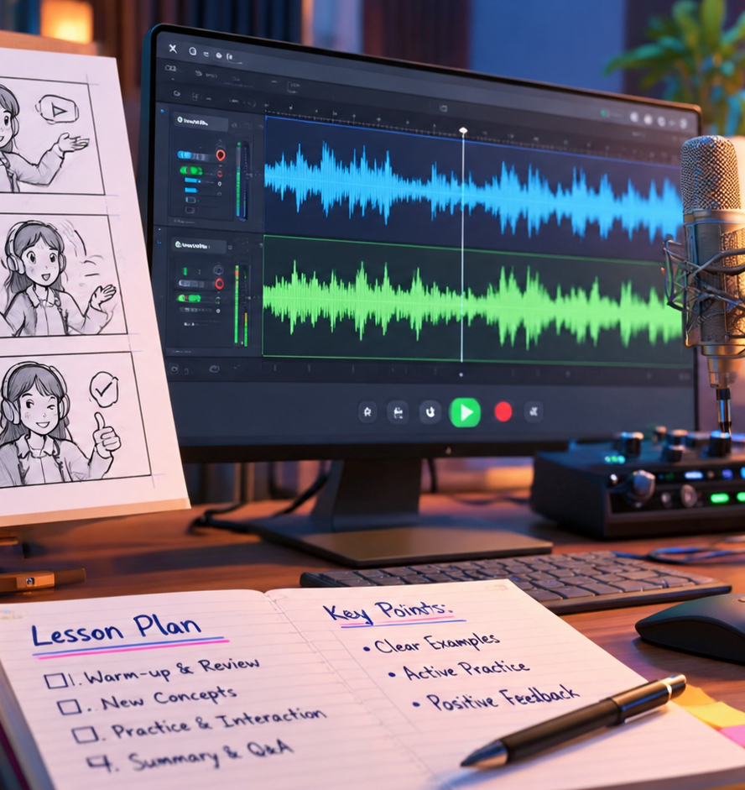
01 / 11
INSTRUCTIONAL DESIGN
Effective Lesson Planning Video
Pedagogical Principles and Technical Production Workflows
YIHA
Notes:
Welcome to this session on effective lesson planning for video instruction. Educational video is one of the most widely used media tools in flipped, hybrid, and online classrooms today. However, simply placing a camera in front of a lecturer does not ensure that students will comprehend or retain the material. To make video truly effective, we must unite pedagogical theory with systematic production workflows. Over the course of this presentation, we will explore how working memory handles multimedia content, how to eliminate extraneous distractions, how to write disciplined scripts, and how to configure audio and video packaging pipelines. By treating educational video design as an engineering and instructional discipline, we can build learning experiences that respect cognitive boundaries, engage students actively, and support universal accessibility across all devices.
Sources:

Slide 2
02 / 11
Pedagogical Foundations and Cognitive Architecture
Working memory processes visual and auditory inputs through dual channels with strictly limited capacity.
Visual and verbal channels process streams independently
Intrinsic load reflects core subject conceptual difficulty
Extraneous load wastes mental effort through poor design
YIHA
Notes:
Instructional video design begins with the cognitive theory of multimedia learning. Research synthesized by Cynthia Brame and Richard Mayer explains that human working memory contains two separate channels: one for visual and pictorial data, and another for auditory and verbal processing. Because each channel possesses strictly limited capacity, presenting excessive uncoordinated stimuli causes cognitive overload. Intrinsic cognitive load represents the inherent difficulty of the content, which we manage by sequencing concepts logically. Extraneous cognitive load represents wasted mental effort caused by confusing layouts, visual noise, or disorganized speech. Our objective when planning video lessons is to eliminate extraneous friction so that working memory can allocate capacity toward germane processing and schema creation. Cited from research on PMC educational videos.
Sources:
https://pmc.ncbi.nlm.nih.gov:443/articles/PMC5132380/

Slide 3
03 / 11
Visual and Auditory Signaling Principles
Direct student focus using explicit on-screen visual cues while pairing spoken narration with graphics.
01
Signaling highlights crucial terms and diagrams on screen
02
Coherence demands removing decorative graphics and music
03
Modality favors spoken voice over dense on-screen text blocks
YIHA
Notes:
Once we understand dual-channel processing, we must structure on-screen elements to guide attention deliberately. Mayer's signaling principle emphasizes that highlighting critical terminology, using directional arrows, or applying contrast changes directs student eyes to the exact point of instruction. At the same time, we must enforce the coherence principle by cutting decorative illustrations, unrelated trivia, and intrusive background soundtracks. The modality principle proves that learners grasp complex mechanics best when visual animations are accompanied by spoken voice rather than walls of text. Showing paragraphs while a narrator speaks forces the visual channel to process text and images at once, causing split-attention fatigue. Cited from Teaching Heart and Soul on reducing extraneous cognitive load.
Sources:
https://www.teachingheartandsoul.com/blog/reducing-extraneous-load

Slide 4
04 / 11
Segmenting Content for Paced Student Engagement
Deconstruct monolithic lectures into focused modules to respect working memory and support nonlinear review.
Recommendation: segment videos into short focused units
Segmenting principle enables self-paced student review
Provide navigation markers and labeled chapter headings
YIHA
Notes:
Student engagement drops sharply when instructional videos run as long unbroken lectures. Under Mayer's segmenting principle, learners demonstrate higher retention when content is chunked into focused, manageable topics. Production guidelines from Columbia University CTL stress establishing concise learning outcomes before recording, which naturally leads to modular scripts. Breaking a broad topic into distinct units allows learners to pause, reflect, and digest material at their own pace. Furthermore, adding labeled chapter markers or timestamp navigation gives students control to revisit technical demonstrations or bypass concepts they already understand. Segmenting prevents cognitive fatigue and transforms long passive viewing into structured, manageable milestones. Cited from Columbia Center for Teaching and Learning video production best practices.
Sources:
https://ctl.columbia.edu/resources-and-technology/teaching-with-technology/diy-video/video-best-practices/

Slide 5
05 / 11
Embedding Active Learning and Retrieval Tasks
Transform passive video watching into active study using guided prompts and formative self-checks.
Incorporate deliberate pause prompts for reflection
Use guided worksheets to verify understanding during viewing
Active recall strengthens long-term memory schema formation
YIHA
Notes:
Passive video watching frequently induces a false sense of mastery, where students confuse visual familiarity with true conceptual competence. To overcome this limitation, video lesson plans must incorporate active learning mechanisms. Literature from the Teachers Institute and biology education studies highlights the value of embedding interactive checkpoints, self-explanation prompts, and structured guided practice into the video sequence. An illustrative example involves pausing playback to prompt students to solve an equation or predict an experimental outcome before showing the answer. These retrieval practice opportunities force working memory to actively retrieve and manipulate information, converting passive media exposure into durable long-term memory encoding. Cited from PMC educational video literature and Teachers Institute lesson planning practices.
Sources:
https://pmc.ncbi.nlm.nih.gov:443/articles/PMC5132380/
https://teachers.institute/managing-teaching-learning/lesson-planning-techniques-formats-best-practices/

Slide 6
06 / 11
Structured Scripting and Visual Generation
Write dual-column scripts and define precise prompt parameters when using generative tools for scene creation.
01
Dual-column scripts synchronize spoken voice with visual cues
02
Prompt frameworks define subject, action, camera, and setting
03
Verify AI generated visual models for pedagogical accuracy
YIHA
Notes:
A well-crafted script is essential for preventing disorganized speech and maintaining visual synchronization. Professional instructional designers use dual-column scripts to map narration directly to specific visual actions. When incorporating modern generative video models to illustrate abstract processes, prompts must follow rigorous descriptive frameworks. According to Google Cloud enterprise video prompting guidelines, prompts must explicitly define the subject, the concrete action, the camera angle, and the scene environment. However, generative tools carry inherent limitations, including factual hallucinations and anatomical errors. Every synthesized visual demonstration must undergo rigorous manual review by the instructor to guarantee factual accuracy prior to classroom use. Cited from Google Cloud video generation documentation.
Sources:
https://docs.cloud.google.com/gemini-enterprise-agent-platform/models/video/video-gen-prompt-guide

Slide 7
07 / 11
Acoustic Clarity and Programmatic Audio Processing
Clear audio intelligibility drives learning outcomes more effectively than high-end visual effects.
Apply EBU R128 loudness normalization using FFmpeg loudnorm
Eliminate background noise and uncontrolled room reverb
Omit background music during dense spoken conceptual delivery
YIHA
Notes:
Research in multimedia design indicates that audio fidelity is among the most critical factors influencing learner comprehension. Poor vocal clarity forces students to waste cognitive capacity decoding distorted speech. According to the Teachers Institute, educators should invest in controlled acoustic environments and high-quality microphones before spending on elaborate visual effects. Programmatically, open-source tools like FFmpeg provide specialized audio filters such as loudnorm for EBU R128 loudness normalization and speech filtering. Applying normalization guarantees a consistent acoustic volume across all video modules. Furthermore, background music should never play beneath technical explanations, as lyrical and melodic tracks compete directly with auditory processing. Cited from FFmpeg filter documentation and Teachers Institute media design.
Sources:
https://ffmpeg.org/ffmpeg-filters.html
https://teachers.institute/designing-courseware/effective-audio-video-educational-design/

Slide 8
08 / 11
Universal Accessibility and Captioning Standards
Provide synchronized WebVTT captions and searchable transcripts to ensure universal instructional access.
WCAG 1.2.2 mandates synchronized captions for prerecorded media
Review speech-to-text transcripts manually to fix domain errors
Interactive transcripts enable keyword search and instant replay
YIHA
Notes:
Instructional video must be designed for universal accessibility from the start. Under Web Content Accessibility Guidelines and Section 508 federal standards, all prerecorded synchronized media requires accurate, synchronized captions. According to W3C WAI standards, automated captions alone are insufficient because speech-to-text systems frequently miss specialized scientific terminology, omit punctuation, and ignore speaker changes. Captions delivered in WebVTT format allow media players to display synchronized text while powering interactive transcripts. These transcripts allow all students, including deaf learners, English language learners, and mobile students in quiet spaces, to search terminology and jump directly to relevant video timestamps. Cited from W3C Web Accessibility Initiative guidelines.
Sources:
https://www.w3.org/WAI/media/av/captions/
https://www.section508.gov/create/synchronized-media/

Slide 9
09 / 11
Packaging Video Formats and Delivery Pipelines
Encode videos with standardized codecs and adaptive streaming protocols for dependable playback.
01
Use H.264 video and AAC audio containers for universal support
02
Deploy HLS and DASH adaptive bitrate streaming protocols
03
Streamcopy commands allow efficient container transmuxing
YIHA
Notes:
High-quality instructional videos must play dependably across varied devices and network conditions. Distributing large uncompressed files leads to buffering interruptions that disrupt the learning flow. Documentation from FFmpeg outlines packaging standards for dynamic adaptive streaming using HLS and DASH protocols. These protocols chop media into multi-second chunks and provide manifest playlists across multiple bitrates. If a student is on a mobile cellular connection, the video player automatically downscales bitrate without crashing or freezing. When bandwidth improves, resolution scales up seamlessly. Packaging media using standard H.264 and AAC streams ensures universal playback across desktop web browsers, tablets, and learning management systems. Cited from FFmpeg formats documentation.
Sources:
https://ffmpeg.org/ffmpeg-all.html
https://ffmpeg.org/ffmpeg-formats.html

Slide 10
10 / 11
Production Workflow and Quality Assurance Review
Execute a structured four-stage production workflow with formal pedagogical and technical audits.
Stage pipeline across pre-production, filming, edit, and audit
Audit lesson videos against pedagogical and accessibility rubrics
Iterate future videos using student quiz and completion data
YIHA
Notes:
Producing effective lesson videos requires an organized production workflow. As outlined in professional media frameworks from Assemble, production must progress sequentially through pre-production planning, recording, post-production editing, and distribution review. Skipping pre-production planning almost always results in disorganized content and expensive reshoots. Before any video is deployed to a live course, instructional designers must conduct a comprehensive quality assurance audit. This review verifies pedagogical coherence, checks loudness normalization against audio standards, tests caption accuracy, and validates mobile playback. Continuous analysis of student comprehension data after publication guides iterative revisions for future lesson modules. Cited from Assemble video workflow templates and Columbia CTL guidelines.
Sources:
https://www.onassemble.com/template-library/video-production-workflow-template
https://ctl.columbia.edu/resources-and-technology/teaching-with-technology/diy-video/video-best-practices/

Slide 11
11 / 11
Synthesizing Effective Lesson Video Production
Evidence-based video instruction connects cognitive load theory, audio clarity, and accessible delivery.
Design content around dual-channel cognitive memory limits
Maintain acoustic clarity and fully verified caption tracks
Package media into modular units with active retrieval checks
YIHA
Notes:
In conclusion, effective educational video production is neither pure filmmaking nor passive lecture capture. It is a systematic instructional design practice grounded in cognitive science. By honoring dual-channel processing limits, educators eliminate visual clutter and present information clearly. By breaking lessons into brief modular units and embedding formative retrieval checkpoints, we transform passive viewing into active learning. Finally, maintaining rigorous audio processing pipelines, providing accurate WebVTT captions, and packaging media for adaptive streaming ensures that every learner has equal access to instructional content. Applying this end-to-end framework guarantees that your video lessons achieve lasting educational impact across diverse classroom environments. Cited from PMC educational video literature.
Sources:
https://pmc.ncbi.nlm.nih.gov:443/articles/PMC5132380/

