Slide 1
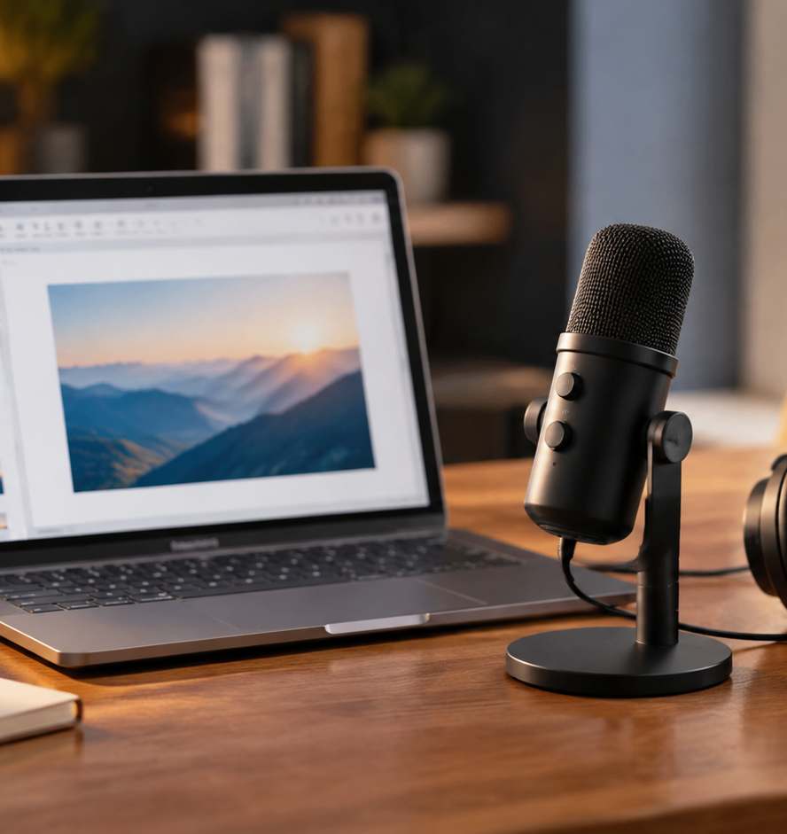
01 / 11
PRESENTATION TECHNOLOGY
How To Record Presentation With Audio
Technical Workflows for Voice-Narrated Decks
YIHA
Notes:
Welcome everyone. Today we are examining how to record presentations with clean synchronized audio. In modern workplaces and remote classrooms, sharing a static slide deck often fails to communicate the complete reasoning behind complex data. Recording audio directly over your slides preserves the context, pacing, and vocal tone that you would normally provide during an in-person meeting. We will explore the technical setup, codec selection, interface navigation in modern presentation software, and essential speaking habits to avoid lost words. Whether you need to deliver training modules, executive briefings, or technical product overviews, these techniques ensure your message is delivered clearly without scheduling conflicts. Over the next ten slides, we will cover setup, recording controls, post-production, and export methods.
Sources:

Slide 2
02 / 11
The Rise of Asynchronous Delivery
Recorded presentations bridge communication gaps across distributed teams without live meetings.
Static slide decks lack the conversational context needed to explain complex ideas
On-demand decks allow team members to review material during their own productive hours
Pre-recording presentations helps speakers refine their pacing and eliminate jitters
YIHA
Notes:
Slide decks created in modern tools serve as visual frameworks, but when distributed without a presenter, they leave significant room for misinterpretation. As documented in Loom's presentation recording guide, slides without voiceover often fail to convey the author's complete reasoning. Furthermore, Microsoft Support documentation highlights that recording your slide show preserves your voice, gestures, and presence so people see your briefing with personality intact. This asynchronous format is especially valuable for remote onboarding, marketing webinars, and technical updates where scheduling a live session across multiple time zones is inefficient. Presenters also benefit by reviewing their recorded footage beforehand, ensuring smooth delivery without live meeting pressure. Communicating through asynchronous audio recordings ensures distributed teams stay aligned on key business data.
Sources:
https://www.atlassian.com/blog/loom/how-to-video-record-yourself-presenting-a-powerpoint
https://support.microsoft.com/en-us/powerpoint/training/record-a-slide-show-with-narration-and-slide-timings

Slide 3
03 / 11
Audio Standards and Cross-Platform Codecs
Standardizing on MP3 and AAC-encoded MP4 files guarantees playback across all devices.
01
MPEG-4 with AAC audio is the primary recommended media standard in PowerPoint
02
Legacy formats like WMA, AIFF, and AVI face deprecation in recent application releases
03
Only MP3 and MP4 files maintain universal playback across Windows, macOS, and mobile
YIHA
Notes:
Technical compatibility across operating systems is a frequent stumbling block in multimedia presentations. Microsoft Support explicitly recommends using MPEG-4 video with Advanced Audio Coding, known as AAC, for dependable cross-platform playback. Legacy file formats such as Windows Media Audio and AIFF are deprecated in PowerPoint version 2505 and above, requiring automatic conversion upon insertion. Millersville University instructional technology documentation confirms that only MP3 and MPEG-4 media play reliably across Windows, Mac, iOS, and Android installations. Distributing proprietary files like WMA frequently results in silent playback errors on macOS devices, making format standardization critical before distribution. Checking codecs early protects against playback failures across diverse end-user operating systems.
Sources:
https://support.microsoft.com/en-us/powerpoint/video-and-audio-file-formats-supported-in-powerpoint
https://wiki.millersville.edu/spaces/instructdocs/pages/93851005/PowerPoint+Audio+and+Video+File+Types

Slide 4
04 / 11
Hardware Setup and Audio Input Selection
Selecting dedicated external microphones and configuring system inputs prevents poor sound.
Dedicated external microphones capture vocal tone far better than built-in laptop mics
System sound settings must grant explicit microphone permissions to the slide software
The options menu inside the recording studio allows manual input device assignment
YIHA
Notes:
Capturing intelligible voice narration requires adequate hardware preparation before opening your slide deck. Built-in laptop microphones are susceptible to room reflections, keyboard clatter, and internal fan noise. As highlighted in Loom's recording guide, using a dedicated microphone substantially improves audio quality compared to standard hardware. In Microsoft PowerPoint, presenters can open the Record tab and check device settings through the options menu. Microsoft Support documentation notes that clicking the three dots icon opens options to select your exact camera and microphone rather than relying on system defaults. Selecting the dedicated external microphone prevents unintended audio switching during your session. Taking time to test input gain levels before recording ensures your voice remains crisp without low volume or harsh digital clipping.
Sources:
https://support.microsoft.com/en-us/powerpoint/training/record-a-slide-show-with-narration-and-slide-timings
https://www.atlassian.com/blog/loom/how-to-video-record-yourself-presenting-a-powerpoint

Slide 5
05 / 11
Executing the Slide Show Recording Workflow
The native recording studio captures narration per slide, enabling seamless retakes.
Selecting Record opens an integrated studio window with start, pause, and stop tools
A three-second countdown begins automatically after pressing the red record button
Re-recording audio on an individual slide overwrites only that specific slide segment
YIHA
Notes:
The recording studio interface inside modern PowerPoint streamlines presentation capture. Presenters navigate to the Record tab and launch the studio, which resembles Presenter View. Clicking the red button or tapping the R key initiates a three-second countdown before recording commences. As detailed in Microsoft Support documentation, PowerPoint records slide durations, animations, inking, and vocal tracks together. A crucial architectural feature of PowerPoint is that media is stored on each individual slide rather than in a single monolithic video file. If you stumble while speaking on a particular slide, you can simply clear and re-record that single slide without needing to redo the entire presentation from the beginning. This modularity saves substantial editing time across large slide decks.
Sources:
https://support.microsoft.com/en-us/powerpoint/training/record-a-slide-show-with-narration-and-slide-timings

Slide 6
06 / 11
Teleprompter Notes and Onscreen Inking
Built-in teleprompter scrolling and live markup tools maintain eye contact and engagement.
01
Teleprompter view displays slide notes near the camera to preserve natural eye contact
02
Auto-scroll speed adjusts to match your preferred conversational speaking tempo
03
Pens, highlighters, and laser pointer movements record directly alongside your voice
YIHA
Notes:
Maintaining natural camera presence while delivering technical content can be challenging. PowerPoint includes a Teleprompter view that positions your speaker notes at the very top of the screen right beneath your webcam lens. As documented in Microsoft Support guides, you can enable auto-scroll and set your preferred reading speed, allowing you to deliver your talking points without looking away from the camera. Additionally, you can utilize the virtual laser pointer, colored pens, and highlighters located on the lower tray. These markup actions are recorded in exact synchronization with your vocal delivery for dynamic playback. During slide review, inking animations appear in real time alongside audio, creating an interactive learning experience that directs viewer focus toward essential visual details.
Sources:
https://support.microsoft.com/en-us/powerpoint/training/record-a-slide-show-with-narration-and-slide-timings

Slide 7
07 / 11
Preventing Audio Loss During Transitions
Pausing speech during slide transitions prevents words from being truncated.
PowerPoint pauses audio recording while visual slide transitions take place
Speaking during a slide transition causes words to cut out of the final recording
Adopt a pacing habit of pausing briefly before and after advancing each slide
YIHA
Notes:
One critical technical rule when recording in PowerPoint is understanding its transition architecture. Because narration files are bound to individual slides, the recording engine pauses audio capture while the visual transition between slides occurs. As noted in both Microsoft Support and Loom documentation, any words spoken while the next slide is loading will not be recorded. To prevent clipped sentences, presenters should adopt a deliberate rhythm: pause speaking, trigger the slide advance, let the new slide settle on screen, and then resume talking. An illustrative example recommendation is to count one second silently before speaking on each new slide. Developing this habit guarantees that every explanation is captured in full without abrupt audio gaps between slides.
Sources:
https://support.microsoft.com/en-us/powerpoint/training/record-a-slide-show-with-narration-and-slide-timings
https://www.atlassian.com/blog/loom/how-to-video-record-yourself-presenting-a-powerpoint

Slide 8
08 / 11
Fine-Tuning Slide Audio and Playback Options
The Playback ribbon provides tools to trim clips and configure continuous audio.
An audio icon appears on recorded slides providing direct access to playback tools
Audio icons can be hidden during slide shows when tracks start automatically
Background audio can be set to play continuously across multiple slide advances
YIHA
Notes:
After completing your recording run, you can inspect individual audio clips in Normal editing view. Each recorded slide displays a speaker icon in the lower-right corner. Microsoft Support documentation details how selecting this icon opens the Playback tab on the ribbon. From here, you can adjust audio volume, trim excess silence from clip boundaries, or hide the audio icon during presentation playback. If your presentation incorporates ambient music or continuous narration across several slides, selecting Play in Background instructs PowerPoint to maintain continuous playback across slide transitions. You can also configure advance timings to cut out trailing silence without re-recording your audio. These post-recording adjustments give presenters fine control over timing and visual polish.
Sources:
https://support.microsoft.com/en-us/powerpoint/training/add-or-delete-audio-in-your-powerpoint-presentation

Slide 9
09 / 11
Exporting to MP4 and Self-Running Files
Exporting decks into video or PPSX files ensures seamless playback for viewers.
01
Exporting to MP4 bakes all slide narration, timings, and ink into a universal video
02
Standalone MP4 files allow easy distribution through web portals and video hosts
03
PowerPoint Show format launches full-screen immediately to protect source slides
YIHA
Notes:
Once your slides and voiceover tracks are finalized, choosing the correct export format determines how easily your audience can view the presentation. In PowerPoint, choosing File, Export, and Create a Video allows you to compile the entire slide deck, timings, ink, and narration into a standalone MP4 video file. TechSmith and Loom documentation emphasize that MP4 videos can be uploaded to learning management systems, video sharing platforms, or company intranets. Video formats guarantee identical playback on any device without requiring presentation software. Alternatively, if recipients need the native slide format without accidental editing, saving as a PowerPoint Show file launches the deck directly in full-screen presentation mode while preserving interactive slide elements.
Sources:
https://www.techsmith.com/blog/record-a-presentation/
https://www.atlassian.com/blog/loom/how-to-video-record-yourself-presenting-a-powerpoint

Slide 10
10 / 11
Native Slide Recording vs External Tools
Match your capture tool to your editing needs and cross-application workflows.
Native PowerPoint recording excels at slide-level modularity and easy single-slide edits
External recorders like Loom offer quick webcam bubbles and browser recording
Advanced editors like Camtasia provide multi-track timelines and text-based audio edits
YIHA
Notes:
Deciding whether to use PowerPoint's native recording studio or dedicated screen capture software depends on your production scope. PowerPoint is ideal when you need modular slide maintenance, because updating a single slide months later does not require re-recording the rest of the deck. However, as noted in TechSmith's analysis and Loom's documentation, dedicated recording software is preferable when demonstrating external desktop applications or browser workflows. Dedicated applications also offer multi-track audio timelines, picture-in-picture webcam bubbles, and advanced post-production features like text-based audio transcription. Snagit offers quick screen captures, while Camtasia supports complex timeline editing. Choosing the right tool ensures efficient deck production across varying technical contexts.
Sources:
https://www.techsmith.com/blog/record-a-presentation/
https://www.atlassian.com/blog/loom/how-to-video-record-yourself-presenting-a-powerpoint

Slide 11
11 / 11
Summary of Presentation Audio Workflows
Disciplined setup and proper pacing create professional recorded presentations.
Select MP3 or AAC media standards to ensure universal playback across operating systems
Pause speaking during slide transitions to prevent cutoffs in recorded narration
Export to MP4 for wide video distribution or retain PPTX for modular slide updates
YIHA
Notes:
In conclusion, recording slide presentations with synchronized audio provides an effective bridge for distributed teams, remote learners, and technical stakeholders. As detailed in Microsoft Support documentation, capturing your voice and annotations preserves the original context and personal presence of your briefing. Standardizing on MP3 and AAC-encoded MP4 files ensures your presentation functions smoothly across Windows, macOS, and mobile devices. Utilizing the built-in teleprompter view and practicing the pacing habit of pausing during slide transitions guarantees clean vocal capture without clipped words. Whether you distribute your deck as an editable slide show or a compiled MP4 video, these workflows ensure your message is delivered clearly and preserved over time without meeting fatigue.
Sources:
https://support.microsoft.com/en-us/powerpoint/training/record-a-slide-show-with-narration-and-slide-timings
https://support.microsoft.com/en-us/powerpoint/video-and-audio-file-formats-supported-in-powerpoint

