Slide 1
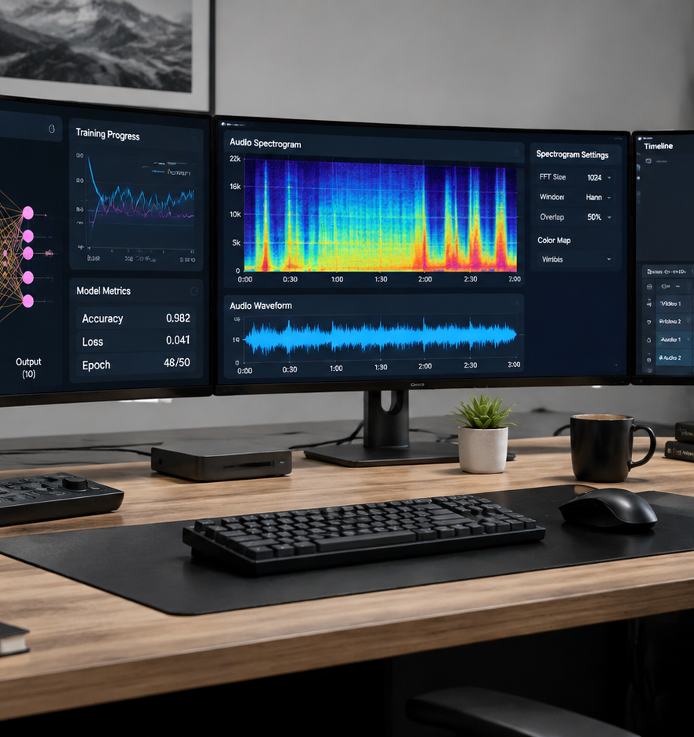
01 / 11
ARTIFICIAL INTELLIGENCE
Best Video AI Presentation Videos
Engineering Workflows, Model Architectures, and Automated Rendering Pipelines
YIHA
Notes:
Welcome everyone. Today we are examining the engineering foundations behind automated video AI presentation systems. High quality presentation videos no longer rely on static slides with disconnected voiceovers. Instead, production grade workflows orchestrate generative diffusion models, multimodal speech decoders, digital audio processing, and automated container multiplexing. Over the next ten slides, we will unpack how these distinct engineering components connect to form robust production pipelines. We will look closely at diffusion transformers, audio visual synchronization, latency trade-offs, and quality assurance testing. By approaching video generation as an end to end software engineering discipline, technical teams can reliably create clear, professional, and accessible presentations at scale.
Sources:

Slide 2
02 / 11
System Architecture of Generative Video Pipelines
End to end presentation systems process multi-rate multimodal data across text, video frames, and audio tokens.
Ingesting structured prompt files and slide timing metadata through unified orchestrators
Aligning heterogeneous sample rates between 25 Hz video frames and 40 Hz speech tokens
Exporting timed subtitle tracks in standard WebVTT format for accessibility compliance
YIHA
Notes:
In this slide, we examine the system architecture supporting generative presentation pipelines. As shown in Shinjan Saha's diffusion models repository on GitHub, the core visual synthesis relies on forward and reverse denoising steps driven by text prompts. However, presentation videos also require simultaneous speech delivery. Research on decoder-based video-text-to-speech synthesis by researchers on arXiv shows that modern decoder-only transformers can process video frames at 25 Hz and speech representations at 40 Hz within a single model. This cross-modal self-attention enables accurate temporal coherence between spoken words and visual cues. Finally, as recommended by W3C Web Accessibility Initiative guidelines, timed caption files ensure full accessibility for diverse audiences by matching on-screen text to spoken narration.
Sources:
https://github.com/Shinjan-saha/Diffusion-Models--From-Prompts-to-Images-and-Video
https://arxiv.org/html/2411.17690v3
https://www.w3.org/WAI/media/av/captions/

Slide 3
03 / 11
Spatiotemporal Synthesis via Diffusion Transformers
Diffusion Transformers model spatial layout and temporal continuity concurrently to prevent visual distortion.
01
Processing space and time simultaneously with scalable patch-based DiT architectures
02
Leveraging emergent temporal correspondences identified in video diffusion representations
03
Enforcing multi-view structural consistency through specialized reconstruction autoencoders
YIHA
Notes:
Slide three focuses on spatiotemporal synthesis using Diffusion Transformers, known as DiT architectures. According to Hugging Face Diffusers documentation, modern models like HunyuanVideo and Wan2.1 utilize DiT backbones to reduce computational overhead while scaling efficiently to larger, higher-resolution video data. Unlike older methods that bolted temporal convolutions onto two-dimensional networks, DiTs model spatial details and temporal motion in a unified representation. Furthermore, the DiffTrack framework published by KAIST researchers demonstrates that video diffusion models naturally form emergent temporal correspondences across frames during denoising. In addition, work like CVD-STORM on arXiv illustrates how auxiliary 4D reconstruction tasks stabilize spatial geometry. This architectural foundation prevents presentation elements from warping unpredictably across consecutive frames.
Sources:
https://huggingface.co/docs/diffusers/en/using-diffusers/text-img2vid
https://github.com/cvlab-kaist/DiffTrack
https://arxiv.org/abs/2510.07944

Slide 4
04 / 11
Controlling Motion and Visual Presentation Style
Constrained prompting and image anchoring guarantee brand consistency and prevent unwanted camera motion.
Anchoring slide layouts with initial frame inputs to preserve essential text and charts
Structuring prompts with clear subject, motion, and lighting constraints
Restricting camera dynamics to smooth pans or subtle orbits to maintain readability
YIHA
Notes:
Controlling visual motion is essential for corporate and technical presentations where slide legibility is paramount. DesignerBox benchmarks evaluate video models across compositional metrics like spatial relationships and camera consistency, noting that prompt adherence varies widely across public benchmarks like T2V-CompBench and VBench. Prompt engineering guides from SeaArt for Wan 3.0 emphasize using reference images as fixed physical anchors while specifying only permitted motion. Similarly, PulseMotionHub guides recommend using source images to define the frame reality, leaving prompt tokens free to direct camera velocity and lighting atmosphere. Restraining motion through structured prompts ensures that slide titles, visual charts, and technical diagrams remain completely legible throughout each generated clip without distracting camera drift.
Sources:
https://designerbox.ai/blog/best-ai-video-model/
https://www.seaart.ai/blog/wan-3-0-prompt-guide
https://www.pulsemotionhub.com/blog-ai-video-prompting-guide.html

Slide 5
05 / 11
Synchronizing Synthetic Narration and Subtitles
Tick-based audio timestamps and multimodal speech alignment ensure accurate subtitle synchronization.
Extracting start offsets and durations measured in 100-nanosecond tick intervals
Formatting output tracks into standard WebVTT format with millisecond precision
Minimizing phoneme level temporal errors using video-conditioned speech synthesis
YIHA
Notes:
Slide five addresses the synchronization of voiceover narration and subtitles. According to Microsoft Azure Speech Service documentation, speech recognition and synthesis engines track audio timing using ticks, where each tick equals one hundred nanoseconds. This precision enables developers to format WebVTT subtitle files down to exact milliseconds for seamless synchronization. W3C captioning standards emphasize that accurate timing and verbatim transcription are required to prevent confusing or contradictory captions during technical explanations. Furthermore, research on decoder-based video-text-to-speech on arXiv demonstrates that joint visual and text conditioning matches reference utterance duration far better than audio-only text-to-speech, eliminating cumulative timing drift between spoken audio and on-screen speaker movements across longer presentation sections.
Sources:
https://learn.microsoft.com/en-us/azure/ai-services/speech-service/captioning-concepts
https://www.w3.org/WAI/media/av/captions/
https://arxiv.org/html/2411.17690v3

Slide 6
06 / 11
Programmatic Compositing and Media Multiplexing
Automated transcoding pipelines combine video, voiceover, and subtitle tracks into standard containers.
01
Configuring container multiplexing and bitstream filtering for web playback
02
Harmonizing generative video frame rates and visual layers using programmatic scripts
03
Integrating accessibility standards into automated media build pipelines
YIHA
Notes:
Once generative assets are created, an automated assembly stage must merge them without manual video editing. FFmpeg format documentation outlines how multiplexers and bitstream filters assemble diverse video, audio, and subtitle streams into compliant MP4 or WebM containers. Hugging Face Diffusers provides video outputs with configurable frame numbers, which must be normalized to standard broadcast frame rates during compositing. Additionally, the W3C Web Accessibility Initiative emphasizes planning descriptive transcripts and clear visual overlays from the project start. Programmatic assembly scripts guarantee that brand assets, high resolution presentation slide overlays, and timed audio tracks align consistently across batch rendering workflows. This programmatic approach ensures that production output satisfies strict engineering standards.
Sources:
https://ffmpeg.org/ffmpeg-formats.html
https://huggingface.co/docs/diffusers/en/using-diffusers/text-img2vid
https://www.w3.org/WAI/media/av/

Slide 7
07 / 11
Vocal Dynamics and Digital Signal Enhancement
Loudness normalization and proper gain staging deliver clear, distortion-free technical narration.
Normalizing loudness levels using EBU R128 dynamic and linear processing filters
Maintaining peak recording headroom between -18 dBFS and -12 dBFS during staging
Eliminating digital clipping and low-frequency rumble with targeted filtering chains
YIHA
Notes:
Audio quality directly impacts audience comprehension in educational and technical presentations. The FFmpeg filters documentation details the loudnorm filter, which implements the EBU R128 standard to measure and normalize integrated loudness across dynamic voice tracks. In their audio engineering guide, Schulz Audio emphasizes the importance of disciplined gain staging, recommending that initial recording peaks target between -18 dBFS and -12 dBFS. This preserves essential headroom for downstream dynamics processing without introducing harsh digital distortion. In addition, Microsoft Azure captioning documentation highlights the importance of clean speech streams for automated processing. Applying high-pass filtering, gentle dynamic smoothing, and EBU R128 normalization guarantees that synthetic voices sound balanced, articulate, and comfortable across all listening devices.
Sources:
https://ffmpeg.org/ffmpeg-filters.html
https://schulz.audio/blog/the-art-of-mastering-gain-staging-keeping-your-signal-clean/
https://learn.microsoft.com/en-us/azure/ai-services/speech-service/captioning-concepts

Slide 8
08 / 11
Compute Latency and Hardware Memory Optimization
Layer group offloading and strategic asset reuse optimize GPU memory and overall rendering expense.
Reducing GPU VRAM demand to ~13 GB on 14B parameter models using group offloading
Compiling inference pipelines with kernel optimization tools to accelerate throughput
Balancing compute expense by combining static slide backgrounds with targeted generative video
YIHA
Notes:
Slide eight explores compute management and VRAM constraints during generative video rendering. Generative video diffusion models require substantial GPU memory that often exceeds standard consumer hardware limits. Technical documentation from Hugging Face Diffusers explains that group offloading moves internal model layers between GPU VRAM and host CPU memory as needed. For large 14-billion parameter models such as Wan2.1, this technique drops required GPU memory to approximately 13 gigabytes of VRAM. Furthermore, compiling models with torch compile accelerates repeated inference passes. Analysis from Inference Systems notes that unmonitored synthetic video generation rapidly consumes GPU budgets. Production teams should deploy generative video selectively for high impact visual sequences while using static rendering for standard slide decks.
Sources:
https://huggingface.co/docs/diffusers/en/using-diffusers/text-img2vid
https://inferensys.com/train/long-form-video-event-extraction-model-training/synthetic-long-form-video-data-generation-for-event-training/evaluating-temporal-consistency-and-fidelity-in-generative-long-form-video-for-event-training

Slide 9
09 / 11
Mitigating Temporal Drift and Visual Artifacts
Dynamic latent rates and optical flow consistency checks prevent object warping and frame jitter.
01
Implementing dynamic latent frame rates to adapt token density based on scene motion
02
Tracking object permanence and optical flow continuity across consecutive frames
03
Validating visual slide transitions against timed caption transcript milestones
YIHA
Notes:
Slide nine addresses common visual defects in generative video, such as flickering and morphing artifacts. Research from Tsinghua University on VGDFR demonstrates that video generation can adapt latent frame density based on scene motion, using fewer tokens during static slide scenes and concentrating capacity on high-motion segments. In addition, technical analysis from Inference Systems explains that traditional static image metrics fail to detect temporal drift like vanishing objects or sudden jitter. Integrating automated optical flow coherence metrics and object permanence checks catches visual glitches early. Pairing these visual checks with W3C caption synchronization rules ensures that slide transitions occur exactly when the narrator introduces new concepts, preventing confusing visual lag during key presentation points.
Sources:
https://github.com/thu-nics/VGDFR
https://inferensys.com/train/long-form-video-event-extraction-model-training/synthetic-long-form-video-data-generation-for-event-training/evaluating-temporal-consistency-and-fidelity-in-generative-long-form-video-for-event-training
https://www.w3.org/WAI/media/av/captions/

Slide 10
10 / 11
Production Deployment of Batch Video Pipelines
Declarative JSON schemas, version control, and regression testing create reliable video pipelines.
Defining multi-scene presentations using structured JSON configuration manifests
Focusing generative video models on B-roll and concept visualizations where appropriate
Maintaining pipeline test suites under continuous integration to eliminate flaky builds
YIHA
Notes:
Slide ten outlines practical engineering patterns for deploying automated video presentation systems. The open source ai-video-gen project demonstrates how developers can drive multi-provider batch generation using structured JSON prompts that define clip sequences, style packs, and logo overlays. In practical filmmaking analyses, the Sora production guide suggests using generative video for B-roll, establishing views, and concept animations while maintaining structured slide graphics for core data. Crucially, as documented by Techment QA engineering practices, maintaining automation scripts under Git version control and implementing automated regression testing prevents pipeline flakiness. This disciplined approach guarantees consistent, dependable video output across recurring production cycles without requiring costly manual rework.
Sources:
https://github.com/JuanLara18/ai-video-gen
https://artificial-intelligence-wiki.com/best-ai-tools/ai-image-and-video-generators/sora-for-filmmakers/
https://www.techment.com/blogs/test-script-maintenance-best-practices-for-long-term-automation-success/

Slide 11
11 / 11
System Summary and Production Guidelines
Reliable AI presentation systems combine diffusion transformers, audio engineering, and automated QA.
Anchor presentation layouts with constrained prompts and fixed first-frame inputs
Normalize vocal dynamics to EBU R128 standards with tick-level WebVTT alignment
Enforce automated quality checks and schema-driven execution in CI/CD pipelines
YIHA
Notes:
To conclude our briefing, building high quality video AI presentations requires mastering the complete technical pipeline. We have examined how diffusion transformers unify spatial and temporal representations, how multimodal speech models align audio tokens with visual frames, and how FFmpeg filtergraphs automate compositing and EBU R128 loudness compliance. Furthermore, as demonstrated by batch automation architectures like the ai-video-gen repository, declarative JSON configurations and continuous quality gates enable organizations to automate technical presentations without sacrificing visual fidelity or factual accuracy. By treating generative media as a disciplined software engineering process, teams can produce scalable, accessible, and engaging video content. Thank you for your time, and I look forward to your questions.
Sources:
https://github.com/JuanLara18/ai-video-gen
https://ffmpeg.org/ffmpeg-formats.html

