Slide 1
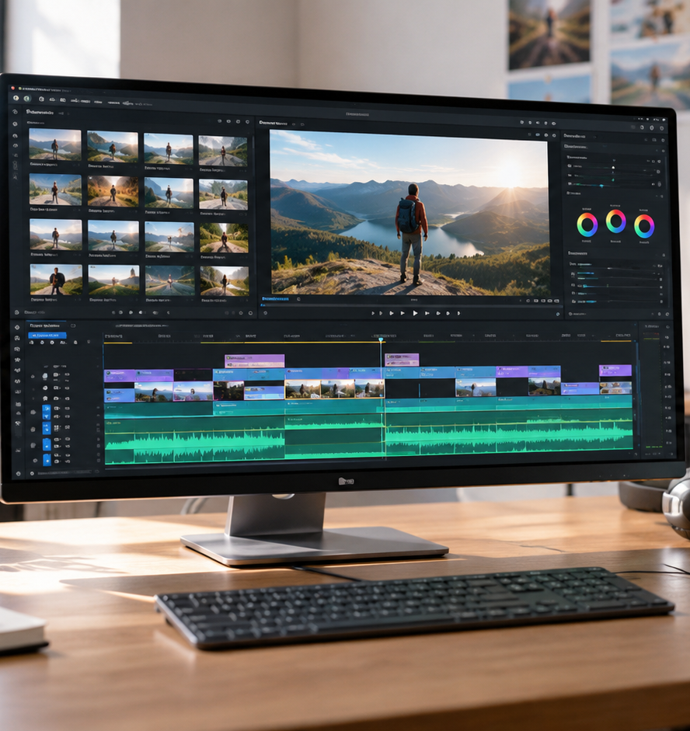
01 / 11
MULTIMEDIA COMMUNICATION
Creating Video Presentation
Generative Pipelines, Presentation Architecture, and Quality Workflows
YIHA
Notes:
Welcome to this session on creating modern video presentations. Over the past decade, workplace and educational communication has shifted rapidly from in-person meetings toward scalable digital formats. Static slide decks often lack spoken nuance, while live meetings cause scheduling bottlenecks across global time zones. Modern video production bridges this gap by combining clear visual staging, structured audio narration, and automated generative workflows. In this presentation, we will explore the transition to asynchronous media, examine the technical diffusion pipelines powering synthetic video, review prompt engineering techniques, and cover operational management strategies. By understanding these concepts, you can produce consistent, accessible, and high-retention video presentations.
Sources:

Slide 2
02 / 11
Evolution Toward Asynchronous Video
On demand video presentations solve scheduling friction while preserving nuanced spoken context.
Asynchronous viewing lets team members pause and review complex topics
Centralized video repositories eliminate repetitive live presentations
Presenters must anticipate audience questions during script drafting
YIHA
Notes:
The move toward asynchronous video is driven by the operational overhead of synchronous meetings. When teams rely solely on live presentations, scheduling conflicts and meeting fatigue reduce engagement. As noted in Genra's AI video guide, synthetic video tools have evolved from producing novel, blurry clips into platforms capable of generating clear visual communication assets. Distributing recorded or synthesized video allows viewers to engage with technical concepts at their own convenience. However, moving to an asynchronous format means presenters lose real-time audience feedback. To compensate, scripts must be structured thoughtfully to address likely questions upfront. For further exploration, consult Genra AI: https://genra.ai/blog/ai-video-generator-complete-guide.
Sources:
https://genra.ai/blog/ai-video-generator-complete-guide

Slide 3
03 / 11
Cognitive Foundations of Presentation Design
Dual channel processing requires balancing spoken narration and visual density to avoid overload.
01
Visual and auditory channels process incoming media simultaneously
02
Dense paragraphs of on screen text compete with spoken voice tracks
03
Example: align spoken descriptions with synchronized visual scenes
YIHA
Notes:
Effective presentation design requires thoughtful coordination between visual imagery and spoken narration. When viewers process video content, displaying dense paragraphs of text while delivering voice commentary risks dividing attention. As Kling AI highlights in its creation guide, visual media should illustrate concepts rather than repeat full sentences word for word. An illustrative example of this principle is presenting an animated mechanical valve while audio narration explains pressure changes. Keeping on-screen elements focused on primary diagrams or motion allows the voice track to deliver essential nuances without distraction. Analysis shows that maintaining visual consistency across scenes preserves viewer orientation. For source guidance, consult Kling AI at https://kling.ai/blog/text-to-video-ai-creation-guide.
Sources:
https://kling.ai/blog/text-to-video-ai-creation-guide

Slide 4
04 / 11
Generative Video Synthesis Architecture
Diffusion models translate prompt embeddings into coherent temporal video frames through iterative denoising.
Text encoding translates natural language prompts into vector embeddings
Iterative noise to signal scheduling refines latent visual structures
Temporal consistency modules enforce motion coherence across frames
YIHA
Notes:
Generative video systems rely on advanced diffusion architectures. As detailed in Seedance's free guide, the pipeline begins with text encoding, converting descriptive sentences into high-dimensional vector embeddings. The system then applies noise-to-signal scheduling, starting with random visual noise and systematically refining it until coherent visual shapes appear. Crucially, temporal consistency mechanisms evaluate sequential frames to prevent abrupt visual shifting and ensure that motion remains plausible across time. Finally, the latent representation is upscaled into standard 720p or 1080p video files. Understanding this pipeline helps creators understand why generation requires computational processing time. Learn more at Seedance: https://www.seedance.tv/blog/text-to-video-ai-free-guide.
Sources:
https://www.seedance.tv/blog/text-to-video-ai-free-guide

Slide 5
05 / 11
Text-to-Video Versus Image-to-Video Modalities
Text prompts offer broad creative flexibility while image conditioning preserves brand and product fidelity.
Text to video generates novel scenes from descriptive written prompts
Image to video animates static images while locking visual geometry
Branded presentations benefit from reference conditioned asset pipelines
YIHA
Notes:
When producing visual scenes, presenters must select the appropriate generative modality. Unconditioned text-to-video allows broad creative exploration, making it ideal for atmospheric backgrounds, metaphors, and conceptual themes. However, consecutive text generations often exhibit visual drift across scenes. According to Genra's AI video guide, image-to-video solves this limitation by taking an approved reference image and animating it. This modality locks brand assets, exact product packaging, and software interfaces in place before motion is synthesized. For corporate presentations where visual consistency is essential, image conditioning delivers far more reliable continuity. Reference: Genra AI at https://genra.ai/blog/ai-video-generator-complete-guide.
Sources:
https://genra.ai/blog/ai-video-generator-complete-guide

Slide 6
06 / 11
Agentic Multi-Stage Production Pipelines
Agentic systems coordinate script generation, scene synthesis, voiceovers, and rendering into unified workflows.
01
Chat driven agents decompose conversational inputs into scene storyboards
02
Automated pipelines orchestrate visual generation and voiceover tracks
03
Presenters must review intermediate outlines before final rendering
YIHA
Notes:
Traditional multimedia creation requires switching between separate applications for scripting, voice recording, clip generation, and final timeline editing. Modern agentic systems streamline this process. As outlined in Genra's comprehensive guide, agentic pipelines accept conversational project briefs, draft narration scripts, split videos into logical scenes, synthesize voice tracks, and layer audio. This removes manual assembly friction. However, agentic automation trades fine frame-by-frame manual control for end-to-end convenience. Presenters should review the agent's outline and script thoroughly before authorizing final generation to ensure conceptual accuracy. Source details: Genra AI at https://genra.ai/blog/ai-video-generator-complete-guide.
Sources:
https://genra.ai/blog/ai-video-generator-complete-guide

Slide 7
07 / 11
Prompt Engineering and Scene Staging
Explicit scene framing, lighting directions, and camera motion terms yield predictable visual outputs.
Specify lighting conditions, physical settings, and subject actions
Incorporate cinematic terms like tracking shot, close up, and dolly in
Keep visual motion measured to avoid distracting the audience
YIHA
Notes:
Prompt engineering for video requires greater descriptive precision than prompting for static images. According to Kling AI's creation guide, vague prompts produce unpredictable visual results. Creators should specify subject behavior, lighting parameters, and physical settings clearly. For instance, rather than prompting for an office scene, describe software engineers collaborating at a workstation under soft directional lighting. Seedance's technical guidance notes that incorporating cinematic camera terms like tracking shot or slow zoom significantly improves model adherence. Presenters must keep motion subtle so visuals support the message rather than distract. Source: Kling AI at https://kling.ai/blog/text-to-video-ai-creation-guide.
Sources:
https://kling.ai/blog/text-to-video-ai-creation-guide
https://www.seedance.tv/blog/text-to-video-ai-free-guide

Slide 8
08 / 11
Platform Constraints and Compute Tradeoffs
Operational planning must account for clip duration caps, queue processing latency, and export limits.
Individual generative clips typically span 5 to 10 seconds in duration
Compute processing requires roughly 60 to 120 seconds per short clip
Recommendation: build production buffers for script and scene revisions
YIHA
Notes:
Working with generative video platforms introduces practical technical boundaries. As reported in Seedance's guide, single generative model passes generally output clips spanning 5 to 10 seconds, requiring creators to stitch multiple clips together for longer presentation narratives. In terms of compute latency, a single short clip typically requires between 60 and 120 seconds to render. Longer multi-scene productions can take 15 minutes or more depending on platform load. Additionally, service tiers affect queue priority, watermarking, and resolution caps. Teams should incorporate buffer periods into production timelines to accommodate iterative re-renders. Review Seedance documentation at https://www.seedance.tv/blog/text-to-video-ai-free-guide.
Sources:
https://www.seedance.tv/blog/text-to-video-ai-free-guide

Slide 9
09 / 11
Editorial Planning and Asset Operations
Relational databases structure scene storyboards, contributor roles, script versions, and review milestones.
01
Database records track individual scene prompts, audio, and review status
02
Structured fields maintain clear links between narration and visual IDs
03
Example: multi chapter modules map voice files directly to video clips
YIHA
Notes:
Producing video presentations systematically requires disciplined operational management. In the LinkedIn Learning course on using Airtable for editorial calendars, instructors demonstrate how relational databases organize complex multimedia projects. In a video production pipeline, each record represents a presentation scene containing fields for script text, audio voiceover files, prompt descriptions, and editorial approval states. An illustrative example is a multi-chapter training project where voice files map directly to specific video clip identifiers. This structure prevents version mismatches and ensures that script changes trigger prompt updates systematically. Reference: LinkedIn Learning at https://www.linkedin.com/learning/creating-an-editorial-calendar-2/using-airtable-as-an-editorial-calendar.
Sources:
https://www.linkedin.com/learning/creating-an-editorial-calendar-2/using-airtable-as-an-editorial-calendar

Slide 10
10 / 11
Quality Verification and Output Standards
Pre-publication review requires verifying scene transitions, checking audio balance, and exporting at standard resolution.
Check scene to scene flow with smooth transitions such as cuts and fades
Verify that narration voiceovers remain clear and distinct above music tracks
Export native 1080p video files for distribution across organizational channels
YIHA
Notes:
Before releasing a presentation video, creators must complete thorough quality verification. First, review visual pacing and transitions between scenes. As outlined in Kling AI's creation guide, maintaining visual continuity and utilizing clean transitions such as cuts or fades gives presentations a deliberate feel. Creators must also ensure that narration voiceovers remain crisp and properly balanced above background audio tracks. For distribution, platforms support direct exports that avoid extra editing tools. Genra's AI guide explains that models render finished output up to 1080p, ready for upload across corporate channels, video portals, and email updates. Sources: Kling AI at https://kling.ai/blog/text-to-video-ai-creation-guide and Genra AI at https://genra.ai/blog/ai-video-generator-complete-guide.
Sources:
https://genra.ai/blog/ai-video-generator-complete-guide
https://kling.ai/blog/text-to-video-ai-creation-guide

Slide 11
11 / 11
Synthesizing Effective Video Presentations
Pairing sound instructional architecture with generative pipelines delivers engaging, scalable presentations.
Design for dual channel processing to prevent viewer cognitive overload
Choose image conditioning when brand and product fidelity are mandatory
Establish structured editorial tracking to sustain repeatable production
YIHA
Notes:
In conclusion, creating impactful video presentations involves balancing sound instructional design with modern generative production tools. Shifting routine informational meetings into asynchronous video formats enables scalable knowledge sharing across organizations while eliminating scheduling friction and meeting fatigue. Achieving consistent results requires respecting viewer attention, choosing reference-conditioned image models when visual fidelity is critical, taking advantage of automated agentic pipelines for rapid multi-scene assembly, and maintaining structured database workflows for asset tracking. Furthermore, conducting pre-publication quality checks on transitions, export resolution, and voiceover balance ensures that the final media communicates clearly to every viewer. Review complete generative video workflow principles at Genra AI: https://genra.ai/blog/ai-video-generator-complete-guide.
Sources:
https://genra.ai/blog/ai-video-generator-complete-guide

