Slide 1
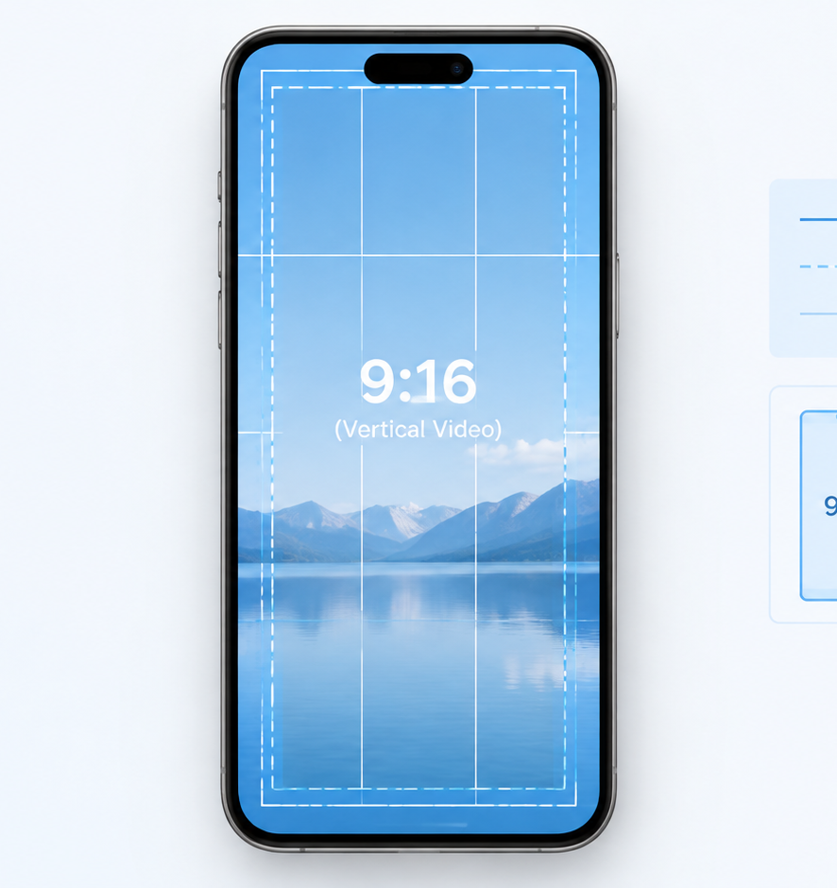
01 / 11
SOCIAL MEDIA PRODUCTION
TikTok Safe Zone
Navigating Vertical Canvas Dimensions, UI Overlays, and Production Governance
YIHA
Notes:
Welcome everyone. Today we examine the technical mechanics of vertical video safe zones, with a direct focus on TikTok and multi-platform short-form video delivery. As mobile content consumption centers on full-bleed 9:16 mobile displays, creative teams face a significant layout challenge. The master canvas must deliver high-resolution video while avoiding the dense interactive chrome that native host applications display directly over the creative footage. Over the course of this presentation, we will explore canvas architecture, exclusion margins, conversion friction, cross-platform variations, and post-production quality assurance workflows. By establishing clear framing discipline, production teams ensure that typography, product demonstrations, and conversion prompts remain unobstructed and completely readable for every mobile user.
Sources:

Slide 2
02 / 11
Anatomy of the Vertical Video Canvas
Mobile short-form video renders edge-to-edge while platform controls paint directly over the master footage.
Master canvas resolution standards fixed at 1080 x 1920 pixels
Top navigation, right engagement rails, and bottom trays float above footage
Creative assets without layout buffers risk immediate collision with native UI
YIHA
Notes:
To understand safe zones, we begin with the visual architecture of mobile video. Short-form video platforms operate primarily on a 1080 by 1920 pixel canvas at a 9:16 aspect ratio, as documented by Vidpros and AdMakeAI. Unlike traditional horizontal broadcast video or desktop web players where navigation controls sit outside the video window, mobile social platforms render video full bleed and place user interface chrome directly across the frame. This overlay includes top navigation elements, the right-side engagement column, and an expansive bottom caption tray. Video editors who treat the canvas as entirely open space risk placing critical graphic titles or narrative points directly beneath these native application controls, obscuring their message from the audience.
Sources:
https://vidpros.com/vertical-video-safe-zone/
https://admakeai.com/blog/vertical-video-dimensions-2026

Slide 3
03 / 11
Defining the Central Usable Safe Zone
The true unobstructed safe zone contracts to a central viewport well inside the 1080 x 1920 frame.
01
Full 1080 x 1920 frame accommodates background video and environmental action
02
Usable central zone for TikTok sits around 886 x 1432 pixels
03
Essential text hooks and brand logos must stay inside unobstructed margins
YIHA
Notes:
While an exported vertical video file measures 1080 by 1920 pixels, the actual unobstructed viewing area is substantially smaller. Technical analysis from AdMakeAI and Vidpros indicates that for TikTok, the usable central viewing area contracts to approximately 886 by 1432 pixels. The safe zone is not an instruction to letterbox footage or pillarbox live video. High-production backgrounds, talent movement, and atmospheric cinematography should always occupy the full 1080 by 1920 canvas to maintain an immersive visual presentation. Instead, the safe zone represents an internal layout boundary. Every mission-critical element, including graphic hooks, promotional discount codes, brand marks, and core subtitles, must reside safely within this central bounding box.
Sources:
https://admakeai.com/blog/vertical-video-dimensions-2026
https://vidpros.com/vertical-video-safe-zone/

Slide 4
04 / 11
Core Boundary Margins and Collision Points
The bottom-right corner represents the highest hazard zone where engagement buttons and caption lines converge.
Recommendation: Clear 120 to 200 pixels along the top edge
Recommendation: Clear 250 to 370 pixels across the bottom tray
Recommendation: Clear 120 to 164 pixels along the right margin
YIHA
Notes:
Designers must observe specific boundary clearances documented by AdMakeAI and Vidpros. On TikTok, the top margin requires 120 to 200 pixels of clearance to avoid profile navigation and search headers. The right margin demands 120 to 164 pixels of buffer to clear the vertical column of like, comment, bookmark, and share icons. The bottom tray requires 250 to 370 pixels of vertical padding for multi-line captions and audio credits. The most hazardous collision area on the mobile canvas is the bottom-right corner, where the interaction rail intersects the caption tray. Any brand logos or critical graphics positioned in that lower-right quadrant will be completely obscured on mobile screens.
Sources:
https://admakeai.com/blog/vertical-video-dimensions-2026
https://vidpros.com/vertical-video-safe-zone/

Slide 5
05 / 11
Commercial Impact of Obstructed CTAs
Buried calls-to-action disrupt direct-response funnels and erode return on paid media spend.
Direct-response video demands clear and immediate call-to-action visibility
Interface collisions obscure URLs, discount codes, and conversion prompts
Unreadable creative wastes paid ad impressions across acquisition campaigns
YIHA
Notes:
Visual obstructions carry severe commercial penalties in performance marketing. Direct-response advertising, as detailed in creative strategy research from UGCClip, relies on explicit visual directives such as 'Shop Now' or discount prompts that direct audience action. When application chrome overlaps a call-to-action button or conceals offer terms, viewer comprehension breaks down immediately. While campaigns spend media budget driving impressions, unreadable graphics prevent viewers from acting on the message. Furthermore, as highlighted by TikTok Newsroom in their Commercial Music Library documentation, short-form creative succeeds when visual and auditory elements reinforce each other cleanly. Buried messaging impairs campaign performance and diminishes overall return on media investment.
Sources:
https://www.ugcclip.app/blog/ugc-creative-strategy-brand-awareness-vs-direct-response
https://newsroom.tiktok.com/commercial-music-library?lang=en

Slide 6
06 / 11
Organic Content Versus Paid Ad Placements
Paid ad units add interactive buttons and disclaimer tags that compress the bottom safe margin further.
01
Paid In-Feed ads introduce interactive CTA buttons across the bottom tray
02
Example: Ad interface elements reduce vertical safe area by roughly 50 to 80 pixels
03
Organic edits must be reformatted before distribution as paid campaign creative
YIHA
Notes:
A common production pitfall is treating organic video posts and paid ad placements identically. As documented by Vidpros and Planable, commercial formats introduce persistent interactive overlays that do not appear on organic creator content. In-Feed ads and Spark Ads include clickable call-to-action buttons, sponsored attribution badges, and interactive cards that expand upward from the bottom tray. These interactive commercial components consume an additional 50 to 80 pixels of vertical screen space along the base of the canvas. Video assets edited for organic distribution will often suffer call-to-action collision when boosted into paid media rotations without repositioning text higher in the frame.
Sources:
https://vidpros.com/vertical-video-safe-zone/
https://planable.io/blog/tiktok-content-calendar/

Slide 7
07 / 11
Cross-Platform Divergence in Safe Boundaries
Differing interface depths and feed crop ratios make a universal conservative safe zone necessary.
Instagram Reels crops 9:16 videos to a 4:5 center slice in home feeds
Example: YouTube Shorts bottom UI consumes approximately 420 to 576 pixels
Recommendation: Universal safe zone of 900 x 1400 pixels secures multi-platform delivery
YIHA
Notes:
When distributing a single video across multiple platforms, creative teams face contrasting interface footprints. As documented by EdicionVideoPro, AdMakeAI, and Vidpros, TikTok, Instagram Reels, and YouTube Shorts each overlay different interactive layouts. YouTube Shorts features a particularly dense bottom tray eating 420 to 576 pixels, while Instagram Reels crops full 9:16 footage to a 4:5 center crop inside the main feed. To publish a single video asset without creating separate edits for each platform, Vidpros recommends designing within a universal safe zone of 900 by 1400 pixels. AdMakeAI notes that maintaining this central clearance guarantees asset visibility across all three networks simultaneously.
Sources:
https://vidpros.com/vertical-video-safe-zone/
https://admakeai.com/blog/vertical-video-dimensions-2026
https://edicionvideopro.com/en/editing-techniques/916-aspect-ratio-guide-vertical-video-for-tiktok-reels/

Slide 8
08 / 11
Dynamic Variables and Viewport Variations
Automated closed captions and expanding text descriptions introduce unpredictable overlay shifts.
Native automated captions now render by default across mobile video feeds
Multi-line written post copy dynamically expands the bottom caption tray
Device aspect ratio differences shift interface positioning on user screens
YIHA
Notes:
Safe zones are not entirely static because application interfaces shift dynamically. As reported by Vidpros and AdMakeAI, major video platforms now enable automated closed captions by default. These automated subtitles generate text across the lower third of the canvas, which creates illegible visual clutter if editors burn custom subtitles into that same screen area. Furthermore, long written post descriptions expand upward when displayed, covering additional visual space. Mobile hardware variations from tall 19.5:9 screens to standard displays alter how chrome renders. Editors should place manual subtitles within the center third of the screen, safely above dynamic caption zones and native description boxes.
Sources:
https://vidpros.com/vertical-video-safe-zone/
https://admakeai.com/blog/vertical-video-dimensions-2026

Slide 9
09 / 11
Post-Production Integration and Validation
Incorporate transparent PNG overlay guides into NLE timelines and verify with pre-flight tools.
01
Place PNG safe zone overlay guides on top timeline tracks in Premiere or CapCut
02
Align typography and graphic hooks during assembly before disabling guide layers
03
Execute pre-flight web preview checks before launching paid ad campaigns
YIHA
Notes:
Ensuring safe zone compliance requires embedding validation directly into editing timelines rather than checking files after export. Vidpros and Assemble recommend that editing teams import transparent PNG safe zone templates as guide layers on top timeline tracks in non-linear editing software such as Adobe Premiere Pro, DaVinci Resolve, Final Cut Pro, or CapCut. Locking an overlay guide above footage allows motion designers and editors to position typography, lower thirds, and animated callouts accurately during initial assembly. For paid advertising campaigns, teams should verify rendered files using web preview simulators to confirm that interactive conversion buttons do not collide with on-screen creative.
Sources:
https://vidpros.com/vertical-video-safe-zone/
https://www.onassemble.com/template-library/video-production-workflow-template

Slide 10
10 / 11
Scaling Frame Discipline Across Creative Teams
Establish documented standards, shared templates, and pre-flight sign-offs across all team roles.
Standardize creative briefs with strict copy length and safe zone bounds
Synchronize motion designers, copywriters, and media buyers on safe margins
Mandate checklist approvals before approving final assets for media launch
YIHA
Notes:
Scaling short-form video production across distributed marketing teams requires institutionalizing clear frame discipline. As demonstrated in workflow analyses by Ziflow and Megabant, formalizing editorial review checkpoints and documented guidelines prevents costly revision cycles and eliminates delivery errors. Creative briefs must specify copy limits so descriptive text does not expand the bottom caption tray. Motion designers must restrict graphical elements to verified safe boundaries, and media buyers must confirm placement specifications prior to rendering. Incorporating safe zone verification into project management review checklists ensures that every video asset delivered by the team meets rigorous professional standards.
Sources:
https://www.ziflow.com/blog/video-production-workflow
https://www.megabant.com/content-production-workflow-tools-processes-and-best-practices/
https://vidpros.com/vertical-video-safe-zone/

Slide 11
11 / 11
Core Takeaways for Flawless Vertical Framing
Rigorous safe zone governance protects brand clarity, viewer engagement, and media investment.
Author at 1080 x 1920 but constrain critical messaging to the safe core
Account for ad button expansions and cross-platform feed cropping rules
Embed visual overlay templates and pre-flight validation in editing workflows
YIHA
Notes:
In summary, successful mobile vertical video production requires maintaining strict boundaries between creative footage and application interface chrome. As demonstrated throughout the research from Vidpros and AdMakeAI, mastering the 1080 by 1920 canvas, respecting exclusion margins, and accounting for commercial button expansions protects core visual messaging. Adopting universal safe zones of 900 by 1400 pixels enables seamless multi-platform delivery across TikTok, Instagram Reels, and YouTube Shorts. Integrating timeline guide templates into post-production editing suites and executing pre-flight preview validation ensures that calls-to-action, text hooks, and brand identities remain fully visible and actionable across every mobile device. Thank you for your time and attention.
Sources:
https://vidpros.com/vertical-video-safe-zone/
https://admakeai.com/blog/vertical-video-dimensions-2026

