Slide 1
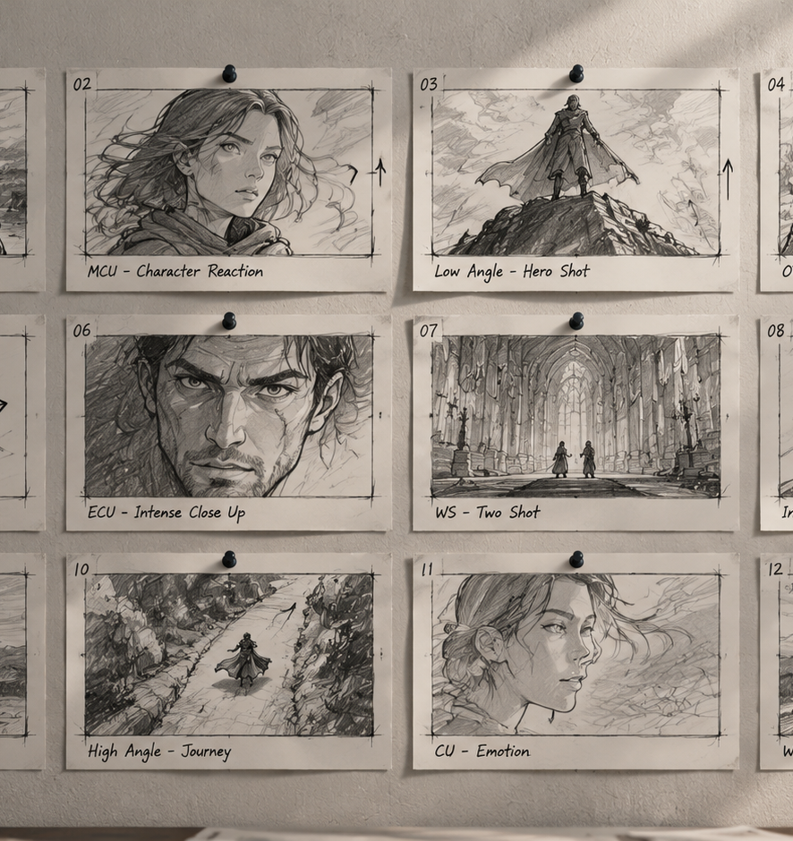
01 / 11
ANIMATION & PRE-PRODUCTION
Animation Storyboard Thumbnails
Principles, Spatial Geometry, and Pipeline Integration
YIHA
Notes:
Welcome everyone. Today we examine animation storyboard thumbnails, which serve as the architectural foundation for animated filmmaking. Before studios invest substantial artistic effort and rendering compute into full production, storyboard artists must resolve narrative, spatial, and editorial challenges. Rough thumbnails allow creative teams to test camera choices, shot flow, and emotional beats rapidly at minimal cost. Throughout this presentation, we will break down visual economy, screen geometry, eyelines, narrative pacing, and the technical handoff to layout departments. By mastering these fundamental staging principles, production teams can avoid expensive revisions downstream while ensuring their cinematic vision translates clearly to the screen.
Sources:

Slide 2
02 / 11
The Strategic Role of Pre-Production Thumbnails
Thumbnail sketches serve as an exploratory blueprint that reduces expensive downstream production revisions.
Visual blueprints translate abstract written scripts into concrete scenes
Low artistic sunk cost encourages broad creative experimentation
Early structural problem solving prevents costly on set and animatic fixes
YIHA
Notes:
In our first technical section, we explore why thumbnail sketching is mandatory in animation pipelines. As noted by industry resources on pre-production planning at storyboardartists.com, storyboards serve as the foundational blueprint connecting an abstract screenplay to finished animation. Because thumbnail sketches are fast and deliberately unpolished, artists can explore diverse staging options, camera angles, and transitions without becoming emotionally or financially committed to finished artwork. Frameworks Artists similarly emphasizes that rough sketches allow directors to test compositions and mood freely without the pressure of final production documentation. Resolving narrative continuity and staging at this stage protects project schedules and budgets.
Sources:
https://storyboardartists.com/why-using-storyboards-are-essential-for-pre-production/
https://www.frameworks-la.com/storyboard-artist-vs-rough-sketch-understanding-the-difference-before-production/

Slide 3
03 / 11
Visual Economy and Gesture Priority
Stripping cosmetic detail reveals underlying character weight, posture, and expressive intent.
01
Miniature panels enforce simplicity and prevent premature decoration
02
Silhouettes and lines of action communicate emotion instantly
03
Simplified structural shapes keep the focus on shot choreography
YIHA
Notes:
Visual economy is the core discipline of thumbnailing. As highlighted in tutorials from storyboardart.org, working at miniature dimensions forces artists to avoid fussing over minor rendering details. Instead, the focus shifts entirely to composition, posing, and narrative communication. When drafting thumbnails, artists prioritize the line of action and distinct silhouettes over cosmetic elements like clothing patterns or facial rendering. If a pose does not read clearly as a simplified stick figure or block silhouette, adding high-detail artwork later will not fix the underlying staging weakness. Clear physical posture and readable body language must carry the narrative weight across every single frame.
Sources:
https://storyboardart.org/storyboard-tutorials/thumbnails-vs-storyboards/

Slide 4
04 / 11
Screen Geometry and Eye Tracing Mechanics
Deliberate shot sizing and camera positioning guide viewer attention across scene transitions.
Four core panel decisions define shot size, angle, motion, and relation
Shot size contrasts control dramatic impact across successive cuts
Camera height and angle establish subject status and vulnerability
YIHA
Notes:
Every thumbnail panel records four critical geometric decisions: shot size, camera angle, camera motion, and framing relationship, as outlined by ScreenWeaver. The relative difference between consecutive shot sizes determines how forcefully an edit impacts the audience. Cutting from a wide establishing view directly into a close-up carries strong emotional weight, whereas cutting between similar shot sizes can feel visually inert. Furthermore, analyses from Katalist AI show how camera height alters psychological tone. High angles diminish subject presence, while low angles convey power. Resolving these spatial choices during thumbnailing ensures the viewer eye naturally tracks the focal subject across cuts.
Sources:
https://www.screenweaver.ai/blog/storyboard-shot-types
https://www.katalist.ai/post/storyboard-shot-types

Slide 5
05 / 11
Script Beat Breakdown and Narrative Pacing
Translating written screenplay text into panel density controls dramatic rhythm and scene flow.
Panel mapping reveals coverage gaps and pacing balance across scenes
Script decomposition anchors each panel to character actions and scenes
Adjusting panel frequency controls perceived temporal acceleration
YIHA
Notes:
Converting written screenplay beats into thumbnail panels requires deliberate pacing management. As demonstrated by CinemaDrop panel templates, mapping out scenes panel by panel allows directors to assess dramatic coverage, shot flow, and narrative rhythm before building motion. Systems like mjj-ai-studio likewise demonstrate the importance of breaking narrative text into distinct storyboard beats, detailing character placement and shot goals. A fast-paced comedic chase or action sequence demands rapid panel density to sketch key movements, while reflective dialogue requires broader holds. Thumbnails allow artists to manipulate this rhythmic density, ensuring scenes do not feel rushed or stagnated.
Sources:
https://www.cinemadrop.com/storyboard-panel-templates
https://github.com/pkp666/mjj-ai-studio

Slide 6
06 / 11
Screen Direction and Spatial Continuity
Locking the 180-degree axis line during thumbnailing maintains clear spatial relationships.
01
Camera placement on one side of the axis preserves eyeline matching
02
Crossing the line requires camera movement, neutral angles, or wide shots
03
Fixed environmental anchors prevent geographic confusion across cuts
YIHA
Notes:
Maintaining spatial continuity is essential for keeping viewers oriented within a scene. Guidelines from ZenStory AI on shot-reverse-shot staging emphasize that establishing an imaginary line between two characters and placing the camera on one consistent side ensures proper eyeline matching. When Character A looks screen-right, Character B must look screen-left. If a director chooses to cross the axis line, the transition must be motivated using an onscreen camera movement, a neutral center-line shot, or a wide re-establishing setup. Resolving these spatial vectors during thumbnail blocking prevents confusing jump cuts and disjointed spatial geography later.
Sources:
https://zenstory.ai/drama-skills/shot-reverse-shot-continuity

Slide 7
07 / 11
Iterative Sequence Review and Pitching
Multi-panel review layouts enable creative teams to spot narrative drag and discard weak scenes early.
Fast thumbnail generation keeps panels disposable without friction
Grid views provide a single source of truth for panel sequence order
Pitching story beats aloud exposes pacing hitches and dead weight
YIHA
Notes:
Once a scene is thumbnailed, the sequence enters the pitching and iterative review cycle. Tab Story Blog notes that thumbnails must remain fast and disposable, enabling artists to discard entire sequences without regret if the narrative concept fails. Digital review workflows, like those detailed by Neolemon, utilize grid and storyboard views as an authoritative source of truth where directors evaluate panel progression alongside dialogue notes. Pitching a thumbnail sequence aloud reveals narrative dead weight that might go unnoticed in script format. If a shot sequence feels slow during a verbal pitch, it can be pruned instantly.
Sources:
https://www.tabstory.net/blog/how-to-make-a-comic-storyboard
https://www.neolemon.com/blog/ai-storyboard-to-animation-pipeline-workflow/

Slide 8
08 / 11
Analog Sketch Sheets Versus Digital Workflows
Paper grids offer tactile immediacy, while digital workspaces provide non-destructive editing flexibility.
Traditional paper offers tactile freedom but slows sequence editing
Digital platforms allow instant layer revisions and asset reuse
Linear block boards simplify story ideation before timeline assembly
YIHA
Notes:
Storyboard artists often weigh tactile analog drawing against flexible digital software. As historical overviews from storyboardartists.com highlight, hand-drawn paper boards provided foundational artistic freedom, but major revisions historically required redrawing physical sheets. Modern digital tools streamline this process by utilizing layers, framing guides, and reusable assets. Furthermore, analyses from Filmora compare linear block-based storyboard layouts with multi-track editing timelines. Block layouts isolate sequential narrative logic and camera choices from technical layer timing. Many modern animation pipelines blend both, using rapid thumbnail sketches for ideation before moving into digital timeline editing software.
Sources:
https://storyboardartists.com/the-evolution-of-storyboarding-from-paper-to-digital/
https://filmora.wondershare.com/answers/capcut-video-studio-storyboard-workflow-compare-timeline-editing.html

Slide 9
09 / 11
Common Technical Traps and Misconceptions
Avoiding premature detailing, flat staging, and ignoring dialogue reservations protects board clarity.
01
Premature rendering wastes time on flawed underlying shot staging
02
Drawing within target delivery aspect ratios avoids late cropping errors
03
Reserving space for dialogue placeholders prevents cluttered frames
YIHA
Notes:
Practitioners frequently encounter recurring traps during early thumbnailing. A major mistake is premature rendering, where artists polish visual textures before confirming that shot staging functions properly. Production insights from DramaSo underscore the necessity of drafting strictly within the target delivery aspect ratio from day one, because re-framing downstream disrupts every shot composition. Additionally, Tab Story Blog warns against omitting dialogue placement during initial sketches. If speech balloons or captions consume more than roughly thirty percent of a panel area, the frame must be re-staged immediately. Maintaining visual depth and reserving room for text ensures robust boards.
Sources:
https://drama.so/en/blog/how-to-turn-storyboard-into-animation
https://www.tabstory.net/blog/how-to-make-a-comic-storyboard

Slide 10
10 / 11
Transitioning Approved Boards to Layout and Animatics
Approved thumbnails advance into timed animatics with scratch audio to validate rhythm.
Animatics serve as a crucial cost filter before full animation rendering
Scratch audio and Foley notes establish precise picture cut motivation
Structured pipelines maintain revision continuity across shot handoffs
YIHA
Notes:
The final stage of the thumbnail process is handing approved frames to animatics and layout. In the pipeline structure documented by Neolemon, storyboards advance directly into timed animatics with scratch audio before asset modeling or animation rendering begins. An animatic functions as a vital cost filter, proving whether cuts work in real time. Sound design plays an essential role here. Story2Board guidelines emphasize separating production audio notes from post-production sound maps. Documenting Foley cues, sound bridges, and music entry points on storyboard frames gives editors a clear roadmap, creating a seamless handoff to layout and animation departments.
Sources:
https://www.neolemon.com/blog/ai-storyboard-to-animation-pipeline-workflow/
https://story2board.com/blog/post-production-sound-storyboard-guide

Slide 11
11 / 11
Key Takeaways for Animation Thumbnail Workflows
Disciplined thumbnailing anchors narrative clarity, spatial continuity, and smooth downstream handoffs.
Prioritize rough silhouettes and gesture economy to explore scenes rapidly
Lock spatial eyelines and the 180-degree axis line early in pre-production
Validate shot pacing with scratch audio animatics before production handoff
YIHA
Notes:
To conclude our presentation, animation storyboard thumbnails represent an indispensable stage in visual pre-production. According to pre-production analysis from storyboardartists.com, storyboards remain the central bridge between initial concept and final animation, ensuring efficient communication across creative teams. Pipeline workflows documented by Neolemon demonstrate that testing narrative sequences through rough static panels prevents costly mistakes before rendering motion. By enforcing visual economy, maintaining screen geometry, and locking spatial continuity, story artists protect production schedules. Transitioning these approved thumbnails into timed animatics with scratch audio ensures that every scene works dynamically before layout begins. Thank you for your time.
Sources:
https://storyboardartists.com/why-using-storyboards-are-essential-for-pre-production/
https://www.neolemon.com/blog/ai-storyboard-to-animation-pipeline-workflow/

