Slide 1
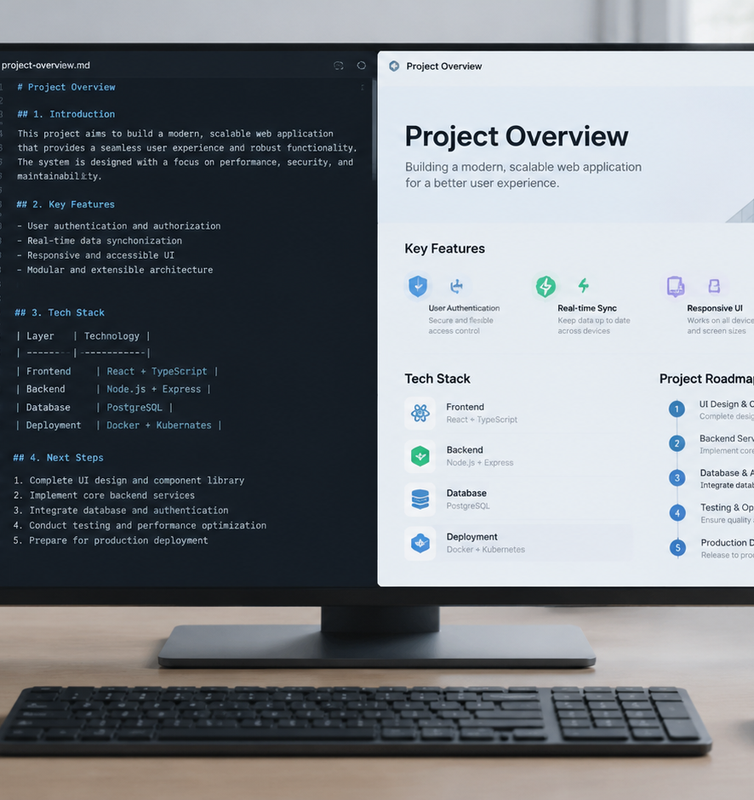
01 / 11
ARTIFICIAL INTELLIGENCE
Prompt To Presentation AI Free
Architecture and Open Toolchains for Automated Slide Generation
YIHA
Notes:
Welcome everyone. Today we are exploring the architecture of prompt-driven presentation systems. Traditionally, creating slide decks required hours of manual alignment, copy pasting, and formatting inside closed presentation applications. Today we will examine how pairing structured prompt frameworks with free, open source tools allows us to build reliable slide decks from plain text descriptions. We will analyze the transition from manual slide crafting to deterministic compilation models, look at prompt architectures that avoid rambling summaries, and demonstrate how plain text formats like Markdown ensure total downstream editability. By the end of this session, you will understand the technical pipeline required to generate high quality presentations entirely free of subscription fees.
Sources:

Slide 2
02 / 11
Evolution from Manual Slides to Prompt Systems
Prompt compilation replaces manual drag and drop layout tasks with deterministic plain text workflows.
Proprietary presentation formats couple slide copy directly to canvas coordinates
Natural language prompts establish a reproducible text compilation pipeline
Marp markdown skills demonstrate automated drafting from audience outlines
YIHA
Notes:
Let us examine how slide design has evolved over time. Historically, presentation decks lived inside proprietary binary or zipped XML containers. Every update to typography or layout required opening an interactive canvas and manually editing individual shapes. In contrast, prompt compilation relies on plain text. As shown in the marp-markdown documentation published on skills.rest, practitioners can turn high level topic prompts, target audience profiles, and rough outlines into structured Markdown slides with standard delimiters. This shifts our mental model from manual graphic placement to predictable compilation, where the core content remains portable, transparent, and easy to inspect in standard text editors. By using declarative frontmatter directives, authors separate formatting styles from factual sentences, ensuring reproducible outputs.
Sources:
https://skills.rest/skill/marp-markdown

Slide 3
03 / 11
Prompt Architectures for Presentation Structure
The Role Task Context Output framework enforces strict structural hierarchies over conversational output.
01
Base neural models predict dialogue continuations rather than visual decks
02
The RTCO framework establishes persona, objective, learner profile, and format
03
Explicit word and bullet constraints prevent slide content overflow
YIHA
Notes:
When querying language models for presentations, generic instructions produce unusable paragraphs. As published in Nature regarding role play with large language models, these systems generate continuation tokens based on contextual prompts and training distributions. Without explicit parameters, the model role-plays a conversational interlocutor rather than a presentation designer. To obtain structured slides, we apply the Role, Task, Context, Output pattern outlined in Schorbit prompt engineering guides. We define the domain role, the exact instructional task, the target audience context, and the strict output syntax. Setting hard constraints on bullet points and header formats forces the model to generate concise, scannable hierarchies. This structured framing guides token generation toward modular slide blocks while suppressing conversational pleasantries and unnecessary filler text.
Sources:
https://www.nature.com/articles/s41586-023-06647-8?error=cookies_not_supported&code=2a979099-d7bf-49c5-a73a-188ba3aa4cbd
https://schorbit.com/prompt-engineering-for-teachers/

Slide 4
04 / 11
Intermediate Representations: Plain Text Over Binary
Text formats like JSON and Markdown prevent syntax corruption and maintain editable structure.
Autoregressive models struggle to generate complex binary file archives directly
Compact notations like TOON and JSON optimize token budgets for structured data
Plain text slides remain versionable, readable, and resilient to compilation errors
YIHA
Notes:
Directly generating binary slide formats like PPTX with a language model often fails because a single broken tag or miscalculated offset invalidates the archive. Instead, robust systems use intermediate text representations. Research into Token-Oriented Object Notation on GitHub demonstrates that compact text structures significantly reduce token counts while making data schemas easier for language models to follow reliably. By generating structured JSON or Marp-flavored Markdown, the model produces clean semantic tokens. Downstream parsers then translate these tokens into finished presentation visuals, guaranteeing that content generation remains isolated from binary rendering rules. This decoupling allows authors to inspect the intermediate markup, make immediate manual adjustments, and avoid corrupting the final slide deck layout.
Sources:
https://github.com/toon-format/toon

Slide 5
05 / 11
Multi-Stage Pipelines Decouple Content and Layout
Chaining outline drafting, text budgeting, and visual layout avoids information imbalance.
Single pass prompts force models to resolve outline, copy, and layout at once
Multi-stage architectures separate narrative structure from visual styling
Sequential pipelines preserve topical consistency across multi-slide decks
YIHA
Notes:
Attempting to create a full presentation in a single prompt creates quality degradation. The model tries to brainstorm topics, balance pacing, craft concise text, and apply visual styling in one pass. To solve this, automated workflows adopt multi-stage architectures. Similar multi-stage sequencing is seen in the Story2Storyboard project on GitHub, where visual narrative generation is split into progressive steps to avoid identity drift. In slide creation, stage one builds a topic outline. Stage two applies strict word budgets to write the slide content. Stage three maps that clean text into presentation layouts. This separation allows users to adjust content before rendering, preventing text overflow and ensuring that every slide maintains consistent pacing across the entire deck.
Sources:
https://github.com/majeeedshaikh/Story2Storyboard

Slide 6
06 / 11
Open-Source and Zero-Cost Execution Engines
Local inference runners and open compilers execute complete prompt-to-slide pipelines at zero cost.
01
Ollama provides local open-weight model inference without subscription fees
02
Self-hosted workflows ensure data privacy and unrestricted generation limits
03
Open command line compilers render Markdown text into PDF or PowerPoint decks
YIHA
Notes:
You do not need paid software or cloud subscriptions to generate high quality presentations from prompts. Local runtimes such as Ollama let users run open-weight models directly on local hardware without incurring API costs. As documented in the Ollama repository on GitHub, developers can interface locally with models like Qwen or Gemma. Coupling local model inference with open source compilers like Marp CLI creates a zero cost toolchain. Text outlines generated by local models are compiled directly into slides on your local machine, keeping private organizational data secure and eliminating recurring software overhead. This setup allows engineering teams to automate presentation rendering within standard local build scripts without third-party vendor dependencies.
Sources:
https://github.com/ollama/ollama

Slide 7
07 / 11
Instructional Workflows and Curriculum Adaptation
Pedagogical prompt frameworks align slide decks to curriculum standards and cognitive levels.
Prompts structure class timing, standards alignment, and formative assessments
Bloom taxonomy parameters ensure slides match required student cognitive depth
Accommodations for diverse learning needs are explicitly defined in prompt templates
YIHA
Notes:
Education is one of the most practical applications for automated presentation design. According to documentation from SurePrompts on lesson plan prompt generation, structured prompt templates help instructors capture essential pedagogical criteria including time allocations, standards, and student accommodations. Prompts engineered with Bloom taxonomy force models to generate slides targeting analysis and evaluation rather than basic memorization. As shown in Schorbit guides, specifying parameters such as class size, ELL support, and lesson duration produces classroom ready decks that include active discussion questions and formative checks rather than superficial overviews. Teachers can rapidly generate differentiated instructional materials that directly support diverse student learning needs while preserving strict pedagogical rigor.
Sources:
https://schorbit.com/prompt-engineering-for-teachers/
https://sureprompts.com/ai-prompt-generator-for-teachers
https://sureprompts.com/lesson-plan-prompt-generator

Slide 8
08 / 11
Benchmarking Fidelity, Aesthetics, and Editability
Code-based generation and template slot filling preserve critical post-generation editability.
Paper2slides compiles academic LaTeX papers into Beamer code using linter checks
Presenton provides open source template filling to output editable PPTX files
Raster rendering yields fixed images that prevent subsequent text corrections
YIHA
Notes:
When evaluating presentation automation systems, we must compare code compilation, template filling, and direct image generation. The paper2slides project on GitHub shows how academic LaTeX papers are converted into Beamer presentations using self-inspection and automated linters. Similarly, Presenton demonstrates template slot filling, populating pre-designed presentation layouts with generated text while preserving native PowerPoint editability. In contrast, systems that render slides as flat image layers block downstream editing. Systems prioritizing plain code or standard templates ensure that humans can refine text, adjust numbers, and fix layouts after generation. Retaining native object structures is essential when presentations require factual updates, layout refinements, or corporate template alignment.
Sources:
https://github.com/takashiishida/paper2slides
https://github.com/presenton/presenton

Slide 9
09 / 11
Spatial Limits, Boundary Collisions, and Hallucinations
Models lack native spatial perception, requiring explicit text budgets to prevent visual overflow.
01
Text-only language models cannot perceive graphic boundaries or font wrap limits
02
Recommendation: Cap slide content between twenty and forty words per visual frame
03
Talk to Your Slides demonstrates inspecting object positions via script execution
YIHA
Notes:
A critical technical challenge in prompt-driven presentation design is spatial unawareness. Standard language models generate text without understanding bounding box coordinates, font sizes, or line wrap limits. As highlighted in the Talk to Your Slides paper on arXiv, direct slide editing requires programmatic inspection of visual objects and text boxes rather than ungrounded text guessing. Unconstrained generation leads to overlapping containers and severe cognitive overload. To mitigate spatial clipping, prompts must enforce strict word count ceilings and adhere to readability standards such as WCAG 2.1, ensuring accessible layout hierarchy. The systematic prompt survey on arXiv emphasizes that constraining output structure prevents hallucinations and guarantees that generated slide elements remain visually balanced.
Sources:
https://arxiv.org/html/2505.11604v1
https://www.w3.org/TR/WCAG21/
https://arxiv.org/abs/2402.07927

Slide 10
10 / 11
Adopting Slides as Code with Human-in-the-Loop Review
Version controlled text decks integrated with human review balance automation and accuracy.
Human-in-the-loop patterns prevent hallucinations before reaching final audiences
Review-and-edit workflows allow human judgment to refine automated drafts
Git repositories provide change tracking, peer review, and automated CI builds
YIHA
Notes:
Treating presentations as version-controlled code brings engineering discipline to slide production. However, full automation requires human verification. AWS architecture guidance on Human-in-the-Loop design patterns details how review-and-edit workflows let human specialists review and enhance generative outputs. As bl0ggers.com emphasizes in its workflow architecture analysis, automated drafting must be bounded by structured intake and human editorial checkpoints. In a slide-as-code pipeline, language models create the initial draft, automated build scripts verify syntax, and subject experts conduct final reviews before publishing. This hybrid structure prevents factual drift while allowing teams to maintain total editorial control over technical accuracy, messaging tone, and visual brand standards.
Sources:
https://awslabs.github.io/generative-ai-atlas/topics/3_0_architecture_and_design_patterns/3_1_system_and_application_design_patterns_for_genai/3_1_1_foundation_architecture_components/3_1_1_8_additional_components/3_1_1_8_1_human_in_the_loop/3_1_1_8_1_human_in_the_loop.html
https://bl0ggers.com/blog/human-in-the-loop-ai-publishing-workflow-architecture

Slide 11
11 / 11
Building Reliable Free Presentation Pipelines
Combining structured prompts, open compilers, and human oversight delivers scalable slide systems.
Decouple content generation from visual rendering using plain text schemas
Deploy local inference and open CLI compilers to remove recurring software fees
Establish human review checkpoints to maintain factual and editorial quality
YIHA
Notes:
In conclusion, prompt to presentation workflows provide a robust alternative to manual slide authoring when designed with sound architectural principles. As demonstrated across open tools like marp-markdown on skills.rest, moving away from opaque binary formats and adopting plain text structures like Markdown and JSON gives teams complete transparency and version control. Utilizing multi-stage prompt engineering prevents hallucination and content imbalance, while local execution tools like Ollama eliminate tool costs. Finally, pairing automated compilation with human-in-the-loop review ensures high factual rigor. The future of presentation creation lies in open, auditable, text-first pipelines that combine algorithmic drafting speed with thoughtful human verification.
Sources:
https://skills.rest/skill/marp-markdown

