Slide 1
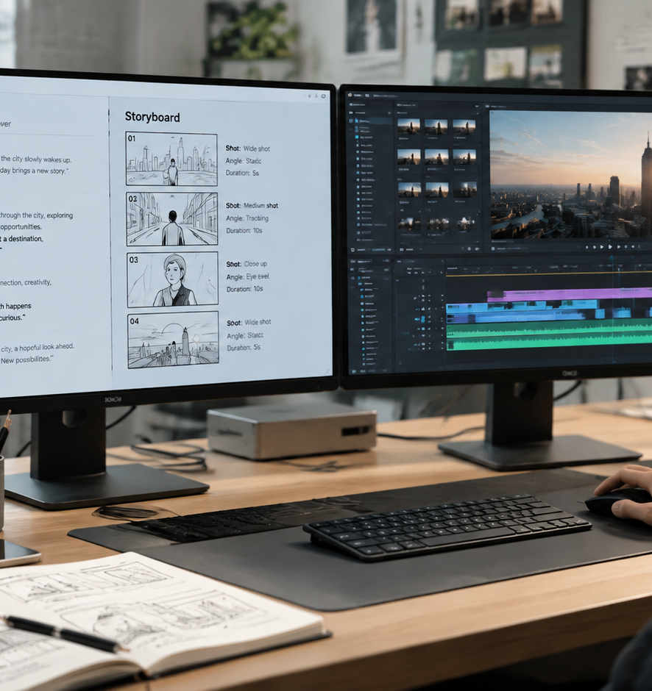
01 / 11
CREATIVE OPERATIONS
App Creator
Audio-Visual Scripting, Continuity, App Previews, and Distribution Systems
YIHA
Notes:
Welcome everyone. Today we examine the structured production framework required to launch mobile and web applications successfully. Building software represents only half of the challenge. Communicating product utility requires disciplined multimedia production, strict adherence to digital marketplace specifications, and consistent audience distribution. We will explore the entire asset lifecycle, beginning with two-column audio-visual scripts that synchronize spoken narration with visual demonstrations. From there, we cover panel storyboarding, shot continuity, and technical compliance for Apple App Store and Google Play video previews. We will also address profile microcopy architecture, content calendar matrices, and centralized asset library governance. By replacing informal drafting with standardized blueprints, teams can eliminate production bottlenecks, reduce review rejections, and build a predictable launch pipeline across channels.
Sources:

Slide 2
02 / 11
Structured Blueprints in Modern Media Production
Production blueprints replace chaotic drafting with unified cross-functional alignment.
Side by side columns align visual demonstrations with spoken audio
Centralized scheduling templates track captions, asset URLs, and publication dates
Standardized structures eliminate miscommunications between cross-functional teams
YIHA
Notes:
Unstructured drafting introduces significant friction across production teams. When video editors, copywriters, and product managers work from scattered notes, visual demonstrations and audio voiceovers frequently fall out of sync. As documented in StudioBinder AV script templates, structured production blueprints separate visual directions from voiceover copy into two distinct side by side columns. This format serves as the foundational standard for commercials, explainer videos, and corporate product demos where clear alignment between visual actions and spoken explanations is essential. In addition, Zapier content planning documentation demonstrates that tracking visual asset links, exact post copy, and publication schedules within a centralized system prevents production delays. Establishing structured templates early ensures that creative assets directly support strategic release goals rather than creating avoidable rework. Sources include StudioBinder AV Script Guide and Zapier Content Calendar Guide.
Sources:
https://www.studiobinder.com/templates/av-scripts/two-column-script-template/
https://zapier.com/blog/social-media-calendar-template/

Slide 3
03 / 11
Two-Column Scripting for Audio-Visual Sync
Decoupling visual capture from spoken copy ensures exact temporal alignment.
01
Left column documents user interface actions and camera movements
02
Right column maps dialogue, voiceovers, and interface sound effects
03
Horizontal layout allows precise pacing verification before recording begins
YIHA
Notes:
Traditional screenplay formats use a single-column layout centered on dialogue and character action. This layout fails to meet the technical needs of software walk-throughs. Two-column scripting resolves this challenge by placing visual interface actions on the left and auditory cues on the right. This approach mirrors the technical structure found in specifications like Timed Text Markup Language 2, where visual regions and audio styling operate as discrete yet temporally coordinated streams. Similarly, FFmpeg formats manage discrete elementary streams by grouping audio and video tracks through precise mapping definitions. In practical video production, this horizontal side by side alignment ensures that on-screen interface demonstrations never race ahead of spoken technical explanations. Technical reviewers, sound designers, and motion editors can verify durations and cues before full rendering begins. Sources include W3C Timed Text Markup Language 2 Specification and FFmpeg Formats Documentation.
Sources:
https://www.w3.org/TR/ttml2/
https://ffmpeg.org/ffmpeg-formats.html

Slide 4
04 / 11
Panel Storyboarding and Visual Sequence Planning
Shot by shot storyboards validate framing, aspect ratios, and narrative rhythm.
Panel ratios match distribution channels such as 16:9 widescreen or 9:16 vertical
Example recommendation: 3 to 6 panels per page for narrative pacing review
Pre-production storyboards catch interface layout errors before video rendering
YIHA
Notes:
After validating a script, teams translate written actions into sequential storyboard panels to establish framing, pacing, and visual rhythm. StudioBinder documentation highlights that matching panel aspect ratios to delivery channels is critical, such as 16:9 for standard video displays and 9:16 for mobile vertical layouts. In practice, production teams organize 3 to 6 panels per page as a common recommendation to balance narrative flow with detailed shot annotations. Storyboards act as an early visual validation gate, allowing creative directors and product teams to detect awkward interface transitions, illegible text overlays, or confusing layouts before recording begins. Reviewing static frames minimizes costly post-production revisions and ensures the interface remains clear throughout the entire visual presentation. Sources include StudioBinder Storyboard Templates and StudioBinder Video Filmmaking Template.
Sources:
https://www.studiobinder.com/blog/downloads/storyboard-template/
https://www.studiobinder.com/templates/storyboards/storyboarding-video-template/

Slide 5
05 / 11
Maintaining Visual Continuity Across Cuts
Reference anchoring and style packs prevent visual drift across dynamic scene cuts.
Reusable reference images anchor character, UI, and environmental identities
Automated pipelines utilize style packs to maintain aesthetic consistency
Predefined failure conditions eliminate subjective reviews of broken shots
YIHA
Notes:
A persistent challenge in rapid-cut digital video is visual continuity. When editing multiple shots, UI colors, fonts, or subjects can unintentionally morph between frames. As CinemaDrop storyboard workflows illustrate, using reference images and anchoring elements ensures that characters, interfaces, and environments retain identical visual properties across different angles and cuts. Open-source pipelines such as JuanLara18 batch video generation project enforce visual consistency across clips through reusable style packs configured in JSON prompts. Furthermore, Veo 3 production guidelines emphasize establishing explicit failure conditions during review. If a software interface shifts shape or visual style changes across cuts, the shot is flagged for correction before timeline assembly. Sources include CinemaDrop Storyboard Guide, JuanLara18 AI Video Gen, and Veo 3 Longform Storyboard Workflow.
Sources:
https://www.cinemadrop.com/storyboard-template-for-short-form-video
https://github.com/JuanLara18/ai-video-gen
https://www.veo3ai.io/blog/veo-3-longform-storyboard-workflow-2026

Slide 6
06 / 11
Platform Guidelines for Mobile App Previews
App Store and Google Play require native device capture and strict duration bounds.
01
Video duration is capped at 30 seconds with up to three previews per language
02
Footage must be captured natively on device without artificial simulations
03
Preview metadata must adhere to a universal 4+ rating and muted autoplay
YIHA
Notes:
Distributing video previews on official mobile marketplaces requires strict technical compliance. Apple App Store guidelines specify that developers may submit up to three app previews per supported language, with each video capped at 30 seconds. Video content must be captured directly from device hardware to reflect real user interactions rather than artificial animations. Furthermore, app previews autoplay with muted audio, requiring strong visual clarity without relying on sound. Apple Review Guidelines require all preview metadata to adhere to a universal 4+ age rating and omit seasonal claims or specific pricing. Google Play Store rules similarly integrate preview videos directly alongside device screenshots on the main store listing. Adhering to these parameters prevents marketplace submission rejections. Sources include Apple Developer App Previews, Apple App Review Guidelines, and Google Play Console Help.
Sources:
https://developer.apple.com/app-store/app-previews/
https://developer.apple.com/app-store/review/guidelines/
https://support.google.com/googleplay/android-developer/answer/9866151?visit_id=639272058059315682-2289213735&rd=1

Slide 7
07 / 11
Pacing Calibration and Early Value Delivery
Deliver core functional utility in opening seconds to overcome muted autoplay drop-off.
Autoplay begins without audio, requiring immediate visual communication of value
Animatics with timing controls allow pacing tests before entering full production
High-impact feature demonstrations must precede secondary narrative details
YIHA
Notes:
Viewer engagement curves in digital environments indicate that audiences evaluate utility within the first few seconds. Traditional narrative build-ups that delay product demonstrations lead to steep viewer drop-off. Apple product page documentation notes that app previews autoplay silently, making the opening seconds critical for capturing attention through immediate visual utility. The core functional value must be visible at once. To test and refine pacing before rendering, Guideflow documentation highlights the use of animatics, which combine storyboard frames with timing controls and scratch audio. Similarly, ToolsInfo research outlines how digital template creators focus on concise, high-impact walk-throughs that convey practical utility without unnecessary introductory fluff. Front-loading key interactions ensures prospective users understand the product value instantly. Sources include Apple Developer Product Page Guide, Guideflow AI Storyboards, and ToolsInfo Template Creator Guide.
Sources:
https://developer.apple.com/app-store/product-page/
https://www.guideflow.com/blog/ai-storyboard-generator
https://toolsinfo.com/role/template-creator/guide

Slide 8
08 / 11
Profile Architecture and Character Constraints
Concise microcopy formulas maximize conversion within strict technical character caps.
Platform limits: TikTok 80 characters, Instagram 150, Twitter 160, LinkedIn 220
Four-part formula includes identity, value proposition, proof, and call to action
Tight microcopy directs discovery traffic straight to application landing pages
YIHA
Notes:
Converting social traffic into active application users requires disciplined microcopy optimization on profile landing surfaces. Major platforms enforce tight technical limits. TikTok caps bios at 80 characters, Instagram and Threads permit 150 characters, Twitter or X allows 160 characters, and LinkedIn headlines permit 220 characters. As documented by Creator Units, teams maximize conversion by applying a four-part structural formula consisting of Identity, Value Proposition, Proof, and Call to Action. Within tight character constraints, every single word must communicate functional purpose and guide traffic toward installation links. Managing these character caps prevents truncated sentences, eliminates redundant phrases, and provides prospective users with a clear path to download the application. Sources include Creator Units Bio Template Generator.
Sources:
https://www.creatorunits.com/tools/social/bio-template-generator

Slide 9
09 / 11
Content Scheduling and Distribution Cadence
Tailor publishing frequencies and formats to each platform distribution algorithm.
01
Example schedule: TikTok 1 to 2 daily, Instagram 5 to 7 weekly, LinkedIn 3 to 5 weekdays
02
Format prioritization: vertical video leads discovery while carousels provide depth
03
Centralized matrices prevent creator burnout and maintain posting consistency
YIHA
Notes:
Consistent post-launch discovery relies on a structured scheduling matrix aligned with platform distribution algorithms. SocialCal calendar analysis shows distinct cadence patterns across platforms. TikTok favors 1 to 2 vertical videos daily, Instagram performs best with 5 to 7 posts weekly leading with Reels, and LinkedIn rewards 3 to 5 weekday updates focused on carousels and text. FFmpeg documentation details how visual video streams and graphical overlays are processed across time, reflecting the technical discipline needed to prepare multi-format exports. Maintaining a centralized calendar that connects publication dates, content pillars, and media asset links prevents operational burnout and ensures consistent algorithmic discovery across all target channels. Sources include SocialCal Content Calendar Template and FFmpeg Filters Documentation.
Sources:
https://www.socialcal.app/social-media-content-calendar-template
https://ffmpeg.org/ffmpeg-filters.html

Slide 10
10 / 11
Integrating Blueprints into a Unified Engine
Decoupled asset management libraries allow pre-approved creative reuse across campaigns.
App Store Connect Asset Library stages previews independently of version releases
Canvas workflows integrate script generation, shot lists, and export pipelines
Reusable creative asset repositories accelerate future product launch cycles
YIHA
Notes:
A high-performing launch system integrates scripts, storyboards, compliance reviews, and distribution schedules into a unified operational lifecycle. Rather than scattering creative assets across local drives and chat messages, teams establish centralized governance. Apple App Store Connect documentation explains how Asset Library allows teams to upload, review, and approve app previews and screenshots independently of specific application binary releases. This operational decoupling enables marketing teams to stage approved visual assets well in advance of launch deadlines. In addition, open-source platforms like pkp666 mjj-ai-studio show how visual workflow canvases link script writing, shot division, and asset tracking into a single production pipeline. Standardizing this workflow creates a scalable, repeatable launch engine. Sources include Apple App Store Connect Asset Library Guide and pkp666 AI Studio Repository.
Sources:
https://developer.apple.com/help/app-store-connect/manage-app-information/manage-your-app-store-assets/
https://github.com/pkp666/mjj-ai-studio

Slide 11
11 / 11
Building a Repeatable Product Launch System
Disciplined documentation transforms app asset creation into a predictable operational discipline.
Anchor production in two-column AV scripts and verified storyboard panels
Strictly comply with marketplace preview standards to avoid submission delays
Systematize release calendars and asset libraries for scalable launch execution
YIHA
Notes:
In summary, building a predictable application launch engine requires disciplined documentation across every creative stage. By implementing two-column audio-visual scripts, creative teams maintain strict alignment between on-screen demonstrations and narration. Panel storyboards validate framing, aspect ratios, and visual continuity before rendering begins. Strict compliance with Apple and Google marketplace specifications ensures smooth preview approvals without costly re-submissions. Finally, structuring content scheduling matrices and centralized asset libraries enables continuous, organized post-launch distribution. When teams treat creative production with the same engineering rigor as application code, multimedia assets consistently drive product adoption. Sources include StudioBinder AV Script Guide, Apple Developer App Previews, and Apple App Store Connect Asset Library Guide.
Sources:
https://www.studiobinder.com/templates/av-scripts/two-column-script-template/
https://developer.apple.com/app-store/app-previews/
https://developer.apple.com/help/app-store-connect/manage-app-information/manage-your-app-store-assets/

