Slide 1
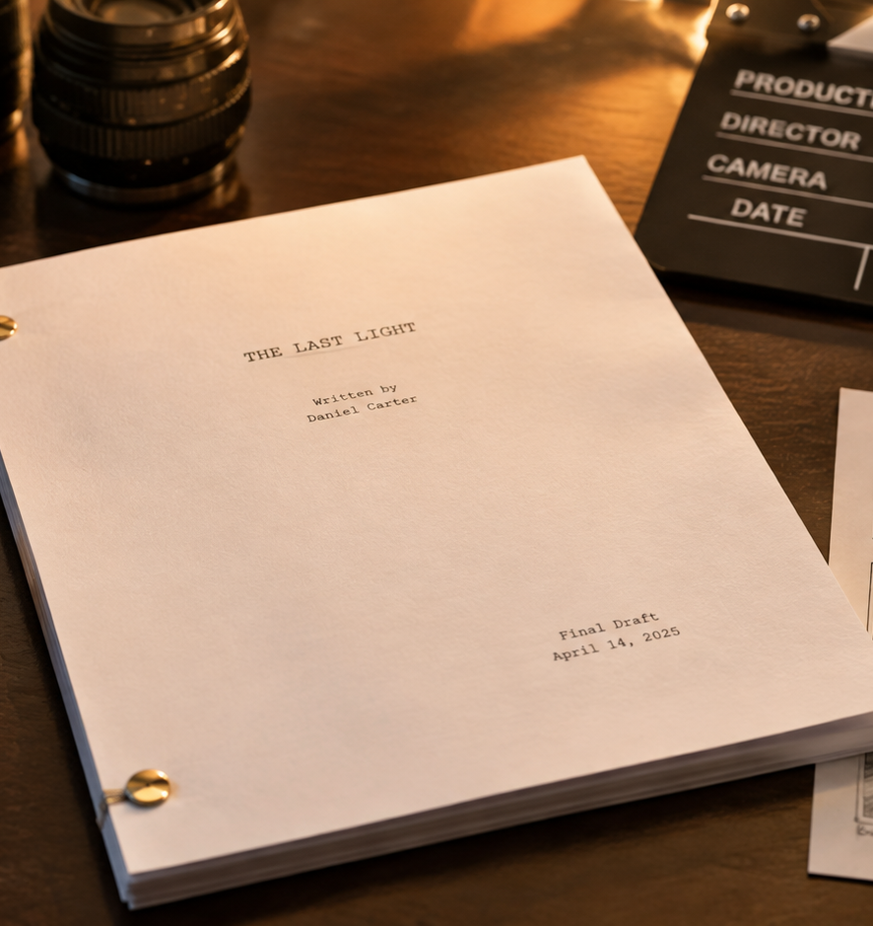
01 / 11
VIDEO PRODUCTION
Script Pad
Audio-Visual Scripting, Grid Synchronization, and Production Workflows
YIHA
Notes:
Welcome to this technical briefing on script pad architecture and production workflow. In non-fiction media, commercial production, and corporate communications, establishing absolute synchronization between spoken narration and on-screen imagery is critical. While dramatic cinema relies on single-column master-scene screenplays, short-form and corporate projects demand a two-column audio-visual layout. This presentation details the structural mechanics of split-page formatting, standardized shot descriptions, audio typography, pacing formulas, and cross-department handoffs. By examining documentation from StudioBinder, Boords, Celtx, and allied production guides, we illustrate how the script pad functions as an operational contract across creative and technical teams. Our discussion will guide you through building robust production tables, preventing pacing desynchronization, and managing stakeholder approvals efficiently before production begins.
Sources:

Slide 2
02 / 11
Evolution of Split-Page and Script Pad Formats
Broadcast television and commercial studios created two-column layouts to eliminate control room ambiguity.
Early television control rooms required parallel camera and audio cues
Broadcast script pads separated live switching from spoken dialogue
Digital formats adapted the layout for marketing and training media
YIHA
Notes:
The split-page format originated in live broadcast television and radio studios where rapid switching between cameras and microphones required instant visual clarity. Studio directors could not pause production to search through blocks of prose for switching instructions. Dividing the script pad into distinct visual and audio tracks allowed technical crews to coordinate physical inputs in real time. As detailed in the StudioBinder two-column script template documentation, this split layout became the standard production format for commercials, corporate presentations, and instructional videos. Unlike traditional screenplay formatting designed for narrative cinema, the digital AV script pad prioritizes simultaneous execution of visual cues and audio tracks. Media teams rely on these templates across word processors and dedicated software to ensure that narrative pacing directly mirrors production realities.
Sources:
https://www.studiobinder.com/templates/av-scripts/two-column-script-template/

Slide 3
03 / 11
Structural Layout of the Two-Column Grid
A synchronized table pairs every visual beat directly with its corresponding audio event.
01
Left column tracks all visible picture and motion graphics
02
Right column records dialogue, voiceover, music, and sound effects
03
Row-by-row structure ensures horizontal temporal alignment
YIHA
Notes:
At its mechanical core, the two-column script pad functions as a synchronized grid where each row represents an individual scene beat. According to Boords, this table structure allows producers, clients, voiceover artists, and video editors to work collaboratively from a single unified document. Production analysis from Beefed AI highlights that the side-by-side alignment of visual cues on the left and audio elements on the right serves as an essential production lingua franca. When each on-screen action corresponds horizontally to its exact spoken phrase or sound effect, ambiguity disappears. If adjustments are made to a specific shot or visual graphic, editors and writers can adjust that isolated row without destabilizing adjacent scenes, ensuring consistent temporal pacing throughout the entire video cut.
Sources:
https://boords.com/video-script-template
https://beefed.ai/en/two-column-av-script-template

Slide 4
04 / 11
Standardizing Shot Descriptions and Visual Cues
Precise visual shorthand and embedded references communicate camera setups efficiently.
Standard abbreviations indicate shot sizes and camera movements
Blocking details define subject actions and graphic placements
Embedded reference frames communicate composition and art direction
YIHA
Notes:
Standardizing descriptions within the visual column is essential for effective communication on set. Production crew members scan this column quickly to identify focal lengths, camera angles, lighting conditions, and on-screen text placements. StudioBinder documentation specifies that writers should detail camera direction, subject blocking, and text overlays in the visual column rather than leaving technical execution to guesswork. In sequences featuring continuous camera movement, such as complex tracking shots, CinemaDrop highlights the necessity of mapping movement into distinct beats to evaluate geography and pacing before filming starts. Inserting reference images directly into table rows further clarifies art direction and composition, ensuring that camera operators, directors of photography, and motion graphic designers share an aligned technical target.
Sources:
https://www.studiobinder.com/templates/av-scripts/two-column-script-template/
https://www.cinemadrop.com/tracking-shot-storyboard-template

Slide 5
05 / 11
Writing Voiceover, Dialogue, and Sound Effects
Typographic conventions separate spoken words from musical cues and technical mixing directions.
Clear speaker tags identify narration versus on-camera dialogue
Bracketed upper-case tags label music beds and sound effects
Explicit visual-only tags prevent empty cells from causing confusion
YIHA
Notes:
Clarity within the audio column prevents recording errors and accelerates audio post-production. StudioBinder scripting guidelines emphasize that all acoustic elements, including spoken dialogue, voiceover narration, musical beds, and ambient sound effects, must be explicitly labeled. Standardized uppercase tags like SFX and MUSIC distinguish sonic textures from spoken performance. CreatorPlanTools notes that placing sound instructions inside brackets prevents voiceover talent from reading technical cues aloud during recording sessions. Furthermore, CreatorPlanTools recommends explicitly marking non-verbal segments with a VISUAL ONLY tag in the audio column. This simple convention informs the sound engineer and video editor that the absence of narration is an intentional creative choice rather than an unfinished script draft.
Sources:
https://www.studiobinder.com/templates/av-scripts/video-script-template/
https://creatorplantools.com/guides/two-column-video-script-template

Slide 6
06 / 11
Timing Metrics, Read Rates, and Duration Control
Dedicated duration fields and out-loud rehearsals maintain strict broadcast and web runtimes.
01
Row-level duration fields assign runtime targets to each beat
02
Read-aloud timing tests account for natural delivery pauses
03
Scratch track recordings validate pacing against visual action
YIHA
Notes:
Controlling duration is critical in commercial and branded media because delivery slots and web audience attention spans are strictly limited. StudioBinder explains that purpose-built two-column templates feature row-by-row duration fields, allowing writers to log precise target runtimes and test delivery with stopwatches. Guidance from Solprompter notes that while word counts provide helpful planning baselines, they do not guarantee exact timing, making out-loud rehearsal with natural pauses essential. CreatorPlanTools demonstrates that recording scratch reads alongside physical demonstrations verifies whether visual actions fit the allotted spoken cadence. If a voiceover line outlasts the corresponding visual action, writers must either tighten the phrasing or extend the visual shot before committing expensive studio time.
Sources:
https://www.studiobinder.com/templates/av-scripts/two-column-script-template/
https://solprompter.com/blog/presentation-script-template/
https://creatorplantools.com/guides/two-column-video-script-template

Slide 7
07 / 11
Translating Script Pads to Storyboards and Shot Lists
Each script row translates directly into storyboard panels and operational shot list items.
Script beats map directly to illustrated storyboard panels
Shot lists extract technical gear, lens, and location requirements
Synchronized row numbers prevent continuity errors on set
YIHA
Notes:
Pre-production transitions smoothly when the locked script pad translates directly into visual storyboards and operational shot lists. Vain New York explains that standard production practice derives the shot list directly from the storyboard and script pad, ensuring that planning documents remain fully aligned without contradictions. While the storyboard visualizes composition, framing, and emotional energy, the shot list extracts operational parameters like lenses, lighting setups, and location schedules. StudioBinder corporate storyboarding documentation demonstrates how breaking down script rows into illustrated panels guarantees that business objectives and brand guidelines are reflected shot for shot. Linking storyboard panels directly to script pad rows allows crew members to track modifications quickly without losing structural continuity.
Sources:
https://www.vainnewyork.com/post/storyboard-vs-shot-list
https://www.studiobinder.com/templates/storyboards/corporate-video-storyboard-template/

Slide 8
08 / 11
Comparing Two-Column Formats with Screenplays
Single-column screenplays serve dramatic storytelling, while two-column pads govern structured production.
Screenplays use Courier typography and master-scene formatting
AV scripts prioritize visual and audio synchronization for fast evaluation
Corporate and commercial reviews benefit from side-by-side clarity
YIHA
Notes:
Understanding when to deploy an AV script pad versus a single-column screenplay is essential for efficient production planning. Celtx documentation clarifies that while traditional screenplays use a single-column layout for dramatic film and television, two-column AV scripts are designed for precise production alignment in corporate, commercial, and educational formats. StudioBinder notes that two-column templates provide immediate visual control over voiceover, graphics, and timing. In narrative screenplays, the industry rule assumes one page equals roughly one minute of screen time. In commercial and corporate media, visual graphics and narration change at decoupled speeds. Presenting picture and sound side by side gives commercial clients and department heads immediate clarity on how the messaging translates visually.
Sources:
https://blog.celtx.com/essential-av-script-template-for-better-video-scripts/
https://www.studiobinder.com/templates/av-scripts/two-column-script-template/

Slide 9
09 / 11
Common Desynchronization Pitfalls and Bottlenecks
Pacing drift and vague descriptions create severe bottlenecks in production and editing.
01
Narration outrunning visuals forces static shots or editing scrambles
02
Vague audio and graphic cues cause guesswork and rework
03
Structured pre-planning eliminates execution friction
YIHA
Notes:
Production desynchronization frequently occurs when script formatting standards lapse. Analysis from TrySight shows that workflow bottlenecks arise when work accumulates behind friction points such as decision fatigue, ambiguous instructions, and missing asset references. In two-column scripting, writing expansive narration opposite brief visual descriptions causes pacing drift, forcing editors to stretch b-roll footage or scramble for cutaways. Assemble workflow guidance stresses that completing a detailed, specific script covering all visual and audio elements during pre-production prevents costly on-set confusion and editing bottlenecks. Specifying exact graphic filenames and clear sound labels in the script pad prevents motion designers and sound mixers from wasting hours interpreting vague artistic intent.
Sources:
https://www.trysight.ai/blog/content-production-bottlenecks
https://www.onassemble.com/template-library/video-production-workflow-template

Slide 10
10 / 11
Iterative Review Loops and Production Sign-Off
Multi-stage approval gates and segment structures ensure full alignment before filming.
Segment banners organize content into manageable review blocks
Sequential checkpoints route drafts from creative to legal review
Locked script approvals prevent expensive on-set alterations
YIHA
Notes:
Securing formal production sign-off requires structured review loops and clear document segmentation. Ziflow notes that multi-stakeholder approval workflows benefit from sequential review gates, routing drafts through internal creative teams before presenting them to clients or compliance reviewers. Organizing the script pad into thematic segment banners allows stakeholders to evaluate specific messaging modules without losing sight of overall project flow. The Video Effect reinforces that thorough pre-production planning protects quality and prevents expensive post-production corrections. Freezing the script pad with formal sign-off before shoot day guarantees that directors, camera operators, and talent execute an approved creative blueprint, keeping production timelines predictable and reducing costly revision cycles.
Sources:
https://www.ziflow.com/blog/video-production-workflow
https://www.thevideoeffect.tv/articles/what-are-the-three-stages-of-video-production

Slide 11
11 / 11
Summary of Script Pad Best Practices
Mastering the two-column format turns script pads into reliable blueprints for production success.
Maintain strict horizontal alignment between picture and sound
Incorporate stopwatch timings to enforce duration limits
Derive storyboards and shot lists directly from locked script rows
YIHA
Notes:
To summarize our analysis, the two-column script pad remains an essential foundational framework for structured media production. By maintaining strict horizontal synchronization between visual cues and audio narration, media teams eliminate ambiguity across all production phases. Implementing duration tracking, stopwatch testing, and explicit typographic tags ensures that tight commercial runtimes are preserved. As emphasized by Boords and StudioBinder production resources, translating locked script rows directly into storyboard panels and shot lists ensures complete continuity from creative ideation to final editorial delivery. Adopting these structured scripting practices establishes clear communication, streamlines multi-stakeholder approvals, and provides camera crews and editors with an authoritative guide for executing professional video projects.
Sources:
https://boords.com/video-script-template
https://www.studiobinder.com/templates/av-scripts/two-column-script-template/

