Slide 1
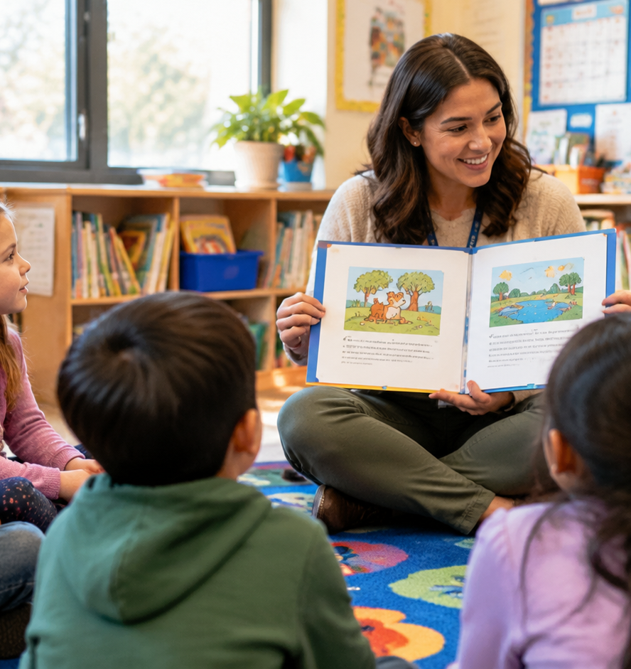
01 / 11
ELEMENTARY EDUCATION
Storytelling Lesson Plans For Elementary
Instructional Strategies for Elementary Oral Literacy
YIHA
Notes:
Welcome to this comprehensive professional development session on storytelling lesson plans for elementary classrooms. Spoken narrative serves as a vital bridge between natural language development and formal reading and writing proficiency. When teachers intentionally weave oral storytelling into daily routines, children build critical foundational competencies, including phonological awareness, expressive vocabulary, and story grammar. Throughout this presentation, we explore practical frameworks across nine core areas, starting with early literacy foundations, progressing through narrative structure and performance techniques, and integrating multisensory tools like storyboards. We will also address cultural folklore, cross-curricular social studies inquiry, collaborative drama, formative assessment rubrics, and targeted scaffolds for multilingual learners. By focusing on structured speaking routines, educators can build inclusive classrooms where all children find confidence in their expressive voices.
Sources:

Slide 2
02 / 11
Oral Tradition as the Foundation of Literacy
Spoken storytelling develops phonological sensitivity, expressive vocabulary, and reading fluency before print mastery.
Spoken language builds lexical representations that support decoding and word recognition
Prosodic oral practice enhances expressive reading fluency and sentence comprehension
Tactile connections like letter tracing bridge oral narratives directly to fine motor writing
YIHA
Notes:
Oral narrative serves as the fundamental bridge to written literacy. Research published in Frontiers in Psychology demonstrates that targeted phonological awareness and spoken sound processing build underlying lexical representations that directly support word recognition, spelling accuracy, and reading comprehension. In our classrooms, oral interpretation provides students with low-stakes practice to master fluency before encountering complex print. According to lesson frameworks from Read Write Think, explicit modeling of prosody, repeated readings, and choral recitation show learners how vocal expression brings meaning to spoken words. Furthermore, early childhood guides from The Schoolhouse highlight that linking oral narrative discussions with hands-on activities, such as tracing letters right after a storytelling circle, establishes an essential physical connection between spoken language and fine motor writing skills. This dual approach ensures that oral development actively reinforces print acquisition.
Sources:
https://www.frontiersin.org/journals/psychology/articles/10.3389/fpsyg.2020.01309/full
https://www.readwritethink.org/classroom-resources/lesson-plans/reading-performance-understanding-fluency
https://www.theschoolhouse.org/post/preschool-education-lesson-plans-themes

Slide 3
03 / 11
Deconstructing Narrative Arc and Story Grammar
Explicit graphic organizers help young learners identify and sequence core narrative components.
01
Core story grammar includes character, setting, problem, key events, and resolution
02
Story innovation lets students adapt characters and settings within stable plot frames
03
Visual organizers help students recall and analyze increasingly complex story structures
YIHA
Notes:
To help elementary students move beyond rambling anecdotes, we must provide explicit structures for story grammar. In the Story Elements Alive framework on Read Write Think, educators guide students through interactive read-alouds where they isolate character traits, settings, central problems, and resolutions using focused graphic organizers. Once students understand these basic building blocks, teachers can introduce the story innovation strategy, as outlined by Read Write Think. In this approach, students take a familiar narrative and systematically modify specific variables, such as swapping out characters, changing the farm setting to an ocean environment, or altering descriptive vocabulary. This allows young writers to experiment creatively within an established, stable narrative sequence. Explicitly mapping story grammar gives children a durable mental template that helps them comprehend more complex literature while organizing their own spoken and written stories.
Sources:
https://www.readwritethink.org/classroom-resources/lesson-plans/story-elements-alive
https://www.readwritethink.org/classroom-resources/lesson-plans/using-story-innovation-teach

Slide 4
04 / 11
Vocal Modulation and Physical Expression
Intentional vocal inflection, eye contact, and physical gesture transform passive recitation into engaging delivery.
Vocal tone, word choice, and conversational pacing convey character emotions effectively
Eye contact and purposeful facial expressions create an active connection with listeners
Targeted physical gestures clarify story action and help manage performance anxiety
YIHA
Notes:
Effective storytelling relies heavily on physical and vocal delivery mechanics. As highlighted in Read Write Think's audio broadcast and podcast curriculum, characters in a drama communicate feelings primarily through tone of voice, word choice, and conversational pace rather than direct narration. When students prepare for live oral storytelling, these auditory techniques combine with physical expression. According to Read Write Think's social studies storytelling lessons, students should explicitly study and practice eye contact, facial expressions, vocal inflection, gestures, and clear enunciation. In our classrooms, we can model how altering pitch, lowering volume to a whisper, or pausing deliberately changes how an audience experiences tension and emotion. Teaching delivery mechanics shows elementary learners that their bodies and voices are communicative instruments, transforming simple memorized recitation into purposeful dramatic communication.
Sources:
https://www.readwritethink.org/classroom-resources/lesson-plans/audio-broadcasts-podcasts-oral
https://www.readwritethink.org/classroom-resources/lesson-plans/storytelling-social-studies-classroom

Slide 5
05 / 11
Multisensory Scaffolding with Storyboards
Visual scene cards and tactile supports allow emerging narrators to organize events sequentially.
Storyboards break narratives into linear chunks so students can focus on discrete scenes
Fairy tale storyboards reinforce temporal transition words like first, next, and finally
Visual representations anchor working memory and support independent oral retellings
YIHA
Notes:
Moving directly from mental concepts to continuous speech can overwhelm the working memory of young elementary students. Multisensory scaffolding provides concrete visual and physical anchors that support oral organization. According to Storyboard That's classroom guide, storyboards break a complex narrative into linear, bite-sized cells, enabling authors to focus on individual scenes, character actions, and contextual details without losing sight of the overall flow. Similarly, Read Write Think's lesson on story structure uses fairy tale storyboards to help first and second graders arrange events chronologically while practicing transition words such as first, then, next, and finally. Using tactile storyboards, puppet figures, or scene illustrations allows children to point to concrete images during oral retellings. This visual scaffolding lowers cognitive anxiety, keeps sequential retellings on track, and boosts narrative confidence.
Sources:
https://www.storyboardthat.com/articles/e/storytelling-with-storyboards
https://www.readwritethink.org/classroom-resources/lesson-plans/teaching-about-story-structure

Slide 6
06 / 11
Folklore and Cultural Perspectives
Comparing world folk tales exposes students to universal narrative motifs and diverse cultural traditions.
01
Global folk tales teach narrative sequencing while fostering respect for cultural diversity
02
Small group jigsaw readings let students compare character traits and cultural context
03
Visual collages and comic adaptations support structured peer oral presentations
YIHA
Notes:
World folklore offers an extraordinary foundation for elementary storytelling because traditional tales were historically crafted for spoken transmission. In Read Write Think's lesson on exploring world cultures through folk tales, small student groups investigate stories from African, Japanese, and Welsh traditions. Students map key plot sequences with graphic organizers, create visual collages or comic books, conduct cultural research, and deliver oral retellings with peer feedback. Lesson Planet resources on oral storytelling further emphasize that examining traditional tales across cultures reveals universal narrative motifs while honoring unique cultural values and customs. By analyzing how different communities solve problems in stories, elementary students expand their cultural empathy and discover common narrative structures across human history. Teachers should ensure tales are introduced within their authentic cultural contexts rather than presented as generic fables.
Sources:
https://www.readwritethink.org/classroom-resources/lesson-plans/exploring-world-cultures-through
https://www.lessonplanet.com/search?keywords=oral+storytelling+lessons

Slide 7
07 / 11
Connecting Stories to Social Studies Inquiry
Personal artifacts and biographical narratives turn abstract historical concepts into lived human experiences.
Personal memory boxes containing meaningful artifacts establish initial oral storytelling comfort
Rehearsing biographical accounts of historical figures develops civic inquiry and empathy
Peer rehearsal routines provide low-stakes practice before whole-class presentations
YIHA
Notes:
Storytelling connects students deeply to social studies by framing history through lived human experiences rather than lists of memorized dates. In Read Write Think's curriculum on storytelling in the social studies classroom, students begin by creating personal memory boxes containing three personal artifacts, practicing short one-minute oral narratives about family memories. They then transfer these narrative skills to historical inquiry by researching biographies of notable figures, creating visual aids, and rehearsing their narratives with three peers before speaking to the entire class. Additional lesson ideas from Lesson Planet emphasize that family interviews and oral history traditions preserve community memory and build active listening habits. This progression helps elementary learners realize that history is composed of real people's lives and decisions, cultivating civic understanding and participatory citizenship in an engaging, accessible manner.
Sources:
https://www.readwritethink.org/classroom-resources/lesson-plans/storytelling-social-studies-classroom
https://www.lessonplanet.com/search?keywords=oral+storytelling

Slide 8
08 / 11
Story-Acting and Classroom Process Drama
Collaborative dramatization and peer role-playing build social cooperation and communication skills.
Dramatizing student narratives encourages perspective taking and mutual trust
Radio dramas and playwriting exercises offer low-pressure formats for oral reading
Guided group enactment develops collaborative problem solving and active listening
YIHA
Notes:
Story-acting and process drama transform oral narrative into an active, collaborative classroom community experience. Drama Notebook's curriculum resources show that dramatic role-playing units, creative scripts, and radio dramas provide elementary students with low-pressure opportunities to practice expressive oral reading while building collaboration and communication skills. Complementing these dramatic exercises, early education frameworks from The Schoolhouse demonstrate that structured group activities and dramatization cultivate vital social and emotional skills, including turn-taking, active listening, and conflict resolution. When children act out peer-authored stories or historical scenarios together, they inhabit multiple character viewpoints and learn to negotiate shared physical space. The presenter should note that effective process drama requires clear spatial boundaries and established behavior norms so that dramatic energy remains constructive, purposeful, and supportive of every child in the room.
Sources:
https://www.dramanotebook.com/drama-curriculum/playwriting-for-kids/
https://www.theschoolhouse.org/post/preschool-education-lesson-plans-themes

Slide 9
09 / 11
Formative Assessment and Oral Rubrics
Clear success criteria and peer feedback loops evaluate narrative skills without stifling creativity.
01
Visible learning rubrics clarify expectations for sequence, volume, and audience engagement
02
Think-pair-share routines generate high-value formative peer feedback before final retellings
03
Four-part lesson structures align teaching cues directly with observable student outcomes
YIHA
Notes:
Evaluating elementary storytelling requires an intentional balance between objective oral standards and creative student expression. As detailed by Structural Learning on formative assessment strategies, visible learning frameworks and clear success criteria empower students to understand their own learning progress. Structural Learning highlights that think-pair-share routines and structured peer feedback loops provide rapid instructional insights, enabling teachers to make immediate adaptations without interrupting narrative flow. Curricular models in ERIC document ED173299 similarly show that organizing lesson plans into clear activity parts, teaching hints, and expected student outcomes provides systematic evaluation criteria. A focused storytelling rubric evaluates narrative sequence, vocal volume, expressive inflection, and audience contact. Using formative peer reviews before final presentations ensures students receive actionable feedback on process and delivery while maintaining enthusiasm for oral communication.
Sources:
https://www.structural-learning.com/post/formative-assessment-strategies-a-teachers-guide
https://eric.ed.gov/?id=ED173299

Slide 10
10 / 11
Scaffolding for Multilingual Learners
Sentence frames, peer brainstorming, and native language assets empower emerging speakers.
Tapping prior knowledge helps English language learners access complex story concepts
Native language partner discussions allow students to clarify ideas before class sharing
Explicit vocabulary instruction provides necessary sentence structures for oral narration
YIHA
Notes:
Inclusive storytelling instruction requires strategic differentiation for multilingual and emerging learners. As emphasized by Colorín Colorado in their guide to reading comprehension strategies for English language learners, students often possess rich background knowledge and personal experiences that they cannot yet fully express in English. Colorín Colorado recommends building background knowledge, explicitly teaching academic and narrative vocabulary, and allowing students to brainstorm with peers in their native language before speaking to the broader group. Teachers can combine these strategies with structural sentence frames and visual storyboards to scaffold oral narration. Giving students low-stakes partner practice ensures that emerging bilingual learners can organize their narrative thoughts comfortably. Recognizing native language assets and offering predictable linguistic scaffolds builds an equitable classroom where all students participate meaningfully in oral storytelling.
Sources:
https://www.colorincolorado.org/article/reading-comprehension-strategies-english-language-learners

Slide 11
11 / 11
Synthesizing Elementary Storytelling Routines
Integrating oral storytelling across disciplines equips students with lasting communication skills.
Oral narrative strengthens phonological processing, reading fluency, and writing craft
Visual scaffolds and process drama make abstract narrative concepts tangible and shared
Inclusive rubrics and peer rehearsals nurture confident and empathetic communicators
YIHA
Notes:
In conclusion, structured storytelling lesson plans do far more than entertain elementary students. By establishing explicit oral language routines, as demonstrated across resources from Read Write Think, Colorín Colorado, and Structural Learning, educators create an enduring foundation for comprehensive literacy development. Spoken narrative builds the auditory and structural schemas that students later rely upon for reading fluency, text comprehension, and written composition. Integrating multisensory scaffolds like storyboards, exploring cultural folklore, connecting stories to social studies inquiry, and facilitating collaborative process drama equips students with essential communication and social competencies. When we provide clear formative rubrics and thoughtful linguistic supports for multilingual learners, we cultivate classroom communities where every child develops the confidence, empathy, and expressive skills to share their stories with the world.
Sources:
https://www.readwritethink.org/classroom-resources/lesson-plans/story-elements-alive
https://www.colorincolorado.org/article/reading-comprehension-strategies-english-language-learners
https://www.structural-learning.com/post/formative-assessment-strategies-a-teachers-guide

