Slide 1
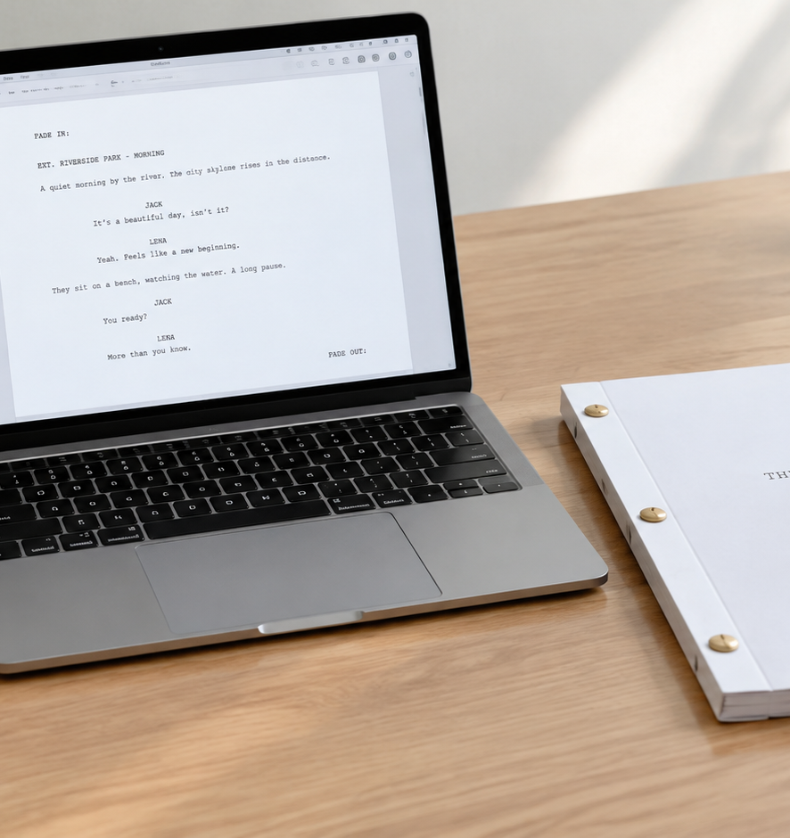
01 / 11
SCREENWRITING & PRODUCTION
Google Doc Script
Formatting Standards, Element Architecture, and Production Workflows
YIHA
Notes:
Welcome to this technical presentation on managing script workflows within Google Docs. While Google Docs was developed as a general-purpose word processor, writing teams and independent creators frequently adopt it for early drafts because of its accessible cloud collaboration and zero upfront licensing fees. However, both narrative screenplays and two-column commercial scripts demand strict layout rules to preserve timing precision and ensure physical readability. In this session, we will examine how to set up exact margin boundaries, remap native paragraph styles to keyboard shortcuts, construct clean audio-visual tables, and implement reliable export pipelines. Understanding these mechanical details enables writers to capture ideas quickly without sacrificing the formatting conventions required by production departments and studio readers.
Sources:

Slide 2
02 / 11
Screenplay Formatting Rules and Production Functions
Script formatting functions as a technical blueprint for timing, scheduling, and physical binding.
Monospaced 12-point Courier New enforces mathematical character consistency
One page of properly formatted script equates roughly to one minute of screen time
Left margin of 1.5 inches accommodates three-hole physical script binding
YIHA
Notes:
Screenplay formatting is not merely an artistic tradition. It operates as a mechanical blueprint used by production managers and assistant directors to schedule shooting days and calculate departmental budgets. As explained in the Celtx Blog guide on scriptwriting and TeraBox documentation, Courier New at 12 points is a mandatory industry standard because it is monospaced. Each letter and space occupies identical horizontal width, creating uniform density across the page. This mathematical predictability allows production teams to estimate that one formatted page corresponds roughly to one minute of screen time. Any change in font choice, size, or margin geometry disrupts this ratio and compromises production scheduling. Furthermore, TeraBox notes that physical scripts require a 1.5-inch left margin to provide room for three-hole punching and metal brads without covering text.
Sources:
https://blog.celtx.com/write-a-script-in-google-docs/
https://content.terabox.com/hub/how-to-use-and-format-a-script-template-in-google-docs

Slide 3
03 / 11
Core Document Setup: Margins, Typography, Pagination
Precise document geometry and header rules must be established before drafting begins.
01
Set left margin to 1.5 inches and top, bottom, and right margins to 1.0 inch
02
Ensure document is set to pages format to maintain header and footer visibility
03
Insert top-right page numbers and activate Different First Page setting
YIHA
Notes:
Before drafting a single line of action or dialogue, writers must establish baseline document geometry. As outlined in TeraBox's script formatting guide, authors should open Page setup and configure a 1.5-inch left margin to create an adequate binding gutter, while fixing top, bottom, and right margins at exactly 1.0 inch. Additionally, Google Docs Editors Help specifies that documents must remain in standard pages format rather than pageless mode, because pageless view disables running headers and footers. Narrative screenplay convention dictates that page numbering begins in the upper right header starting on page two. Writers achieve this layout by placing page numbers in the header, aligning them to the right margin, and checking the Different First Page option so the title page or initial script page remains unnumbered.
Sources:
https://content.terabox.com/hub/how-to-use-and-format-a-script-template-in-google-docs
https://support.google.com/docs/answer/86629

Slide 4
04 / 11
Element Architecture: Headings, Indents, and Dialogue
Google Docs ruler indents measure relative to the left margin rather than the page edge.
Scene headings and action lines align flush at 0.0 inches on the ruler
Dialogue blocks require a 1.0-inch ruler indent for standard center alignment
Character cues require a 2.2-inch ruler indent and parentheticals use 1.6 inches
YIHA
Notes:
Screenplays organize narrative information into distinct structural elements that require precise horizontal placement across the page. As highlighted in FilmDaft's illustrated guide, writers must remember that the Google Docs visual ruler measures indentation relative to the left margin rather than the absolute paper edge. Because the document left margin is already established at 1.5 inches, dialogue blocks that conventionally sit 2.5 inches from the paper edge must be set to a 1.0-inch indent on the Docs ruler. In this same configuration, parentheticals require a 1.6-inch ruler indent, while character names sit at a 2.2-inch indent. Dark Skies notes that scene headings and action descriptions sit flush against the left margin at 0.0 inches, while scene transitions should be set flush with the right margin.
Sources:
https://filmdaft.com/how-to-format-a-screenplay-in-google-docs-illustrated-guide/
https://darkskiesfilm.com/how-to-write-a-movie-script-in-google-docs/

Slide 5
05 / 11
Remapping Paragraph Styles to Shortcut Keys
Assigning custom paragraph styles to heading levels enables rapid keyboard formatting.
Update Heading 1 through 3 to store element margins, fonts, and line spacing
Apply styles rapidly during drafting using standard keyboard shortcuts
Capitalization cannot be stored natively in styles and requires manual casing
YIHA
Notes:
Manually adjusting margins for every line of dialogue or action slows writing to a crawl. The most effective native workflow in Google Docs involves remapping default paragraph styles, as documented in Google Docs Editors Help. Writers can format a sample line with the correct font, spacing, and ruler indent, and then choose Update to match for that specific style. In practice, Heading 1 can represent Scene Headings, Heading 2 can represent Character Names, and Heading 3 can represent Dialogue blocks. This setup allows authors to switch formatting on the fly with standard shortcut keys. However, TeraBox documentation highlights an important operational limitation: Google Docs paragraph styles cannot store text case rules. Consequently, authors must manually type character cues and scene headings in capital letters or run custom Apps Script routines to fix letter casing.
Sources:
https://support.google.com/docs/answer/116338
https://content.terabox.com/hub/how-to-use-and-format-a-script-template-in-google-docs

Slide 6
06 / 11
Audio-Visual and Non-Narrative Script Architectures
Commercial and documentary productions require a two-column layout built with borderless tables.
01
Visual actions and camera directions occupy the left column
02
Voiceover, dialogue, and music cues align in the parallel right column
03
Borderless tables maintain layout stability across desktop and mobile devices
YIHA
Notes:
Not every video project follows the single-column conventions of theatrical feature films. Commercial advertising, corporate presentations, and documentary videos rely on two-column Audio-Visual scripts. According to StudioBinder's production guide, an AV script cleanly separates visual elements from auditory cues, aligning on-screen graphics, b-roll, and camera movements in the left column with spoken voiceover and music cues in the right column. In Google Docs, TeraBox explains that writers can construct this layout by inserting a two-column table. Writers then navigate to Table properties and change the border width to 0pt, rendering the grid lines invisible. This borderless table technique provides a rigid spatial structure that keeps visual instructions locked beside their corresponding audio cues, preventing accidental text wrapping or margin misalignment during drafting and mobile review.
Sources:
https://www.studiobinder.com/templates/av-scripts/two-column-script-template/
https://content.terabox.com/hub/how-to-use-and-format-a-script-template-in-google-docs

Slide 7
07 / 11
Extending Functionality with Add-ons and Plaintext Syntax
Marketplace add-ons and Fountain syntax automate screenplay formatting within Google Docs.
Screenplay Formatter provides a sidebar with one-click element formatting buttons
Fountain plain-text markup separates fast drafting from visual presentation
Add-on tools handle auto-capitalization that native paragraph styles omit
YIHA
Notes:
When manual formatting becomes tedious, writers can extend Google Docs through third-party tools. As TeraBox describes, the Screenplay Formatter add-on from the Google Workspace Marketplace installs a sidebar equipped with dedicated buttons for scene headings, character cues, dialogue, and parentheticals. This add-on instantly adjusts indentations and automatically enforces the capitalization rules that native styles lack. Alternatively, FilmDaft points to the Fountain plain-text markup language, developed by John August and Stu Maschwitz. Fountain allows authors to write script content in plain text using intuitive markdown syntax on any device, and then convert that draft into a standard screenplay format using extensions like Fountainize. Both approaches bridge the functional gap between standard word processing and dedicated screenwriting applications without requiring manual ruler manipulation.
Sources:
https://filmdaft.com/how-to-format-a-screenplay-in-google-docs-illustrated-guide/
https://content.terabox.com/hub/how-to-use-and-format-a-script-template-in-google-docs

Slide 8
08 / 11
Real-Time Collaboration, Revision History, and Security
Cloud collaboration enables simultaneous writing sessions but lacks script-specific revisions.
Multiple writers can draft and leave targeted marginal comments simultaneously
Version history tracks every revision pass and supports named draft checkpoints
General revision tools lack colored production pages and scene difference logs
YIHA
Notes:
The strongest incentive for drafting in Google Docs is its cloud collaboration framework. As Dark Skies notes, writers working in teams or remote writing rooms can edit identical documents simultaneously, highlight passages to leave contextual comments, and avoid the file conflicts associated with emailing desktop drafts back and forth. Google Docs also features automatic cloud saving and a comprehensive Version history panel, allowing writers to restore earlier drafts or label named checkpoints. However, Celtx highlights an important limitation for formal film workflows: Google Docs revision tracking was designed for general prose. It cannot generate traditional production revision colors, such as blue, pink, or yellow passes, nor can it isolate scene-by-scene script modifications for department heads preparing shoot days.
Sources:
https://darkskiesfilm.com/how-to-write-a-movie-script-in-google-docs/
https://blog.celtx.com/write-a-script-in-google-docs/

Slide 9
09 / 11
Technical Tradeoffs Versus Dedicated Screenwriting Software
Platform limitations require manual maintenance of pagination splits and scene data.
01
Dialogue split tags like MORE and CONT'D must be inserted manually across page breaks
02
Mobile Docs apps do not support visual ruler tab stops, causing margin drift
03
Lack of native metadata tools prevents automatic scene numbering and breakdowns
YIHA
Notes:
While Google Docs is accessible and cost-effective, it presents notable friction when preparing scripts for actual filming. Dark Skies explains that professional screenwriting tools automatically manage dialogue crossing page breaks by appending MORE at the bottom of a page and CONTINUED at the top of the next page. In Google Docs, writers must track page breaks and insert these tags by hand. Furthermore, TeraBox reports that mobile applications on iOS and Android do not fully support visual ruler tab stops, which can cause customized character indents to collapse during mobile editing sessions. Additionally, general word processors cannot track character counts, generate production breakdown sheets, or automate scene numbering, necessitating extra manual labor during pre-production.
Sources:
https://darkskiesfilm.com/how-to-write-a-movie-script-in-google-docs/
https://content.terabox.com/hub/how-to-use-and-format-a-script-template-in-google-docs

Slide 10
10 / 11
Standard Operating Procedure for Production Delivery
A disciplined review and export pipeline prepares Google Docs drafts for production handoff.
Apply Keep with next formatting to bind character cues to dialogue blocks
Download locked PDF files to secure layout geometry and pagination integrity
Import PDFs into bridge software to generate standard Final Draft FDX files
YIHA
Notes:
To prepare a Google Docs script for cast and crew distribution, production teams must follow a disciplined delivery pipeline. As TeraBox outlines, writers should select character names and dialogue and activate Keep with next under paragraph spacing. This setting ensures character names never become stranded alone at the bottom of a page without their corresponding dialogue. Once all visual breaks are verified, writers must export the file as a PDF via File Download to lock margins and font metrics permanently in place. For formal scheduling and budgeting handoffs, Celtx explains that production departments usually require Final Draft FDX files. Because Google Docs cannot natively export to FDX format, teams must run the locked PDF through intermediary bridge software to produce scheduling files.
Sources:
https://content.terabox.com/hub/how-to-use-and-format-a-script-template-in-google-docs
https://blog.celtx.com/write-a-script-in-google-docs/

Slide 11
11 / 11
Summary and Best Practices for Script Management
Google Docs serves early collaborative drafting when technical boundaries are respected.
Establish exact Courier New typography, margin geometry, and ruler indents early
Use borderless tables for AV formats and shortcut-mapped styles for screenplays
Migrate mature drafts to specialized production software before shooting begins
YIHA
Notes:
To conclude, Google Docs offers a collaborative and cost-effective platform for screenwriters and media production teams during early creative development. By configuring 12-point Courier New, setting accurate 1.5-inch left margins, and remapping heading styles, writers can produce clean narrative drafts that adhere to industry reading expectations. Similarly, two-column borderless tables provide an effective layout for corporate and commercial AV workflows. However, as documented by both Celtx and TeraBox, writers should recognize the limitations of general word processors regarding dialogue pagination, mobile tab stop instability, and the lack of native FDX export capabilities. Treating Google Docs as a collaborative drafting tool while migrating mature drafts to dedicated software ensures that production teams maintain both creative agility and operational rigor.
Sources:
https://blog.celtx.com/write-a-script-in-google-docs/
https://content.terabox.com/hub/how-to-use-and-format-a-script-template-in-google-docs

