Slide 1
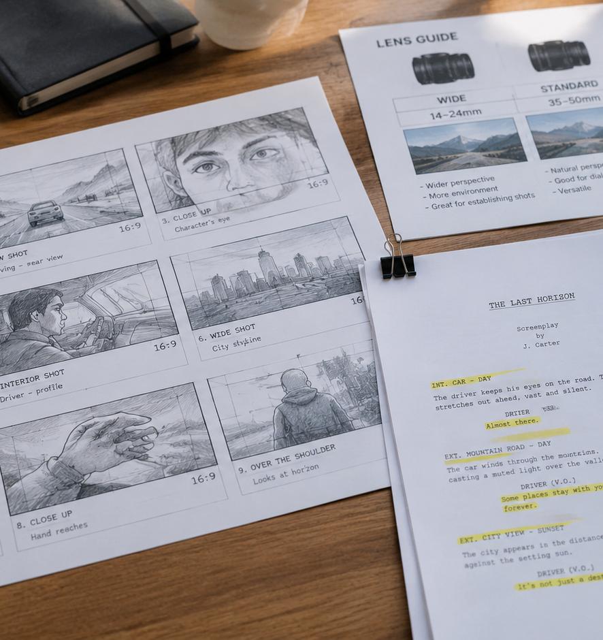
01 / 11
FILMMAKING
How To Write A Storyboard For A Short Film
Pre-Production Visualization, Staging, and Crew Communication
YIHA
Notes:
Welcome to this comprehensive presentation on how to write an effective storyboard for a short film. Pre-production on an independent short film is frequently defined by tight schedules, limited budgets, and compact production crews. Under these conditions, a storyboard functions as a crucial technical blueprint rather than an artistic portfolio piece. It enables the director, cinematographer, assistant director, and editing team to visualize the finished production before principal photography begins. In this session, we will examine how to deconstruct your screenplay, prioritize complex sequences, establish reliable frame geometry, annotate technical camera cues, and evaluate narrative pacing using animatics. By building a disciplined pre-visualization workflow, filmmakers can avoid costly mistakes on set and ensure that every production department remains unified around a clear visual plan. Let us begin by exploring how to triage a screenplay during pre-production breakdown.
Sources:

Slide 2
02 / 11
Script Breakdown and Prioritizing Scenes
Break down the screenplay into narrative beats to identify high priority sequences before drawing individual frames.
Deconstruct screenplay text into manageable narrative beats
Prioritize complex blocking and visual effects over simple setups
Example: outline two or three key beats per scene before boarding
YIHA
Notes:
Every successful storyboard process starts with an organized script breakdown. As detailed in the pre-production tutorial on Garden of Edits, learning to create a storyboard is about crafting a project roadmap. Directors must break down screenplays into manageable narrative chunks, isolating the pivotal scenes and emotional turns that propel the story forward. Scriptly highlights that filmmakers should break the outline into individual shots and define what the audience needs to witness during each dramatic beat. Rather than exhausting resources trying to draw every standard conversation, directors should triage their script. Standard dialogue scenes between two seated characters can be planned quickly on a shot list. Conversely, sequences involving multi-actor blocking, stunts, camera moves, and visual effects require full panel drawings. Identifying these high-priority setups early ensures that storyboard preparation directly protects the production budget and shooting schedule.
Sources:
https://www.gardenofedits.com/a-guide-on-how-to-create-a-storyboard-for-your-short-film/
https://scriptlyai.app/blog/storyboard-template-short-film

Slide 3
03 / 11
Translating Dramatic Beats to Visual Coverage
Frame choices must mirror character psychology and narrative turning points rather than arbitrary aesthetics.
01
Identify visual beats where character emotion or status shifts
02
Use economy shots like expressive two-shots for double duty
03
Recommendation: budget 15 to 25 panels for very short runtimes
YIHA
Notes:
Framing and visual progression must always mirror dramatic beats and character psychology. As explained by Story2Board in their guide for short films, a visual beat occurs whenever something changes on screen, such as a character entrance, an emotional shift, or a sudden revelation. Short films require specific strategies like the economy shot, where a single camera setup such as an expressive two-shot fulfills both establishing context and dialogue coverage. Story2Board also highlights motivated cuts, meaning transitions should be driven by an actor gaze, a physical movement, or a sound trigger. StoryBirdie emphasizes that shot size serves as the most important creative choice because it controls emotional distance. Wide shots establish setting and detachment, while close-ups bring the audience into direct emotional intimacy with the actor. Framing must always stem from story intent rather than decorative camera choices.
Sources:
https://story2board.com/how-to-storyboard/short-film
https://storybirdie.com/blog/how-to-storyboard-a-short-film-step-by-step

Slide 4
04 / 11
Standardizing Frame Geometry and Aspect Ratios
Set storyboard panels in your project aspect ratio to maintain accurate composition and annotation space.
Lock frame geometry to intended formats such as 16:9 widescreen
Use 2.39:1 for wide scope or 9:16 for vertical screen projects
Recommendation: format 3 to 6 frames per page for clear note space
YIHA
Notes:
Maintaining frame geometry from the first sketch is critical for production accuracy. StudioBinder stresses locking panels into the intended project aspect ratio, with 16:9 widescreen serving as the standard across modern monitors and streaming formats. The CREA Journal filmmaking guide notes that alternative ratios, such as 2.39:1 scope for wide cinema or 9:16 for vertical platforms, demand dedicated frame templates from the start. Both StudioBinder and Scriptly recommend placing three to six panels on each storyboard page. Including more than six frames per sheet squeezes note space until essential camera and lighting directions become unreadable. Conversely, placing fewer than three frames consumes excessive paper without improving communication. Establishing uniform rectangular proportions guarantees that headroom, lateral margins, and compositional framing translate cleanly to the camera sensor when your crew sets up on location.
Sources:
https://www.studiobinder.com/templates/storyboards/16x9-storyboard-template/
https://crea.website/en/journal/how-to-write-a-storyboard

Slide 5
05 / 11
Blocking, Composition, and Graphic Staging
Clear geometric sketches and spatial relationships communicate scene blocking without requiring drawing mastery.
Utilize stick figures, boxes, and basic shapes for actor positions
Establish depth planes across foreground, midground, and background
Example: divide composition into three distinct depth planes
YIHA
Notes:
Many emerging directors avoid storyboarding because they believe they lack traditional illustration talent. However, StoryBirdie notes that simple stick figures, circular heads, and basic geometric forms communicate blocking effectively, citing Steven Spielberg rough drawings for Jaws as proof. The production crew only needs to understand three primary facts: what elements appear in the frame, where the camera sits, and how the composition is arranged. Scriptly reinforces that simple shapes communicate actor blocking and eyelines because a template is a planning tool rather than an artistic showcase. Garden of Edits points out that employing classic composition methods such as the rule of thirds and layered depth planes helps establish spatial relationships before setting up lights. Focusing on functional graphic staging ensures that the entire crew understands character placement and perspective without requiring finished artwork.
Sources:
https://storybirdie.com/blog/how-to-storyboard-a-short-film-step-by-step
https://scriptlyai.app/blog/storyboard-template-short-film

Slide 6
06 / 11
Camera Movement Notations and Directional Arrows
Apply standard arrow conventions to distinguish actor movement from dynamic camera positioning.
01
Place camera move indicators on or outside the panel border
02
Draw actor and object trajectories entirely inside the frame
03
Example: red arrows for camera shifts and blue arrows for actors
YIHA
Notes:
Conveying movement within static illustrations requires consistent visual notations. The CREA Journal guide outlines a strict framework for directional indicators: camera moves belong on or outside the frame borders, while actor movements and object actions belong inside the drawing. For instance, a camera push-in is indicated by sketching a smaller inner rectangle where the shot terminates. A camera pan uses an arrow along the outer frame border, while a lens zoom employs small diagonal corner arrows pointing inward or outward. Boords emphasizes using arrows to clarify actor walking paths and camera angles so anyone viewing the board understands the scene instantly. CREA Journal also recommends adopting a two-color convention, such as red for camera motion and blue for character movement, to eliminate confusion between actor blocking and camera movement on set.
Sources:
https://crea.website/en/journal/how-to-write-a-storyboard
https://boords.com/how-to-storyboard/short-film

Slide 7
07 / 11
Panel Annotations, Dialogue Cues, and Audio
Pair each visual panel with structured text fields detailing shot size, motion, dialogue, and audio notes.
Recommendation: maintain 4 core fields for shot metadata
Include dialogue snippets, sound triggers, and match-cut cues
Keep notes concise so crew members can scan pages instantly
YIHA
Notes:
A visual panel only delivers half the necessary production data. The accompanying written notes supply the technical blueprint. StoryboardArt outlines four foundational fields that belong beneath every panel: shot number, shot size abbreviation, camera move description, and a single present-tense action line. The guide cautions filmmakers to include only text that earns its place, keeping descriptions concise so crew members can scan pages effortlessly. Transitions such as match cuts or dissolves should be named explicitly in the notes area. CinemaDrop notes that adding dialogue snippets and sound cues directly beneath shots clarifies narrative pacing and dramatic intent. Standardizing this metadata layout across every production sheet ensures that the cinematographer, assistant director, and sound recordist can instantly extract the specific technical details required to execute each shot on location.
Sources:
https://storyboardart.org/storyboard-tutorials/how-to-make-storyboard-short-film/
https://www.cinemadrop.com/storyboard-template-for-short-film

Slide 8
08 / 11
Balancing Storyboards Against Shot Lists
Combine visual storyboards for complex staging with structured shot lists for efficient shooting orders.
Use storyboards to solve spatial relationships and staging
Use shot lists to organize setups into efficient shooting orders
Example: take phone photos on scout visits to verify space
YIHA
Notes:
Filmmakers must understand the operational distinctions between storyboards and shot lists. As explained in the CREA Journal guide, a storyboard presents an illustrated narrative sequence, whereas a shot list is a tabulated sheet sorted into shooting order grouped by camera direction. CREA Journal recommends combining both approaches: draw storyboards for scenes that defy simple verbal description, and transfer straightforward setups directly to a structured shot list. When sketching by hand feels too slow, CREA Journal suggests creating photo-boards by posing collaborators on location and shooting reference frames with a mobile phone. This scouting exercise quickly confirms whether the real room accommodates your desired camera positions and focal lengths. Garden of Edits reinforces that your storyboard should guide your logistical shot list, helping the production remain organized while adapting to physical constraints.
Sources:
https://crea.website/en/journal/how-to-write-a-storyboard
https://www.gardenofedits.com/a-guide-on-how-to-create-a-storyboard-for-your-short-film/

Slide 9
09 / 11
Testing Timing and Scene Rhythm with Animatics
Assemble static panels into timed animatics with scratch audio to diagnose narrative drag before filming.
01
Place numbered panels on an editing timeline to test duration
02
Add scratch audio and temp dialogue to audition scene pacing
03
Example: test 2 to 4 second panel holds against rough audio
YIHA
Notes:
Static frames cannot demonstrate temporal rhythm on their own. StoryboardArt recommends assembling a rough animatic by placing numbered storyboard panels onto a basic video editing timeline. Assigning an estimated duration to each frame and pairing visuals with scratch audio or temp dialogue allows filmmakers to audition dramatic pacing before filming. This exercise reveals whether comedic beats hold enough pause, whether action sequences flow logically, or whether suspense scenes drag. CinemaDrop highlights that testing dialogue beats and audio cues against visual panels helps creators identify missing coverage and narrative bottlenecks early. Discovering structural flaws or pacing issues during animatic testing saves valuable production time, allowing the director to solve editorial problems during pre-production when revisions cost nothing rather than during principal photography or post-production.
Sources:
https://storyboardart.org/storyboard-tutorials/how-to-make-storyboard-short-film/
https://www.cinemadrop.com/storyboard-template-for-short-film

Slide 10
10 / 11
Crew Distribution, Version Control, and Set Use
Implement strict versioning rules and distribute clean PDF exports to keep all departments aligned on set.
Establish standardized file names such as Film_Scene02_Shot05_v01
Example: label inserted panels between shots 12 and 13 as shot 12A
Export clear PDF packets for the director, DP, AD, and editor
YIHA
Notes:
Maintaining version control across production departments prevents costly miscommunication on set. StoryboardArt outlines a critical rule for pre-production management: never renumber existing shots during revisions. If an additional shot is inserted between shots twelve and thirteen, label the newcomer 12A rather than shifting subsequent shot numbers. Establishing a standardized file naming structure before starting protects project organization across revisions. StudioBinder emphasizes exporting completed boards as fixed PDF documents so that files cannot be altered accidentally. These PDF packets can be shared with department heads, enabling the assistant director to schedule setup times, the cinematographer to prepare lighting packages, and the editor to organize scene assembly. Having consistent, clearly labeled storyboard packets guarantees that all crew members work from identical creative blueprints during filming.
Sources:
https://storyboardart.org/storyboard-tutorials/how-to-make-storyboard-short-film/
https://www.studiobinder.com/guides/storyboards/how-to-create-a-storyboard-for-a-short-film/

Slide 11
11 / 11
Executing a Cohesive Pre-Production Blueprint
A disciplined storyboard bridges creative vision and set logistics, giving crews the confidence to execute cleanly.
Triage high-priority scenes to conserve pre-production energy
Rely on standard aspect ratios, clear arrows, and concise notes
Recommendation: review boards across 2 to 3 production departments
YIHA
Notes:
In summary, writing a storyboard for a short film is a practical engineering exercise that connects artistic vision with set logistics. By analyzing the screenplay, prioritizing complex staging, standardizing frame geometry, and adopting clear motion arrows, filmmakers provide their crew with an unambiguous guide. Testing pacing through animatics and enforcing disciplined version control protects both the production budget and shooting schedule. As Garden of Edits reminds directors, the storyboard is a living document meant to evolve across pre-production and filming. StoryboardArt reinforces that storyboarding demonstrates the ability to think like a director by solving visual problems before stepping onto set. When approached with intentionality, storyboarding transforms an abstract script into an organized, confident production experience that helps filmmakers tell compelling visual stories.
Sources:
https://www.gardenofedits.com/a-guide-on-how-to-create-a-storyboard-for-your-short-film/
https://storyboardart.org/storyboard-tutorials/how-to-make-storyboard-short-film/

