Slide 1
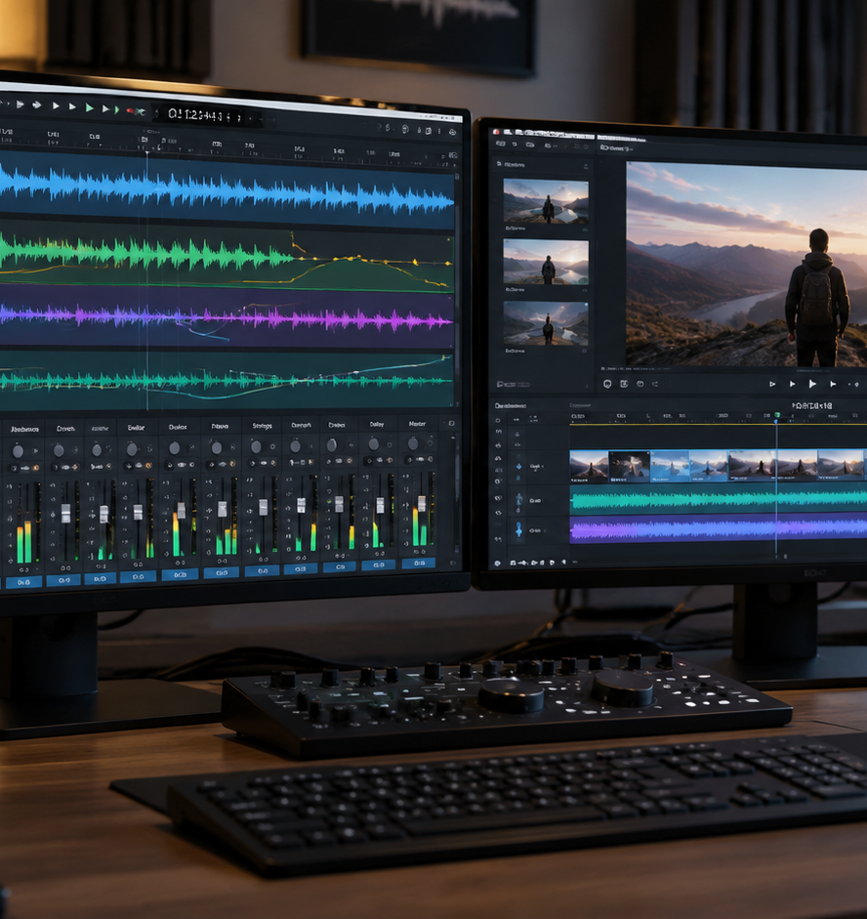
01 / 11
VIDEO PRODUCTION
Video Presentation Sound Effects
Auditory Architecture, Cognitive Load, and Timeline Synchronization
YIHA
Notes:
Welcome to this guide on video presentation sound effects. In recorded video presentations, audio elements must function as deliberate structural cues rather than decorative additions. Throughout this slide deck, we evaluate how sound design connects with viewer comprehension, pre-production planning, and post-production mixing. Drawing on research regarding cognitive load and professional timeline editing workflows, we explore how to layer audio effects, manage volume envelopes, and align audio transients with visual motion. By establishing consistent standards during pre-production and adhering to disciplined gain staging, authors can ensure their presentation audio remains clear and effective across various viewing devices. This session outlines the core technical workflows required to build and verify a professional presentation soundscape.
Sources:

Slide 2
02 / 11
Cognitive Function and Auditory Attention
Audio cues must reduce extraneous load and assist germane processing during video delivery.
2021 study: online student survey analyzed extraneous and germane load (n = 2012)
Extraneous cognitive load represents information processing that does not contribute to learning
Recommendation: use auditory cues strictly to orient attention toward primary visual content
YIHA
Notes:
When introducing sound effects into video presentations, authors must evaluate the cognitive demands placed on the audience. Research by Costley and colleagues published in the Journal of Computing in Higher Education (April 2021) and indexed in ERIC under EJ1289628 investigated cognitive load among 2,012 university students participating in online courses in South Korea. The authors defined extraneous load as mental processing that does not support learning, while germane load represents processing that actively contributes to understanding. Their analysis revealed that viewing strategies mediated the relationship between these loads, converting a large negative relationship into a small positive relationship. For presentation authors, this finding demonstrates that uncoordinated or decorative audio adds extraneous processing, whereas purposeful auditory cues help viewers navigate instructional material without distraction.
Sources:
https://eric.ed.gov/?id=EJ1289628

Slide 3
03 / 11
Functional Categories of Presentation Audio
Grouping sound effects by functional purpose maintains narrative consistency across the presentation.
01
Audio effects stack tools allow non-destructive layering of sound clips
02
Subtle acoustic accents can highlight key visual transitions and data reveals
03
Recommendation: avoid distracting acoustic modifications that confuse the audience
YIHA
Notes:
To build an effective presentation soundscape, creators must organize audio cues by functional role. Technical documentation from Storyboard Pro 20 Online Help explains how sound effects can be layered onto audio clips using an Effect Stack view. In a video presentation, sound clips generally serve distinct structural purposes, including transitional cues between major topics, subtle accents for data reveals, and interface feedback for demonstrations. The software documentation notes that while tools like Delay or Pitch Shift can alter clips to simulate echoes or cartoon voices, presentation designers should apply audio effects with purpose. Establishing clear functional categories ensures that every sound effect on the timeline reinforces the narrative structure rather than appearing as an arbitrary novelty.
Sources:
https://docs.toonboom.com/help/storyboard-pro-20/storyboard/sound/add-effect.html

Slide 4
04 / 11
Storyboard Sound Cues and Pre-Production
Planning audio cues during storyboarding coordinates visual pacing with sound placement.
Map sound clips beneath visual storyboard panels before final editing begins
Recommendation: prepare a cue sheet with shot numbers and parameter targets
Non-destructive editing allows parameter adjustment without altering source audio files
YIHA
Notes:
Effective audio design begins during pre-production rather than at the final editing stage. As detailed in Storyboard Pro 25 Online Help, production software enables editors to place and adjust sound clips directly alongside visual panels. By building an audio cue sheet during the storyboard phase, creators can log panel numbers, visual actions, sound asset names, and anticipated volume levels. Storyboard Pro 25 Online Help notes that effects applied to audio clips operate non-destructively, allowing editors to modify parameters or remove effects without permanently changing original audio files. Early planning prevents conflicts where sudden sound transients overlap with critical speech, ensuring that animators create sufficient visual space for necessary acoustic cues.
Sources:
https://docs.toonboom.com/help/storyboard-pro-25/storyboard/Effects/sound-effects.html

Slide 5
05 / 11
Context, Tone, and Acoustic Restraint
Professional presentations require restrained sound choices to preserve credibility.
Stylized effects like pitch shifting or heavy delays can undermine serious subject matter
Recommendation: reserve auditory accents for primary structural transitions
Disable unnecessary effects in the stack to maintain clean acoustic delivery
YIHA
Notes:
Professional video presentations demand careful acoustic restraint. Documentation from Storyboard Pro 20 Online Help highlights that extreme audio processing, such as pitch shifting to produce cartoon voices or delay effects to create echoing chasms, serves specific narrative or comedic goals. In corporate or instructional video presentations, such overt modifications distract audiences and degrade professional credibility. Instead, authors should select understated, natural acoustic textures. Storyboard Pro 20 Online Help demonstrates that editors can selectively disable or delete individual effects within the Effect Stack view to fine-tune the listening experience. By reserving audio accents for major structural milestones and disabling redundant effects, presenters keep the audience focused on the core message.
Sources:
https://docs.toonboom.com/help/storyboard-pro-20/storyboard/sound/add-effect.html

Slide 6
06 / 11
Gain Staging and Voice Intelligibility
Balancing volume parameters prevents secondary sound effects from masking spoken dialogue.
01
Effect Stack view provides direct control over Gain and Volume Envelope parameters
02
Keyframe interpolation allows smooth volume transitions between defined points
03
Recommendation: attenuate sound effects so spoken voiceover remains prominent
YIHA
Notes:
Spoken voiceover conveys the core information in a video presentation, so it must remain intelligible at all times. In Storyboard Pro 25 Online Help, the documentation explains that default audio controls include Gain and Volume Envelope settings within the Effect Stack view. Editors can insert keyframes along the timeline to interpolate volume values smoothly between specific points. In practical mixing workflows, presentation designers must set voiceover as the primary acoustic element while keeping sound effects on secondary tracks with reduced gain. When sound effects coincide with narration, lowering the volume envelope of the effect prevents auditory masking. Storyboard Pro 25 Online Help also highlights that real-time playback and timeline scrubbing allow editors to test these volume relationships directly.
Sources:
https://docs.toonboom.com/help/storyboard-pro-25/storyboard/Effects/sound-effects.html

Slide 7
07 / 11
Frame-Accurate Timeline Synchronization
Aligning sound keyframes with visual motion eliminates perceptual lag and reinforces impact.
Scrubbing through the timeline enables precise alignment between audio and picture
Repositioning the playhead and adjusting parameter values generates keyframes automatically
Interpolation between keyframes ensures smooth acoustic shifts across playback
YIHA
Notes:
Synchronizing audio cues with visual animation requires precise frame alignment. According to Storyboard Pro 24 Online Help, editors can scrub the playhead across both the Timeline view and the Effect Stack view to evaluate temporal placement. The software documentation explains that setting an initial keyframe and then advancing the playhead to enter a new numerical parameter creates a second keyframe automatically. During playback, the software interpolates smoothly between these keyframe values. For video presentations, sound designers must ensure that the onset of an audio cue aligns exactly with the visual arrival or transition of an on-screen graphic. Scrubbing the timeline allows editors to identify discrepancies and adjust keyframes before final rendering.
Sources:
https://docs.toonboom.com/help/storyboard-pro-24/storyboard/sound/keyframe-effects.html

Slide 8
08 / 11
Asset Documentation and Licensing Governance
Maintaining systematic source documentation protects presentations against legal disputes.
Academic research catalogs source metadata, identifiers, and institutional affiliations
Recommendation: track commercial synchronization rights for every library sound asset
Systematic asset logging prevents copyright conflicts and unauthorized distribution
YIHA
Notes:
Sound design requires thorough governance to ensure legal compliance. Just as scholarly research cataloged in ERIC under document EJ1289628 records detailed bibliographical metadata, publisher information, and institutional affiliations, commercial presentation projects must record precise licensing details for all audio assets. Organizations using sound effect libraries must confirm that commercial synchronization rights permit the intended distribution channels, including web streaming, social platforms, and corporate communications. Maintaining a centralized log of audio asset filenames, license agreements, and allowed usage parameters prevents copyright infringement and avoids unexpected takedown notices. Verifying licensing terms prior to project sign-off ensures that presentation assets remain legally compliant throughout their lifecycle.
Sources:
https://eric.ed.gov/?id=EJ1289628

Slide 9
09 / 11
Playback Environments and Audio Translation
Auditioning audio across diverse devices ensures intelligibility on all listening setups.
01
Non-destructive effect parameters allow ongoing adjustments across different playback tools
02
Compact laptop and phone speakers alter audio reproduction compared to studio monitors
03
Recommendation: test presentation audio on multiple speaker systems before delivery
YIHA
Notes:
Video presentations are played across many environments, from mobile phones and laptops to conference rooms. Technical guidelines in Storyboard Pro 20 Online Help show that sound clip parameters can be adjusted and auditioned repeatedly using non-destructive controls. Because built-in laptop and mobile speakers have limited physical drivers, they cannot reproduce full acoustic ranges and may distort if pushed too hard. Presentation editors must avoid relying solely on professional studio monitors or high-end headphones when balancing audio. Testing playback across typical target devices allows creators to identify harsh frequencies or buried audio cues. Non-destructive effect editing ensures that parameters can be adjusted iteratively until the mix translates cleanly across all intended hardware.
Sources:
https://docs.toonboom.com/help/storyboard-pro-20/storyboard/sound/add-effect.html

Slide 10
10 / 11
Quality Review Protocols and Listener Fatigue
Structured review procedures and listening breaks protect against perceptual fatigue.
2021 research demonstrates that deliberate viewing strategies actively regulate cognitive load
Prolonged editing sessions induce auditory fatigue and reduce sensitivity to volume balance
Recommendation: conduct low volume audits to verify narration intelligibility
YIHA
Notes:
Establishing a structured quality review protocol is essential before exporting the final presentation master. Research published in the Journal of Computing in Higher Education (ERIC EJ1289628) demonstrated that specific viewing strategies mediated cognitive processing, proving that deliberate review structures directly affect comprehension. Similarly, sound designers must counter listener fatigue during post-production. Extended exposure to repetitive audio transients desensitizes human hearing, making it difficult to detect volume imbalances or abrasive peaks. Editorial teams should take scheduled listening breaks and perform a low-volume playback check. Auditioning the mix at low volume reveals whether spoken dialogue remains distinct over background sound effects, guaranteeing a polished final presentation.
Sources:
https://eric.ed.gov/?id=EJ1289628

Slide 11
11 / 11
Core Principles of Presentation Sound Design
Disciplined sound design combines cognitive alignment with systematic timeline editing.
Align acoustic cues with visual changes to support germane cognitive processing
Utilize keyframe interpolation and volume envelopes to protect dialogue clarity
Audit sound mixes across multiple playback environments before final handoff
YIHA
Notes:
In conclusion, effective sound design in video presentations is defined by intentional planning, cognitive alignment, and technical control. Evidence from the 2021 study in the Journal of Computing in Higher Education, cataloged in ERIC under EJ1289628, demonstrates that managing extraneous cognitive load is vital for instructional effectiveness. By incorporating audio cues into early storyboards, applying non-destructive effects, and using keyframe automation for gain staging, creators can elevate visual presentations without overwhelming the audience. Ensuring that every sound effect serves a distinct purpose, adheres to commercial licensing standards, and translates across diverse consumer devices guarantees a professional result. A disciplined audio workflow ultimately strengthens visual messaging and audience engagement.
Sources:
https://eric.ed.gov/?id=EJ1289628

