Slide 1
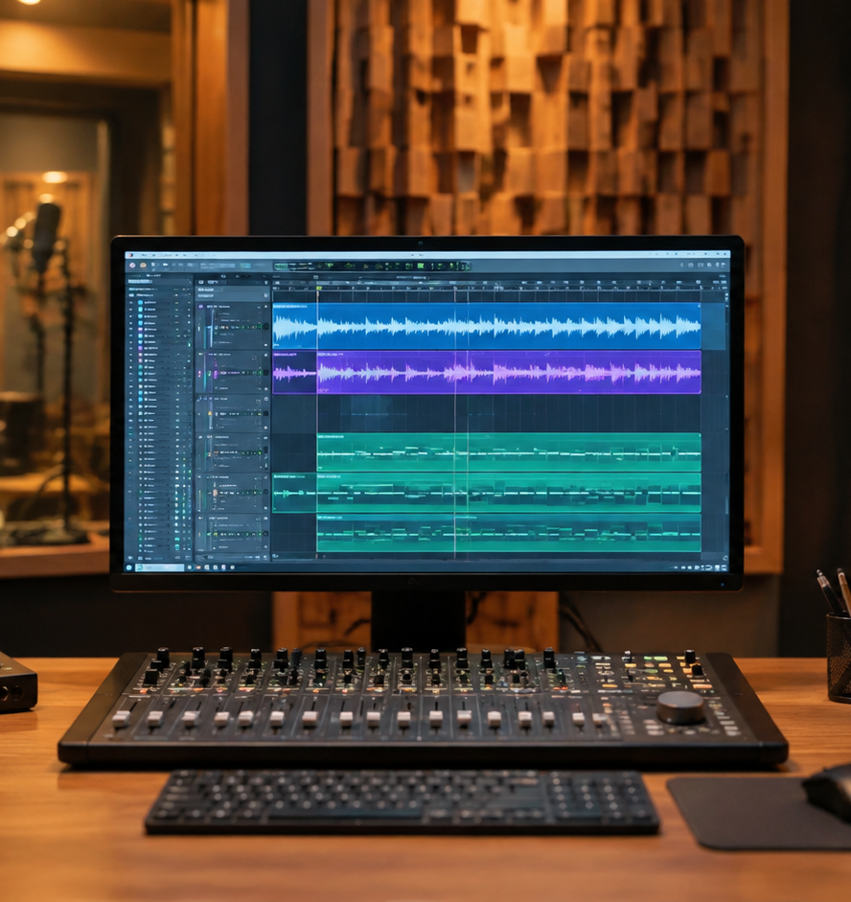
01 / 11
VIDEO PRODUCTION
YouTube Presentation Background Music
Audio Engineering, Cognitive Load Management, and Platform Standards
YIHA
Notes:
Welcome everyone to this session on selecting and mixing background music for YouTube video presentations. While background music can create a welcoming atmosphere and eliminate awkward pauses in asynchronous video, improper mixing frequently degrades speech clarity and taxes audience attention. Today, we will examine the scientific principles of auditory perception, cognitive load, and vocal intelligibility to establish a professional audio workflow. We will explore how background sounds interact with working memory, why instrumental tracks are essential to prevent informational masking, and how audio engineering techniques like frequency carving and dynamic ducking protect the presenter voice. Furthermore, we will review streaming loudness benchmarks and YouTube copyright policies to ensure your presentation videos remain compliant and effective across all playback devices.
Sources:

Slide 2
02 / 11
Purpose and Function of Presentation Audio
Background audio establishes pacing and texture but must never overpower the speaker voice.
Smooths unnatural room silence between spoken presentation phrases
Different acoustic backgrounds alter memory recall and heart rates
Joyful music and rain noise create cognitive interference relative to silence
YIHA
Notes:
In digital video presentations, background audio helps smooth transitions between spoken sentences and prevents total dead air during natural pauses. However, research demonstrates that ambient audio directly alters cognitive encoding and autonomic arousal. In an empirical study on background music and episodic memory published in PMC4606564, researchers tested 54 participants across conditions of silence, rain sounds, joyful music, and emotionally touching music. The results indicated that while emotionally touching music and silence supported higher recognition accuracy and faster reaction times, joyful music and continuous rain noise significantly impaired memory performance. Furthermore, music listening elicited faster heart rates compared to silence. This evidence proves that background sound is not neutral background filler. Presenters must recognize that musical accompaniment acts as an active sensory signal that directly influences viewer attention, memory formation, and physiological engagement during recorded presentations.
Sources:
https://pmc.ncbi.nlm.nih.gov:443/articles/PMC4606564/

Slide 3
03 / 11
Cognitive Load and Seductive Detail Risks
Irrelevant auditory inputs compete for finite working memory resources during instruction.
01
Kahneman capacity model shows competing tasks degrade overall performance
02
Irrelevant auditory inputs introduce persistent negative effects on verbal memory
03
Complex conceptual slides benefit from silence to protect comprehension
YIHA
Notes:
When designing instructional presentations, we must consider how auditory inputs impact cognitive load. According to Kahneman's capacity model cited in PMC4606564, human cognitive processing relies on a finite pool of mental resources. When simultaneous tasks compete for these resources and combined demands exceed capacity, performance deteriorates. Meta-analytic findings cited in the study show that background music causes small but persistent negative effects on memory tasks, including memorizing words, comprehending complex texts, multimedia learning, and numerical analysis. Furthermore, research by Reaves and colleagues noted in the literature showed that older adults recalled 10 percent fewer items when background music was playing compared to silence. When a presentation slide delivers intricate diagrams, dense tables, or abstract arguments, adding background music introduces extraneous cognitive processing. Presenters should reserve total silence for conceptually demanding slides to prevent overloading audience working memory.
Sources:
https://pmc.ncbi.nlm.nih.gov:443/articles/PMC4606564/

Slide 4
04 / 11
Speech Masking and Cortical Audio Tracking
Vocal tracks create informational masking that disrupts neural tracking of spoken narration.
Cortical tracking of speech envelopes is hindered by background music
Vocal tracks cause informational masking that competes with spoken narration
Pure instrumental beds reduce linguistic interference during speech perception
YIHA
Notes:
Speech perception in multimedia environments depends on the brain ability to isolate target narration from background sounds. In neurobiological research published in PMC9599198, researchers examined speech comprehension and cortical tracking of speech envelopes using temporal response functions around 100 milliseconds. Participants listened to an audiobook at a 0 dB signal-to-noise ratio alongside silence, instrumental music, or songs with lyrics. The study revealed that speech comprehension was significantly impaired during background music compared to silence, and neural tracking of the speech envelope was severely disrupted when vocal tracks were present. Vocal music creates informational masking because lyric processing competes directly for linguistic cognitive resources. In contrast, isolated instrumental music reduced this linguistic conflict. For video presentations, creators must strictly avoid background tracks containing vocals, spoken samples, or prominent vocal chops. Pure instrumental music ensures that cortical auditory tracking remains focused entirely on the presenter spoken narration.
Sources:
https://pmc.ncbi.nlm.nih.gov/articles/PMC9599198/

Slide 5
05 / 11
Acoustic and Arrangement Criteria for Audio Beds
Predictable loops, moderate tempos, and sparse arrangements protect viewer focus.
Recommendation: Maintain steady musical tempos between 80 and 110 BPM
Tonal stability in simple keys minimizes cognitive distraction for listeners
Sparse arrangements using soft pads leave adequate space for narration
YIHA
Notes:
Selecting the right instrumental track requires careful evaluation of compositional structure and arrangement density. Research on auditory stream segregation in PMC9599198 indicates that familiar and predictable musical structures allow listeners to allocate fewer attentional resources to background music, making it easier to track concurrent speech. As a practical recommendation, presenters should choose instrumental beds with steady tempos between 80 and 110 beats per minute, which maintain energy without sounding frantic. Tonal stability in simple major or natural minor keys helps prevent unexpected harmonic shifts that distract listeners. We recommend sparse arrangements centered on sustained warm pads, muted electric pianos, or subtle ambient textures. An illustrative example is an eight-bar repetitive progression that establishes a subtle foundation while avoiding virtuosic soloing. Predictable, uncluttered arrangements allow the audience brain to filter out the music effortlessly, dedicating maximum cognitive bandwidth to the presentation content.
Sources:
https://pmc.ncbi.nlm.nih.gov:443/articles/PMC9599198/

Slide 6
06 / 11
Frequency Carving and Dynamic Ducking Techniques
Targeted equalization cuts and automated sidechain ducking clear acoustic space for vocals.
01
Recommendation: Carve cuts of 2 to 4 dB between 1 kHz and 3.5 kHz on music
02
Recommendation: Duck music beds by 4 to 6 dB during active spoken narration
03
Recommendation: Set attack times of 20 to 50 ms and release times of 250 to 500 ms
YIHA
Notes:
Even well-arranged instrumental tracks can conflict with the frequency range of human speech. Research in PMC9599198 highlights that concurrent auditory streams competing at equal sound levels cause substantial perceptual interference, underscoring the need for clear acoustic separation. Analysis shows that the critical window for vocal intelligibility lies between 1 kHz and 4 kHz, where consonant articulation resides. As an engineering recommendation, apply a parametric equalizer to carve a 2 dB to 4 dB cut across 1 kHz to 3.5 kHz on the music bus. Furthermore, implement sidechain ducking keyed directly to the narration channel. As a technical recommendation, set the sidechain compressor to lower the music bed by 4 dB to 6 dB whenever the presenter speaks, utilizing a fast attack time of 20 to 50 milliseconds and a smooth release of 250 to 500 milliseconds. This ensures narration stays clear while music fills natural speaking pauses.
Sources:
https://pmc.ncbi.nlm.nih.gov/articles/PMC9599198/

Slide 7
07 / 11
Loudness Standards and YouTube Normalization
Balancing music well below dialogue prevents algorithmic normalization penalties.
Recommendation: Target YouTube loudness benchmark of -14 LUFS integrated
Recommendation: Maintain a true peak ceiling of -1.0 dBTP to avoid clipping
Recommendation: Balance background music 18 to 24 dB below vocal peaks
YIHA
Notes:
Proper loudness calibration is essential to deliver professional audio across streaming platforms. In laboratory psychoacoustic research described in PMC4606564, researchers controlled experimental auditory stimuli by matching their intensity to 89.0 dB using MP3Gain software, illustrating the necessity of objective volume standardization. For digital video distribution on YouTube, analysis shows that automated volume normalization evaluates integrated loudness across the entire video. As an operational recommendation, creators should master presentation audio to YouTube target benchmark of -14 LUFS integrated, maintaining a true peak safety ceiling of -1.0 dBTP to avoid digital clipping and downstream processing penalties. To preserve vocal clarity, we recommend balancing background music 18 dB to 24 dB below the peak level of the vocal track. For example, if narration measures -16 LUFS, keeping the music bed between -34 LUFS and -40 LUFS ensures the speaker remains commanding while preventing automatic loudness attenuation by platform algorithms.
Sources:
https://pmc.ncbi.nlm.nih.gov/articles/PMC4606564/

Slide 8
08 / 11
Copyright Compliance and YouTube Content ID
Automated Content ID systems flag unauthorized audio, requiring verified safe licensing.
YouTube Audio Library provides copyright-safe music immune to Content ID claims
Creative Commons tracks require full attribution in video descriptions
Standard YouTube Audio Library licenses permit use without attribution
YIHA
Notes:
Navigating copyright compliance is critical when publishing presentations on YouTube. Uploading unauthorized commercial music exposes channels to Content ID fingerprinting, resulting in automated monetization claims, audio muting, or copyright strikes. According to official guidelines from the YouTube Help Center at support.google.com/youtube/answer/3376882, music and sound effects downloaded from the YouTube Studio Audio Library are copyright-safe and will not receive claims through the Content ID system. The documentation specifies that creators can monetize eligible videos using Audio Library assets. When using tracks licensed under Creative Commons, creators are required to include the designated artist attribution in the video description. Conversely, tracks with standard YouTube Audio Library licenses require no attribution. Sourcing audio directly from verified libraries protects your channel from sudden copyright disputes, ensuring that corporate webinars, tutorials, and academic presentations remain accessible without interruption or loss of monetization.
Sources:
https://support.google.com/youtube/answer/3376882

Slide 9
09 / 11
Structural Audio Pacing Across Presentation Slides
Deploying audio selectively highlights key milestones and reserves silence for complex data.
01
Recommendation: Use brief 3 to 5 second audio cues to mark chapter shifts
02
Silence provides an optimal baseline that supports accurate memory recall
03
Recommendation: Remove background music completely on data-heavy slides
YIHA
Notes:
Continuous background music across a lengthy presentation induces cognitive fatigue. Strategic presentation pacing involves applying music dynamically across slide sections. Experiments on memory encoding detailed in PMC4606564 demonstrated that silence provided a superior baseline for fast and accurate recall compared to continuous auditory backgrounds like joyful music or rain noise. As an editorial recommendation, use short 3 to 5 second audio cues to introduce major section headers and slide chapter transitions. This signals narrative progression without sustained distraction. Furthermore, as a strict presentation recommendation, cut background music completely whenever presenting data-heavy slides, complex process diagrams, or critical quantitative findings. Giving viewers complete acoustic silence during high-density instructional moments allows their limited cognitive capacity to focus entirely on visual and analytical comprehension. Reintroducing a subtle audio bed during concluding summaries restores engagement without fatiguing the listener.
Sources:
https://pmc.ncbi.nlm.nih.gov/articles/PMC4606564/

Slide 10
10 / 11
Pre-Publishing Audio Quality Audits
Rigorous multi-device monitoring ensures vocal clarity on small speakers and in mono.
Verify mono fold-down compatibility to avoid stereo phase cancellation
Audit playback on mobile phone speakers to confirm vocal intelligibility
Inspect automated closed captions to detect vocal masking problems
YIHA
Notes:
Before publishing your presentation video to YouTube, a rigorous multi-device audio audit is mandatory. Perceptual research in PMC9599198 demonstrated that listeners with lower musical listening skills experience significantly greater difficulty understanding speech in noisy auditory environments. This finding reminds us that everyday viewers consume content in suboptimal acoustic conditions. Analysis indicates that video creators should test their final audio mix on mobile phone speakers, laptop grilles, and entry-level earbuds. As an engineering recommendation, collapse the audio mix to mono to verify that wide stereo synthesizer pads do not cause destructive phase cancellation that hollows out center-panned vocals. Additionally, upload an unlisted draft to inspect YouTube automated closed captions. If automatic speech recognition algorithms misinterpret spoken words due to background music bleed, human viewers will experience similar comprehension barriers. Auditing across diverse listening environments guarantees consistent intelligibility.
Sources:
https://pmc.ncbi.nlm.nih.gov:443/articles/PMC9599198/

Slide 11
11 / 11
Engineering Audio for Presentation Clarity
Disciplined mixing, arrangement choices, and legal compliance maximize video effectiveness.
Prioritize spoken clarity above decorative background audio elements
Apply frequency carving and sidechain ducking to protect narration
Use copyright-safe tracks to ensure uninterrupted video distribution
YIHA
Notes:
In conclusion, background music in YouTube presentations serves as an intentional communication tool rather than mere acoustic decoration. As neurobiological and cognitive research from PMC9599198 and PMC4606564 demonstrates, auditory distractors can significantly impede speech tracking, working memory, and recall accuracy. By selecting sparse instrumental beds with predictable structures, carving vocal frequencies between 1 kHz and 4 kHz, and implementing sidechain ducking, presenters protect spoken clarity. Calibrating overall levels to YouTube -14 LUFS target and sourcing audio through the YouTube Studio Audio Library as documented in support.google.com/youtube/answer/3376882 ensures technical polish and complete copyright compliance. Finally, using strategic silence during data-heavy slides respects viewer cognitive bandwidth. When engineering discipline and instructional design unite, background music enhances video pacing without compromising the clarity and authority of your presentation.
Sources:
https://pmc.ncbi.nlm.nih.gov/articles/PMC9599198/
https://support.google.com/youtube/answer/3376882

