Slide 1
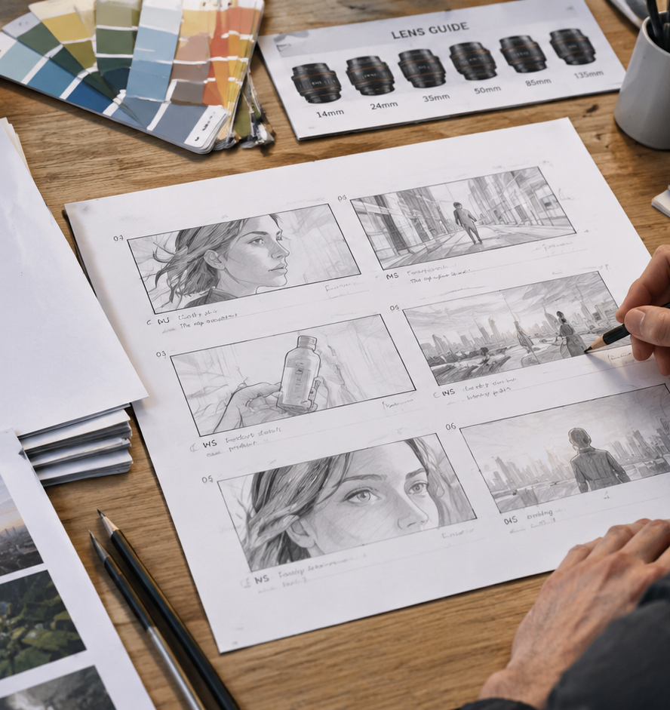
01 / 11
VIDEO ADVERTISING
You're Creating A Storyboard For A Video Ad
Pre-Production Visual Planning and Execution for Video Ads
YIHA
Notes:
Welcome everyone. Today we are exploring how to construct a professional, production-ready storyboard for a video ad. In commercial advertising, creative teams face strict timeframes, tight budgets, and demanding brand requirements. A commercial storyboard is not merely an artistic exercise, but an essential operational blueprint that bridges high-level marketing concepts with actual camera setups and post-production workflows. Throughout this session, we will examine how pre-visualization aligns brand clients, agency directors, and production crews. We will cover commercial timing arcs, platform aspect ratios, safe zones, audio synchronization, camera notation, animatic prototyping, and production handoffs. By establishing clear visual blueprints before filming begins, your team eliminates ambiguity, controls costs, and ensures that the final commercial delivers on its core marketing objectives.
Sources:

Slide 2
02 / 11
De-Risking Production with Pre-Visual Blueprints
Pre-production storyboards establish a visual blueprint that prevents budget overruns and coordinates all crew departments.
Map scene sequences, camera angles, and visual style in advance
Calculate equipment, location, and personnel needs accurately
Example: planning scene blocking reveals physical space limits
YIHA
Notes:
Pre-production planning forms the bedrock of cost management in commercial filmmaking. When you map out every camera angle, transition, and stylistic choice in advance, you remove ambiguity from physical set operations. According to Shoots.video, storyboarding serves as a foundational roadmap that guides the director, cinematographer, and crew while allowing producers to accurately estimate equipment, props, and personnel allocations. Similarly, Mack Media Group emphasizes that a comprehensive storyboard acts as a visual blueprint for commercial video production. By establishing scene requirements early, teams safeguard realistic budgets across cast, locations, and gear packages. Planning physical blocking on paper exposes spatial and lighting limitations before arriving on set, ensuring every dollar invested in production delivers clear creative value.
Sources:
https://www.shoots.video/post/the-role-of-storyboarding-in-pre-production-enhancing-visual-narrative/
https://mackmediagroup.com/6-proven-strategies-for-efficient-pre-production-planning-in-commercial-video-production/

Slide 3
03 / 11
Structuring the 15-to-30 Second Commercial Arc
Commercial storyboards are strict timing documents with dedicated panel durations for hooks, proof, and legal disclaimers.
01
Allocate seconds 0:00 to 0:05 to hook viewers and show brand identity
02
Balance problem, proof, product usage, and clear decision frames
03
Recommendation: reserve 4 seconds at the tail for legal disclaimers
YIHA
Notes:
A commercial storyboard is fundamentally a timing document with illustrations attached. As analyzed by ScreenWeaver, every panel must carry an exact duration in seconds that totals the contracted media placement length. In a standard thirty-second commercial, the first five seconds must earn the viewer's continued attention and present the brand. Seconds five to twelve introduce narrative tension, followed by product demonstration from seconds twelve to twenty-one. Seconds twenty-one to twenty-six deliver proof, while seconds twenty-six to thirty hold the end card and legal disclaimers. Furthermore, Nemo Video outlines a five-beat short-form structure spanning problem, proof, usage, result, and decision frames. Recording exact durations beneath each storyboard panel ensures that required legal text receives sufficient hold time and prevents costly editorial restructuring.
Sources:
https://www.screenweaver.ai/blog/storyboard-for-commercial-ads
https://www.nemovideo.com/blog/ai-video-editing/short-form-video-storyboard-template

Slide 4
04 / 11
Aspect Ratios and Compositional Safe Zones
Commercial framing must adapt to platform aspect ratios while keeping text and logos clear of native app interfaces.
Account for 16:9 widescreen, 1:1 square, and 9:16 vertical displays
Keep critical calls to action inside tested interface safe zones
Recommendation: position vertical text at least 400px above bottom
YIHA
Notes:
Video advertising campaigns frequently deliver across varied digital platforms simultaneously. As documented by Prompt Architects, distribution specs range from standard 16:9 widescreen on YouTube to 9:16 vertical displays on TikTok, Instagram Reels, and YouTube Shorts, alongside 1:1 and 4:5 ratios on LinkedIn. Moreover, AdMakeAI highlights that vertical mobile canvases feature aggressive native interface overlays. On YouTube Shorts, bottom descriptions, channel titles, and engagement icons can obscure between 420 and 576 pixels of the lower frame. Storyboard artists must incorporate safe zone guides directly onto vertical sketch templates. Placing crucial messaging, logos, and calls to action safely above native button rows ensures viewer visibility across every target application.
Sources:
https://prompt-architects.com/blog/362-aspect-ratios-and-platform-specs-for-ai-video
https://admakeai.com/blog/vertical-video-dimensions-2026

Slide 5
05 / 11
Synchronizing Dialogue, Sound, and Captions
Every panel must synchronize spoken dialogue, background soundscapes, and accessible on-screen captions.
Pair visual descriptions directly with audio and sound effects
Center accessible subtitles horizontally in clear fonts
Lock caption timing to audio tracks for silent mobile autoplay
YIHA
Notes:
A storyboard panel is incomplete without a dedicated secondary audio row. According to Nereo, effective audio-visual planning requires pairing visual descriptions directly with explicit sound descriptions. Specifying dialogue, ambient room tone, foley, and musical energy ensures that background scores do not overpower spoken lines. In addition, Microsoft Learn emphasizes the critical importance of synchronizing caption text with speech timing across video productions. Because many social video ads are initially viewed on mobile devices with sound muted, storyboards must indicate subtitle placement and pacing. Centering captions horizontally in prominent fonts outside native UI overlays ensures accessible viewing without covering key product interactions on screen.
Sources:
https://www.nereo.io/blog/ai-video-generator-free-no-sign-up-with-sound
https://learn.microsoft.com/en-us/azure/ai-services/speech-service/captioning-concepts

Slide 6
06 / 11
Standardizing Camera Movement and Notation
Clear directional notation and camera symbols eliminate confusion between the director and camera operators.
01
Use standardized arrows for pans, tilts, zooms, and tracking shots
02
Mark rack focus shifts with clear optical boundary brackets
03
Indicate subject movement vectors distinct from camera travel
YIHA
Notes:
Directional notation serves as the common visual grammar connecting directors, cinematographers, and camera operators. As explained by CinemaDrop, standardized storyboard symbols communicate camera movement intent clearly across sequential panels. Outer framing arrows signify pans and tilts, while corner crop marks indicate zooms or push-in tracking shots. Standardizing these visual cues allows the production team to understand how perspective, scale, and emotion evolve from beat to beat. In addition, optical focus transitions like a rack focus require explicit bracket notation to illustrate focal depth shifts between foreground elements and background subjects. Establishing unambiguous visual shorthand on storyboard panels eliminates guesswork on set and accelerates lighting and camera setup turnarounds.
Sources:
https://www.cinemadrop.com/storyboard-camera-movement-symbols

Slide 7
07 / 11
Concept Boards Versus Technical Shooting Boards
Distinguish between client concept boards for narrative approval and technical shooting boards for crew execution.
Concept boards prioritize visual tone, story flow, and pacing
Shooting boards specify lens selections, lighting, and camera setups
Lock client sign-offs before generating crew shooting boards
YIHA
Notes:
Commercial productions depend on two distinct tiers of storyboarding. According to Video Production Agency, shooting boards are designed specifically for the camera, lighting, and art departments, detailing technical information such as lens choices, camera movements, and lighting setups. In contrast, client concept boards focus on storytelling clarity, emotional tone, and commercial narrative arc. As Sketch to Video AI points out, concept pitches succeed when clients can follow narrative pacing and visual ideas without getting distracted by dense technical crew annotations. Maintaining this distinction allows agency executives to secure brand sign-off on creative messaging before technical teams draft detailed shooting boards for equipment rentals and stage operations.
Sources:
https://www.videoproductionagency.com/what-is-a-storyboard-and-how-is-it-used-in-filmmaking/
https://www.sketchtovideoai.com/blog/how-to-turn-storyboard-into-ai-video-client-pitches

Slide 8
08 / 11
Animatic Assembly and Motion Timing Prototyping
Assembling timed animatics with scratch audio exposes pacing defects and timing errors before production starts.
Convert static storyboard panels into timed video timelines
Layer temporary voiceover and sound effects to test edit rhythm
Verify demonstration shot durations fit within total ad limits
YIHA
Notes:
Static illustrated panels cannot fully represent temporal motion. As explained by DrawStory, building an animatic adds precise duration to each storyboard frame, creating the first moving preview of the ad project. Testing panel timing alongside scratch voiceover and temporary music exposes pacing flaws that remain invisible on paper. For instance, an agency may discover that a product demonstration requires six seconds of screen time rather than the three seconds originally assumed. Furthermore, Video Production Agency notes that animatics combine drawings with timing to help visualize complex sequences before committing to full production. Locking the animatic timing early establishes reliable frame counts and prevents expensive re-shoots during editorial post-production.
Sources:
https://www.drawstory.ai/blog/how-to-turn-storyboard-to-video
https://www.videoproductionagency.com/what-is-a-storyboard-and-how-is-it-used-in-filmmaking/

Slide 9
09 / 11
Scope Drift, Overcrowding, and Feasibility Constraints
Avoid overpacked frames and unrealistic shot counts that exceed physical shoot days and ad airtime limits.
01
Limit visual actions to what viewers can absorb in brief seconds
02
Account for transition frame requirements between video streams
03
Recommendation: restrict short commercials to 6 to 10 total setups
YIHA
Notes:
A common pitfall in commercial advertising is overcrowding individual frames with excessive visual information. In a fifteen or thirty-second spot, rapid shifts overwhelm viewers and obscure key marketing claims. Technical constraints in post-production reinforce this reality. As detailed in the FFmpeg Filters Documentation, visual transitions such as cross-fades require dedicated frame overlap durations between video streams, meaning editors cannot cut rapidly without creating abrupt visual collisions. Furthermore, the FFmpeg Formats Documentation highlights how digital video containers require consistent frame timing and keyframe intervals for stable playback. On physical sets, every unique camera angle requires relocation and lighting adjustments. Constraining commercial storyboard setups prevents unmanageable production delays and ensures polished execution.
Sources:
https://ffmpeg.org/ffmpeg-filters.html
https://ffmpeg.org/ffmpeg-formats.html

Slide 10
10 / 11
Translating Storyboards into Production Call Sheets
Group storyboard shots by location and setup to optimize production schedules and streamline editorial assembly.
Consolidate wide shots and close-ups to minimize camera repositioning
Derive equipment packages and call sheets directly from shot lists
Use numbered storyboard panels to guide offline editorial rough cuts
YIHA
Notes:
Once a commercial storyboard receives final approval, it becomes the operational driver for production scheduling and post-production editing. Citing Lumina Studio, pre-production workflows translate visual storyboards directly into actionable shot lists, equipment requirements, and schedule checklists. Consolidating shots by location and camera configuration allows crews to film all wide setups together and all close-up angles together, eliminating redundant repositioning and lighting shifts during shoot days. On set, the numbered storyboard acts as a production checklist to track filming progress. When post-production begins, offline editors utilize numbered storyboard panels and animatic timecodes to assemble raw camera takes into structured rough cuts that strictly follow the approved creative vision.
Sources:
https://www.lumina-os.com/blog/ai-video-scripting-storyboard-workflow/

Slide 11
11 / 11
Executing Disciplined Commercial Storyboards
A rigorous storyboard aligns creative intent with production reality, safeguarding media investments from script to screen.
Integrate timing, framing safe zones, and sound into every panel
Validate shot pacing with timed animatics prior to filming
Handoff signed-off panels into structured shot lists and edits
YIHA
Notes:
To conclude our review, creating a commercial storyboard for a video ad is essential for transforming abstract creative concepts into controlled, successful productions. Citing Shoots.video, storyboarding serves as a vital pre-production roadmap that enhances visual storytelling, streamlines departmental collaboration, and ensures wise resource allocation. By enforcing strict duration allocations, respecting platform safe zones, documenting standardized camera symbols, and assembling timed animatics, creative teams prevent costly on-set misunderstandings. A well-constructed storyboard protects the client's financial investment, empowers production crews to execute with precision, and guarantees that the finished commercial spot communicates its core brand message effectively across every broadcast and digital distribution channel.
Sources:
https://www.shoots.video/post/the-role-of-storyboarding-in-pre-production-enhancing-visual-narrative/

