Slide 1
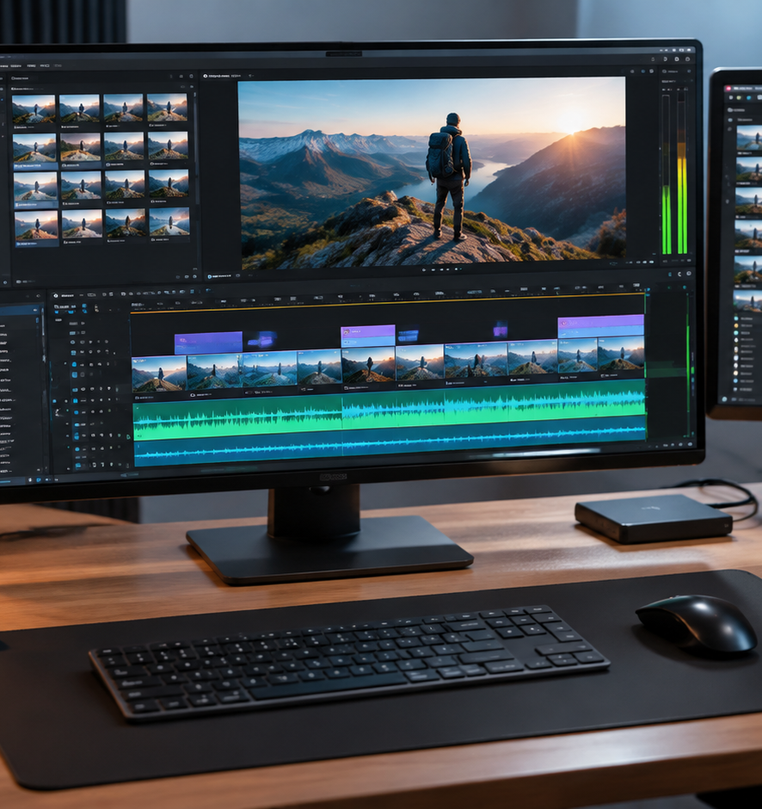
01 / 11
VIDEO PRODUCTION
Best Product Presentation Video
Technical Architecture and Engineering Workflow for Product Demonstration Videos
YIHA
Notes:
Welcome everyone. Today we are examining the core engineering and production principles behind the best product presentation videos. Modern buyers evaluate technical products through video demonstration. A successful product video does not happen by accident, as it requires aligning strategic messaging with precise media production workflows. Throughout this presentation, we will dissect how to construct clear narratives, record high-fidelity software captures, integrate modern generative tools, balance audio according to international broadcast standards, and deploy optimized files across responsive web platforms.
Sources:

Slide 2
02 / 11
Audience Dynamics and Stage-Specific Objectives
Video formats and runtimes must match viewer intent across awareness, consideration, and onboarding stages.
Recommendation: Awareness videos can run up to two minutes
Recommendation: Conversion explainers target 60 to 90 seconds
Decision stage buyers require objective validation of pain points
YIHA
Notes:
According to research on content mapping across the customer journey from 310 Creative, buyers move through awareness, consideration, and decision stages, each requiring distinct technical detail. Awareness viewers need to understand the problem, while decision stage prospects need objective evidence of the solution. StudioBinder notes that a product explainer video functions to transform a confused visitor into a confident buyer by demonstrating functionality at scale without requiring a live sales representative. For video duration, StudioBinder recommends 60 to 90 seconds for conversion-focused explainers, up to two minutes for awareness videos, and up to five minutes for onboarding videos where viewers are already committed.
Sources:
https://www.310creative.com/blog/map-content-across-buyers-journey
https://www.studiobinder.com/blog/product-explainer-video/

Slide 3
03 / 11
Narrative Architecture and Structural Blueprinting
Focus on the core operational problem and keep conversion video scripts under 225 words.
01
Validate the core operational problem before unveiling the product
02
Recommendation: Focus scripts on one to three capabilities under 225 words
03
Establish storyboard blueprints to eliminate expensive revisions
YIHA
Notes:
StudioBinder highlights an insight from video strategist Ian Gibbons: effective explainers focus on explaining the user problem rather than drowning them in product features. The recommended conversion script structure opens with problem validation, introduces the product as the solution, highlights one to three key benefits, adds proof, and closes with a clear call to action, all within 225 words. LinkedIn analysis indicates that on-demand video combines visual clarity and narration far more dynamically than static slide decks. In pre-production, Pretzel Logic Productions underscores that thorough call sheets and shot lists prevent wasted resources, while storyboards prevent misalignments before animation begins.
Sources:
https://www.studiobinder.com/blog/product-explainer-video/
https://pretzellogicproductions.com/pre-production-video-planning-guide/
https://www.linkedin.com/pulse/comparing-video-presentations-traditional-slide-decks-5urqe

Slide 4
04 / 11
Visual Capture and UI Motion Graphics Standards
Capture high-fidelity screen media with stable frame rates and focused UI camera motion.
Use Screen Capture API standards with selective cursor visibility
Pair native screen recordings with motion graphics for polish
Apply directional zooming to guide viewer focus across complex UIs
YIHA
Notes:
Screen recordings form the foundation of software demonstrations. Modern web standards outlined in MDN Screen Capture API specifications utilize MediaDevices.getDisplayMedia to capture clean browser views, including controls to manage cursor visibility across always, motion, or never states. StudioBinder notes that pairing screen captures from tools like Loom or Camtasia with motion graphics built in After Effects creates an efficient middle ground for product teams. This approach avoids full 3D animation costs while delivering crisp UI walkthroughs. Directing attention with smooth zooms and graphic callouts ensures users follow the visual narrative without squinting at dense interface layouts.
Sources:
https://developer.mozilla.org/en-US/docs/Web/API/Screen_Capture_API
https://www.studiobinder.com/blog/product-explainer-video/

Slide 5
05 / 11
Generative Video Synthesis and Diffusion Transformers
Diffusion Transformer models enable dynamic visual inserts when frame parameters are controlled.
DiT models scale transformer architectures over latent video patches
Higher Gflops correlate with lower Fréchet Inception Distance
Calculate model frame counts explicitly to ensure motion smoothness
YIHA
Notes:
Generative synthesis offers new avenues for video inserts and b-roll. The landmark paper by Peebles and Xie on Diffusion Transformers demonstrated that replacing standard U-Net backbones with transformer blocks operating on latent patches scales efficiently, with higher computational Gflops consistently yielding lower FID scores. As detailed in Hugging Face Diffusers documentation, video generation requires temporal and spatial alignment, where parameters like num_frames govern motion smoothness and duration. MimicPC notes that modern architectures like Mochi 1 use Asymmetric DiT with video autoencoders to compress data twelvefold, while models like Wan 2.1 use Control-LoRAs to enforce style consistency across generated scenes.
Sources:
https://arxiv.org/abs/2212.09748
https://huggingface.co/docs/diffusers/en/using-diffusers/text-img2vid
https://www.mimicpc.com/learn/creating-ai-videos-with-comfyui-text-to-video-workflows

Slide 6
06 / 11
Acoustic Dynamics and Loudness Normalization
Clean dialogue recordings and sidechain ducking ensure broadcast-standard clarity.
01
Recommendation: Place mics 6 to 12 inches off-axis with -12 to -6 dB peaks
02
Recommendation: Apply 6 to 12 dB sidechain ducking with 30 to 80 ms attack
03
Automate master normalization to ITU-R BS.1770 and EBU R128 targets
YIHA
Notes:
Poor audio ruins viewer retention faster than sub-par visuals. CapCut audio documentation advises recording dialogue with directional mics placed 6 to 12 inches from the mouth, slightly off-axis to mitigate plosives, targeting recording peaks between -12 dB and -6 dB for dynamic headroom. For ducking background music under dialogue, a baseline duck of 6 to 12 dB, with 30 to 80 millisecond attack and 250 to 700 millisecond release, prevents audible pumping. Finally, master delivery files must pass through normalization filters. Using the FFmpeg loudnorm filter applies EBU R128 and ITU-R BS.1770 standards, balancing integrated loudness and true peak thresholds automatically.
Sources:
https://www.capcut.com/create/audio-ducking-for-clear-dialogue-in-video
https://ffmpeg.org/ffmpeg-filters.html

Slide 7
07 / 11
Caption Synchronization and Accessibility Standards
Synchronized WebVTT and SRT captions ensure accessibility and message retention in silent feeds.
Deploy standardized WebVTT and SRT caption tracks across players
Verify automatic speech recognition outputs to eliminate errors
Multimodal decoders reduce phoneme timing errors during synthesis
YIHA
Notes:
According to the W3C Web Accessibility Initiative, captions are essential for deaf and hard-of-hearing viewers, as well as users watching in silent work environments. W3C notes that automatically generated captions do not satisfy accessibility standards without manual review, as single misrecognized words can invert technical meaning. Microsoft Learn documentation on Azure Speech Service explains that speech-to-text systems process partial hypotheses before confirming final text boundaries, outputting standard SRT and WebVTT files. Additionally, research on multimodal synchronization on arXiv demonstrates that unified video-text decoders significantly reduce phoneme timing errors compared to text-only speech synthesis baselines.
Sources:
https://www.w3.org/WAI/media/av/captions/
https://learn.microsoft.com/en-us/azure/ai-services/speech-service/captioning-concepts
https://arxiv.org/html/2411.17690v3

Slide 8
08 / 11
Encoding Pipelines and Multi-Resolution Packaging
Optimize container metadata and codecs for rapid progressive playback and low latency.
H.264 guarantees universal browser support across all devices
HEVC achieves comparable visual quality at lower bitrates
Set the faststart container flag to initiate instant web playback
YIHA
Notes:
Video delivery requires careful codec evaluation. MDN web video codec documentation explains that H.264 provides universal compatibility across legacy browsers and hardware decoders, while modern codecs like HEVC theoretically achieve equivalent visual fidelity at half the bit rate. As DCAST notes, encoding involves balancing resolution, frame rate, and bitrate to avoid client buffering. Using FFmpeg command-line tools allows teams to script multi-stream conversions, downmix stereo audio to AAC at 128 kbps, and apply the faststart flag. Moving the MP4 moov atom header to the beginning of the container enables instant streaming before the full file finishes downloading.
Sources:
https://developer.mozilla.org/en-US/docs/Web/Media/Guides/Formats/Video_codecs
https://dcast.tv/blog/video-encoding-settings-bitrate-resolution-and-quality-optim
https://ffmpeg.org/ffmpeg.html

Slide 9
09 / 11
Perceptual Quality Assessment and Production Pitfalls
Objective metrics like VMAF validate visual quality and protect against compression blur.
01
Prevent narrative overload and visual clutter during pre-production
02
Integrate Netflix VMAF algorithms in FFmpeg for objective validation
03
Use No Enhancement Gain mode to detect genuine compression artifacts
YIHA
Notes:
Production pitfalls include cognitive overload, cluttered interfaces, and temporal rendering glitches. Shoots.video emphasizes that storyboarding serves as a visual roadmap that identifies structural narrative issues before filming starts. For synthetic assets, GenAI ML Institute highlights the emergence of virtual pre-visualization boards to spot staging flaws early. To evaluate technical encoding quality objectively, engineers use the Netflix VMAF framework, available open-source on GitHub and built into FFmpeg via libvmaf. VMAF evaluates human visual perception by combining multiple feature algorithms, offering a No Enhancement Gain mode that evaluates codecs accurately without artificial sharpening.
Sources:
https://github.com/Netflix/vmaf
https://www.shoots.video/post/the-role-of-storyboarding-in-pre-production-enhancing-visual-narrative/
https://www.genaimlinstitute.com/blog/ai-in-video-production

Slide 10
10 / 11
End-to-End Orchestration and Web Deployment
Establish standardized asset workflows and automated multi-stage rendering pipelines.
Standardize asset directories across raw captures, audio, and exports
Recommendation: Run 480p draft passes to validate pacing before rendering
Deploy frame-accurate review steps to accelerate team sign-offs
YIHA
Notes:
A reproducible production pipeline transforms ad-hoc video tasks into a predictable growth engine. Ziflow outlines four core workflow stages including development, pre-production, production, and post-production, emphasizing that standardized directory hierarchies and frame-accurate timestamp review systems prevent versioning chaos. In advanced automated environments, Undercode Testing documents using Python environments and preliminary 480p rendering drafts to verify transition logic and motion vectors before initiating full-resolution renders. WaveSpeed AI illustrates chaining LLM script drafting, asset generation, and animation models into unified API pipelines to deliver responsive video assets at scale.
Sources:
https://www.ziflow.com/blog/video-production-workflow
https://undercodetesting.com/breaking-the-generative-loop-advanced-ai-video-production-pipelines-and-creative-workflow-engineering-video/
https://wavespeed.ai/landing/ai-video-workflow

Slide 11
11 / 11
Summary Blueprint for Product Presentation Videos
Disciplined narrative structure and automated media engineering deliver high-converting video presentations.
Anchor messaging in validated customer problems with strict word counts
Enforce audio ducking and EBU R128 loudness standards across all edits
Automate FFmpeg encoding, faststart flags, and WebVTT caption delivery
YIHA
Notes:
In conclusion, crafting the best product presentation video requires disciplined engineering across both creative storytelling and media distribution. By anchoring your script in customer problem validation, keeping runtimes between 60 and 90 seconds for conversion, maintaining clean UI screen recordings, normalizing audio levels to EBU R128 standards, and delivering web-optimized MP4 files with synchronized WebVTT captions, you create technical presentations that inform and convert. Thank you for your time, and please review our cited documentation from StudioBinder, W3C, and Netflix VMAF for detailed technical implementation guidelines.
Sources:
https://www.studiobinder.com/blog/product-explainer-video/
https://www.w3.org/WAI/media/av/captions/
https://github.com/Netflix/vmaf

