Slide 1
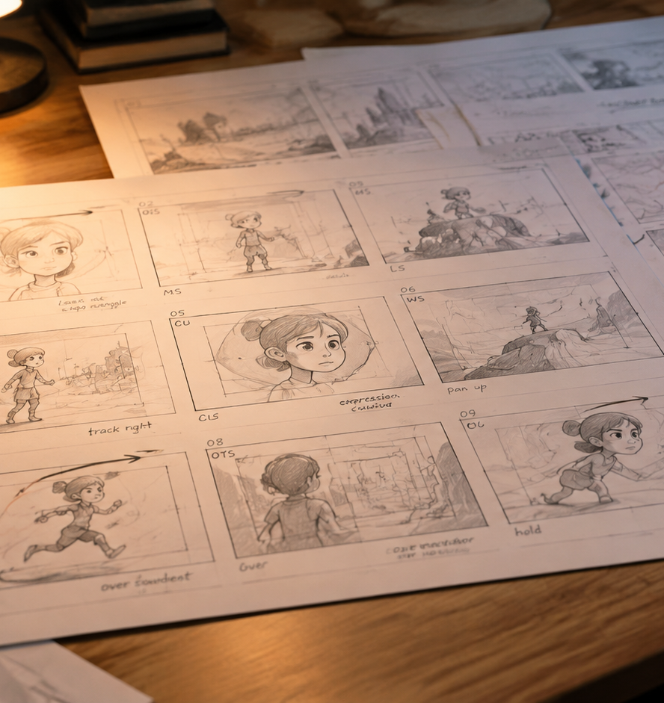
01 / 11
ANIMATION & FILMMAKING
Animation Short Film Storyboard
Pre-Production Visual Architecture for Animated Shorts
YIHA
Notes:
Welcome to this technical walkthrough on storyboarding for animated short films. In animated filmmaking, every visual element, environment, character rig, and performance must be constructed from the ground up, making unvetted alterations during active production prohibitively expensive. The storyboard serves as our central architectural blueprint, locking in narrative continuity, emotional arcs, staging clarity, and timing before animators, background painters, or modelers begin active asset fabrication. Throughout this presentation, we examine the complete pre-production workflow, spanning script beat translation, visual staging grammar, dynamic arrow notation, and animatic editing. We will also address medium-specific technical constraints across traditional hand-drawn, digital 3D, and physical stop-motion animation, culminating in a structured handoff protocol for layout teams.
Sources:

Slide 2
02 / 11
Pre-Production Role of the Storyboard
Storyboards establish visual structure early to minimize costly revisions during animation.
Serves as the central visual roadmap for entire production teams
Pre-production planning eliminates expensive revisions during asset creation
Identifies narrative and pacing flaws before asset fabrication
YIHA
Notes:
The primary role of the storyboard during animation pre-production is risk reduction and structural verification. In live-action shooting, a director can capture additional coverage and make extensive editorial adjustments in post-production. In animation, however, every unneeded shot modeled, rigged, or rendered represents severe waste in artist hours and project budget. As documented by Ruby Films, comprehensive storyboarding substantially streamlines production timelines by eliminating misunderstandings and preventing costly revisions before asset creation begins. Furthermore, resources from Video Production Agency confirm that storyboards provide an indispensable roadmap for pacing, camera choreography, and resource allocation. This visual documentation creates early consensus among directors, animators, and layout supervisors, ensuring the entire team executes a unified creative vision. Reference materials can be examined at https://rubyfilms.co.uk/the-role-of-storyboarding-in-pre-production-visualizing-your-film/ and https://www.videoproductionagency.com/what-is-a-storyboard-and-how-is-it-used-in-filmmaking/.
Sources:
https://rubyfilms.co.uk/the-role-of-storyboarding-in-pre-production-visualizing-your-film/
https://www.videoproductionagency.com/what-is-a-storyboard-and-how-is-it-used-in-filmmaking/

Slide 3
03 / 11
Translating Script Beats into Visual Beats
Deconstruct text into discrete emotional moments and purposeful visual beats.
01
Break script scenes into core narrative and emotional intentions
02
Map character arcs across sequential pictorial panels
03
Example: A brief script moment expands into three distinct shots
YIHA
Notes:
A written script communicates events through descriptive text, but a storyboard must translate those lines into visible action and emotional resonance. As outlined in the guide from Garden of Edits, the artist must break down the script into fundamental beats and plot points to establish narrative rhythm. An illustrative example occurs when a script describes a sudden realization. Instead of relying on a single static frame, the storyboard artist creates three distinct panels: an establishing medium shot, a sharp close-up on the eyes, and a wide shot capturing isolation. This visual breakdown ensures each cut communicates specific character intent. You can review detailed methodology at https://www.gardenofedits.com/a-guide-on-how-to-create-a-storyboard-for-your-short-film/ and pipeline structures at https://github.com/pkp666/mjj-ai-studio.
Sources:
https://www.gardenofedits.com/a-guide-on-how-to-create-a-storyboard-for-your-short-film/
https://github.com/pkp666/mjj-ai-studio

Slide 4
04 / 11
Composition, Framing, and Staging Clarity
Direct viewer attention using proven visual grammar, silhouettes, and depth layers.
Standardize panels to intended aspect ratios like 16:9 widescreen
Apply the rule of thirds and leading lines to guide visual focus
Preserve the 180-degree line of action to prevent spatial confusion
YIHA
Notes:
Composition in animation is not merely decorative styling. It functions as an active system that directs viewer attention and establishes emotional weight. As detailed in the Story2Board composition guide, deliberate framing choices like the rule of thirds, negative space, symmetry, and leading lines dictate narrative priority before characters deliver dialogue. In animation, artists must also prioritize readable character silhouettes, ensuring physical posture and intent remain clear even in pure silhouette. Maintaining spatial continuity across consecutive panels, especially adhering to the 180-degree line of action, prevents jarring disorientation when cutting between characters. Every storyboard panel must consciously organize depth layers across foreground framing, primary focal subjects, and background elements within the 16:9 widescreen frame. Review these visual grammar principles at https://story2board.com/blog/film-composition-framing-storyboard-guide.
Sources:
https://story2board.com/blog/film-composition-framing-storyboard-guide

Slide 5
05 / 11
Communicating Dynamic Motion with Vector Arrows
Standardized vector arrows clarify character paths, body turns, and camera tracks.
Use internal arrows to depict character movement and eye lines
Differentiate subject trajectory from outer frame camera shifts
Recommendation: Place high-contrast directional arrows inside each frame
YIHA
Notes:
Static drawings cannot convey temporal motion without clear notation, which makes a standardized arrow language essential. Practical production guides from Boords emphasize that directional arrows must appear in every action panel to clarify subject pathing, character turns, and entrance vectors. In professional animation storyboards, artists deploy solid arrows inside the frame to delineate character velocity, physical gestures, and internal body rotations. Conversely, outlined arrows placed along frame borders denote camera moves like pans, tracking sequences, or tilts. This unambiguous visual shorthand enables animators to interpret momentum, acceleration, and spatial staging without confusion. Choreographing staging and motion deliberately brings written scenes into dynamic physical reality. Technical cinematography guidance can be referenced at https://storyboardart.org/storyboard-tutorials/cinematography-and-film-for-storyboard-artists/ and https://boords.com/how-to-storyboard/short-film.
Sources:
https://boords.com/how-to-storyboard/short-film
https://storyboardart.org/storyboard-tutorials/cinematography-and-film-for-storyboard-artists/

Slide 6
06 / 11
Camera Movement Syntax and Annotations
Pair precise cinematic terminology with detailed dialogue and audio notes.
01
Distinguish physical moves like trucks and push-ins from optical zooms
02
Include standard shot size abbreviations like WS, MCU, and ECU
03
Record dialogue cues, sound effects, and shot numbering below panels
YIHA
Notes:
A storyboard panel remains incomplete without technical annotations that translate cinematic vision into production instructions. Artists must maintain disciplined camera terminology across all boards. As analyzed in LzyPrompt camera syntax documentation, a push-in physically moves the camera base to create organic perspective shifts and background parallax, whereas an optical zoom magnifies the image and flattens scene depth. Similarly, pans rotate horizontally on a stationary tripod, while trucks slide physically alongside moving subjects. Beneath each drawn frame, artists record shot numbering, character dialogue, Foley effects, ambient sound, and preliminary duration estimates. Modern production pipelines increasingly adopt structured formats like the Video Notation Schema to log these precise camera, lighting, and audio attributes. For reference details, see https://lzyprompt.com/blog/hailuo-ai-camera-movement-prompts/ and https://github.com/context-notation/video-notation-schema.
Sources:
https://lzyprompt.com/blog/hailuo-ai-camera-movement-prompts/
https://github.com/context-notation/video-notation-schema

Slide 7
07 / 11
Assembling the Animatic with Timing and Audio
The animatic transforms static panels into a timed timeline with audio cues.
Import sequential storyboard panels into video editing timelines
Synchronize frames against scratch dialogue and temp music tracks
Calibrate pacing and narrative rhythm before full animation begins
YIHA
Notes:
The transition from static sketches to an animatic marks the moment an animated short film discovers its temporal rhythm. Production resources from StudioBinder explain that an animatic functions as the vital bridge connecting static storyboard drawings to the first draft of active animation. In this stage, storyboard panels are imported into a video editing timeline, held for their precise screen durations, and cut against scratch dialogue, temporary background scores, and spot sound effects. This timed reel exposes narrative drag, dead screen time, and awkward transitional cuts before artists undertake expensive character animation. As demonstrated in Boords production analyses, resolving shot durations on the editorial timeline prevents animating seconds of footage that would otherwise be discarded in final editing. Review the workflow at https://www.studiobinder.com/animatic-storyboard-software/ and https://boords.com/storyboard-examples.
Sources:
https://www.studiobinder.com/animatic-storyboard-software/
https://boords.com/storyboard-examples

Slide 8
08 / 11
The Story Pitch Process and Iterative Feedback
Live pitches expose narrative drag and tonal disconnects early for quick revision.
Pitch sequences dynamically to test emotional response and clarity
Rapid thumbnail revisions take minutes compared to days of rework
Recommendation: Hold formal pitch reviews before locking story sequences
YIHA
Notes:
Storyboarding is an inherently collaborative and iterative process. Rather than distributing panels for silent review, storyboard artists deliver live pitch presentations to directors, producers, and creative peers. The artist acts out dialogue lines and demonstrates physical timing, revealing immediately whether dramatic moments land or visual pacing drags. As noted in StudioBinder pre-production guides, receiving and integrating editorial feedback is just as crucial as initial sketching. If a sequence falters, an artist can execute thumbnail revisions in minutes, avoiding days of redraws during full production. Studio analyses from Story-boards.ai highlight that rapid exploratory iterations empower directors to test alternative angles, high wide perspectives, and dynamic tracking shots before freezing story assets. Refer to practical pitching and revision guidance at https://www.studiobinder.com/guides/storyboards/how-to-create-a-storyboard-for-a-short-film/ and https://www.story-boards.ai/content-hub/blog/the-ultimate-guide-to-ai-storyboarding-for-animation-studios.
Sources:
https://www.studiobinder.com/guides/storyboards/how-to-create-a-storyboard-for-a-short-film/
https://www.story-boards.ai/content-hub/blog/the-ultimate-guide-to-ai-storyboarding-for-animation-studios

Slide 9
09 / 11
Medium Constraints Across 2D, 3D, and Stop-Motion
Adapt staging and visual solutions to the physical realities of each medium.
01
2D hand-drawn requires simplified background perspective changes
02
3D animation supports virtual cameras but demands asset conservation
03
Stop-motion framing must respect practical rig and stage dimensions
YIHA
Notes:
Storyboards must respect the distinct physical and technological constraints of the selected animation medium. Guidance from Vancouver Film School emphasizes that professional storyboarding visualizes narrative while identifying the concrete asset requirements, set builds, and character rigs needed downstream. In 2D hand-drawn animation, sweeping camera rotations force background artists to illustrate shifting perspective layouts frame by frame, dramatically increasing production overhead. In 3D computer animation, virtual cameras move freely through modeled space, yet storyboards must avoid introducing gratuitous background characters or one-off props that trigger expensive 3D asset builds. In stop-motion fabrication, boards must account for real world stage rigging, physical armature scale, and practical camera clearances on miniature sets. Pipeline comparisons can be reviewed at https://vfs.edu/news/what-is-storyboarding and https://drama.so/en/blog/how-to-turn-storyboard-into-animation.
Sources:
https://vfs.edu/news/what-is-storyboarding
https://drama.so/en/blog/how-to-turn-storyboard-into-animation

Slide 10
10 / 11
Final Packaging and Layout Department Handoff
Deliver structured layout packages containing lenses, asset cues, and exposure notes.
Fix story structure on the board to avoid expensive render changes
Export approved panels alongside focal lengths and camera data
Generate asset breakdown lists and character keys for layout artists
YIHA
Notes:
Once storyboards and the animatic receive formal directorial approval, the pre-production phase culminates in a technical packaging handoff to layout. Production analyses from DramaSo underscore that the storyboard serves as the ultimate pipeline hinge point, because altering story structure on panels requires minutes, whereas resolving narrative errors in layout, animation, or rendering demands days of labor. The handoff package supplies approved panels, exposure timing sheets, virtual focal length specifications, and itemized asset breakdown lists. Layout artists utilize these vetted materials to position 3D virtual cameras, stage background geometry, and establish precise character blocking. As documented in production examples by Boords, disciplined handoff packages ensure animators work from verified blueprints without artistic ambiguity. Review pipeline handover protocols at https://drama.so/en/blog/how-to-turn-storyboard-into-animation and https://boords.com/storyboard-examples.
Sources:
https://drama.so/en/blog/how-to-turn-storyboard-into-animation
https://boords.com/storyboard-examples

Slide 11
11 / 11
Key Principles for Short Film Storyboard Success
Disciplined storyboarding protects project budgets, visual clarity, and creative intent.
Treat storyboards as architectural blueprints for entire pipelines
Test pacing and timing iteratively using fully realized animatics
Recommendation: Lock story revisions before releasing layout packages
YIHA
Notes:
To conclude, storyboarding for an animated short film represents the essential architectural bridge connecting abstract narrative ideas to concrete production execution. By breaking written scripts into structured visual beats, applying disciplined composition and staging rules, deploying dynamic vector arrows, and validating scene pacing on animatic timelines, creative teams safeguard their budgets and protect narrative cohesion. Production principles documented by DramaSo reinforce the golden rule of animation: narrative revisions take minutes on a storyboard, but demand days of costly labor once assets enter layout, character animation, and final rendering queues. Investing disciplined pre-production effort into the storyboard guarantees that the finished short film delivers clarity, emotional power, and visual impact. Pipeline benchmarks and pre-production workflows are detailed at https://drama.so/en/blog/how-to-turn-storyboard-into-animation.
Sources:
https://drama.so/en/blog/how-to-turn-storyboard-into-animation

