Slide 1
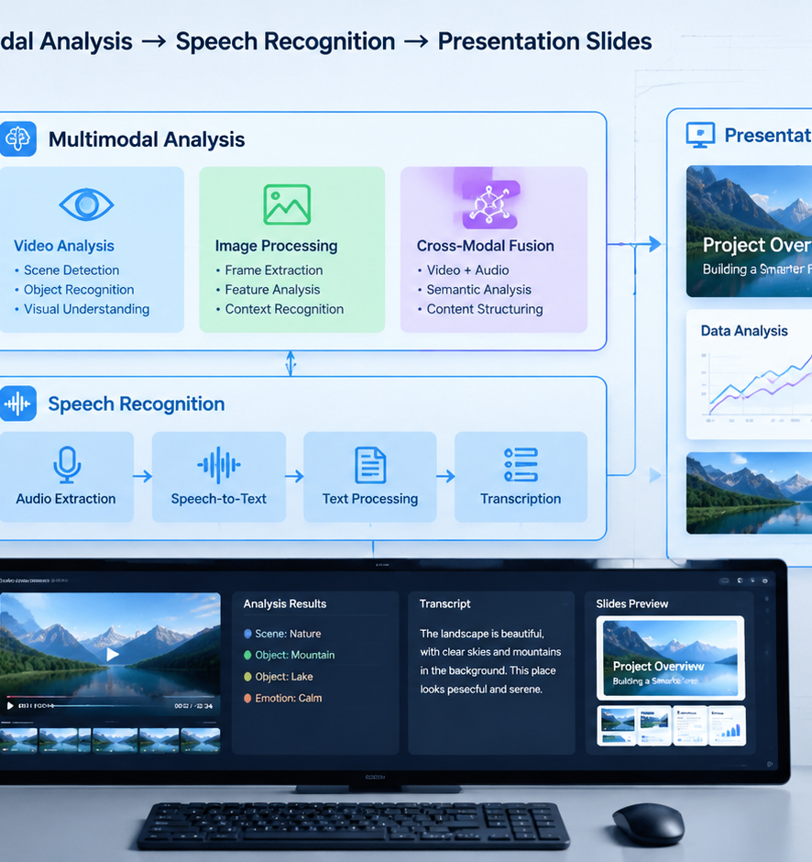
01 / 11
ARTIFICIAL INTELLIGENCE
YouTube Video To Presentation AI
Multimodal Systems for Converting Video Streams into Structured Slide Decks
YIHA
Notes:
Welcome to this technical presentation on converting YouTube videos into structured presentation decks. Video is inherently continuous and time bound, making it difficult for teams, researchers, and educators to locate specific information quickly. In contrast, presentation slides provide a modular format where readers can scan headings, review diagrams, and navigate directly to key concepts. Building an automated system that bridges these two formats requires a coordinated engineering architecture. We will examine how software pipelines extract audio streams, query caption tracks, perform scene detection, and align spoken narration with visual frames. We will also analyze how large language models structure raw transcripts into clean slide schemas and how layout engines render final files. Finally, we will address common technical failure modes and review production architectures that incorporate human oversight.
Sources:

Slide 2
02 / 11
The Challenge of Extracting Knowledge from Video
Video timelines force sequential viewing, creating friction for rapid review and structured knowledge retrieval.
Continuous timelines prevent rapid scanning and information lookup
Platform metrics like average view duration track viewer retention
Modular presentations allow non-linear scanning and fast search
YIHA
Notes:
Linear video presents operational friction for users who need structured information. As outlined in Search and discovery tips on YouTube Help (https://support.google.com/youtube/answer/11914225), streaming platforms track engagement through metrics such as average view duration and average percentage viewed. Video is designed for sequential consumption, but technical review requires fast retrieval and modular organization. Production analysis by Inference Systems (https://inferensys.com/automate/youtube-operations-and-channel-growth-automation/multi-agent-workflow-for-real-time-video-performance-alerting-and-diagnosis) details how workflows monitor early retention dips to detect when content pacing causes audiences to drop off. Converting continuous video into structured slide decks solves this challenge by organizing spoken explanations and visual demonstrations into modular units that learners can navigate and reference without scrub bar friction.
Sources:
https://support.google.com/youtube/answer/11914225
https://inferensys.com/automate/youtube-operations-and-channel-growth-automation/multi-agent-workflow-for-real-time-video-performance-alerting-and-diagnosis

Slide 3
03 / 11
Audio Ingestion and Speech Recognition Pipelines
Audio pipelines ingest native caption tracks or run speech recognition models to build timestamped transcripts.
01
Developer APIs provide programmatic access to existing caption tracks
02
Speech recognition generates timestamped transcripts when captions fail
03
Diarization modules distinguish multiple speakers during discussions
YIHA
Notes:
Extracting the verbal layer is the first phase of the conversion pipeline. According to platform documentation for Captions in the YouTube Data API (https://developers.google.com/youtube/v3/docs/captions), developer endpoints support listing, downloading, inserting, and updating caption resources tied to specific videos. Caption metadata indicates whether tracks were uploaded with fixed timestamps or auto-synchronized by platform algorithms. When native captions are absent or incomplete, automated systems extract audio streams and process them through automated speech recognition models. These models output timestamped word sequences and phoneme data that downstream modules align with visual frames. Incorporating speaker diarization ensures that comments from multiple presenters are accurately attributed across generated slide hierarchies.
Sources:
https://developers.google.com/youtube/v3/docs/captions

Slide 4
04 / 11
Visual Keyframe Extraction and Scene Detection
Computer vision models detect visual transitions and extract candidate keyframes across the video stream.
Keyframe extraction detects scene changes and slide transitions
Frame sampling reduces compute load compared to full-frame processing
Structural similarity algorithms flag candidate presentation slides
YIHA
Notes:
Spoken transcripts do not capture screen diagrams, code examples, or interface actions. To build visual slide decks, the system must detect key visual moments. As detailed in technical workflows by Inference Systems (https://inferensys.com/automate/youtube-operations-and-channel-growth-automation/multi-agent-workflow-for-real-time-video-performance-alerting-and-diagnosis), multimodal agent pipelines evaluate video structure by cross-referencing visual frames with transcripts. Rather than analyzing every single video frame, pipelines sample video at periodic intervals. When structural similarity metrics between consecutive sampled frames drop below a defined threshold, the algorithm records a scene transition. These keyframe boundaries isolate candidate slide images, distinguishing full slide transitions from minor webcam motion or cursor movement.
Sources:
https://inferensys.com/automate/youtube-operations-and-channel-growth-automation/multi-agent-workflow-for-real-time-video-performance-alerting-and-diagnosis

Slide 5
05 / 11
Video Text Extraction and On-Screen Analysis
Optical character recognition extracts on-screen text, code, and diagram labels to supplement transcripts.
Optical text extraction recovers on-screen code and data tables
Layout parsing identifies slide headers, body bullets, and figures
Visual text extraction fills gaps left by spoken narration
YIHA
Notes:
Presenters often display dense information without reciting every word aloud. In an analysis of video presentation extraction, Presenti AI (https://presenti.ai/blog/convert-youtube-to-ppt/) observes that relying solely on spoken transcripts captures verbal explanations while missing essential on-screen demonstrations and data tables. To capture this visual layer, computer vision pipelines run optical character recognition on extracted keyframes. Layout parsing models segment the image into discrete regions, identifying slide titles, bullet points, and diagram boxes. Extracting text directly from video frames recovers technical terminology, variable names, and numerical values that the speaker omitted, ensuring the final presentation reflects the full scope of technical instruction.
Sources:
https://presenti.ai/blog/convert-youtube-to-ppt/

Slide 6
06 / 11
Multimodal Alignment of Spoken and Visual Cues
Cross-modal synchronization models link spoken sentences with visual frames to eliminate temporal drift.
01
Unified decoders model temporal co-dependencies across modalities
02
Research shows visual conditioning tightens phoneme-level timing
03
Cross-modal alignment links spoken references to visual elements
YIHA
Notes:
Presenters frequently speak about a concept before or after changing a slide, introducing temporal lag between speech and visual content. In research on multimodal synchronization mechanisms in arXiv:2411.17690 (https://arxiv.org/html/2411.17690v3), investigators demonstrated that unified transformer decoders successfully align heterogeneous streams, showing that visual conditioning reduced phoneme timing errors in speech synthesis experiments compared to text baselines. In video to presentation pipelines, multimodal alignment connects spoken sentences to corresponding on-screen graphics. This alignment resolves verbal cues like 'in this chart' to specific bounding boxes on screen. Furthermore, temporal filtering discards sponsor announcements and banter, ensuring only core educational content appears in the slide outline.
Sources:
https://arxiv.org/html/2411.17690v3

Slide 7
07 / 11
Structuring Transcripts into Slide Hierarchies
Language models convert conversational transcripts into structured slide schemas using chapter markers.
Language models summarize spoken text into structured slide schemas
Chapter markers provide natural topic boundaries for slide titles
Strict schema validation guarantees titles, takeaways, and bullets
YIHA
Notes:
Conversational speech cannot be placed directly into a presentation because spoken delivery contains repeated phrases, filler words, and narrative tangents. As documented by BananaSlides (https://www.bananaslides.com/tools/youtube-to-ppt-converter), modern conversion tools pass transcripts through large language models to construct structured slide-by-slide outlines, weighting slide depth by the time a presenter dedicated to each topic. Presenti AI (https://presenti.ai/blog/convert-youtube-to-ppt/) highlights that video chapter timestamps offer ready-made section headings that preserve the author's logical progression. Applying strict schema validation guarantees that generated outputs contain clear slide titles, executive takeaways, bullet points, and presenter notes ready for document rendering.
Sources:
https://www.bananaslides.com/tools/youtube-to-ppt-converter
https://presenti.ai/blog/convert-youtube-to-ppt/

Slide 8
08 / 11
Automated Slide Deck Rendering and Layout Engines
Document engines transform structured JSON schemas into native PowerPoint files or styled visual decks.
OpenXML layout engines generate native editable PowerPoint files
Image models can render unified typography and visual palettes
Recommendation: Target 8 to 12 slides for 10-minute video overviews
YIHA
Notes:
After generating a structured outline, document rendering engines assemble the presentation file. As documented by BananaSlides (https://www.bananaslides.com/tools/youtube-to-ppt-converter), some tools render slides as designed graphical images, applying consistent typography, colors, and layout rules across every slide. Other rendering systems use OpenXML specifications to build native PowerPoint presentations, creating editable text boxes and inserting cropped video keyframes directly into the layout. Recommendation from BananaSlides documentation: Use 8 to 12 slides for a ten-minute video and 15 to 25 slides for an hour-long recording. Setting these baseline parameters ensures that the resulting presentation maintains high clarity and readability without overwhelming viewers with cluttered slides.
Sources:
https://www.bananaslides.com/tools/youtube-to-ppt-converter

Slide 9
09 / 11
Common Failure Modes and Technical Bottlenecks
Pipelines must handle speech hallucinations, low-resolution visual occlusions, and legal boundaries.
01
Acoustic noise and technical jargon can cause transcription errors
02
Video compression artifacts and face overlays obscure diagrams
03
Copyright law requires adherence to platform terms and fair use
YIHA
Notes:
Automated video processing systems face distinct technical and legal constraints. Speech recognition models can produce errors or hallucinate terms when processing audio with heavy background noise, rapid delivery, or uncommon technical terminology. On the visual side, low resolution, compression artifacts, and speaker webcam boxes can obscure critical parts of slides and diagrams. In addition to technical challenges, teams must consider intellectual property laws. As documented in Copyright on YouTube Help (https://support.google.com/youtube/answer/2797466), original video creators hold automatic copyright over their works, and exceptions like fair use permit unauthorized usage only under specific educational or research circumstances. Automated pipelines must respect creator rights and platform terms.
Sources:
https://support.google.com/youtube/answer/2797466

Slide 10
10 / 11
Designing a Production Pipeline with Human Oversight
Enterprise systems combine multi-agent task orchestration with mandatory human review checkpoints.
Asynchronous task queues coordinate audio, visual, and text agents
Confidence scoring routes ambiguous slides to human review queues
Human editing validates visual proof and removes spoken artifacts
YIHA
Notes:
Enterprise-grade implementations require combining automated agent pipelines with human governance. System architectures from Inference Systems (https://inferensys.com/automate/youtube-operations-and-channel-growth-automation/multi-agent-workflow-for-real-time-video-performance-alerting-and-diagnosis) demonstrate the value of orchestrating multi-agent networks using frameworks like LangGraph, using confidence scoring, detailed logging, and human approval gates for critical actions. In presentation pipelines, asynchronous queues handle ingestion, speech recognition, visual extraction, and schema drafting. Audience retention analyses from Nitro Media Group (https://www.nitromediagroup.com/video-retention-short-vs-long-videos-platform-comparison/) observe that audience drop-offs often occur when content lacks proof or repeats setup. Human reviewers ensure that generated decks contain verified proof points, remove spoken filler, and confirm diagram accuracy before final publication.
Sources:
https://inferensys.com/automate/youtube-operations-and-channel-growth-automation/multi-agent-workflow-for-real-time-video-performance-alerting-and-diagnosis
https://www.nitromediagroup.com/video-retention-short-vs-long-videos-platform-comparison/

Slide 11
11 / 11
Conclusion: Building Robust Video-to-Slide Systems
Integrating multimodal analysis with human oversight enables dependable, high-quality presentation generation.
Multimodal pipelines connect spoken narration with visual frames
Schema enforcement guarantees structured, editable presentations
Human review gates protect factual accuracy and brand standards
YIHA
Notes:
To conclude our review, converting video streams into structured presentations bridges the gap between linear media and modular documentation. As demonstrated in technical research on multimodal alignment (https://arxiv.org/html/2411.17690v3) and multi-agent production architectures from Inference Systems (https://inferensys.com/automate/youtube-operations-and-channel-growth-automation/multi-agent-workflow-for-real-time-video-performance-alerting-and-diagnosis), modern artificial intelligence can reliably synchronize speech, computer vision keyframes, and structured document schemas. By enforcing strict output templates and incorporating human review gates, organizations can automate the conversion of recorded lectures, tutorials, and technical demonstrations into clean, actionable presentation decks while maintaining high standards of factual accuracy, design consistency, and intellectual property compliance.
Sources:
https://arxiv.org/html/2411.17690v3
https://inferensys.com/automate/youtube-operations-and-channel-growth-automation/multi-agent-workflow-for-real-time-video-performance-alerting-and-diagnosis

