Slide 1
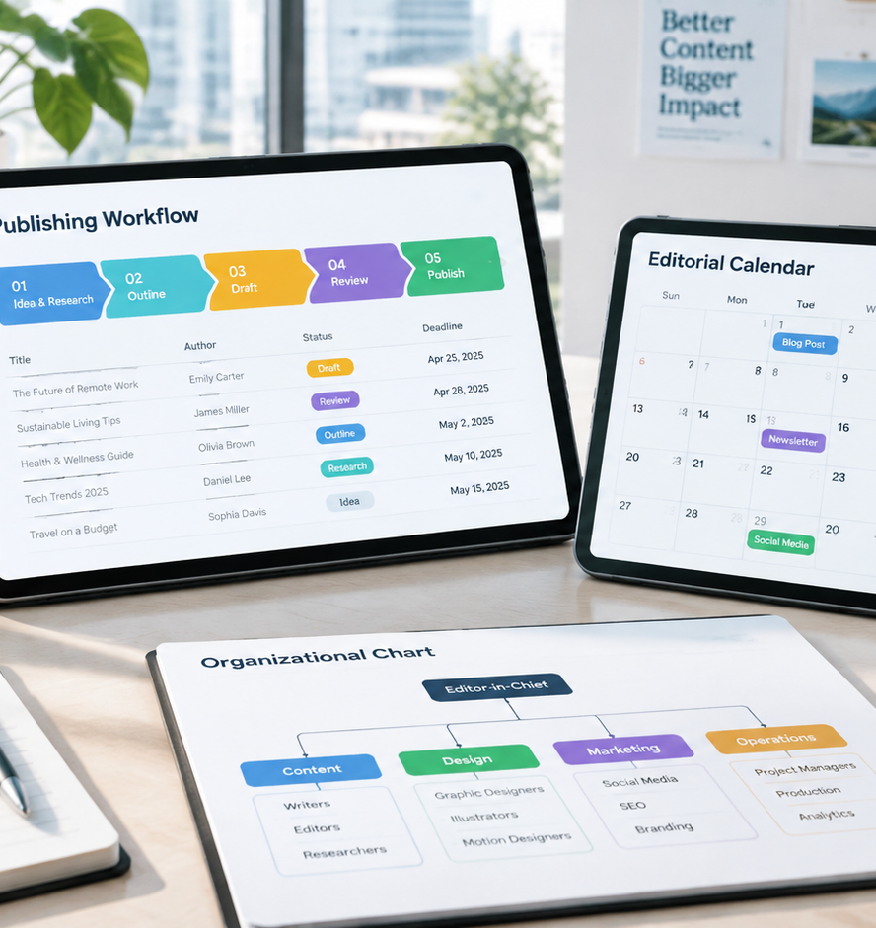
01 / 11
CONTENT OPERATIONS
Content
Architecture, Governance, and Operational Scale
YIHA
Notes:
Welcome everyone. Today we examine how marketing teams build, govern, and scale their content operations. When publishing functions without an operational backbone, teams frequently experience erratic schedules, uneven quality, and rising acquisition costs. A well-constructed content template transforms disconnected creative tasks into a dependable production engine. Over the course of this presentation, we explore foundational metadata schemas, the structural differences between authoring and distribution calendars, conditional approval gates, and the architectural trade-offs between collaborative spreadsheets and relational databases. We will also examine capacity planning buffers and formal service-level agreements to protect editorial standards. By grounding creative workflows in disciplined data architecture, organizations establish repeatable production cadences and build lasting topical authority while avoiding administrative fatigue.
Sources:

Slide 2
02 / 11
Transitioning from Reactive to Structured Operations
Unstructured publishing causes erratic scheduling, while phased templates establish operational visibility.
Ad hoc creation causes irregular scheduling and duplicated work
Templates define clear dependencies across multiple production phases
Structured workflows maintain consistent messaging and high standards
YIHA
Notes:
Ad hoc publishing creates significant hidden friction within marketing organizations. When teams lack a documented workflow, every piece of content becomes an emergency project with undefined roles, unclear briefs, and unpredictable timelines. According to the workflow model in the Instagantt content production schedule, structured operations divide content development into sequential, manageable phases. These phases include audience research, content brief creation, written drafting, visual design production, compliance review, and multi-channel publication synchronization. Documenting these phases in a shared template ensures that prerequisites and dependencies are visible to all contributors before drafting begins. This proactive visibility prevents assets from stalling and allows editors to coordinate complex cross-functional handoffs smoothly.
Sources:
https://www.instagantt.com/gantt-chart-templates/content-production-and-publishing-schedule

Slide 3
03 / 11
Core Data Schema in Content Planning Documents
A functional planning template requires structured metadata columns that force strategic decisions before drafting.
01
Essential fields include author, topic, keywords, status, and dates
02
Intent columns capture target queries, audience stage, and call to action
03
Controlled dropdown taxonomies prevent data drift and system bloat
YIHA
Notes:
A content calendar that captures only titles and target dates functions as an informal to-do list rather than a strategic planning instrument. As Strategyc highlights in their guide to building Google Sheets content calendars, high-performing templates incorporate specific columns that force writers and strategists to make critical decisions before creating assets. Core fields include the assigned author, primary search terms, target audience persona, workflow status, and scheduled deadlines. Capturing target customer questions and search metadata directly in the template ensures that every asset is designed for structured discovery and topical authority from day one. Using controlled dropdown menus for these fields maintains data integrity across quarters.
Sources:
https://www.strategyc.io/blog/content-calendar-template-google-sheets

Slide 4
04 / 11
Distinguishing Editorial and Omnichannel Systems
Editorial calendars manage core asset authoring, while omnichannel systems orchestrate derivative distribution.
Editorial calendars focus on long-form drafting and editorial progress
Omnichannel systems coordinate derivative snippets and campaign rollouts
Separating authoring from distribution prevents visual clutter
YIHA
Notes:
Teams often struggle with planning documents because they confuse editorial production with multi-channel distribution. As explained in Smartsheet's guide to content calendar templates, editorial calendars are primarily designed to organize author assignments, deadlines, and review stages for primary publications such as articles, whitepapers, or newsletters. In contrast, an omnichannel marketing calendar coordinates how that primary asset is repurposed into social updates, email sequences, and paid distribution. Keeping production tracking distinct from promotional distribution prevents templates from becoming unwieldy while ensuring full campaign visibility across channels. Maintaining this structural boundary allows creators to focus on deep drafting while distribution teams coordinate promotional amplification independently.
Sources:
https://www.smartsheet.com/content/content-calendar-template-examples

Slide 5
05 / 11
Establishing Clear Governance and Approval Gateways
Configurable approval gateways protect brand integrity without stalling low-risk creative workflows.
Review gateways should match the audience risk level of each asset
Sequential gates cover editorial, brand, technical, and legal reviews
Conditional rejection routing sends assets directly to needed stages
YIHA
Notes:
Standard operating procedures and approval gates are essential for turning static templates into operational reality. According to Ziflow's content approval workflow framework, organizations should match the number of review stages directly to asset risk and audience visibility. A routine social post does not require the multi-stage review that regulated or client-facing marketing materials demand. Furthermore, advanced workflows utilize conditional rejection routing. If legal or compliance reviewers identify an issue, the system routes the asset back directly to the author rather than restarting the entire brand review process. This conditional routing eliminates redundant review cycles and prevents administrative stagnation while maintaining strict compliance oversight.
Sources:
https://www.ziflow.com/blog/content-approval-workflow

Slide 6
06 / 11
Balancing Funnel Stages Across the Editorial Portfolio
Documented templates maintain portfolio balance across educational discovery and conversion assets.
01
Example guideline: prioritize educational assets for discovery
02
Balance remaining capacity across evaluation and conversion copy
03
Tagging funnel stages prevents over-indexing on sales messaging
YIHA
Notes:
Without explicit portfolio tracking in your planning document, content production naturally tilts toward immediate promotional demands, starving top-of-funnel discovery. As shown in the Small Business Expo content calendar framework, an intentional editorial strategy categorizes content by customer funnel position. Their model recommends an illustrative allocation where approximately sixty percent of output focuses on top-of-funnel educational content that addresses core audience problems and builds category authority. The remaining capacity balances solution comparison and conversion copy. Tracking this allocation within your master template prevents strategic blind spots, ensures balanced customer nurturing, and sustains steady organic discovery across the entire buyer journey.
Sources:
https://www.thesmallbusinessexpo.com/blog/content-calendar-template/

Slide 7
07 / 11
Evaluating Spreadsheets Versus Relational Databases
Relational databases preserve taxonomy consistency and custom views as publishing teams expand.
Spreadsheets offer rapid setup and accessible collaboration for small teams
Relational databases maintain metadata integrity across complex schemas
Multiple filtered views allow writers and designers to share master data
YIHA
Notes:
Choosing the right platform for your content template involves balancing simplicity against structural integrity. As detailed in Sustainable Catalyst's research on editorial metadata and content systems, flat spreadsheets work well for small teams but become fragile as contributor counts grow. Relational databases such as Airtable or Notion preserve critical structural connections among pillar topics, cluster posts, and governance records. Furthermore, relational platforms allow different team roles to work in personalized views, such as a writer list or a designer pipeline, while remaining synchronized with the same master database. This architecture eliminates duplicate records and keeps cross-functional handoffs aligned as operational complexity scales.
Sources:
https://sustainablecatalyst.com/editorial-metadata-and-content-systems/

Slide 8
08 / 11
Automating Downstream Handshakes and Publishing
Connecting central planning records to content management systems eliminates manual data entry errors.
Integrations connect central planning boards directly to publishing tools
Status changes trigger automated notifications and draft creation
Clean metadata enables reliable handoffs to distribution platforms
YIHA
Notes:
Manual administrative handoffs between planning tools and publishing platforms consume valuable hours and invite human error. As highlighted in the monday.com analysis of content management templates, connecting planning boards directly to communication apps and publishing platforms creates seamless execution. When an asset reaches approved status in the master tracker, automated webhooks can generate draft shells in content management systems, notify community managers in collaboration channels, and push promotional copy into scheduling software. Implementing these integrations requires structured data hygiene across the master planning sheet, ensuring that metadata fields like title tags and URLs transfer accurately without manual intervention.
Sources:
https://monday.com/blog/marketing/content-management-templates/

Slide 9
09 / 11
Avoiding Template Bloat and Administrative Decay
Over-engineered templates cause team friction, so teams must focus on essential fields and realistic capacity.
01
Excessive mandatory fields lead team members to abandon templates
02
Collect only metadata that informs decisions or tracks performance
03
Recommendation: maintain an operational capacity buffer near twenty percent
YIHA
Notes:
The most common failure mode for content templates is over-engineering. As Hashmeta emphasizes in their ninety-day planning guide, a complicated calendar that nobody updates is far worse than a simple template used consistently. Teams should resist the temptation to track dozens of non-essential fields and instead focus on the core attributes that guide production and distribution. Additionally, planning production at full theoretical capacity leaves no margin for unexpected revisions or delays. Maintaining an intentional operational buffer, such as planning at eighty percent capacity as suggested in the Small Business Expo guide, keeps the publication schedule resilient over time.
Sources:
https://hashmeta.com/blog/content-calendar-template-90-day-planning-framework/

Slide 10
10 / 11
Sustaining Editorial Standards as Organizations Mature
Formal service-level agreements and regular audits preserve content quality across growing teams.
Service-level agreements define review turnaround times and handoffs
Monitoring rework rates identifies briefing and capacity bottlenecks
Scheduled audits ensure legacy content stays accurate and relevant
YIHA
Notes:
As organizations expand, maintaining high editorial standards requires documented operational contracts across departments. As explored in the AI Content Marketing editorial SLAs framework, formal service-level agreements establish explicit expectations between writers, editors, subject matter experts, and compliance teams. These agreements define concrete turnaround times, minimum review criteria, and clear handoff specifications. Measuring rework rates highlights whether recurring bottlenecks stem from poor briefing quality or overburdened reviewers. Combining clear SLAs with periodic metadata audits ensures that your content library compounds in value rather than deteriorating into unmaintained clutter, preserving institutional quality across years of growth.
Sources:
https://www.aicontent.marketing/content-slas-for-ai-editorial-teams-how-to-scale-speed-without-breaking-quality

Slide 11
11 / 11
Building a Resilient Content Operations Engine
Disciplined planning schemas, clear governance, and lean maintenance transform content into a compounding asset.
Standardize metadata schemas to guide strategic decision-making
Align approval gates and SLAs to asset risk and team capacity
Maintain lean workflows to prevent administrative burnout
YIHA
Notes:
To conclude, building an effective content operation is not about creating the most elaborate spreadsheet or purchasing complex software. It is about establishing clear data schemas, well-defined approval gates, and sustainable production rhythms that your team can maintain over the long haul. By treating your content templates as operational frameworks rather than static calendars, as outlined across our research sources including monday.com and Ziflow, you create an engine that consistently produces high-value, compliant, and strategic content. Sustainable publishing ultimately requires balancing ambitious editorial goals with disciplined workflow governance, clear team accountability, and realistic capacity planning across every campaign.
Sources:
https://monday.com/blog/marketing/content-management-templates/

