Slide 1
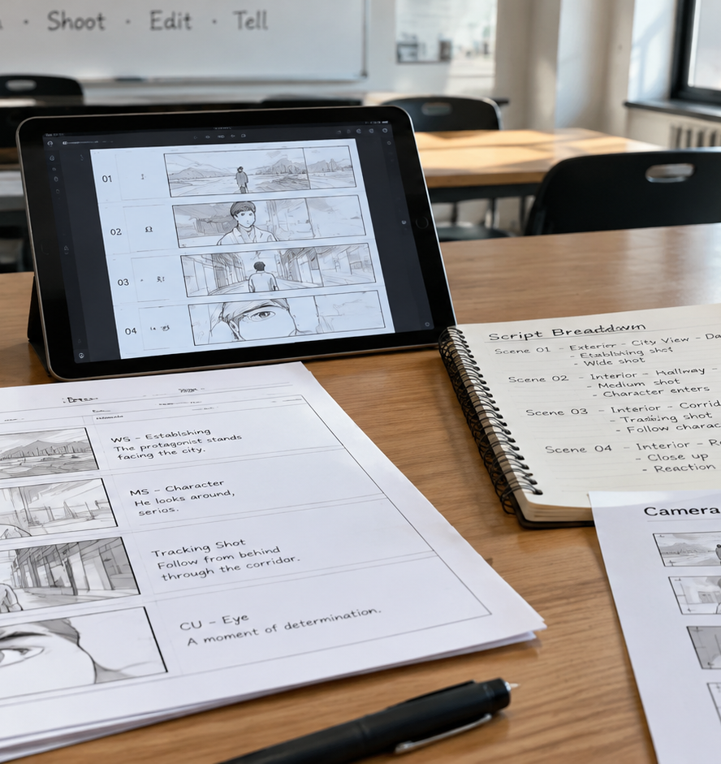
01 / 11
MEDIA EDUCATION
Free Storyboard Creator For Students
Pedagogical Workflows, Software Architectures, and Compliance
YIHA
Notes:
Welcome, educators and media arts coordinators. Today we examine how free storyboard creators can be successfully deployed in student media classrooms. Storyboarding is not simply drawing cartoon strips. It represents the foundational pre-visualization phase where script analysis connects with production logistics. Students who plan their framing, camera moves, and scene transitions on paper or digital boards consistently produce more coherent films. Throughout this presentation, we will review the anatomy of functional panels, compare software architectures, examine privacy compliance under FERPA and COPPA, and demonstrate how to establish objective peer review workflows and academic grading rubrics for student coursework.
Sources:

Slide 2
02 / 11
Visual Pre-Visualization in Media Education
Transforming scripts into sequenced visual frames trains critical media literacy and reduces on-set production errors.
Script-to-frame breakdown develops spatial awareness and narrative comprehension
Automated and visual tools allow students to focus on framing rather than drawing
Pre-production planning identifies narrative gaps prior to equipment deployment
YIHA
Notes:
In media education, visual pre-visualization bridges textual literacy and cinematic storytelling. When students analyze a screenplay, converting written lines into distinct visual shots forces them to confront spatial relationships, pacing, and visual continuity. Resources such as the awesome-ai-storyboarding repository highlight how pre-production tools range from 3D scene builders to script-driven pipeline software. Platforms like Anijam demonstrate that modern tools help students produce structured frames with consistent characters and camera directions without requiring professional drawing training. As shown in these tools, this pedagogy teaches students to solve creative and logistical challenges on paper before setting foot on location, saving valuable production time and classroom resources.
Sources:
https://github.com/mcqx4/awesome-ai-storyboarding
https://www.anijam.ai/tools/ai-storyboard-generator/

Slide 3
03 / 11
Anatomy of a Functional Storyboard Panel
Standard storyboard panels communicate aspect ratios, camera trajectories, and essential technical metadata.
01
Widescreen 16:9 aspect ratios provide standard framing for digital video projects
02
Directional movement arrows communicate camera pans, tilts, zooms, and actor blocking
03
Recommendation: three to six panels per sheet allow clear dialogue and technical notes
YIHA
Notes:
A functional storyboard panel serves as an explicit visual blueprint for cast and crew. According to StudioBinder's short film guides, every panel should be framed using a defined aspect ratio. The 16:9 format is widely recommended for modern video education because it matches standard digital cameras and widescreen video monitors. Directional arrows inside the frame represent essential camera moves like zooms, tracks, and pans that static sketches cannot convey alone. Additionally, as detailed in StudioBinder's template documentation, maintaining three to six frames per page leaves adequate space below the drawings for scene numbers, shot types, dialogue lines, and audio cues without visual crowding.
Sources:
https://www.studiobinder.com/guides/storyboards/how-to-create-a-storyboard-for-a-short-film/
https://www.studiobinder.com/blog/downloads/storyboard-template/

Slide 4
04 / 11
Evaluating Digital Storyboard Architectures
Selecting software depends on balancing student illustration ability, setup speed, and production planning depth.
Drag-and-drop asset builders eliminate drawing barriers for introductory learners
Freehand drawing suites grant complete composition control for animation students
Script-linked organizers convert text beats directly into editable production cards
YIHA
Notes:
Digital storyboard software divides into three distinct architectures. Drag-and-drop asset tools, such as Storyboard That, let students choose pre-rendered figures, backgrounds, and props. This format eliminates intimidation for beginners who cannot sketch by hand, though it limits custom framing choices. As discussed in ZipDo's software reviews, freehand drawing tools give experienced artists complete compositional freedom but present a steep learning curve for non-art majors. Finally, script-centric platforms organize scenes into linked cards and shot lists, prioritizing crew logistics over drawing. Media teachers must choose an architecture based on the specific learning goals and artistic backgrounds of their students.
Sources:
https://zipdo.co/best/digital-storyboard-software/
https://www.storyboardthat.com/

Slide 5
05 / 11
Student Data Privacy and Compliance Mandates
Classroom deployment of online tools requires compliance with FERPA records rules and COPPA consent guidelines.
FERPA governs student educational records across federally funded school districts
COPPA mandates verifiable parental consent for digital tools used by students under 13
Freemium software often lacks enterprise protections against student data tracking
YIHA
Notes:
Student privacy is a non-negotiable consideration when introducing web software into classrooms. BatesonLaw legal reviews emphasize that educational technology platforms trigger both FERPA and COPPA obligations. FERPA requires that vendors accessing education records act within approved school official guidelines and maintain strict data minimization. COPPA protects children under age 13, requiring verifiable parental consent before commercial sites can collect personal data. Furthermore, educational AI privacy guidelines point out that free consumer platforms rarely provide institutional data protection agreements. Teachers must avoid free tools that monetize user tracking or require unvetted student accounts, opting instead for district-approved tools or guest access workflows.
Sources:
https://batesonlaw.com/student-data-privacy-ferpa-and-coppa-interaction/
https://artificial-intelligence-wiki.com/industry-ai/ai-in-education/ai-student-data-privacy/

Slide 6
06 / 11
Script Breakdown to Sequenced Visual Frames
Systematic breakdown workflows translate screenplay dialogue into structured, continuity-checked shot lists.
01
Script parsing extracts scenes, cast, props, and camera setups into organized lists
02
Visual consistency across panels prevents narrative disorientation during playback
03
Sequential planning links screen time estimates with physical equipment requirements
YIHA
Notes:
A dependable storyboard begins with a thorough script breakdown. As illustrated by open-source breakdown tools like scriptbreak, screenplays must be separated into scenes, locations, characters, and shot elements before visualization starts. The research in Story2Storyboard emphasizes that preserving visual consistency across sequential frames is essential to prevent confusing jumps in identity, costume, or lighting. Teaching students this structured breakdown method ensures that each frame in their storyboard corresponds to an intentional, achievable camera setup. This connects written dialogue directly to the technical resources, schedule, and lighting setups required on production day.
Sources:
https://github.com/wassermanproductions/scriptbreak
https://github.com/majeeedshaikh/Story2Storyboard

Slide 7
07 / 11
Navigating Free Tier Constraints and Exports
Freemium limits on frame counts, project saves, and exports require intentional classroom management.
Common free tiers impose restrictive limits such as six frames per storyboard board
Export watermarks and paywalled PDF downloads can hinder physical on-set distribution
Exporting locked 16:9 PDF files protects sequences against accidental layout changes
YIHA
Notes:
Educators must prepare students for common constraints in freemium software. As noted by Krock.io's comparison of free creators, many platforms enforce a six-frame limit per board or restrict users to a single active project. A complete scene often requires numerous shots, meaning these arbitrary limitations can interrupt production planning. StudioBinder's template resources recommend locking completed work into standardized 16:9 PDF documents. Exporting to PDF prevents accidental frame rearrangement, enables clean printing for crew binders, and creates a clear archival record for grading. Instructors must evaluate export formats before assigning classroom projects to prevent end-of-term export roadblocks.
Sources:
https://krock.io/blog/free-storyboard-creator/
https://www.studiobinder.com/templates/storyboards/16x9-storyboard-template/

Slide 8
08 / 11
Open-Source and Offline Desktop Alternatives
Offline and open-source applications eliminate cloud subscriptions, frame caps, and internet dependence.
Open-source desktop tools remove account sign-ups, monthly fees, and panel ceilings
Paper-to-digital workflows let students draw on paper and import frames via QR code
Local storage architectures ensure student media files remain private on local machines
YIHA
Notes:
Open-source software offers a powerful alternative to cloud subscriptions for resource-conscious schools. Wonder Unit's Storyboarder operates completely offline, eliminating account registration, recurring costs, and cloud privacy risks. One of its standout features is a paper-to-digital workflow. Students print paper storyboard sheets containing alignment QR codes, draw with standard pens or pencils, and snap a picture with a webcam or camera. The software automatically crops each box and places the drawings into digital timeline panels. This hybrid model accommodates students who prefer tactile sketching while keeping all student data securely stored on local school hardware.
Sources:
https://wonderunit.com/storyboarder/

Slide 9
09 / 11
Structuring Collaborative Peer Review
Panel-specific feedback and view-only sharing links refine narrative pacing before physical production shoots.
01
Shareable review links allow peer critique without forcing extra account creation
02
Frame-level annotations pinpoint confusing screen directions and missing cuts
03
Structured critique rounds verify that outside viewers comprehend narrative beats
YIHA
Notes:
Peer critique is where storyboards receive their true test of narrative clarity. As highlighted in production review workflows by Krock.io, platforms that offer real-time sharing allow teammates and instructors to place specific annotations directly onto individual frames. Collaborative practices explored in Zendeck's workflow models suggest structuring reviews into planned rounds rather than chaotic, continuous updates. In the classroom, student reviewers check whether the visual sequence conveys the intended emotion, whether screen direction remains clear, and whether the proposed coverage is feasible. Pinpointing confusing cuts during the storyboard phase saves hours of frustration during actual filming.
Sources:
https://krock.io/blog/free-storyboard-creator/
https://zendeck.ai/zendeck/collaborative-ai-presentations-real-time-coediting-version-control.html

Slide 10
10 / 11
Academic Rubrics for Storyboard Assessment
Objective grading rubrics evaluate continuity, camera framing variety, and practical shoot feasibility.
Assessment targets spatial continuity and adherence to the 180-degree rule
Grading rubrics evaluate shot variety ranging from wide masters to close-ups
Production feasibility reviews location, lighting, and equipment resource planning
YIHA
Notes:
Assessing student storyboards requires clear academic rubrics that grade cinematic thinking rather than draftsmanship. According to Shoots.video's pre-production analysis, a good storyboard serves as a technical roadmap that balances creative storytelling with realistic resource budgeting. An effective rubric evaluates whether the student maintains the 180-degree line of action, uses purposeful camera transitions, and includes varied framing from establishing shots to close-ups. Additionally, as StudioBinder templates illustrate, rubrics should evaluate feasibility by checking whether scenes respect available lighting, location parameters, and gear limitations. Objective criteria ensure equitable grading across varied drawing talents.
Sources:
https://www.shoots.video/post/the-role-of-storyboarding-in-pre-production-enhancing-visual-narrative/
https://www.studiobinder.com/templates/storyboards/video-storyboard-template/

Slide 11
11 / 11
Building a Sustainable Pre-Production Pipeline
Equipping students with accessible storyboard tools establishes lifelong disciplines in visual media production.
Select tools that protect privacy, avoid paywalls, and match student skill levels
Integrate structured script breakdowns and panel annotations in early coursework
Use objective rubrics to validate story flow and practical production readiness
YIHA
Notes:
To build a sustainable student media pipeline, educators must deliberately align pedagogical objectives with software capabilities. Whether utilizing free browser tools, paper-to-digital workflows, or open-source desktop software like Wonder Unit's Storyboarder, the core objective remains constant: training students to think visually and plan methodically before they shoot. By enforcing student data privacy standards, teaching standard panel anatomy documented by StudioBinder, and applying structured peer review rubrics, media programs empower students to become deliberate visual storytellers and disciplined production team members. Thank you for your commitment to fostering media literacy.
Sources:
https://wonderunit.com/storyboarder/
https://www.studiobinder.com/guides/storyboards/how-to-create-a-storyboard-for-a-short-film/

