Slide 1
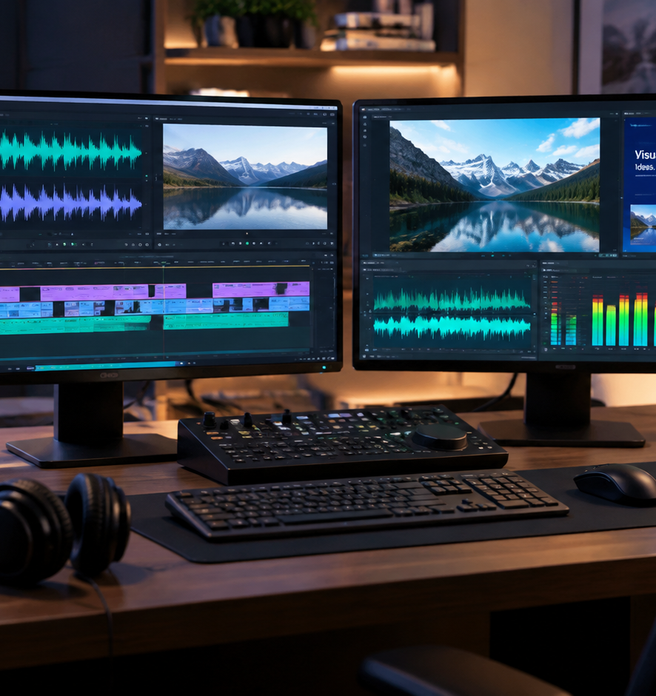
01 / 11
VIDEO ENGINEERING
How Do You Create A Video Of A Presentation
Engineering Reliable Audio, Video, and Caption Workflows
YIHA
Notes:
Welcome to this technical session on converting slide presentations into digital video. Transforming slide decks into high-quality video involves balancing visual fidelity, timing accuracy, and accessibility. Today we examine the core architectures available for recording and rendering presentation media, starting from basic desktop screen capture up through automated headless rendering pipelines and adaptive delivery packaging. We will analyze audio normalization rules, subtitle formatting, and codec configurations to help you build reliable production workflows. Throughout this session, we will examine how software engines handle visual assets, how modern encoders preserve typography, and how accessibility standards guide final media packaging.
Sources:

Slide 2
02 / 11
Architectures for Presentation Video
Three primary architectures govern how presentation decks are converted into digital video files.
Real time capture records live display frames along with active commentary
Native application export renders graphics and transitions internally
Headless pipelines convert slide pages and synthetic audio programmatically
YIHA
Notes:
There are three primary architectural patterns for turning presentations into video. The first is real-time screen capture, where software records desktop graphics and live microphone audio simultaneously. The second pattern relies on native application export routines built into presentation tools. As documented in Microsoft technical community discussions on PowerPoint Video Export Timing Differences, native export can exhibit small slide duration drifts across long sequences when per-slide durations accumulate minor discrepancy gaps over many slides. The third pattern uses automated headless rendering, shown in projects like the LecSlideGen Multi-Agent Slide Generation repository, which programmatically coordinates slide assets before passing them to video encoders. Choosing between these approaches depends on whether you prioritize spontaneous presenter pacing or automated asset regeneration.
Sources:
https://learn.microsoft.com/en-us/answers/questions/5222706/powerpoint-video-export-exported-time-per-slide-is
https://github.com/nka151203/multiagent-lecture-slide-generation

Slide 3
03 / 11
Real Time Screen and Audio Capture
Synchronizing display frames and microphone streams requires managing separate hardware clocks.
01
Display capture grabs OS compositor frame buffers in real time
02
Presenter camera video compositing layers webcam feeds over slide visuals
03
Separate audio clocks require careful stream mapping to avoid drift
YIHA
Notes:
Capturing a presentation in real time demands careful synchronization between independent media streams. Display capture interfaces grab rendered frames directly from the operating system graphics compositor, while web cameras and audio interfaces run on their own hardware clocks. The FFmpeg Documentation outlines how audio and video streams must be mapped into separate processing filtergraphs to prevent channel collisions and accidental overwrites during encoding. If system load spikes during a live presentation, frame drops can lead to progressive audio-visual sync drift. For this reason, hardware-accelerated color conversion and robust buffer management in graphics memory are critical when compositing presenter camera overlays onto high-resolution presentation slides.
Sources:
https://ffmpeg.org/ffmpeg.html

Slide 4
04 / 11
Exporting from Presentation Engines
Built-in export tools maintain native graphics fidelity but face timing and media constraints.
Native engines preserve vector typography and complex visual transitions
Narrated slide recordings embed timings directly inside the presentation
Export routines can strip closed caption tracks and external media links
YIHA
Notes:
Presentation software packages provide native export engines designed to convert decks directly into movie files. As explained in the Keynote User Guide for Mac, authors can record slide narration, rehearse transitions, and export self-playing movies directly from the authoring tool. Native exports preserve typography and vector assets cleanly because the underlying layout engine manages rasterization. However, Section 508 guidelines on Synchronized Media remind us that native exports often omit closed caption tracks and secondary audio descriptions. This requires creators to inspect the exported video file and re-integrate necessary accessibility tracks in post-production before distributing the presentation across enterprise or academic channels.
Sources:
https://support.apple.com/guide/keynote/welcome/mac
https://www.section508.gov/create/synchronized-media/

Slide 5
05 / 11
Processing Presentation Audio
Broadcast loudness compliance and frequency filtering ensure clear, intelligible speech.
High pass filtering removes low frequency room noise and handling rumble
Dynamic compression controls spoken volume variations across slides
Loudness normalization aligns audio to the standard -23 LUFS target
YIHA
Notes:
High audio quality is vital for educational and corporate presentation recordings. Spoken voice tracks should undergo filtering to eliminate rumble, alongside dynamic compression to even out volume shifts across slides. The EBU R128 recommendation establishes an integrated program target of -23 LUFS with a -1 dBTP true peak ceiling, moving industry standards away from arbitrary peak normalization. The FFmpeg Filters Documentation details dynamic normalization filters that measure audio loudness and adjust gain automatically to meet these international delivery specifications. Applying standardized loudness gating ensures that pauses between slide explanations do not artificially skew overall measurement values.
Sources:
https://docslib.org/doc/5905660/ebu-r128-2020-audio-loudness-normalisation-permitted-maximum-level
https://ffmpeg.org/ffmpeg-filters.html

Slide 6
06 / 11
Programmatic Headless Rendering
Headless command line tools automate slide image rasterization and audio multiplexing.
01
Slide decks are exported into sequential high resolution image frames
02
Audio track durations determine the exact display length for each slide
03
FFmpeg demuxers combine static images and spoken narration reliably
YIHA
Notes:
Programmatic video rendering eliminates manual recording by automating media assembly through code. In this model, slides are exported as high-resolution raster images, and narration audio is generated or recorded per slide. As demonstrated in technical course repositories such as the Tertiary Courses AI Video Lab, FFmpeg can be driven programmatically to multiplex frame sequences and audio tracks into final deliverables. This architecture ensures deterministic timing and enables rapid batch updates whenever deck content changes. Teams managing extensive libraries of technical lectures can update text slides and instantly regenerate complete video files without scheduling studio re-recording sessions.
Sources:
https://github.com/tertiarycourses/TGS-2020505925-Create-Short-Video-Film-using-AI/tree/main/labs/lab-02-frames-formats-aspect-ratios

Slide 7
07 / 11
Synthesizing Motion with Generative AI
Generative video diffusion models can create smooth transitions between static slide keyframes.
Diffusion models interpolate intermediate motion between presentation slides
Generative inbetweening produces continuous visual concept progressions
Strict prompting is required to prevent distortion of technical diagrams
YIHA
Notes:
Generative AI introduces new techniques for enhancing static presentation visuals. Research on Generative Inbetweening for Keyframe Interpolation demonstrates how image-to-video diffusion models can generate intermediate frames between distant visual states. In presentation production, this allows technical diagrams to transition fluidly rather than jumping abruptly from one state to another. However, generative tools must be managed carefully, as unconstrained diffusion models can introduce visual artifacts or distort precise technical text. Presenters must verify generated visual transitions to ensure that conceptual intermediate steps remain accurate and do not introduce fabricated data or misleading geometric distortions.
Sources:
https://arxiv.org/html/2408.15239v1

Slide 8
08 / 11
Accessible Captions and Subtitles
Standardized caption files ensure compliance and broad accessibility across environments.
Speech recognition engines generate millisecond accurate word timestamps
Standard WebVTT and SRT formats integrate cleanly with web video players
Section 508 guidelines mandate synchronized captions for recorded media
YIHA
Notes:
Captions are essential for deaf viewers and help audience members in noisy or sound-sensitive environments. According to the Section 508 Synchronized Media guidelines, federal accessibility standards require synchronized captions for recorded presentations. The W3C Web Accessibility Initiative guide on captions explains that subtitles must capture spoken words and meaningful sound cues to ensure equivalent media access. Azure Speech Service documentation details how speech-to-text systems generate millisecond timecodes in WebVTT and SRT formats for seamless player integration. Human review remains necessary to verify technical terms, abbreviations, and proper line breaks before delivering the final video package.
Sources:
https://www.section508.gov/create/synchronized-media/
https://www.w3.org/WAI/media/av/captions/
https://learn.microsoft.com/en-us/azure/ai-services/speech-service/captioning-concepts

Slide 9
09 / 11
Video Encoding and MP4 Multiplexing
Optimizing encoding parameters for presentation text preserves sharpness and streaming speed.
01
Constant Rate Factor tuning maintains sharp typography across static slides
02
Standard yuv420p pixel format guarantees broad device decoding support
03
Relocating the moov atom to the container start enables fast web streaming
YIHA
Notes:
Encoding presentation video requires settings tailored to high-contrast text and static slides. The FFmpeg Formats Documentation explains how selecting standard pixel formats like yuv420p ensures reliable hardware playback across desktop and mobile devices. Without this color space conversion, modern browser decoders may fail to render the video or introduce severe color artifacts. Applying the faststart flag shifts the MP4 moov metadata atom to the front of the file, allowing viewers to start watching immediately over HTTP connections without waiting for the entire presentation to download before playback begins.
Sources:
https://ffmpeg.org/ffmpeg-formats.html

Slide 10
10 / 11
Packaging and Delivery Validation
Testing container support and player controls guarantees seamless enterprise playback.
Evaluate MP4 and WebM containers across target browser environments
Ensure players offer accessible caption toggles and speed controls
Verify playback smoothly adapts across varying network bandwidth levels
YIHA
Notes:
The final stage of presentation video production is validation and delivery. According to the MDN Media Container Formats guide, providing standard container formats ensures reliable cross-browser playback across desktop and mobile ecosystems. Furthermore, the W3C Media Planning resource emphasizes testing player accessibility controls, including caption visibility, keyboard navigation, and playback speed adjustments. Validating these player capabilities ensures enterprise viewers experience dependable playback on any device. Teams should confirm that both mobile devices and enterprise desktop environments render captions clearly and handle variable network throughput cleanly.
Sources:
https://developer.mozilla.org/en-US/docs/Web/Media/Guides/Formats/Containers
https://www.w3.org/WAI/media/av/planning/

Slide 11
11 / 11
Summary of Presentation Video Production
Combining automated rendering, audio normalization, and accessible packaging ensures success.
Select the capture architecture matching your production scale
Enforce audio loudness standards and synchronized subtitle files
Encode with web friendly metadata flags for instant browser playback
YIHA
Notes:
To summarize, creating an effective video of a presentation requires addressing every link in the technical media chain. By choosing an appropriate rendering method, applying EBU R128 loudness normalization, embedding accessible WebVTT captions, and encoding with the faststart flag in FFmpeg, you ensure high technical quality. Referring to the W3C Media Planning guidelines will keep your digital presentations clear, compliant, and accessible for diverse audiences worldwide. Careful testing of playback speed, keyboard shortcuts, and stream buffering completes a professional presentation production workflow.
Sources:
https://www.w3.org/WAI/media/av/planning/

