Slide 1
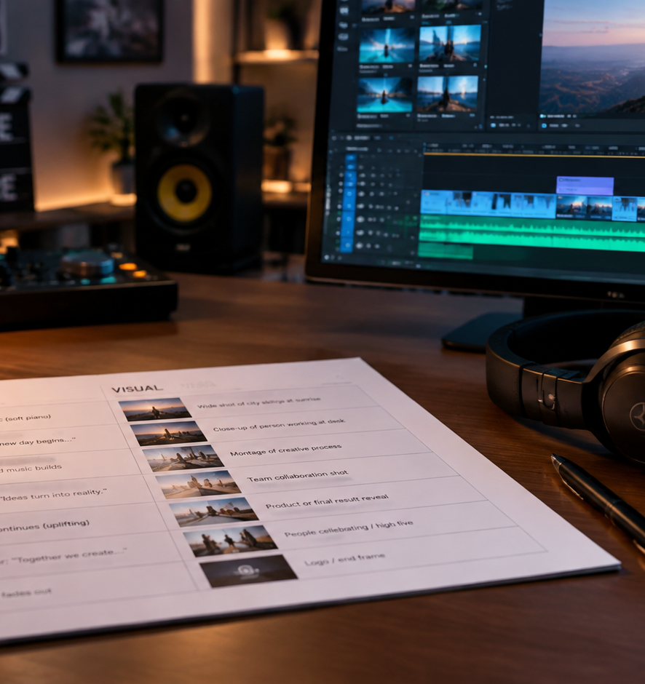
01 / 11
VIDEO PRODUCTION
Avp Script
Two-Column Scripting Standards for Video Production
YIHA
Notes:
Welcome to our technical overview of audio-visual presentation scripting. Today we examine the structure, mechanics, and production workflows of the classic two-column AV script. In corporate, educational, and commercial media, video is not simply written as prose; it is engineered as two parallel streams of information that occur simultaneously. By establishing a shared spatial layout before production begins, teams avoid expensive shoot mistakes and misaligned edits. Throughout this session, we will explore the anatomy of the grid, technical visual notation, audio track conventions, runtime estimation models, cross-functional collaboration practices, format limitations, and the step-by-step drafting sequence from creative brief to final script lock.
Sources:

Slide 2
02 / 11
Dual-Stream Media Architecture in Video Pre-Production
Audio and visual media streams require independent technical planning and synchronized execution.
Reflects technical container architecture separating video and audio data streams
Synchronizes visual proof directly with verbal assertions and marketing messages
Fulfills communication and accessibility needs by planning visual and sound cues
YIHA
Notes:
Video production operates on parallel technical tracks. Digital video files contain distinct video and audio streams that must be muxed and synchronized, as reflected in core media frameworks like the ffmpeg documentation. When we write an AV script, we mirror this architecture in human form. Traditional screenwriting stacks dialogue beneath character action, which works well for emotional theatrical scenes but fails in message-driven formats. Corporate and educational videos require immediate visual proof for every verbal claim made. The AV script forces the writer to define what the viewer sees at the exact moment a line of audio is delivered, ensuring that spoken content and visual context reinforce each other seamlessly.
Sources:
https://ffmpeg.org/ffmpeg.html
https://www.w3.org/WAI/media/av/captions/

Slide 3
03 / 11
Spatial Anatomy of the Two-Column Grid
Dividing the page into video on the left and audio on the right links synchronous moments row by row.
01
Standard layout places visual direction on the left and audio elements on the right
02
Discrete horizontal rows map individual production beats and synchronized moments
03
Pre-production row mapping eliminates interpretation errors across creative departments
YIHA
Notes:
The visual structure of the AV script is deliberately simple yet rigorous. As documented in production guidance from the University of Florida EDIS publication AEC343, dividing the page creates a spatial grid where video instructions occupy the left side and audio instructions occupy the right side. Resources from StudioBinder and Beefed AI emphasize that each row represents a distinct production event. When an editor looks across a single row, there is zero ambiguity about which graphic or camera angle pairs with which sentence of voiceover. This row-based alignment provides immediate clarity across all production stages.
Sources:
https://ask.ifas.ufl.edu/publication/WC024
https://www.studiobinder.com/templates/av-scripts/two-column-script-template/
https://beefed.ai/en/two-column-av-script-template

Slide 4
04 / 11
Engineering the Visual Column Directive Track
The visual track must specify shot sizes, camera motion, on-screen text, and graphic assets.
Standard camera framing notation includes wide shots, medium shots, and close-ups
Directs explicit camera movements such as pans, tilts, tracking moves, and zooms
Documents exact on-screen typography, lower thirds, and B-roll asset filenames
YIHA
Notes:
The left column belongs to the visual team. StudioBinder's video scripting guides emphasize that this column must convey technical direction rather than vague prose. Cinematographers and motion graphic artists require concrete parameters. The script should explicitly state the shot size, whether it is an establishing wide shot or an extreme close-up. It must document camera motion, like a slow dolly push or a handheld pan. Furthermore, on-screen text overlays, title banners, and lower thirds must be quoted verbatim. Educational research from the University of Florida notes that showing key text on screen while it is spoken significantly enhances viewer comprehension.
Sources:
https://ask.ifas.ufl.edu/publication/WC024
https://www.studiobinder.com/templates/av-scripts/video-script-template/

Slide 5
05 / 11
Structuring Spoken Dialogue and Sound Design
The audio track details voiceover, sync dialogue, sound effects, and music beds.
Distinguishes voiceover narration from on-camera synchronous dialogue lines
Formats discrete sound effects clearly using prominent SFX labels and brackets
Marks visual-only beats explicitly so crew members recognize intentional pauses
YIHA
Notes:
The right column represents everything heard in the final mix. Following conventions from EpicScribe and CreatorPlanTools, audio directions must clearly differentiate between voiceover, synchronous dialogue, background music, and sound effects. Sound effect cues should be formatted in capital letters and brackets so that voice talent does not mistakenly read sound directions aloud during recording sessions. When a video includes a demonstration that requires visual focus without narration, the writer should explicitly mark the cell as visual only. Leaving a cell blank risks causing crew members to assume the script is incomplete.
Sources:
https://epicscribe.io/blog/writing-sound-effects-audio-drama-scripts.html
https://creatorplantools.com/guides/two-column-video-script-template
https://www.studiobinder.com/templates/av-scripts/two-column-script-template/

Slide 6
06 / 11
Runtime Estimation and Pacing Synchronization
Row duration tracking and speech timestamping coordinate demonstrations with spoken audio.
01
Adds start and end timestamps per row as an operational planning aid for pacing
02
Example: A six-second demonstration row counts toward total runtime without words
03
Synchronizes timestamped speech cues to prevent viewer cognitive disconnect
YIHA
Notes:
Controlling video runtime requires detailed pacing coordination. Production guidelines from CreatorPlanTools show that adding an optional timing column with rough start and end timestamps, such as 00:00 to 00:08, ensures that demonstrations and spoken lines stay synchronized. The script must budget non-verbal demonstration time; for instance, holding a close-up while pressing tape flat requires six seconds of video time even though zero words are spoken. Forcing narration into that space to satisfy arbitrary word counts undermines viewer comprehension. As W3C accessibility guidelines note, accurate temporal alignment between spoken information and visual cues is essential for clear understanding.
Sources:
https://creatorplantools.com/guides/two-column-video-script-template
https://www.w3.org/WAI/media/av/captions/

Slide 7
07 / 11
Cross-Functional Alignment Across Departments
The two-column script unites writers, crew, animators, and clients on a single working document.
Prevents translation loss between scriptwriting, cinematography, and editing
Provides clients with clear visual context alongside marketing and technical claims
Includes explicit asset naming and version metadata in script headers
YIHA
Notes:
Video production involves multiple distinct disciplines that often interpret text differently. Analysis from Beefed AI highlights that projects suffer when scripts mix visual notes and vague audio cues without clear alignment, leading to last-minute on-set guesswork, re-shoots, and post-production rework. The two-column AV script prevents this translation failure. Directors and camera operators use the visual column to build call sheets and shot lists. Voice artists record directly from the audio column. Motion graphic designers receive exact typographic text and asset file paths. Clients can approve copy with full knowledge of the visuals that support it.
Sources:
https://beefed.ai/en/two-column-av-script-template
https://www.studiobinder.com/templates/av-scripts/two-column-script-template/

Slide 8
08 / 11
Two-Column AV Format Versus Screenplay Format
Single-column screenplays serve narrative drama, while two-column AV scripts excel in message media.
Screenplay formats prioritize dramatic action lines and sequential dialogue flow
Two-column scripts emphasize precise spatial synchronization between word and image
Production rule: Use screenplays for character drama and AV formats for commercial video
YIHA
Notes:
Industry practitioners often ask when to use a standard screenplay layout versus a two-column AV script. As Scriptease and StudioBinder explain, the rule of thumb depends on narrative versus message-driven structure. Narrative film and episodic television rely on standard master scene formatting, where character actions and dialogue are read in a single vertical stream. However, in short-form corporate videos, commercials, and training content, tight synchronization between specific spoken words and visual graphics is essential. A single-column format cannot cleanly show that a graphic must appear precisely on the fourth word of a sentence, making the two-column grid the standard choice.
Sources:
https://scriptease.app/blog/av-two-column-script-format/
https://www.studiobinder.com/templates/av-scripts/two-column-script-template/

Slide 9
09 / 11
Structural Limitations and Production Failure Modes
The two-column format struggles with rapid ensemble dialogue and non-linear interactive structures.
01
Rapid ensemble character dialogue fractures the grid into awkward visual cells
02
Non-linear branching interactive narratives require specialized flowcharts
03
Unlinked word processing tables risk vertical drift between audio and visuals
YIHA
Notes:
While the two-column AV script is ideal for short-form structured content, it has clear structural limitations. As highlighted by Celtx, trying to write complex, multi-character theatrical scenes in two columns leads to fragmented, unnatural visual cells that disrupt dialogue flow during rehearsals. Furthermore, non-linear interactive media with multiple user paths cannot be effectively mapped within a simple two-column document. Finally, when teams draft AV scripts in basic word processors without dedicated row locking, editing one column can cause text rows to drift out of alignment with adjacent cells, creating confusing instructions for the production crew.
Sources:
https://blog.celtx.com/essential-av-script-template-for-better-video-scripts/
https://content.terabox.com/hub/how-to-use-and-format-a-script-template-in-google-docs

Slide 10
10 / 11
Production Lifecycle: From Brief to Final Lock
A disciplined multi-stage workflow protects budgets by securing approvals before filming.
Draft audio narration first to secure message tone, runtime, and logical flow
Map visual cues, shot sizes, and graphic assets directly against audio rows
Conduct stopwatch read-throughs and lock scripts before recording voice talent
YIHA
Notes:
A reliable AV script drafting workflow follows five clear phases. First, extract goals, audience parameters, and runtime constraints from the creative brief. Second, outline and write the audio column first, establishing tone and flow before visual mapping. Third, populate the visual column with specific shot framing, camera movements, and graphic callouts. Fourth, conduct a live read-through with a stopwatch to verify speech pacing and visual demonstration lengths. Finally, secure formal sign-off from all stakeholders before recording professional voice talent. As the University of Florida notes, changing voiced audio after production is exceptionally difficult and expensive.
Sources:
https://ask.ifas.ufl.edu/publication/WC024
https://www.studiobinder.com/templates/av-scripts/two-column-script-template/

Slide 11
11 / 11
Mastering the Audio-Visual Pre-Production Standard
Rigorous AV scripting turns creative ideas into structured, predictable production assets.
Aligns sight and sound through disciplined row-by-row horizontal pairing
Bridges communication across creative writers, technical crews, and clients
Standardizes technical notation to avoid expensive re-shoots and editing delays
YIHA
Notes:
In conclusion, the two-column audio-visual script remains an essential industry tool for non-narrative media production. By separating sight and sound into synchronized parallel tracks, it establishes a reliable contract between creative intent and technical execution. Whether you are producing an internal training module, a high-stakes commercial spot, or an educational explainer, investing the time to build a detailed, timed, and locked AV script protects your production budget and ensures that your message lands with clarity on screen. Thank you for your time, and let us open the floor to questions.
Sources:
https://ask.ifas.ufl.edu/publication/WC024
https://www.studiobinder.com/templates/av-scripts/two-column-script-template/

