Slide 1
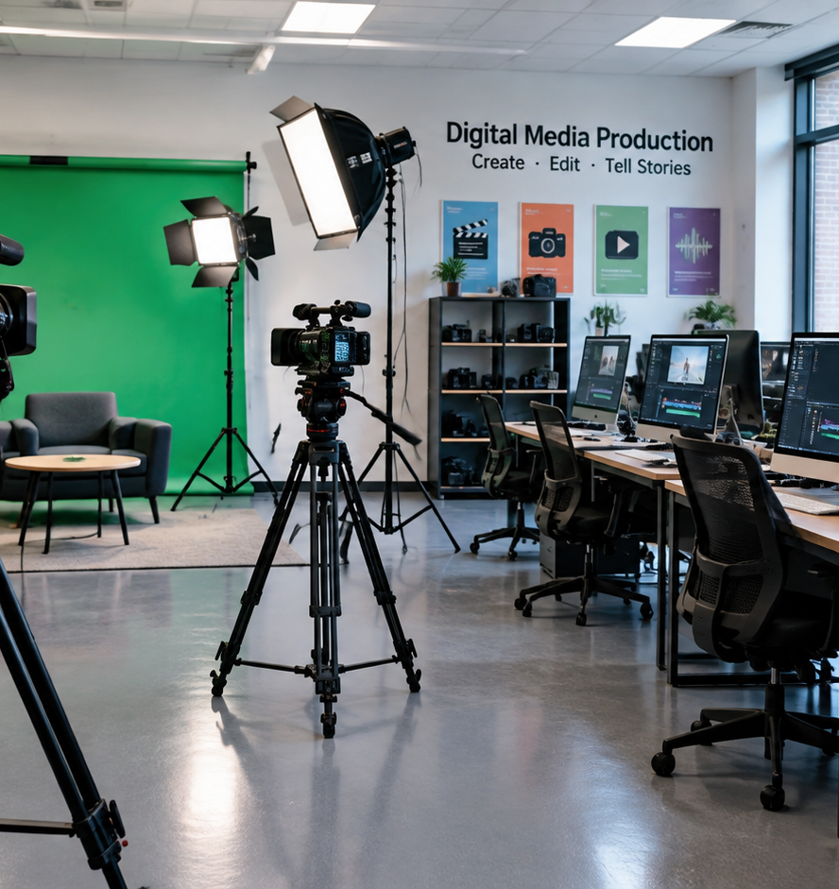
01 / 11
EDUCATION & MEDIA ARTS
Video Production Lesson Plans
Structured Frameworks and Classroom Best Practices for Media Arts Educators
YIHA
Notes:
Welcome to this comprehensive instructional presentation on designing secondary and post secondary video production lesson plans. As media educators, our goal is to bridge imaginative visual storytelling with industry standard technical competencies. When video programs rely solely on unstructured assignments, students often miss essential foundational skills and documentation gets lost when faculty transition. By anchoring our curricula in Career and Technical Education standards, we create durable learning pathways that foster critical thinking, digital literacy, and collaborative teamwork. Over the course of this presentation, we will examine each critical phase of the media arts curriculum, including pre-production scripting, camera operation, studio lighting safety, audio recording, editing architecture, ethics, rubrics, and demo reel curation. These strategies ensure our classrooms prepare students for lifelong creative and vocational success.
Sources:

Slide 2
02 / 11
Standards-Based Media Arts Curriculum
Aligning video production courses with CTE standards ensures measurable student outcomes and enduring program stability.
Embed industry-informed employable skills directly into classroom lesson objectives
Document repeatable curriculum structures so courses survive educator transitions
Balance technical camera operations with soft skills like collaboration and punctuality
YIHA
Notes:
Grounding media arts curricula in recognized educational frameworks protects program sustainability and equips students with career-ready capabilities. As documented by EditMentor, developing a formal curriculum creates an institutional legacy so valuable media programs do not disappear when retiring teachers leave. In California, educators collaborated with industry partners through the Department of Education to ensure Career and Technical Education standards teach employable skills. The curriculum must balance hard technical mechanics with essential workplace habits like punctuality, peer communication, and project accountability. Ziflow further illustrates that organizing creative media projects into structured sequential stages prevents chaotic workflows, missed deadlines, and uncoordinated reviews. By codifying these standards into daily lesson plans, media educators help students build transferable digital literacy while producing dynamic creative work.
Sources:
https://editmentor.com/blog/video-production-lesson-plans/
https://www.ziflow.com/blog/video-production-workflow

Slide 3
03 / 11
Pre-Production Foundations
Requiring complete scripts and storyboards before equipment checkout ensures efficient and focused shooting sessions.
01
Conduct table readings of student scripts to evaluate narrative rhythm and character roles
02
Mandate scripts and shot lists prior to camera equipment checkout
03
Use storyboards as visual roadmaps to establish shot framing and scene pacing in advance
YIHA
Notes:
Pre-production forms the essential structural foundation for all student filmmaking projects. Research from Video Production Agency explains that storyboarding originated in the 1920s animation studios of Walt Disney, where detailed sketches allowed creative teams to experiment with camera angles, narrative rhythm, and scene compositions before production began. In the modern classroom, pre-production planning prevents chaotic shooting sessions and equipment mismanagement. EditMentor recommends requiring students to submit completed scripts, detailed shot lists, and storyboard cells before granting access to camera checkouts. Additionally, conducting classroom table readings allows student peers to act out screenplays, evaluate character roles, and refine dialogue cadence prior to filming. This rigorous planning stage ensures that production days run smoothly, saving classroom time and elevating the quality of finished student films.
Sources:
https://editmentor.com/blog/video-production-lesson-plans/
https://www.videoproductionagency.com/what-is-a-storyboard-and-how-is-it-used-in-filmmaking/

Slide 4
04 / 11
Cinematography and Visual Grammar
Hands-on filming drills teach camera mechanics, shot framing scales, and intentional visual storytelling in class.
Introduce intentional shot framing including high angles, low angles, and Dutch tilts
Use shooting boards to specify technical camera movements and lens selections
Example: assign one-minute silent visual narrative drills to practice framing
YIHA
Notes:
Developing visual grammar requires structured camera drills that move students from equipment basics to deliberate framing choices. Analysis by Video Production Agency shows that deliberate shot composition, camera angles, and shot sizes communicate emotional tone and meaning to audiences. Students learn how varying perspective through high angles, low angles, or Dutch tilts changes viewer perception. To build practical handling confidence, EditMentor highlights project-based exercises such as shooting one-minute silent films or two-minute news packages. These focused assignments allow students to experiment with framing mechanics and spatial relationships without getting lost in complicated narrative plots. Additionally, pairing advanced upperclassmen with incoming freshmen creates a supportive peer mentoring environment that reinforces safe camera handling, collaborative set etiquette, and visual storytelling discipline across the entire classroom.
Sources:
https://editmentor.com/blog/video-production-lesson-plans/
https://www.videoproductionagency.com/what-is-a-storyboard-and-how-is-it-used-in-filmmaking/

Slide 5
05 / 11
Studio Safety and Lighting Setup
Strict studio safety protocols and clear crew role assignments build disciplined professional set habits.
Assign clear studio roles including director, cinematographer, and audio technician
Example: demonstrate key and fill lighting setups on an interview subject
Enforce physical set safety rules to prevent tripping hazards from studio cables
YIHA
Notes:
Studio management requires establishing strict equipment safety procedures alongside crew role assignments before operating studio gear. Curated lesson frameworks on Lesson Planet emphasize that students must investigate specific production roles and compile reference guides covering location scouting and physical set preparation. EditMentor notes that allocating distinct roles, including director, cinematographer, and audio technician, establishes clear accountability during set operations. For an illustrative example of studio lighting practice, instructors can demonstrate how a primary key light establishes facial exposure while a fill light controls contrast and a backlight separates the talent from dark backgrounds. Instructors should emphasize physical safety recommendations, ensuring that all light stands are properly balanced and studio cables are taped down cleanly to prevent tripping hazards during fast-paced student shoots.
Sources:
https://www.lessonplanet.com/search?keywords=video+production
https://editmentor.com/blog/video-production-lesson-plans/

Slide 6
06 / 11
Field Audio and Sound Design
High-quality audio requires dedicated sound operators on set and careful track balancing during post-production.
01
Designate dedicated student audio technicians to monitor recording during shoots
02
Clean dialogue tracks, balance levels, and add sound effects in post-production
03
Recommendation: capture sixty seconds of room tone on location to smooth dialogue cuts
YIHA
Notes:
Capturing clear production audio requires disciplined set practices and careful post-production balancing. EditMentor stresses that every production crew needs a dedicated audio technician responsible for capturing sound assets during filming exercises. In post-production, as detailed in workflow frameworks from Ziflow, dedicated sound design and mixing stages are required to clean dialogue tracks, integrate atmospheric effects, and balance overall audio levels. Media instructors should provide practical guidance on microphone selection, directing students to choose directional microphones for location dialogue while managing ambient noise. Recommendation: Instructors should teach crews to record sixty seconds of ambient room tone at each filming location to create seamless audio transitions during dialogue editing. These deliberate field sound habits prevent common technical errors that distract viewers from well-composed visual footage.
Sources:
https://www.ziflow.com/blog/video-production-workflow
https://editmentor.com/blog/video-production-lesson-plans/

Slide 7
07 / 11
Non-Linear Editing and Asset Management
Systematic folder structures, metadata logging, and multi-pass editing workflows prevent lost assets and confusion.
Establish standardized directory structures for raw footage, audio assets, and project files
Utilize modern non-linear editing software to assemble rough cuts and manage media
Mandate iterative revision stages rather than accepting first draft timeline exports
YIHA
Notes:
Post-production efficiency depends on rigorous digital asset organization and structured review cycles. According to Apple, professional editing platforms like Final Cut Pro optimize performance by transcoding footage into Apple ProRes, enabling smooth timeline playback, rapid background rendering, and comprehensive audio and color controls. Ziflow explains that systematic asset management, including descriptive file naming, timecode logging, and metadata tagging, keeps complex projects organized across multiple drafts. Furthermore, EditMentor cautions against treating editing as an unstructured free-for-all, noting that editing sessions are most productive when paired directors and editors execute focused cuts. Most importantly, instructors must mandate iterative revision stages rather than accepting first draft timeline exports, teaching students that professional post-production relies on constructive notes, precise trims, and meticulous final polishing.
Sources:
https://www.apple.com/final-cut-pro/
https://www.ziflow.com/blog/video-production-workflow
https://editmentor.com/blog/video-production-lesson-plans/

Slide 8
08 / 11
Media Ethics and Copyright Compliance
Instruction in intellectual property, royalty-free licensing, and compliance checkpoints builds ethical creators.
Teach students why commercial music and media clips require proper legal authorization
Illustrative example: require signed talent releases for all on-screen interview subjects
Guide students to source legal background audio from verified royalty-free repositories
YIHA
Notes:
Media ethics and legal compliance are essential components of responsible digital literacy in media education. EditMentor highlights that video production curricula should foster digital literacy and cultural awareness, teaching students to evaluate media messages thoughtfully. Ziflow notes that professional distribution workflows establish formal compliance checkpoints, where completed cuts undergo legal review before multi-platform delivery. In the classroom, instructors must teach students why unauthorized copyrighted music and commercial video clips cannot be used in student projects. Platforms like Visme highlight the importance of utilizing copyright-free and royalty-free media assets for legitimate project creation. Illustrative example: When producing a short documentary or news piece, students must secure signed talent appearance releases and source background music exclusively from verified Creative Commons or public domain archives.
Sources:
https://www.ziflow.com/blog/video-production-workflow
https://www.visme.co/ai-lesson-plan-generator/

Slide 9
09 / 11
Formative Critiques and Rubric Design
Objective assessment criteria across camera framing, audio clarity, and pacing remove subjective grading biases.
01
Implement objective criteria categories covering composition, audio clarity, and pacing
02
Conduct structured peer critique sessions focused on specific narrative and craft elements
03
Assess collaborative teamwork alongside final digital media file deliverables
YIHA
Notes:
Fair evaluation in media arts requires transparent, objective assessment frameworks that separate technical execution from subjective taste. Guidelines published by University of Technology Sydney outline key video assessment categories, including recording clarity, shot composition, lighting, framing, editing flow, personal presentation, and collaborative teamwork. These criteria can be implemented through analytical rubrics that clarify expectations for both instructors and learners. EditMentor emphasizes that peer feedback and collaborative reviews teach students how to receive constructive critique and complete professional commitments on schedule. Implementing structured critique protocols, where students evaluate specific technical criteria such as dialogue clarity and pacing, encourages thoughtful self-reflection. Requiring a formal revision cycle based on rubric feedback ensures that assessment actively drives student growth rather than merely grading a final product.
Sources:
https://educationexpress.uts.edu.au/collections/using-video-for-assessment/resources/video-assessment-criteria-categories/
https://editmentor.com/blog/video-production-lesson-plans/

Slide 10
10 / 11
Portfolio Curation and Career Pathways
Demo reels, authentic client projects, and software certifications build compelling career pathways for media students.
Recommendation: partner with community clients to produce promotional and news packages
Guide students to assemble focused demo reels highlighting specific production roles
Prepare students for industry recognized software credentials to validate vocational skills
YIHA
Notes:
The culminating milestone of a media arts pathway is assembling an authentic showcase of student craftsmanship. EditMentor emphasizes that college professors and vocational educators should align curricula with industry standards and help students secure real employment opportunities. Connecting students with authentic community clients, such as local small businesses, school programs, or municipal councils, provides invaluable experience and builds high-quality demo reels. Furthermore, earning industry credentials, such as official editing software certifications, provides external verification of vocational competency. Digital presentation tools, as documented by Visme, enable students to assemble interactive portfolios and visual roadmaps that display their creative journey. Graduating with a focused demo reel, client references, and recognized technical credentials gives media arts students a substantial advantage when entering higher education or the creative workforce.
Sources:
https://editmentor.com/blog/video-production-lesson-plans/
https://www.visme.co/ai-lesson-plan-generator/

Slide 11
11 / 11
Building Sustainable Media Programs
Structured lesson planning unites vocational discipline with artistic expression to build enduring student success.
Standardize end-to-end production workflows across all classroom media projects
Empower student collaboration through clearly assigned on-set crew responsibilities
Prepare confident media creators equipped with transferable digital literacy skills
YIHA
Notes:
In conclusion, building structured video production lesson plans transforms media classrooms into engaging vocational environments. By uniting Career and Technical Education standards with rigorous pre-production planning, disciplined camera mechanics, safe studio practices, organized editing workflows, and objective rubric assessments, educators prepare students for dynamic creative futures. As emphasized throughout the pedagogical guidelines from EditMentor, codifying lesson plans into documented curricula ensures that school media programs remain sustainable, measurable, and resilient across faculty transitions. Moving beyond unstructured filming activities to systematic media arts education empowers students to become skilled visual storytellers, critical media consumers, and collaborative workplace professionals capable of meeting the demands of modern digital industries.
Sources:
https://editmentor.com/blog/video-production-lesson-plans/

