Slide 1
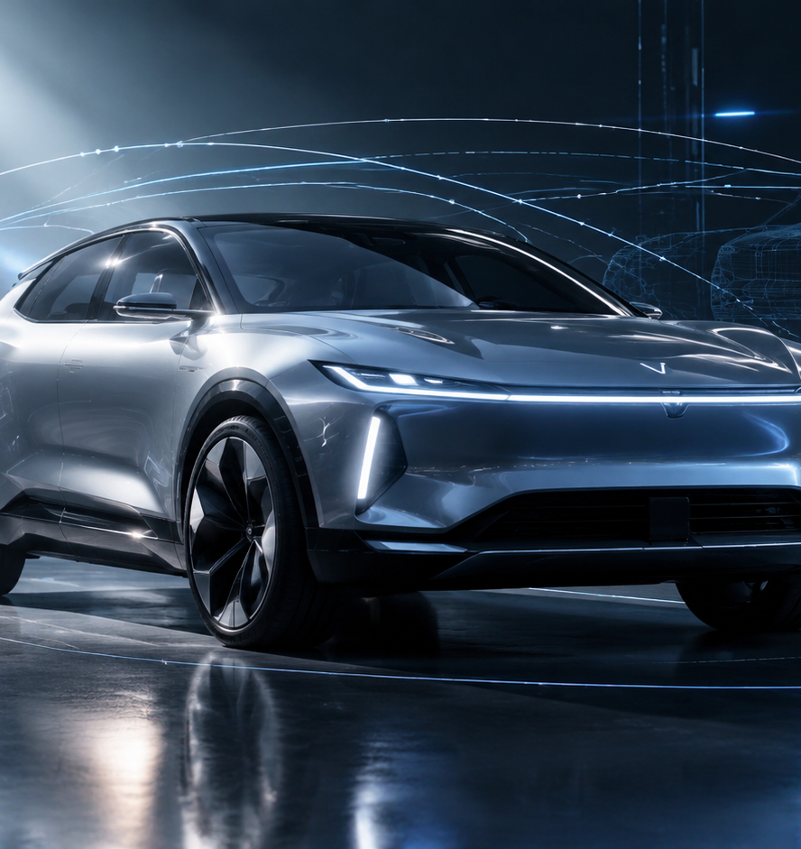
01 / 11
AUTOMOTIVE TECHNOLOGY
Car Presentation AI Video Maker
Architectures, Workflows, and Quality Controls for Automotive Video Generation
YIHA
Notes:
Welcome to this technical briefing on car presentation AI video makers. Today we explore how generative video diffusion models, multi-stage pipeline architectures, and multimodal audio systems are changing automotive product demonstrations. Creating vehicle presentations historically required multi-week rendering schedules in ray-traced computer graphics suites or complex real-time game engine setups. Modern generative models provide an agile alternative, synthesizing dynamic vehicle sequences directly from slide content, reference imagery, and structured prompts. However, transitioning from experimental generation to production-grade showcases requires disciplined pipeline engineering, reliable brand consistency controls, and automated quality gating. Over the next ten slides, we review the machine learning architectures, camera controls, integration architectures, and operational guardrails necessary to deploy automated car presentation video makers at enterprise scale.
Sources:

Slide 2
02 / 11
Transitioning from Traditional CGI to Generative Video
Multi-stage draft rendering and caching architectures reduce compute overhead in automotive video production.
Generative pipelines replace manual ray-traced rendering with rapid draft loops
Multi-stage preview drafts allow quick validation of camera motion and pacing
Production APIs implement Redis and CDN caching to prevent duplicate GPU inference
YIHA
Notes:
Traditional automotive CGI pipelines rely on ray-traced offline render farms that calculate physical light bounces across high-polygon vehicle meshes. While accurate, these workflows are slow and costly when marketing teams require dozens of regional background variations or trim configurations. As detailed by Undercode Testing in their 2026 workflow analysis, advanced production pipelines resolve this by breaking the generative loop into multi-stage draft rendering. Creative teams generate low-resolution preview passes to evaluate spatial motion, transition logic, and framing before initiating neural super-resolution upscaling to final resolution. Furthermore, as Saifullah Adenwalla highlights on SitePoint, deploying generative video APIs requires a dedicated caching layer, such as Redis coupled with content delivery networks. Caching repeated prompt queries prevents redundant, costly GPU inference cycles and protects client-facing interfaces from unpredictable generation latency.
Sources:
https://undercodetesting.com/breaking-the-generative-loop-advanced-ai-video-production-pipelines-and-creative-workflow-engineering-video/
https://www.sitepoint.com/building-dynamic-interfaces-integrating-generative-video-apis-into-web-applications/

Slide 3
03 / 11
Video Diffusion Architectures and World Models
Temporal latent layers and cross-frame attention preserve vehicle motion and temporal coherence.
01
Latent diffusion models insert temporal layers into image backbones for video synthesis
02
Evaluations on driving video datasets confirm high-resolution temporal consistency
03
Zero-shot cross-frame attention anchors subsequent frames back to the opening shot
YIHA
Notes:
Pure image diffusion models synthesize photorealistic individual frames, but naive sequence generation suffers from severe temporal flicker. In their foundational research on Latent Diffusion Models, Blattmann and colleagues demonstrated that pre-trained image generators can be converted into high-resolution video models by inserting temporal layers and fine-tuning on encoded video sequences. Their Video LDM architecture synthesized video up to high resolutions and was validated directly on real driving footage. In parallel, Khachatryan and co-authors introduced Text2Video-Zero, proving that zero-shot video synthesis is achievable without additional video dataset training. Text2Video-Zero warps latent codes using motion dynamics and reprograms frame-level self-attention so that each generated frame attends back to the first frame. This anchors vehicle context and foreground geometry across the presentation sequence.
Sources:
https://arxiv.org/abs/2304.08818
https://arxiv.org/abs/2303.13439

Slide 4
04 / 11
Parametric Camera Controls and Motion Trajectories
Cinematic automotive shots succeed when prompts describe exact physical mechanics rather than jargon.
Dolly zooms require explicit instructions pairing forward camera motion with lens zoom
Parallax lateral tracking reliably generates high depth perception with minimal artifacts
Isolating focal length from physical camera movement prevents unintended frame cropping
YIHA
Notes:
Automotive showcases rely on dynamic cinematic shots, including sweeping orbits, low-angle tracking, and reveal passes. However, empirical testing published by Gigwise in September 2026 demonstrates that high-level film jargon frequently fails in generative video models. Compound terms such as contra-zoom, trombone shot, or roll-and-reveal produce plain push-in shots or fail outright. The study revealed that models comply when prompts describe exact mechanical movements, such as specifying that the camera dollies in while the lens zooms out so the subject remains centered while the background warps. Similarly, documentation from VideosPrompt emphasizes the necessity of separating camera translation from focal length adjustments. Conflating a dolly with an optical zoom causes models to digitally crop frames rather than moving through physical space, flattening the perceived curvature of the vehicle.
Sources:
https://www.gigwise.com/ai-video-generator-camera-moves-40-cinematic-shots-tested/
https://videosprompt.org/blogs/cinematic-camera-movement-ai-video-prompts

Slide 5
05 / 11
Preserving Vehicle Geometry and Brand Consistency
Multi-angle reference imagery and hybrid 2D-3D latents enforce vehicle badge and contour fidelity.
Reference image anchoring maintains consistent vehicle appearance across multiple scenes
Providing multiple camera angles of the vehicle improves styling stability across cuts
Hybrid latent architectures combine 2D detail injection with 3D causal decoding
YIHA
Notes:
Automotive branding demands strict geometric fidelity, because any morphing of grille meshes, brand logos, or headlight signatures breaks commercial utility. As analyzed by MindStudio regarding video reference systems, conditioning video generation on static reference images produces far higher visual consistency than relying on text prompts alone. Feeding multi-angle reference photos allows the diffusion model to preserve styling cues across an entire presentation storyboard. On the research frontier, the Mirage architecture documented by Wang and colleagues tackles coherent asset insertion in driving environments. Mirage injects temporally agnostic latents from a pre-trained 2D encoder into a 3D variational autoencoder decoder, restoring fine geometric surface details without violating temporal causality. Furthermore, its two-stage alignment strategy coordinates coarse 3D placement with fine 2D refinement to eliminate vehicle pose misalignment.
Sources:
https://www.mindstudio.ai/blog/what-is-sora-reference-system-character-consistency
https://arxiv.org/abs/2512.24227

Slide 6
06 / 11
Multimodal Generation with Synchronized Audio
Frame-accurate temporal annotation aligns synthetic powertrain audio and voiceovers with vehicle dynamics.
01
Multimodal models require strict temporal alignment between acoustic cues and visual events
02
Automated timestamping requires human validation to eliminate audio drift and offset errors
03
Harmonizing engine notes and voiceovers prevents misleading cross-modal representations
YIHA
Notes:
A compelling car presentation requires cohesive sound design, where exhaust notes, tire dynamics, and professional voiceover match vehicle maneuvers on screen. As Annotera highlights in their technical documentation on audio-video sync annotation, multimodal artificial intelligence models depend on frame-accurate temporal alignment. When acoustic events and visual actions diverge by fractions of a second during training or synthesis, models learn corrupted cross-modal representations that degrade realism. Automated detection tools can propose initial speech boundaries and sound markers, but recording inconsistencies, delayed feeds, and variable frame rates necessitate human-in-the-loop validation. In an automotive presentation pipeline, explicit timestamping ensures that synthetic narration and powertrain acoustics align precisely with visual moments like braking, accelerating, or panning across vehicle trim options.
Sources:
https://www.annotera.ai/services/video-annotation/audio-video-sync-annotation/
https://www.annotera.ai/blog/audio-video-sync-annotation-multimodal-ai/

Slide 7
07 / 11
Automated Pipelines from CAD and Slides to Video
Staged pipelines extract slide text and asset metadata to drive automated multi-scene video rendering.
AI presentation converters extract slide text and still imagery into structured prompts
Automated scripting tools generate multi-language voiceovers and layout transitions
Structured JSON orchestrates asset extraction, draft video synthesis, and timeline assembly
YIHA
Notes:
Automotive dealerships and product teams frequently maintain vehicle details in slide decks and spec sheets. Commercial tools like FlexClip demonstrate how AI-driven PowerPoint converters can ingest slides or product URLs, extract copy and visual assets, and automatically apply multi-language text-to-speech voiceovers and dynamic transitions. Similarly, VEED provides browser-based automated presentation pipelines that transform written prompts and slides into structured video decks. In an enterprise car presentation workflow, engineering data and slide decks serve as ground truth. An orchestration service parses vehicle specs into JSON payloads, calls specialized video diffusion APIs to generate corresponding exterior driving and interior showcase clips, and automatically composites text overlays and synthesized narration into a completed video presentation.
Sources:
https://www.flexclip.com/create/product-video.html
https://www.veed.io/tools/ai-presentation-maker

Slide 8
08 / 11
Evaluating Generative Video Against Traditional 3D
Generative diffusion accelerates iteration velocity but requires automated quality evaluation.
Consistency diffusion models bypass long iterative denoising to enable faster feedback
Rapid iteration loops allow prompt adjustments and scene refinements in shorter cycles
Continuous integration regression testing catches temporal flickering and broken causality
YIHA
Notes:
Comparing generative video against traditional ray-traced game engines reveals significant operational tradeoffs. As reported by OpusClip, consistency diffusion models represent an important architectural evolution, drastically reducing required denoising steps per frame. This acceleration enables creators to review and iterate on multi-scene video presentations in minutes rather than hours. However, traditional 3D engines guarantee deterministic physics, whereas generative models do not. Technical analysis by Inference Systems emphasizes that standard image metrics like FID or PSNR fail to detect video defects such as disappearing geometry or non-physical movements. Enterprise pipelines must therefore implement automated regression testing within continuous integration workflows, measuring optical flow continuity and sequence integrity to reject flawed clips.
Sources:
https://www.opus.pro/blog/14x-faster-ai-video-generation-consistency-diffusion-models
https://inferensys.com/train/long-form-video-event-extraction-model-training/synthetic-long-form-video-data-generation-for-event-training/evaluating-temporal-consistency-and-fidelity-in-generative-long-form-video-for-event-training

Slide 9
09 / 11
Physical Inconsistencies and Generative Limitations
Pure diffusion models face failure modes in wheel rotation, curved reflections, and small emblems.
01
Wheel motion frequently exhibits reverse rotation, static freezing, or road detachment
02
Metallic clear coats and curved body panels suffer from warping surface reflections
03
Efficient attention architectures reduce computational load to expand temporal context
YIHA
Notes:
Because generative video models optimize probabilistic visual distributions rather than rigid physical dynamics, automotive scenes frequently trigger distinct mechanical failure modes. Rotating wheels are notoriously prone to temporal aliasing, appearing to freeze, spin backward, or lose contact with the road plane. Furthermore, curved vehicle clear coats require complex optical reflections, and diffusion models frequently warp ambient reflections across car doors and hoods as the camera moves. As documented in research by Blattmann and colleagues on Stable Video Diffusion, rigorous dataset curation and multi-stage pretraining are required to improve motion representations. Moreover, research compiled in Awesome Video Attention shows that efficient attention techniques reduce computational load, enabling models to handle longer temporal contexts that help reduce these physical motion errors.
Sources:
https://arxiv.org/abs/2311.15127
https://github.com/hao-ai-lab/Awesome-Video-Attention

Slide 10
10 / 11
Enterprise Deployment and Production Governance
Scalable video generation requires centralized asset libraries, quality gates, and API workflows.
Centralized asset libraries store approved logos, color hex codes, and reference photos
Systematic quality control reviews track prompt effectiveness and identify workflow gaps
Scriptable HTTP APIs allow seamless scaling from browser tests to automated rendering
YIHA
Notes:
Scaling car presentation video makers across enterprise automotive organizations requires systems-level production engineering. In their marketing systems analysis, Auralume AI emphasizes that scaling video generation is fundamentally a workflow problem rather than an isolated model choice. Organizations must establish centralized asset repositories containing verified logo files, exact brand color definitions, and approved reference photography. Tracking workflow efficiency is critical, as monitoring quality control pass rates helps engineering teams identify when prompt matrices or input references require immediate tightening. Complementing operational governance, platforms like RunComfy demonstrate how models such as Wan 3.0 transition from interactive UI playgrounds to programmatic HTTP APIs. This allows engineering teams to automate multi-scene vehicle rendering with reproducible seeds, fixed aspect ratios, and synchronized audio tracks directly within production applications.
Sources:
https://auralumeai.com/posts/how-to-build-a-scalable-ai-video-production-workflow-for-marketing-that-actually
https://www.runcomfy.com/models/wan-ai/wan-3.0/text-to-video

Slide 11
11 / 11
Building Robust Automotive Video Makers
Combining diffusion architectures with structured pipelines enables scalable car video presentation.
Generative diffusion accelerates video turnaround from weeks to minutes
Mechanical prompt syntax and reference anchors preserve vehicle brand fidelity
Automated evaluation gates and API caching ensure reliable enterprise delivery
YIHA
Notes:
In conclusion, Car Presentation AI Video Makers represent a major technological evolution in automotive product communication. By replacing monolithic offline rendering pipelines with generative diffusion models, automotive teams can produce dynamic, multi-scene video presentations from static engineering slides and spec sheets in minutes rather than weeks. However, achieving production-level reliability requires strict adherence to workflow engineering principles, as documented by Undercode Testing and foundational research by Blattmann and colleagues on Video LDMs. Presenters and developers must replace abstract filmmaking jargon with precise mechanical camera descriptions, anchor brand geometry using multi-angle reference systems, and implement frame-accurate audio-video synchronization. Finally, integrating automated quality evaluation harnesses, Redis caching, and centralized asset governance ensures that automotive organizations can scale video creation without sacrificing brand fidelity or technical reliability.
Sources:
https://undercodetesting.com/breaking-the-generative-loop-advanced-ai-video-production-pipelines-and-creative-workflow-engineering-video/
https://arxiv.org/abs/2304.08818

