Slide 1
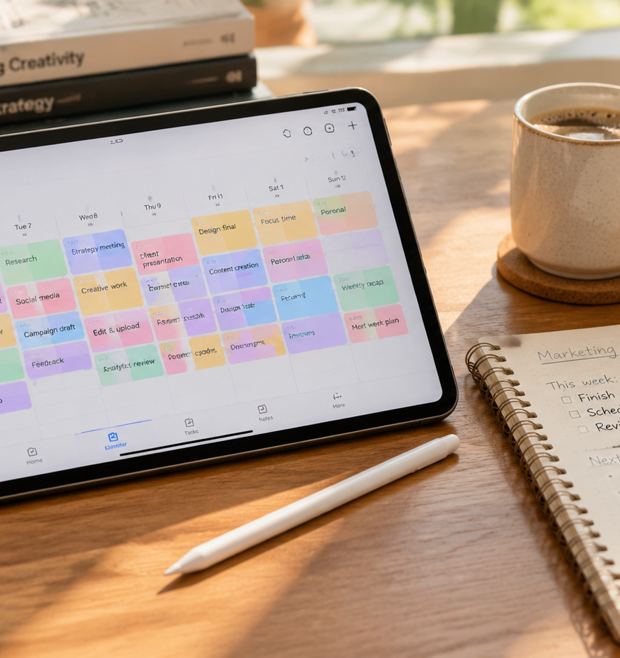
01 / 11
SOCIAL MEDIA STRATEGY
Facebook Content Calendar
Publishing Architecture, Data Schemas, and Operational Governance
YIHA
Notes:
Welcome to this comprehensive overview of building and operating an effective Facebook content calendar. Publishing successfully on a business Page requires operational discipline rather than spontaneous inspiration. When marketing teams operate without an organized schedule, they inevitably face chaotic deadlines, inconsistent post quality, and creative burnout. Over the course of this presentation, we will walk through the core components of an enterprise-grade publishing workflow. We will explore how to construct a robust database schema, navigate Meta distribution dynamics, balance diverse formats such as Reels and Stories, and implement batching protocols. Furthermore, we will examine the governance workflows and crisis pause procedures necessary to protect your brand identity across digital channels. By treating the calendar as a living operational system, your team can maintain continuous alignment with business goals while executing with speed and precision.
Sources:

Slide 2
02 / 11
Purpose and Role of a Facebook Calendar
Structured calendars eliminate operational chaos and align publishing schedules with strategic business priorities.
Transitions Page management from reactive rushes to steady execution
Reveals hidden gaps across marketing themes and customer stages
Provides shared visibility for leadership and cross-functional teams
YIHA
Notes:
Moving from ad hoc posting to an editorial calendar provides operational consistency and strategic alignment across marketing teams. According to Sprout Social at sproutsocial.com/insights/content-calendar, establishing a structured framework brings your marketing strategy to life, guarantees consistent posting schedules, and helps leadership gain clear visibility into planned initiatives. In addition, research from TrySight at trysight.ai/blog/blog-content-calendar highlights that mapping content across quarterly timelines exposes systemic gaps that reactive publishing conceals. Teams can immediately identify whether they are neglecting bottom of funnel considerations, omitting core product updates, or missing key seasonal milestones. Rather than scrambling to determine what copy to write on a given morning, an organized calendar gives every contributor a clear roadmap, reducing team fatigue and reinforcing brand authority over time.
Sources:
https://sproutsocial.com/insights/content-calendar/
https://www.trysight.ai/blog/blog-content-calendar

Slide 3
03 / 11
Core Data Fields and Schema Architecture
Standardized tracking fields organize copy, media files, and approvals into a repeatable pipeline.
01
Logs publish date, exact delivery hour, and targeted post format
02
Stores links to vetted visual assets and finalized copywriting
03
Assigns clear ownership and explicit workflow approval statuses
YIHA
Notes:
A dependable Facebook content calendar relies on an explicit data schema that captures every post variable before publication. As outlined by Sprout Social at sproutsocial.com/insights/social-media-calendar, standardizing essential fields like publishing date, delivery time, post format, copy text, asset links, and approval status ensures accurate execution. Buffer notes at buffer.com/resources/social-media-content-calendar that maintaining a structured overview of all scheduled initiatives enables team leads to allocate graphic design and copywriting resources weeks in advance. When post records include cloud repository links and designated reviewers, team members avoid misplaced assets and last minute confusion. This structural discipline creates an auditable record of all Page activity, transforming an ordinary spreadsheet or database into an efficient operational control center for cross-functional collaboration.
Sources:
https://sproutsocial.com/insights/social-media-calendar/
https://buffer.com/resources/social-media-content-calendar/

Slide 4
04 / 11
Feed Distribution Dynamics and Cadence
Publishing frequency should reflect sustainable team capacity and genuine audience appetite.
Aligns cadence with team capacity to avoid creative exhaustion
Buffer platform study identified Thursday morning windows as peak
Engagement shows marked reductions during weekend posting windows
YIHA
Notes:
Determining publishing cadence requires balancing audience consumption patterns against internal production capacity. Writesy explains at writesy.ai/blog/content-calendar-how-often-post that the correct posting frequency is the rate your team can sustain without compromising editorial quality, warning that arbitrary quotas create superficial content. Regarding timing, Buffer evaluated Facebook publishing patterns at buffer.com/resources/best-time-to-post-on-facebook and identified Thursday morning at nine o'clock as a peak engagement period, with weekday mornings consistently outperforming weekends. Engagement dropped significantly on Saturdays across their dataset. However, universal industry figures should serve only as initial baselines for experimentation. Page managers must analyze their specific audience analytics to determine when their own community members actively interact with feed updates.
Sources:
https://buffer.com/resources/best-time-to-post-on-facebook/
https://www.writesy.ai/blog/content-calendar-how-often-post

Slide 5
05 / 11
Balancing Formats Across the Publishing Week
Combining video Reels, image carousels, text, and Stories supports diverse engagement goals.
Reels deliver discovery potential to connect with non-followers
Static graphics and carousels foster community discussions
Stories offer daily interactive touchpoints and real-time notices
YIHA
Notes:
Maintaining an engaging Facebook Page requires diversifying formats across the weekly schedule rather than relying exclusively on a single post type. UpGrad explains at upgrad.com/blog/content-calendar-template that varying content formats across weekly blocks prevents feed monotony and keeps audience attention fresh. In addition, The Small Business Expo notes at thesmallbusinessexpo.com/blog/content-calendar-template that structuring weekly calendars around defined thematic pillars ensures that each post targets a distinct marketing objective. Short video Reels excel at organic reach among non-followers, while photo carousels and text discussions deepen engagement with existing fans. Ephemeral Stories provide an informal channel for daily updates and interactive polls. Planning these distinct formats in advance ensures creative teams produce assets according to proper technical specifications.
Sources:
https://www.upgrad.com/blog/content-calendar-template/
https://www.thesmallbusinessexpo.com/blog/content-calendar-template/

Slide 6
06 / 11
Meta Business Suite Versus Dedicated Tools
Native tools provide free foundational scheduling while third-party platforms support multi-channel workflows.
01
Meta Business Suite handles free native Page scheduling and Reels
02
Third-party software unifies cross-network posting and analytics
03
Dedicated suites introduce advanced governance for multi-user teams
YIHA
Notes:
Selecting the right tool depends on your team size and operational complexity. Sprout Social points out at sproutsocial.com/insights/schedule-facebook-posts that Meta Business Suite provides an accessible, zero cost native scheduling environment that enables small businesses to schedule posts, manage Reels, and review basic metrics across Facebook and Instagram. However, as Young Urban Project explains at youngurbanproject.com/11-best-content-calendar-tools-to-plan-schedule-automate, enterprise organizations and multi-brand agencies frequently outgrow native limitations. Dedicated third-party management tools provide multi-channel distribution, advanced role permissions, unified community inboxes, and sophisticated analytics dashboards. While third-party software introduces recurring licensing costs, it eliminates the manual friction of switching between multiple separate network dashboards, making it essential for complex multi-platform marketing teams.
Sources:
https://sproutsocial.com/insights/schedule-facebook-posts/
https://www.youngurbanproject.com/11-best-content-calendar-tools-to-plan-schedule-automate/

Slide 7
07 / 11
Production Batching and Asset Staging
Batching creative and editorial tasks creates a reliable buffer that prevents last-minute delays.
Recommendation: Consolidate drafting into dedicated weekly blocks
Recommendation: Place at least one buffer day between task handoffs
Stage approved visual media in centralized folders before scheduling
YIHA
Notes:
Drafting social copy and designing visual assets on the day of publication introduces unnecessary stress and inevitable mistakes. Zapier recommends at zapier.com/blog/content-calendar-template that teams include cushion time in their calendar, specifically advising at least one buffer day between creation phases and task handoffs to manage unexpected delays smoothly. TrySight explains at trysight.ai/blog/blog-content-calendar that establishing clear content formats in advance allows writers and designers to align their production schedules with realistic expectations. By batching copywriting, visual staging, and asset formatting into dedicated focus blocks, marketing teams create a dependable pipeline of pre-approved posts. Staging completed media assets inside organized repositories guarantees that all creative components are validated before entering the live scheduling queue.
Sources:
https://zapier.com/blog/content-calendar-template/
https://www.trysight.ai/blog/blog-content-calendar

Slide 8
08 / 11
Review Workflows and Page Governance
Defined approval gates and role permissions protect brand consistency and prevent unvetted updates.
Restricts Page access through role-based administrative permissions
Routes draft captions through designated editorial checkpoints
Designates explicit operational owners for calendar maintenance
YIHA
Notes:
Establishing rigorous governance protocols protects brand reputation and operational security across multi-contributor Page environments. Young Urban Project notes at youngurbanproject.com/11-best-content-calendar-tools-to-plan-schedule-automate that structured approval workflows and role-based access permissions prevent unvetted content from reaching public feeds while preserving client and brand trust. Furthermore, TrySight highlights at trysight.ai/blog/maintaining-seo-content-calendar that successful publishing operations require explicit role ownership, distinguishing between content drafting, editorial verification, and administrative queue management. Assigning granular permissions within Meta Business Suite ensures junior associates or external agency partners can draft updates without possessing unilateral broadcasting authority. These standardized review stages catch factual errors and tone misalignments before content is scheduled for publication.
Sources:
https://www.youngurbanproject.com/11-best-content-calendar-tools-to-plan-schedule-automate/
https://www.trysight.ai/blog/maintaining-seo-content-calendar

Slide 9
09 / 11
Managing Timely Events and Operational Pauses
Flexible planning buffers and clear pause protocols ensure agility during breaking news or crises.
01
Recommendation: Reserve unallocated calendar buffer capacity
02
Establish immediate pause procedures for queues during crises
03
Collaborate in real time using responsive shared database views
YIHA
Notes:
An editorial calendar must remain flexible enough to adapt to fast-moving real-world circumstances. TrySight emphasizes at trysight.ai/blog/blog-content-calendar that over-planning without flexibility is a common failure point, recommending that teams leave unallocated capacity within their publishing pipeline to accommodate breaking industry news and timely interactions. In addition, The Tech Edvocate explains at thetechedvocate.org/how-to-use-airtable-for-content-calendar that utilizing dynamic shared platforms allows teams to collaborate in real time, adjust task records instantly, and notify team members when priorities shift. When critical operational issues or major public events arise, having established protocols to pause scheduled queues prevents automated promotional updates from publishing during sensitive moments, safeguarding the brand against public relations missteps.
Sources:
https://www.trysight.ai/blog/blog-content-calendar
https://www.thetechedvocate.org/how-to-use-airtable-for-content-calendar/

Slide 10
10 / 11
Refining Cadence Through Analytics and Audits
Closing the operational loop with recurring performance audits keeps publishing aligned with audience data.
Recommendation: Conduct a 15-minute weekly audit of published posts
Track retention, reach, and interaction patterns across post types
Feed proven high-performing formats directly into upcoming schedules
YIHA
Notes:
A content calendar functions best as an evolving system guided by ongoing analytical feedback. TrySight explains at trysight.ai/blog/maintaining-seo-content-calendar that separating editorial planning from ongoing performance data creates a severe operational disconnect, recommending a recurring fifteen-minute weekly audit to evaluate pipeline status and post outcomes. Sprout Social notes at sproutsocial.com/insights/social-media-calendar that tracking post metrics alongside specific publishing times allows marketers to pinpoint engagement spikes and optimize future schedules accordingly. Page managers should monitor key signals such as reach, retention, and audience comments within Meta Insights to identify which topics and formats deliver the strongest resonance. Continuously integrating these empirical insights into upcoming monthly schedules ensures your Facebook calendar remains highly effective.
Sources:
https://sproutsocial.com/insights/social-media-calendar/
https://www.trysight.ai/blog/maintaining-seo-content-calendar

Slide 11
11 / 11
Key Principles for Facebook Publishing Success
Operational discipline, format diversity, and iterative auditing turn the calendar into an engine for growth.
Standard schemas and role governance eliminate publishing bottlenecks
Balanced format mixes engage audiences across all funnel stages
Routine data reviews guide future scheduling with factual clarity
YIHA
Notes:
In summary, building a resilient Facebook content calendar bridges the gap between overarching marketing strategy and day to day execution. As Sprout Social highlights across their editorial guides at sproutsocial.com/insights/content-calendar and sproutsocial.com/insights/social-media-calendar, moving to an integrated calendar system protects brand consistency, streamlines team collaboration, and drives measurable business results. By enforcing structured data schemas, pacing format distribution, batching production workflows, maintaining governance controls, and instituting weekly analytical audits, your Page can sustain meaningful community engagement over the long term. Thank you for your time today. We invite you to implement these operational principles within your own team workflows to build a predictable and successful publishing engine.
Sources:
https://sproutsocial.com/insights/content-calendar/
https://sproutsocial.com/insights/social-media-calendar/

