Slide 1
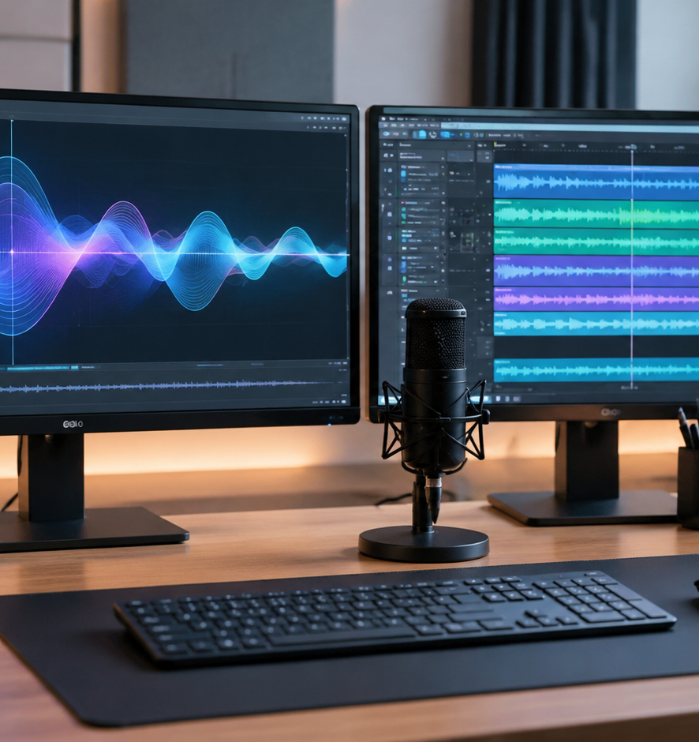
01 / 11
PRESENTATION DESIGN
How To Add Audio In Presentation
Technical Standards, Playback Automation, and Media Optimization
YIHA
Notes:
Welcome to this comprehensive technical briefing on incorporating audio into slide presentations. When designed thoughtfully, audio converts flat slide decks into rich learning experiences and scalable asynchronous resources. However, successful execution demands technical precision across multiple disciplines. You must understand cognitive processing so that spoken narration complements visuals rather than overwhelming the viewer. You also need to manage underlying digital audio codecs to avoid system incompatibilities across Mac and Windows platforms. Finally, you must configure playback automation and guarantee accessibility compliance. In this session, we will explore practical methods for embedding assets, setting triggers, trimming tracks, and verifying delivery hardware.
Sources:

Slide 2
02 / 11
Multi-Channel Delivery and Cognitive Load
Sound must reinforce visual diagrams rather than duplicate written slide copy to avoid cognitive friction.
Human cognition processes visual and auditory information through dual pathways
Redundant onscreen text and spoken narration create cognitive friction
Audio narration provides context that bullet points alone cannot convey
YIHA
Notes:
Instructional design research demonstrates that human working memory processes incoming information through two separate channels: visual and auditory. When a presenter displays dense lines of text while simultaneously reciting the exact same words, both channels compete for processing capacity. This duplication creates cognitive friction and distracts the audience. As detailed in Loom's technical analysis of recorded slide decks, static slides cluttered with bullet points leave audience members struggling to stay engaged. The effective approach is to display visual diagrams on screen while providing explanatory spoken context through the audio track. To explore these recording insights, refer to Loom's guide at https://www.atlassian.com/blog/loom/how-to-video-record-yourself-presenting-a-powerpoint.
Sources:
https://www.atlassian.com/blog/loom/how-to-video-record-yourself-presenting-a-powerpoint

Slide 3
03 / 11
Selecting Reliable Audio Codecs and Containers
Standardize on AAC-encoded M4A or MP3 files to avoid deprecated codecs and cross-platform playback failures.
01
Standardize on AAC encoded M4A or MP3 for cross-platform compatibility
02
PowerPoint version 2505 and later deprecates legacy WMA and AIFF formats
03
Uncompressed WAV files maintain fidelity but expand file sizes significantly
YIHA
Notes:
Selecting the right container and compression codec is vital for cross-platform reliability. According to official Microsoft documentation on supported media formats, PowerPoint strongly recommends MPEG-4 audio with Advanced Audio Coding, or AAC, as well as MP3. In PowerPoint version 2505 and later, legacy formats such as Windows Media Audio and AIFF are deprecated. Although legacy files may undergo automatic conversion during insertion, relying on them creates conversion delays or playback failures on other systems. In particular, WMA files fail on macOS. While uncompressed WAV files maintain pristine audio quality, their massive file sizes inflate presentation archives. For full specifications, review Microsoft Support at https://support.microsoft.com/en-us/powerpoint/video-and-audio-file-formats-supported-in-powerpoint and SoundOn at https://www.soundon.global/forum/best-audio-file-types-for-powerpoint?lang=en.
Sources:
https://support.microsoft.com/en-us/powerpoint/video-and-audio-file-formats-supported-in-powerpoint
https://www.soundon.global/forum/best-audio-file-types-for-powerpoint?lang=en

Slide 4
04 / 11
Embedded Packaging Versus External Linking
Embed audio directly into the OpenXML container to ensure file portability and prevent broken external links.
Use Insert Audio to package media inside OpenXML presentation archives
Embedded assets eliminate broken file paths when distributing decks
Verify file expansion after insertion to confirm media is truly embedded
YIHA
Notes:
Presenters can either embed audio directly within the presentation archive or link to an external file. Modern presentations use the OpenXML zip standard, storing slide definitions alongside embedded media assets. Embedding packages the audio directly inside the container, ensuring the presentation remains intact when sent over email or shared cloud storage. Conversely, external linking points to a file on your local drive. If that linked file is moved, renamed, or deleted, playback breaks during delivery. As explained in WP Reset's media guide, you can verify proper embedding by checking the deck file size before and after insertion. For technical analysis, see WP Reset at https://wpreset.com/how-to-embed-a-video-in-a-powerpoint-a-complete-guide-to-embedding-video-in-powerpoint-presentations-managing-playback-and-troubleshooting/ and Microsoft Q&A at https://learn.microsoft.com/en-us/answers/questions/5438862/powerpoint-updating-and-compressing-audio-files-up.
Sources:
https://wpreset.com/how-to-embed-a-video-in-a-powerpoint-a-complete-guide-to-embedding-video-in-powerpoint-presentations-managing-playback-and-troubleshooting/
https://learn.microsoft.com/en-us/answers/questions/5438862/powerpoint-updating-and-compressing-audio-files-up

Slide 5
05 / 11
In-App Voiceover and Hardware Capture Setup
Use external microphones for clean gain staging and pause during slide transitions to avoid audio drops.
Select dedicated external microphones over laptop internal mics
Configure input gain to avoid clipping and eliminate room reverberation
Pause speaking during slide transitions as native engines mute audio
YIHA
Notes:
Recording narration directly within presentation software requires disciplined audio hygiene. As TechSmith points out in their recording tutorials, relying on integrated laptop microphones introduces fan noise, keyboard clicks, and hollow room resonance. Using a dedicated USB or XLR external microphone produces clean vocal capture. Presenters must stage input levels carefully to prevent clipping on loud syllables while keeping quiet speech above the noise floor. In addition, Loom notes a critical technical constraint: native PowerPoint recording engines momentarily silence audio capture while slide transitions animate. Presenters must briefly pause speaking before advancing to the next slide. Consult TechSmith at https://www.techsmith.com/blog/record-a-presentation/ and Loom at https://www.atlassian.com/blog/loom/how-to-video-record-yourself-presenting-a-powerpoint.
Sources:
https://www.techsmith.com/blog/record-a-presentation/
https://www.atlassian.com/blog/loom/how-to-video-record-yourself-presenting-a-powerpoint

Slide 6
06 / 11
Configuring Start Triggers and Playback Rules
Set playback triggers to Automatically or In Click Sequence and hide speaker shapes to keep slides uncluttered.
01
Select Automatically, When Clicked, or In Click Sequence on Playback tab
02
Enable Hide During Show only when audio is triggered without clicking
03
Synchronize audio cues with slide elements using the Animation Pane
YIHA
Notes:
Once you insert an audio asset, the contextual Playback tab unlocks automation settings. You can set the clip to play automatically upon slide display, trigger on click, or integrate into the slide click sequence. As WiseChecker explains, selecting Hide During Show removes the speaker graphic from view during slide shows, maintaining professional visual polish. However, hiding the icon only works when audio plays automatically or through an animation trigger, because users cannot click an invisible icon. PPT Design further emphasizes coordinating audio clips with visual animations in the Animation Pane by setting triggers to Start With Previous or Start After Previous. Review WiseChecker at https://wisechecker.com/hide-audio-icon-powerpoint-slide-show/ and PPT Design at https://ppt-design.com/blog/audio-animation-in-powerpoint-the-complete-guide.
Sources:
https://wisechecker.com/hide-audio-icon-powerpoint-slide-show/
https://ppt-design.com/blog/audio-animation-in-powerpoint-the-complete-guide

Slide 7
07 / 11
Waveform Trimming, Fades, and Gain Staging
Apply non-destructive trimming and millisecond fade curves to eliminate abrupt noises and balance audio levels.
Trim head and tail silence using the non-destructive Trim Audio utility
Add millisecond fade-in and fade-out durations to soften clip transitions
Balance clip volume levels so speech remains distinct from music
YIHA
Notes:
Built-in editing tools in modern presentation applications allow presenters to refine audio tracks without external software. The Trim Audio dialog lets you drag start and end markers to eliminate dead air, throat clearing, or false starts. Because this trimming is non-destructive, the underlying file retains full audio data until presentation compression is run. Applying brief millisecond fade-in and fade-out curves prevents sudden pops or abrupt cutoffs during transitions. Furthermore, careful gain staging prevents musical tracks from masking spoken narration. PresentationSkills emphasizes balancing volume levels so speech remains distinct and clear throughout the slide show. Detailed trimming workflows can be found in WiseChecker at https://wisechecker.com/hide-audio-icon-powerpoint-slide-show/ and PresentationSkills at https://www.presentationskills.me/how-to-add-audio-or-music-to-canva/.
Sources:
https://wisechecker.com/hide-audio-icon-powerpoint-slide-show/
https://www.presentationskills.me/how-to-add-audio-or-music-to-canva/

Slide 8
08 / 11
Sustaining Audio Across Multi-Slide Sequences
Use Play in Background to loop audio continuously across slide transitions without manual interruption.
Activate Play in Background to sustain continuous audio across slides
Combine Play Across Slides with Loop Until Stopped for continuous sound
Set stop boundaries in the Animation Pane to isolate specific slide ranges
YIHA
Notes:
By default, slide audio stops as soon as the presenter navigates to another slide. Microsoft PowerPoint resolves this with the Play in Background button on the Playback tab. This single preset automatically turns on Play Across Slides, activates Loop Until Stopped, configures automatic start, and enables Hide During Show. If your design requires music to play only across a specific section of slides, you can configure boundaries manually. By opening the Animation Pane and adjusting effect options, you can specify the exact slide count after which playback halts. Detailed configuration steps are documented in official Microsoft training at https://support.microsoft.com/en-us/powerpoint/training/add-or-delete-audio-in-your-powerpoint-presentation and WPS Office at https://www.wps.com/blog/how-to-add-sound-effects-to-powerpoint/.
Sources:
https://support.microsoft.com/en-us/powerpoint/training/add-or-delete-audio-in-your-powerpoint-presentation
https://www.wps.com/blog/how-to-add-sound-effects-to-powerpoint/

Slide 9
09 / 11
Accessibility Compliance and Synchronized Captions
Attach WebVTT or SRT closed captions to prerecorded slide audio to comply with WCAG 1.2.2 requirements.
01
WCAG 1.2.2 requires synchronized captions for prerecorded slide media
02
Format captions using WebVTT timestamps formatted as hh:mm:ss.fff
03
Insert VTT files via Playback Insert Captions for toggled display
YIHA
Notes:
Ensuring accessibility in presentation media is essential for reaching diverse audiences. The Web Content Accessibility Guidelines, specifically Success Criterion 1.2.2, require synchronized captions for prerecorded multimedia to support deaf and hard-of-hearing viewers. As explained in W3C Web Accessibility Initiative documentation, captions must include both spoken dialogue and critical non-speech acoustic cues. These timed text files are formatted using WebVTT standards with precise timestamps formatted down to milliseconds. In PowerPoint, authors attach these caption tracks using the Insert Captions option on the Playback tab, giving viewers on-demand closed captions during playback. Learn more about caption standards at W3C WAI at https://www.w3.org/WAI/media/av/captions/ and Microsoft Learn at https://learn.microsoft.com/en-us/azure/ai-services/speech-service/captioning-concepts.
Sources:
https://www.w3.org/WAI/media/av/captions/
https://learn.microsoft.com/en-us/azure/ai-services/speech-service/captioning-concepts

Slide 10
10 / 11
Media Optimization and System Verification
Run Optimize Compatibility and Compress Media utilities before testing on target hardware.
Execute Optimize Compatibility to convert legacy formats to H.264 and AAC
Compress media to reduce file sizes and purge trimmed audio data
Test audio routing and room speaker levels on presentation hardware
YIHA
Notes:
Large presentations with embedded high-resolution audio files can cause presentation lag or fail email file size limits. In PowerPoint for Windows, opening File and Info provides the Optimize Media Compatibility and Compress Media utilities. Optimize Compatibility detects legacy codecs and converts them into standardized H.264 video and AAC audio streams to prevent missing codec errors on other computers. Meanwhile, Compress Media reduces bitrates and permanently discards trimmed waveform sections. Before live delivery, verify output routing on the exact hardware and conference room setup you will use. For technical support details, review Microsoft Q&A discussions at https://learn.microsoft.com/en-us/answers/questions/5339846/powerpoint-video-compression-compatibility-unsuppo and W3C captioning guidance at https://www.w3.org/WAI/media/av/captions/.
Sources:
https://learn.microsoft.com/en-us/answers/questions/5339846/powerpoint-video-compression-compatibility-unsuppo
https://www.w3.org/WAI/media/av/captions/

Slide 11
11 / 11
Delivering Polished Presentation Audio
Follow a structured workflow covering format selection, embedded storage, trigger rules, and hardware rehearsal.
Select AAC encoded M4A or MP3 to ensure universal platform support
Automate playback triggers and hide icons to maintain clean visual design
Attach WebVTT captions and verify audio routing prior to presentation
YIHA
Notes:
In summary, executing reliable audio in presentations requires technical preparation across every phase of production. By standardizing on universally supported formats like AAC-encoded M4A or MP3, embedding media within the OpenXML package, and setting proper trigger automation, you eliminate unexpected failures during delivery. Incorporating WebVTT closed captions ensures accessibility compliance for all participants. Finally, running file compression and rehearsing on the delivery hardware guarantees smooth playback and clear sound levels. For official codec requirements and configuration practices, consult Microsoft Support documentation at https://support.microsoft.com/en-us/powerpoint/video-and-audio-file-formats-supported-in-powerpoint.
Sources:
https://support.microsoft.com/en-us/powerpoint/video-and-audio-file-formats-supported-in-powerpoint

