Slide 1
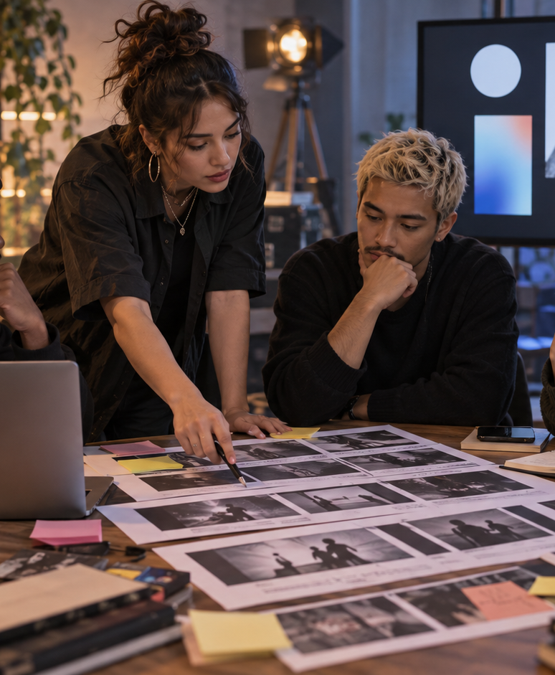
YIHA TEMPLATE SERIES
How To Create A Music Video Storyboard PPT Template
Track each shot in a neon-lit performance video for indie artist Mira Vale.
11 EDITABLE SLIDES
LIME STUDIO
Notes:
Cover template. Replace the title, subtitle and hero image. All text remains editable.

Slide 2
YIHA / EDITABLE PPTX
OVERVIEW
02
START HERE
how to create a music video storyboard in four chapters
01
Concept
02
Shot List
Define the concept
Map key scenes
03
Production
04
Edit Plan
List shot details
Assign crew roles
Notes:
Agenda layout. Rename the four chapters to match your narrative.

Slide 3
YIHA / EDITABLE PPTX
BIG IDEA
03
ONE IDEA
Plan a stylish rooftop shoot from concept to final edit.
Use this page for the core message, campaign promise, or thesis that frames the rest of the deck.
Notes:
Statement slide. Keep the headline short and make it the single idea people should remember.

Slide 4
YIHA / EDITABLE PPTX
SNAPSHOT
04
AT A GLANCE
Three lenses on how to create a music video storyboard
01
02
03
PRIMARY TOPIC
CONTENT ANGLE
NEXT ACTION
how to create a music video storyboard
Plan a stylish rooftop shoot from concept…
Video & Film: Review the cut
EXAMPLE — REPLACE
EXAMPLE — REPLACE
EXAMPLE — REPLACE
Notes:
Metric-card template. Every value is a clearly marked placeholder; replace it with sourced project data.

Slide 5
YIHA / EDITABLE PPTX
ROADMAP
05
FROM IDEA TO IMPACT
A five-stage Video & Film workflow
1
2
3
4
5
Define the concept
Map key scenes
List shot details
Assign crew roles
Review the cut
DISCOVER
FRAME
CREATE
LAUNCH
LEARN
Notes:
Roadmap layout. Replace each stage label and description while preserving the left-to-right story.

Slide 6
YIHA / EDITABLE PPTX
COMPARISON
06
CHOOSE THE STRONGER PATH
how to create a music video storyboard: before and after
BEFORE
AFTER
Scenes feel scattered across notes and chats.
The rooftop storyline is easy to follow.
The crew lacks a shared visual direction.
Each frame has a clear purpose and order.
Shot timing gets unclear during prep.
The team can prep with fewer back-and-forths.
Notes:
Comparison layout. Use for current/future state, option A/B, or problem/solution.

Slide 7
YIHA / EDITABLE PPTX
AUDIENCE
07
DESIGN FOR REAL PEOPLE
Three audience lenses
01
02
03
MUSIC TEAMS
CREATIVE STUDENTS
FREELANCE DIRECTORS
Need a clear visual plan for directing a small music video shoot.
Need a simple structure to organize scenes, mood, and camera ideas.
Need a polished way to pitch a video concept and sequence it fast.
Notes:
Persona-card template. Replace roles, motivations and friction points with audience research.

Slide 8
YIHA / EDITABLE PPTX
STORYBOARD
08
BUILD THE STORY BEAT BY BEAT
Four scenes, one coherent arc
01
02
03
04
[ DROP VISUAL HERE ]
[ DROP VISUAL HERE ]
[ DROP VISUAL HERE ]
[ DROP VISUAL HERE ]
HOOK
TENSION
REVEAL
ACTION
Define the concept
Map key scenes
List shot details
Assign crew roles
Notes:
Storyboard template. Add one visual and one narrative beat per card.

Slide 9
YIHA / EDITABLE PPTX
CASE STUDY
09
TURN THE IDEA INTO A PROOF POINT
how to create a music video storyboard: a compact case-study structure
01
Insight
THE CHALLENGE
Map key scenes
How do you turn Mira Vale's rooftop performance into a clear, shoot-ready plan?
02
Move
List shot details
03
Result
Add the real constraint, audience and baseline here.
Review the cut
Notes:
Case-study template. Replace the example prompt with an actual challenge, action and sourced outcome.

Slide 10
YIHA / EDITABLE PPTX
ACTION PLAN
10
MOVE IN FOUR FOCUSED SPRINTS
how to create a music video storyboard: a practical action plan
WEEK 01
WEEK 02
WEEK 03
WEEK 04
ALIGN
BUILD
SHIP
LEARN
Define the concept
Map key scenes
List shot details
Review the cut
OWNER [ NAME ]
OWNER [ NAME ]
OWNER [ NAME ]
OWNER [ NAME ]
Notes:
Action-plan template. Replace sprint labels, deliverables and owners.

Slide 11
MAKE THE NEXT SLIDE COUNT
Bring the vision into focus.
Replace this closing message with a decision, invitation, or single next step.
ADD YOUR CALL TO ACTION →
yiha.ai/slides
Notes:
Closing template. End with one clear decision or call to action.

