Slide 1
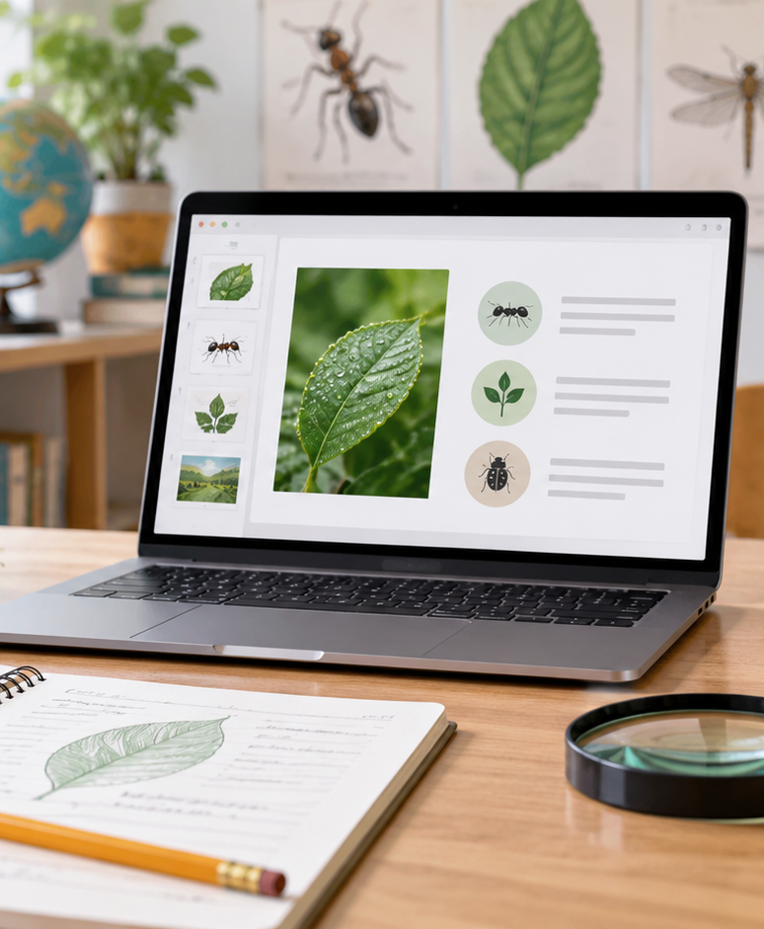
YIHA TEMPLATE SERIES
Intro To Pests Lesson Plan PPT Template
Ms. Rivera’s class studies how ants enter kitchens and how to prevent them.
11 EDITABLE SLIDES
COBALT TYPE
Notes:
Cover template. Replace the title, subtitle and hero image. All text remains editable.

Slide 2
YIHA / EDITABLE PPTX
OVERVIEW
02
START HERE
intro to pests lesson plan in four chapters
01
What Pests Are
02
How They Enter
Observe the trail
Map entry points
03
Class Investigation
04
Prevention Plan
Set safe barriers
Review class notes
Notes:
Agenda layout. Rename the four chapters to match your narrative.

Slide 3
YIHA / EDITABLE PPTX
BIG IDEA
03
ONE IDEA
Spot entry points, track habits, and plan simple prevention.
Use this page for the core message, campaign promise, or thesis that frames the rest of the deck.
Notes:
Statement slide. Keep the headline short and make it the single idea people should remember.

Slide 4
YIHA / EDITABLE PPTX
SNAPSHOT
04
AT A GLANCE
Three lenses on intro to pests lesson plan
01
02
03
PRIMARY TOPIC
CONTENT ANGLE
NEXT ACTION
intro to pests lesson plan
Spot entry points, track habits, and plan…
Education: Share prevention tips
EXAMPLE — REPLACE
EXAMPLE — REPLACE
EXAMPLE — REPLACE
Notes:
Metric-card template. Every value is a clearly marked placeholder; replace it with sourced project data.

Slide 5
YIHA / EDITABLE PPTX
ROADMAP
05
FROM IDEA TO IMPACT
A five-stage Education workflow
1
2
3
4
5
Observe the trail
Map entry points
Set safe barriers
Review class notes
Share prevention tips
DISCOVER
FRAME
CREATE
LAUNCH
LEARN
Notes:
Roadmap layout. Replace each stage label and description while preserving the left-to-right story.

Slide 6
YIHA / EDITABLE PPTX
COMPARISON
06
CHOOSE THE STRONGER PATH
intro to pests lesson plan: before and after
BEFORE
AFTER
Students confuse pests with harmless insects.
Students can identify common pest signs.
The kitchen trail is hard to trace.
The class maps where pests may enter.
Prevention ideas feel too general.
Prevention steps are clear and practical.
Notes:
Comparison layout. Use for current/future state, option A/B, or problem/solution.

Slide 7
YIHA / EDITABLE PPTX
AUDIENCE
07
DESIGN FOR REAL PEOPLE
Three audience lenses
01
02
03
GRADE 4 CLASS
SCIENCE TEACHER
AFTER-SCHOOL CLUB
Needs a simple, visual lesson that explains pest behavior and prevention.
Needs a ready-made outline for a short, engaging classroom presentation.
Needs an easy activity that connects home habits to pest control basics.
Notes:
Persona-card template. Replace roles, motivations and friction points with audience research.

Slide 8
YIHA / EDITABLE PPTX
STORYBOARD
08
BUILD THE STORY BEAT BY BEAT
Four scenes, one coherent arc
01
02
03
04
[ DROP VISUAL HERE ]
[ DROP VISUAL HERE ]
[ DROP VISUAL HERE ]
[ DROP VISUAL HERE ]
HOOK
TENSION
REVEAL
ACTION
Observe the trail
Map entry points
Set safe barriers
Review class notes
Notes:
Storyboard template. Add one visual and one narrative beat per card.

Slide 9
YIHA / EDITABLE PPTX
CASE STUDY
09
TURN THE IDEA INTO A PROOF POINT
intro to pests lesson plan: a compact case-study structure
01
Insight
THE CHALLENGE
Map entry points
How can Ms. Rivera’s class explain why ants keep appearing near the snack shelf?
02
Move
Set safe barriers
03
Result
Add the real constraint, audience and baseline here.
Share prevention tips
Notes:
Case-study template. Replace the example prompt with an actual challenge, action and sourced outcome.

Slide 10
YIHA / EDITABLE PPTX
ACTION PLAN
10
MOVE IN FOUR FOCUSED SPRINTS
intro to pests lesson plan: a practical action plan
WEEK 01
WEEK 02
WEEK 03
WEEK 04
ALIGN
BUILD
SHIP
LEARN
Observe the trail
Map entry points
Set safe barriers
Share prevention tips
OWNER [ NAME ]
OWNER [ NAME ]
OWNER [ NAME ]
OWNER [ NAME ]
Notes:
Action-plan template. Replace sprint labels, deliverables and owners.

Slide 11
MAKE THE NEXT SLIDE COUNT
Turn observations into a simple prevention plan.
Replace this closing message with a decision, invitation, or single next step.
ADD YOUR CALL TO ACTION →
yiha.ai/slides
Notes:
Closing template. End with one clear decision or call to action.

