Slide 1
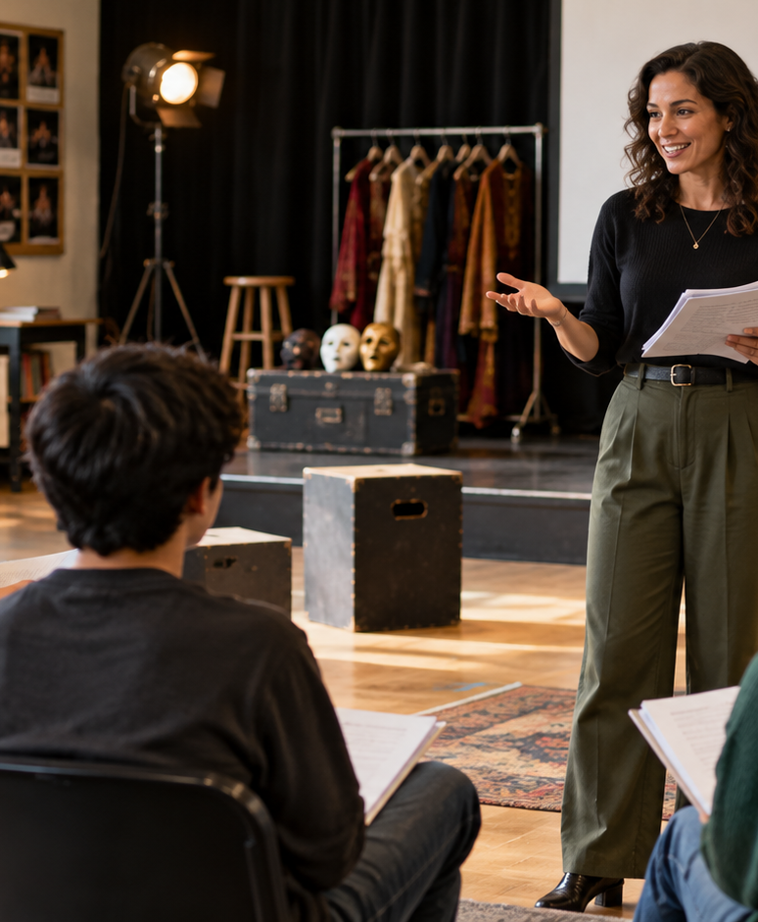
YIHA TEMPLATE SERIES
Intro To Theatre Lesson Plans PPT Template
Ms. Rivera guides eighth graders through a first scene study of A Midsummer Night's Dream.
11 EDITABLE SLIDES
LIME STUDIO
Notes:
Cover template. Replace the title, subtitle and hero image. All text remains editable.

Slide 2
YIHA / EDITABLE PPTX
OVERVIEW
02
START HERE
intro to theatre lesson plans in four chapters
01
Warm-Up
02
Script Study
Warm up the room
Read the scene aloud
03
Stage Practice
04
Class Reflection
Block simple movements
Rehearse in pairs
Notes:
Agenda layout. Rename the four chapters to match your narrative.

Slide 3
YIHA / EDITABLE PPTX
BIG IDEA
03
ONE IDEA
Build confidence through scene work, voice, and movement.
Use this page for the core message, campaign promise, or thesis that frames the rest of the deck.
Notes:
Statement slide. Keep the headline short and make it the single idea people should remember.

Slide 4
YIHA / EDITABLE PPTX
SNAPSHOT
04
AT A GLANCE
Three lenses on intro to theatre lesson plans
01
02
03
PRIMARY TOPIC
CONTENT ANGLE
NEXT ACTION
intro to theatre lesson plans
Build confidence through scene work, voic…
Education: Share and reflect
EXAMPLE — REPLACE
EXAMPLE — REPLACE
EXAMPLE — REPLACE
Notes:
Metric-card template. Every value is a clearly marked placeholder; replace it with sourced project data.

Slide 5
YIHA / EDITABLE PPTX
ROADMAP
05
FROM IDEA TO IMPACT
A five-stage Education workflow
1
2
3
4
5
Warm up the room
Read the scene aloud
Block simple movements
Rehearse in pairs
Share and reflect
DISCOVER
FRAME
CREATE
LAUNCH
LEARN
Notes:
Roadmap layout. Replace each stage label and description while preserving the left-to-right story.

Slide 6
YIHA / EDITABLE PPTX
COMPARISON
06
CHOOSE THE STRONGER PATH
intro to theatre lesson plans: before and after
BEFORE
AFTER
Students whisper and rush through lines.
Students speak with clearer pace and volume.
No one knows where to stand on stage.
Blocking gives the scene a simple shape.
The scene feels confusing and flat.
The class understands the story beat by beat.
Notes:
Comparison layout. Use for current/future state, option A/B, or problem/solution.

Slide 7
YIHA / EDITABLE PPTX
AUDIENCE
07
DESIGN FOR REAL PEOPLE
Three audience lenses
01
02
03
MIDDLE SCHOOLERS
DRAMA TEACHERS
AFTER-SCHOOL CLUBS
Need a friendly first introduction to acting, stage directions, and speaking clearly.
Need a clear lesson flow for guiding beginners through a short scene.
Need an easy activity plan that keeps students engaged and working together.
Notes:
Persona-card template. Replace roles, motivations and friction points with audience research.

Slide 8
YIHA / EDITABLE PPTX
STORYBOARD
08
BUILD THE STORY BEAT BY BEAT
Four scenes, one coherent arc
01
02
03
04
[ DROP VISUAL HERE ]
[ DROP VISUAL HERE ]
[ DROP VISUAL HERE ]
[ DROP VISUAL HERE ]
HOOK
TENSION
REVEAL
ACTION
Warm up the room
Read the scene aloud
Block simple movements
Rehearse in pairs
Notes:
Storyboard template. Add one visual and one narrative beat per card.

Slide 9
YIHA / EDITABLE PPTX
CASE STUDY
09
TURN THE IDEA INTO A PROOF POINT
intro to theatre lesson plans: a compact case-study structure
01
Insight
THE CHALLENGE
Read the scene aloud
How can Ms. Rivera help beginners turn a short scene into a confident class performance?
02
Move
Block simple movements
03
Result
Add the real constraint, audience and baseline here.
Share and reflect
Notes:
Case-study template. Replace the example prompt with an actual challenge, action and sourced outcome.

Slide 10
YIHA / EDITABLE PPTX
ACTION PLAN
10
MOVE IN FOUR FOCUSED SPRINTS
intro to theatre lesson plans: a practical action plan
WEEK 01
WEEK 02
WEEK 03
WEEK 04
ALIGN
BUILD
SHIP
LEARN
Warm up the room
Read the scene aloud
Block simple movements
Share and reflect
OWNER [ NAME ]
OWNER [ NAME ]
OWNER [ NAME ]
OWNER [ NAME ]
Notes:
Action-plan template. Replace sprint labels, deliverables and owners.

Slide 11
MAKE THE NEXT SLIDE COUNT
Turn first reads into a real performance.
Replace this closing message with a decision, invitation, or single next step.
ADD YOUR CALL TO ACTION →
yiha.ai/slides
Notes:
Closing template. End with one clear decision or call to action.

