Slide 1
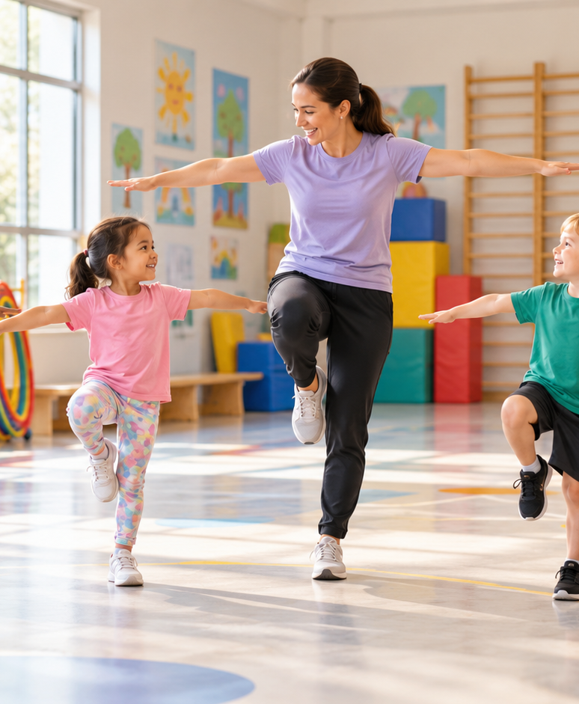
YIHA TEMPLATE SERIES
Kindergarten Physical Education Lesson Plans PPT Template
Coach Mia guides five-year-olds through a playful obstacle course and a calm cool-down.
11 EDITABLE SLIDES
COBALT TYPE
Notes:
Cover template. Replace the title, subtitle and hero image. All text remains editable.

Slide 2
YIHA / EDITABLE PPTX
OVERVIEW
02
START HERE
kindergarten physical education lesson pl… in four chapters
01
Warm-Up
02
Skill Practice
Warm up with animal moves
Practice safe jumping
03
Game Time
04
Cool-Down
Try a relay game
Add balance challenges
Notes:
Agenda layout. Rename the four chapters to match your narrative.

Slide 3
YIHA / EDITABLE PPTX
BIG IDEA
03
ONE IDEA
Active play with clear routines
Use this page for the core message, campaign promise, or thesis that frames the rest of the deck.
Notes:
Statement slide. Keep the headline short and make it the single idea people should remember.

Slide 4
YIHA / EDITABLE PPTX
SNAPSHOT
04
AT A GLANCE
Three lenses on kindergarten physical education lesson pl…
01
02
03
PRIMARY TOPIC
CONTENT ANGLE
NEXT ACTION
kindergarten physical education lesson pl…
Active play with clear routines
Education: Finish with stretches
EXAMPLE — REPLACE
EXAMPLE — REPLACE
EXAMPLE — REPLACE
Notes:
Metric-card template. Every value is a clearly marked placeholder; replace it with sourced project data.

Slide 5
YIHA / EDITABLE PPTX
ROADMAP
05
FROM IDEA TO IMPACT
A five-stage Education workflow
1
2
3
4
5
Warm up with animal moves
Practice safe jumping
Try a relay game
Add balance challenges
Finish with stretches
DISCOVER
FRAME
CREATE
LAUNCH
LEARN
Notes:
Roadmap layout. Replace each stage label and description while preserving the left-to-right story.

Slide 6
YIHA / EDITABLE PPTX
COMPARISON
06
CHOOSE THE STRONGER PATH
kindergarten physical education lesson pl…: before and after
BEFORE
AFTER
Students start the lesson restless and unsure of the rules.
Children follow a steady routine from warm-up to cool-down.
Activity stations feel uneven and hard to manage.
Each station has a clear purpose and simple direction.
Transitions take too long between each movement task.
The class stays engaged with easy, playful movement changes.
Notes:
Comparison layout. Use for current/future state, option A/B, or problem/solution.

Slide 7
YIHA / EDITABLE PPTX
AUDIENCE
07
DESIGN FOR REAL PEOPLE
Three audience lenses
01
02
03
KINDERGARTEN TEACHERS
PE INSTRUCTORS
SCHOOL STAFF
A simple class plan that keeps young children moving and attentive.
A ready structure for introducing basic movement skills in a fun way.
A clear lesson flow that supports safe, organized activity time.
Notes:
Persona-card template. Replace roles, motivations and friction points with audience research.

Slide 8
YIHA / EDITABLE PPTX
STORYBOARD
08
BUILD THE STORY BEAT BY BEAT
Four scenes, one coherent arc
01
02
03
04
[ DROP VISUAL HERE ]
[ DROP VISUAL HERE ]
[ DROP VISUAL HERE ]
[ DROP VISUAL HERE ]
HOOK
TENSION
REVEAL
ACTION
Warm up with animal moves
Practice safe jumping
Try a relay game
Add balance challenges
Notes:
Storyboard template. Add one visual and one narrative beat per card.

Slide 9
YIHA / EDITABLE PPTX
CASE STUDY
09
TURN THE IDEA INTO A PROOF POINT
kindergarten physical education lesson pl…: a compact case-study structure
01
Insight
THE CHALLENGE
Practice safe jumping
How can Ms. Lina keep her kindergarten class active, focused, and safe in one lesson?
02
Move
Try a relay game
03
Result
Add the real constraint, audience and baseline here.
Finish with stretches
Notes:
Case-study template. Replace the example prompt with an actual challenge, action and sourced outcome.

Slide 10
YIHA / EDITABLE PPTX
ACTION PLAN
10
MOVE IN FOUR FOCUSED SPRINTS
kindergarten physical education lesson pl…: a practical action plan
WEEK 01
WEEK 02
WEEK 03
WEEK 04
ALIGN
BUILD
SHIP
LEARN
Warm up with animal moves
Practice safe jumping
Try a relay game
Finish with stretches
OWNER [ NAME ]
OWNER [ NAME ]
OWNER [ NAME ]
OWNER [ NAME ]
Notes:
Action-plan template. Replace sprint labels, deliverables and owners.

Slide 11
MAKE THE NEXT SLIDE COUNT
Playful movement makes learning feel easy.
Replace this closing message with a decision, invitation, or single next step.
ADD YOUR CALL TO ACTION →
yiha.ai/slides
Notes:
Closing template. End with one clear decision or call to action.

