Slide 1
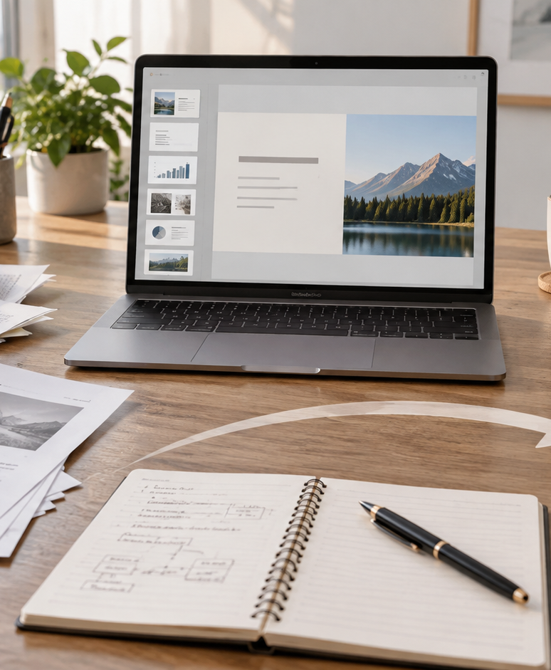
YIHA TEMPLATE SERIES
Make A Presentation From A Pdf AI PPT Template
Turn a scanned field report into a polished investor update in minutes.
11 EDITABLE SLIDES
VIOLET POP
Notes:
Cover template. Replace the title, subtitle and hero image. All text remains editable.

Slide 2
YIHA / EDITABLE PPTX
OVERVIEW
02
START HERE
make a presentation from a pdf ai in four chapters
01
Project Snapshot
02
Key Findings
Upload the PDF
Extract key points
03
Next Steps
04
Q&A
Choose a layout
Refine slide text
Notes:
Agenda layout. Rename the four chapters to match your narrative.

Slide 3
YIHA / EDITABLE PPTX
BIG IDEA
03
ONE IDEA
Convert a PDF brief into a clear, client-ready deck.
Use this page for the core message, campaign promise, or thesis that frames the rest of the deck.
Notes:
Statement slide. Keep the headline short and make it the single idea people should remember.

Slide 4
YIHA / EDITABLE PPTX
SNAPSHOT
04
AT A GLANCE
Three lenses on make a presentation from a pdf ai
01
02
03
PRIMARY TOPIC
CONTENT ANGLE
NEXT ACTION
make a presentation from a pdf ai
Convert a PDF brief into a clear, client-…
AI Workflows: Export the deck
EXAMPLE — REPLACE
EXAMPLE — REPLACE
EXAMPLE — REPLACE
Notes:
Metric-card template. Every value is a clearly marked placeholder; replace it with sourced project data.

Slide 5
YIHA / EDITABLE PPTX
ROADMAP
05
FROM IDEA TO IMPACT
A five-stage AI Workflows workflow
1
2
3
4
5
Upload the PDF
Extract key points
Choose a layout
Refine slide text
Export the deck
DISCOVER
FRAME
CREATE
LAUNCH
LEARN
Notes:
Roadmap layout. Replace each stage label and description while preserving the left-to-right story.

Slide 6
YIHA / EDITABLE PPTX
COMPARISON
06
CHOOSE THE STRONGER PATH
make a presentation from a pdf ai: before and after
BEFORE
AFTER
Important points are buried in long PDF pages.
The main story is clear and easy to follow.
Slides take too long to build from scratch.
Slides are organized into a clean presentation flow.
The message feels inconsistent across sections.
The deck is ready for review and editing.
Notes:
Comparison layout. Use for current/future state, option A/B, or problem/solution.

Slide 7
YIHA / EDITABLE PPTX
AUDIENCE
07
DESIGN FOR REAL PEOPLE
Three audience lenses
01
02
03
CONSULTANTS
FOUNDERS
TEACHERS
Need to turn dense reports into crisp presentations for clients.
Need a fast way to present a PDF proposal to investors.
Need to convert lesson handouts into simple classroom slides.
Notes:
Persona-card template. Replace roles, motivations and friction points with audience research.

Slide 8
YIHA / EDITABLE PPTX
STORYBOARD
08
BUILD THE STORY BEAT BY BEAT
Four scenes, one coherent arc
01
02
03
04
[ DROP VISUAL HERE ]
[ DROP VISUAL HERE ]
[ DROP VISUAL HERE ]
[ DROP VISUAL HERE ]
HOOK
TENSION
REVEAL
ACTION
Upload the PDF
Extract key points
Choose a layout
Refine slide text
Notes:
Storyboard template. Add one visual and one narrative beat per card.

Slide 9
YIHA / EDITABLE PPTX
CASE STUDY
09
TURN THE IDEA INTO A PROOF POINT
make a presentation from a pdf ai: a compact case-study structure
01
Insight
THE CHALLENGE
Extract key points
How can a PDF brief become a polished presentation for a Monday client meeting?
02
Move
Choose a layout
03
Result
Add the real constraint, audience and baseline here.
Export the deck
Notes:
Case-study template. Replace the example prompt with an actual challenge, action and sourced outcome.

Slide 10
YIHA / EDITABLE PPTX
ACTION PLAN
10
MOVE IN FOUR FOCUSED SPRINTS
make a presentation from a pdf ai: a practical action plan
WEEK 01
WEEK 02
WEEK 03
WEEK 04
ALIGN
BUILD
SHIP
LEARN
Upload the PDF
Extract key points
Choose a layout
Export the deck
OWNER [ NAME ]
OWNER [ NAME ]
OWNER [ NAME ]
OWNER [ NAME ]
Notes:
Action-plan template. Replace sprint labels, deliverables and owners.

Slide 11
MAKE THE NEXT SLIDE COUNT
Start with the PDF and shape the story.
Replace this closing message with a decision, invitation, or single next step.
ADD YOUR CALL TO ACTION →
yiha.ai/slides
Notes:
Closing template. End with one clear decision or call to action.

