Slide 1
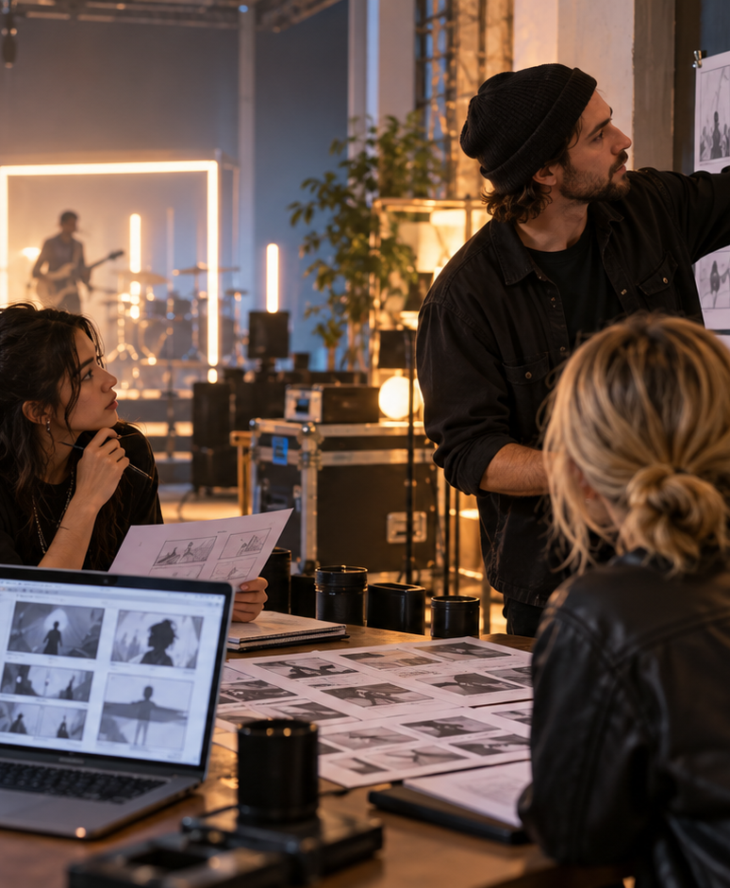
YIHA TEMPLATE SERIES
Music Video Storyboard PowerPoint Template
A neon rooftop shoot follows Mira as she chases a lost melody through the city.
11 EDITABLE SLIDES
VIOLET POP
Notes:
Cover template. Replace the title, subtitle and hero image. All text remains editable.

Slide 2
YIHA / EDITABLE PPTX
OVERVIEW
02
START HERE
A clear story in four chapters
01
Concept
02
Scene Flow
Set the opening mood
Map each scene beat
03
Shot List
04
Final Cut
Mark camera moves
Align lyrics to cuts
Notes:
Agenda layout. Rename the four chapters to match your narrative.

Slide 3
YIHA / EDITABLE PPTX
BIG IDEA
03
ONE IDEA
A visual plan for a midnight performance story.
Use this page for the core message, campaign promise, or thesis that frames the rest of the deck.
Notes:
Statement slide. Keep the headline short and make it the single idea people should remember.

Slide 4
YIHA / EDITABLE PPTX
SNAPSHOT
04
AT A GLANCE
Three signals that set the direction
72%
3.4×
28d
PRIMARY SIGNAL
MOMENTUM
TIME HORIZON
Set the opening mood
Map each scene beat
Mark camera moves
EXAMPLE — REPLACE
EXAMPLE — REPLACE
EXAMPLE — REPLACE
Notes:
Metric-card template. Every value is a clearly marked placeholder; replace it with sourced project data.

Slide 5
YIHA / EDITABLE PPTX
ROADMAP
05
FROM IDEA TO IMPACT
A five-stage working rhythm
1
2
3
4
5
Set the opening mood
Map each scene beat
Mark camera moves
Align lyrics to cuts
Review final flow
DISCOVER
FRAME
CREATE
LAUNCH
LEARN
Notes:
Roadmap layout. Replace each stage label and description while preserving the left-to-right story.

Slide 6
YIHA / EDITABLE PPTX
COMPARISON
06
CHOOSE THE STRONGER PATH
Before and after, side by side
BEFORE
AFTER
Scenes feel disconnected from the track
Each beat supports the song's story
Shot ideas are scattered across notes
The team follows one clear sequence
The ending lacks a strong visual payoff
The finale lands with a memorable image
Notes:
Comparison layout. Use for current/future state, option A/B, or problem/solution.

Slide 7
YIHA / EDITABLE PPTX
AUDIENCE
07
DESIGN FOR REAL PEOPLE
Three audience lenses
01
02
03
MUSIC DIRECTOR
VIDEO PRODUCER
CREATIVE TEAM
Needs a clear visual arc that matches the song's emotional turns.
Needs a simple way to organize locations, shots, and transitions.
Needs a shared reference for styling, pacing, and performance cues.
Notes:
Persona-card template. Replace roles, motivations and friction points with audience research.

Slide 8
YIHA / EDITABLE PPTX
STORYBOARD
08
BUILD THE STORY BEAT BY BEAT
Four scenes, one coherent arc
01
02
03
04
[ DROP VISUAL HERE ]
[ DROP VISUAL HERE ]
[ DROP VISUAL HERE ]
[ DROP VISUAL HERE ]
HOOK
TENSION
REVEAL
ACTION
Set the opening mood
Map each scene beat
Mark camera moves
Align lyrics to cuts
Notes:
Storyboard template. Add one visual and one narrative beat per card.

Slide 9
YIHA / EDITABLE PPTX
CASE STUDY
09
TURN THE IDEA INTO A PROOF POINT
A compact case-study structure
01
Insight
THE CHALLENGE
Map each scene beat
How should Mira's rooftop performance unfold from the first verse to the final chorus?
02
Move
Mark camera moves
03
Result
Add the real constraint, audience and baseline here.
Review final flow
Notes:
Case-study template. Replace the example prompt with an actual challenge, action and sourced outcome.

Slide 10
YIHA / EDITABLE PPTX
ACTION PLAN
10
MOVE IN FOUR FOCUSED SPRINTS
A 30-day action plan
WEEK 01
WEEK 02
WEEK 03
WEEK 04
ALIGN
BUILD
SHIP
LEARN
Set the opening mood
Map each scene beat
Mark camera moves
Review final flow
OWNER [ NAME ]
OWNER [ NAME ]
OWNER [ NAME ]
OWNER [ NAME ]
Notes:
Action-plan template. Replace sprint labels, deliverables and owners.

Slide 11
MAKE THE NEXT SLIDE COUNT
Turn the song into a clear visual journey.
Replace this closing message with a decision, invitation, or single next step.
ADD YOUR CALL TO ACTION →
yiha.ai/slides
Notes:
Closing template. End with one clear decision or call to action.

