Slide 1
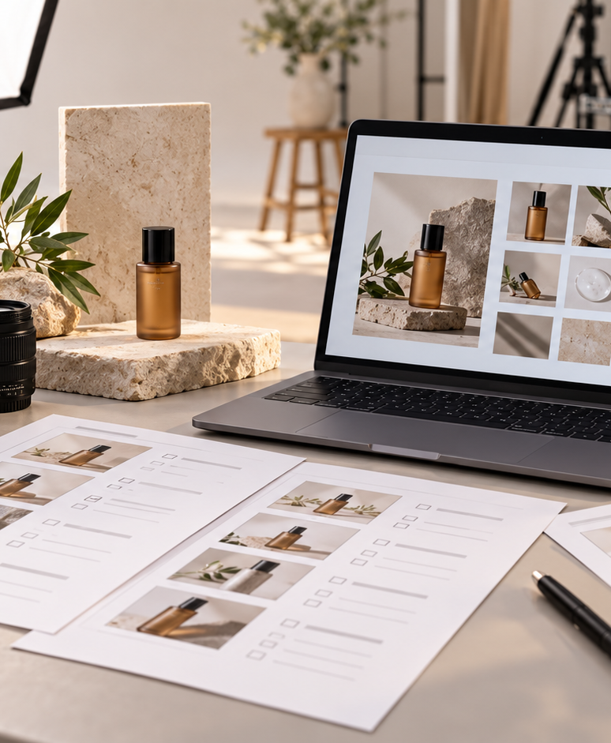
YIHA TEMPLATE SERIES
Product Photography Shot List PPT Template
Map a clean studio shoot for a new ceramic mug line launching in spring.
11 EDITABLE SLIDES
OCEAN SIGNAL
Notes:
Cover template. Replace the title, subtitle and hero image. All text remains editable.

Slide 2
YIHA / EDITABLE PPTX
OVERVIEW
02
START HERE
A clear story in four chapters
01
Hero Frames
02
Props & Styling
Set hero angles
List prop needs
03
Lighting Plan
04
Shot Review
Map lighting setup
Sequence detail shots
Notes:
Agenda layout. Rename the four chapters to match your narrative.

Slide 3
YIHA / EDITABLE PPTX
BIG IDEA
03
ONE IDEA
Plan every frame before the camera rolls.
Use this page for the core message, campaign promise, or thesis that frames the rest of the deck.
Notes:
Statement slide. Keep the headline short and make it the single idea people should remember.

Slide 4
YIHA / EDITABLE PPTX
SNAPSHOT
04
AT A GLANCE
Three signals that set the direction
72%
3.4×
28d
PRIMARY SIGNAL
MOMENTUM
TIME HORIZON
Set hero angles
List prop needs
Map lighting setup
EXAMPLE — REPLACE
EXAMPLE — REPLACE
EXAMPLE — REPLACE
Notes:
Metric-card template. Every value is a clearly marked placeholder; replace it with sourced project data.

Slide 5
YIHA / EDITABLE PPTX
ROADMAP
05
FROM IDEA TO IMPACT
A five-stage working rhythm
1
2
3
4
5
Set hero angles
List prop needs
Map lighting setup
Sequence detail shots
Review final picks
DISCOVER
FRAME
CREATE
LAUNCH
LEARN
Notes:
Roadmap layout. Replace each stage label and description while preserving the left-to-right story.

Slide 6
YIHA / EDITABLE PPTX
COMPARISON
06
CHOOSE THE STRONGER PATH
Before and after, side by side
BEFORE
AFTER
Shots are discussed on set and take too long to finalize.
Each frame has a clear purpose and reference.
Props and angles feel inconsistent across the product series.
The team follows one shared plan from setup to review.
The team lacks a simple order for the day’s shoot.
The final images feel cohesive across the whole collection.
Notes:
Comparison layout. Use for current/future state, option A/B, or problem/solution.

Slide 7
YIHA / EDITABLE PPTX
AUDIENCE
07
DESIGN FOR REAL PEOPLE
Three audience lenses
01
02
03
BRAND MANAGER
PHOTOGRAPHER
CREATIVE TEAM
Wants a clear shoot plan that keeps the product story consistent.
Needs a practical shot list to organize angles, props, and setup.
Needs aligned visuals for ads, web banners, and social posts.
Notes:
Persona-card template. Replace roles, motivations and friction points with audience research.

Slide 8
YIHA / EDITABLE PPTX
STORYBOARD
08
BUILD THE STORY BEAT BY BEAT
Four scenes, one coherent arc
01
02
03
04
[ DROP VISUAL HERE ]
[ DROP VISUAL HERE ]
[ DROP VISUAL HERE ]
[ DROP VISUAL HERE ]
HOOK
TENSION
REVEAL
ACTION
Set hero angles
List prop needs
Map lighting setup
Sequence detail shots
Notes:
Storyboard template. Add one visual and one narrative beat per card.

Slide 9
YIHA / EDITABLE PPTX
CASE STUDY
09
TURN THE IDEA INTO A PROOF POINT
A compact case-study structure
01
Insight
THE CHALLENGE
List prop needs
How can the team plan a mug shoot that covers hero, detail, and lifestyle frames?
02
Move
Map lighting setup
03
Result
Add the real constraint, audience and baseline here.
Review final picks
Notes:
Case-study template. Replace the example prompt with an actual challenge, action and sourced outcome.

Slide 10
YIHA / EDITABLE PPTX
ACTION PLAN
10
MOVE IN FOUR FOCUSED SPRINTS
A 30-day action plan
WEEK 01
WEEK 02
WEEK 03
WEEK 04
ALIGN
BUILD
SHIP
LEARN
Set hero angles
List prop needs
Map lighting setup
Review final picks
OWNER [ NAME ]
OWNER [ NAME ]
OWNER [ NAME ]
OWNER [ NAME ]
Notes:
Action-plan template. Replace sprint labels, deliverables and owners.

Slide 11
MAKE THE NEXT SLIDE COUNT
A simple shot list keeps the shoot focused and polished.
Replace this closing message with a decision, invitation, or single next step.
ADD YOUR CALL TO ACTION →
yiha.ai/slides
Notes:
Closing template. End with one clear decision or call to action.

