Slide 1
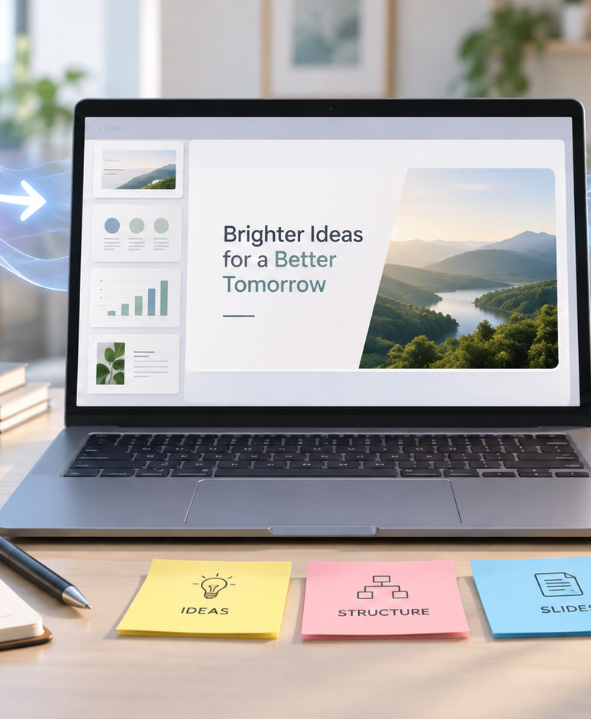
YIHA TEMPLATE SERIES
Prompt To Presentation AI PPT Template
A startup turns a rough product brief into a clear investor deck in one afternoon.
11 EDITABLE SLIDES
ELECTRIC CORAL
Notes:
Cover template. Replace the title, subtitle and hero image. All text remains editable.

Slide 2
YIHA / EDITABLE PPTX
OVERVIEW
02
START HERE
prompt to presentation ai in four chapters
01
Project Brief
02
Slide Outline
Paste the prompt
Pick a slide style
03
Draft Deck
04
Final Polish
Refine the outline
Generate the deck
Notes:
Agenda layout. Rename the four chapters to match your narrative.

Slide 3
YIHA / EDITABLE PPTX
BIG IDEA
03
ONE IDEA
Brief to deck, fast and focused
Use this page for the core message, campaign promise, or thesis that frames the rest of the deck.
Notes:
Statement slide. Keep the headline short and make it the single idea people should remember.

Slide 4
YIHA / EDITABLE PPTX
SNAPSHOT
04
AT A GLANCE
Three lenses on prompt to presentation ai
01
02
03
PRIMARY TOPIC
CONTENT ANGLE
NEXT ACTION
prompt to presentation ai
Brief to deck, fast and focused
Business: Review and edit
EXAMPLE — REPLACE
EXAMPLE — REPLACE
EXAMPLE — REPLACE
Notes:
Metric-card template. Every value is a clearly marked placeholder; replace it with sourced project data.

Slide 5
YIHA / EDITABLE PPTX
ROADMAP
05
FROM IDEA TO IMPACT
A five-stage Business workflow
1
2
3
4
5
Paste the prompt
Pick a slide style
Refine the outline
Generate the deck
Review and edit
DISCOVER
FRAME
CREATE
LAUNCH
LEARN
Notes:
Roadmap layout. Replace each stage label and description while preserving the left-to-right story.

Slide 6
YIHA / EDITABLE PPTX
COMPARISON
06
CHOOSE THE STRONGER PATH
prompt to presentation ai: before and after
BEFORE
AFTER
Ideas stay buried in long notes and chat threads.
A clear outline appears from a single prompt.
Slides take too long to structure from scratch.
Slides follow a consistent, polished flow.
The message feels uneven across the deck.
The team can review and refine faster.
Notes:
Comparison layout. Use for current/future state, option A/B, or problem/solution.

Slide 7
YIHA / EDITABLE PPTX
AUDIENCE
07
DESIGN FOR REAL PEOPLE
Three audience lenses
01
02
03
FOUNDERS
MARKETERS
CONSULTANTS
Need a quick way to turn scattered notes into a pitch-ready presentation.
Need a simple workflow for shaping campaign ideas into clear slides.
Need to convert client prompts into structured, professional decks.
Notes:
Persona-card template. Replace roles, motivations and friction points with audience research.

Slide 8
YIHA / EDITABLE PPTX
STORYBOARD
08
BUILD THE STORY BEAT BY BEAT
Four scenes, one coherent arc
01
02
03
04
[ DROP VISUAL HERE ]
[ DROP VISUAL HERE ]
[ DROP VISUAL HERE ]
[ DROP VISUAL HERE ]
HOOK
TENSION
REVEAL
ACTION
Paste the prompt
Pick a slide style
Refine the outline
Generate the deck
Notes:
Storyboard template. Add one visual and one narrative beat per card.

Slide 9
YIHA / EDITABLE PPTX
CASE STUDY
09
TURN THE IDEA INTO A PROOF POINT
prompt to presentation ai: a compact case-study structure
01
Insight
THE CHALLENGE
Pick a slide style
How can a small team turn one product prompt into a clean investor story?
02
Move
Refine the outline
03
Result
Add the real constraint, audience and baseline here.
Review and edit
Notes:
Case-study template. Replace the example prompt with an actual challenge, action and sourced outcome.

Slide 10
YIHA / EDITABLE PPTX
ACTION PLAN
10
MOVE IN FOUR FOCUSED SPRINTS
prompt to presentation ai: a practical action plan
WEEK 01
WEEK 02
WEEK 03
WEEK 04
ALIGN
BUILD
SHIP
LEARN
Paste the prompt
Pick a slide style
Refine the outline
Review and edit
OWNER [ NAME ]
OWNER [ NAME ]
OWNER [ NAME ]
OWNER [ NAME ]
Notes:
Action-plan template. Replace sprint labels, deliverables and owners.

Slide 11
MAKE THE NEXT SLIDE COUNT
From prompt to presentation, with less friction.
Replace this closing message with a decision, invitation, or single next step.
ADD YOUR CALL TO ACTION →
yiha.ai/slides
Notes:
Closing template. End with one clear decision or call to action.

