Slide 1
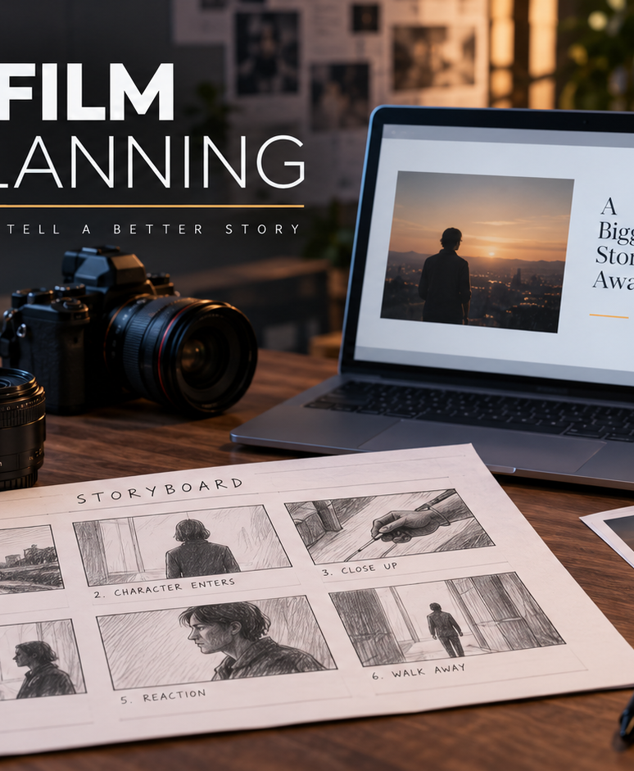
YIHA TEMPLATE SERIES
Short Film Shot List PPT Template
A midnight diner drama follows one lost phone, one witness, and a ticking train departure.
11 EDITABLE SLIDES
COBALT TYPE
Notes:
Cover template. Replace the title, subtitle and hero image. All text remains editable.

Slide 2
YIHA / EDITABLE PPTX
OVERVIEW
02
START HERE
short film shot list template in four chapters
01
Story Beat
02
Shot Order
Open on empty street
Track the diner entrance
03
Camera Notes
04
Wrap-Up
Frame the phone reveal
Cut to the platform
Notes:
Agenda layout. Rename the four chapters to match your narrative.

Slide 3
YIHA / EDITABLE PPTX
BIG IDEA
03
ONE IDEA
Map each shot to the story beat and keep the crew aligned.
Use this page for the core message, campaign promise, or thesis that frames the rest of the deck.
Notes:
Statement slide. Keep the headline short and make it the single idea people should remember.

Slide 4
YIHA / EDITABLE PPTX
SNAPSHOT
04
AT A GLANCE
Three lenses on short film shot list template
01
02
03
PRIMARY TOPIC
CONTENT ANGLE
NEXT ACTION
short film shot list template
Map each shot to the story beat and keep…
Video & Film: End on the missed train
EXAMPLE — REPLACE
EXAMPLE — REPLACE
EXAMPLE — REPLACE
Notes:
Metric-card template. Every value is a clearly marked placeholder; replace it with sourced project data.

Slide 5
YIHA / EDITABLE PPTX
ROADMAP
05
FROM IDEA TO IMPACT
A five-stage Video & Film workflow
1
2
3
4
5
Open on empty street
Track the diner entrance
Frame the phone reveal
Cut to the platform
End on the missed train
DISCOVER
FRAME
CREATE
LAUNCH
LEARN
Notes:
Roadmap layout. Replace each stage label and description while preserving the left-to-right story.

Slide 6
YIHA / EDITABLE PPTX
COMPARISON
06
CHOOSE THE STRONGER PATH
short film shot list template: before and after
BEFORE
AFTER
Scenes are planned in scattered notes.
Each shot follows a clear story purpose.
Crew members interpret the action differently.
The team shares one organized visual plan.
The shoot order feels rushed and unclear.
The final sequence feels tighter and easier to film.
Notes:
Comparison layout. Use for current/future state, option A/B, or problem/solution.

Slide 7
YIHA / EDITABLE PPTX
AUDIENCE
07
DESIGN FOR REAL PEOPLE
Three audience lenses
01
02
03
STUDENT FILMMAKERS
INDIE DIRECTORS
PRODUCTION TEAMS
Need a simple way to plan scenes before the shoot starts.
Need a clear shot sequence that supports pacing and coverage.
Need a shared reference for camera, action, and location notes.
Notes:
Persona-card template. Replace roles, motivations and friction points with audience research.

Slide 8
YIHA / EDITABLE PPTX
STORYBOARD
08
BUILD THE STORY BEAT BY BEAT
Four scenes, one coherent arc
01
02
03
04
[ DROP VISUAL HERE ]
[ DROP VISUAL HERE ]
[ DROP VISUAL HERE ]
[ DROP VISUAL HERE ]
HOOK
TENSION
REVEAL
ACTION
Open on empty street
Track the diner entrance
Frame the phone reveal
Cut to the platform
Notes:
Storyboard template. Add one visual and one narrative beat per card.

Slide 9
YIHA / EDITABLE PPTX
CASE STUDY
09
TURN THE IDEA INTO A PROOF POINT
short film shot list template: a compact case-study structure
01
Insight
THE CHALLENGE
Track the diner entrance
How can a simple shot list keep a tense diner scene moving toward its final reveal?
02
Move
Frame the phone reveal
03
Result
Add the real constraint, audience and baseline here.
End on the missed train
Notes:
Case-study template. Replace the example prompt with an actual challenge, action and sourced outcome.

Slide 10
YIHA / EDITABLE PPTX
ACTION PLAN
10
MOVE IN FOUR FOCUSED SPRINTS
short film shot list template: a practical action plan
WEEK 01
WEEK 02
WEEK 03
WEEK 04
ALIGN
BUILD
SHIP
LEARN
Open on empty street
Track the diner entrance
Frame the phone reveal
End on the missed train
OWNER [ NAME ]
OWNER [ NAME ]
OWNER [ NAME ]
OWNER [ NAME ]
Notes:
Action-plan template. Replace sprint labels, deliverables and owners.

Slide 11
MAKE THE NEXT SLIDE COUNT
Turn the scene into a shoot-ready plan.
Replace this closing message with a decision, invitation, or single next step.
ADD YOUR CALL TO ACTION →
yiha.ai/slides
Notes:
Closing template. End with one clear decision or call to action.

