Slide 1
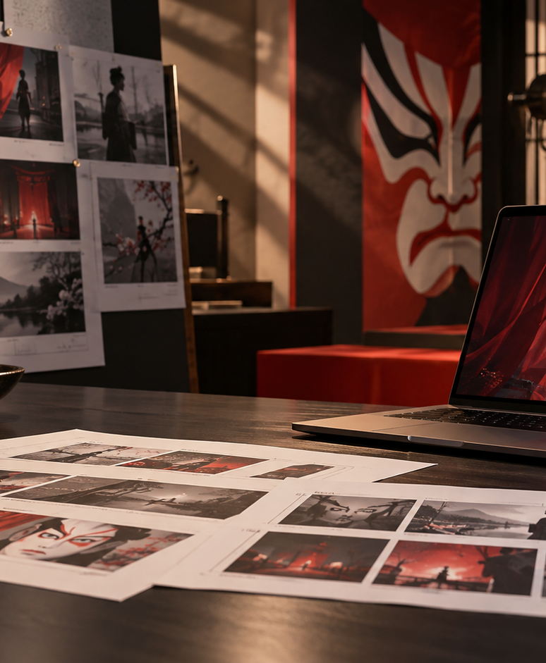
YIHA TEMPLATE SERIES
Sora Kabuki Storyboard News PPT Template
A newsroom team turns a city festival into a fast, visual story for evening broadcast.
11 EDITABLE SLIDES
LIME STUDIO
Notes:
Cover template. Replace the title, subtitle and hero image. All text remains editable.

Slide 2
YIHA / EDITABLE PPTX
OVERVIEW
02
START HERE
sora kabuki storyboard news in four chapters
01
Opening Beat
02
Street Scenes
Gather key scenes
Write the lead
03
Interview Notes
04
Final Wrap
Map shot order
Add voiceover cues
Notes:
Agenda layout. Rename the four chapters to match your narrative.

Slide 3
YIHA / EDITABLE PPTX
BIG IDEA
03
ONE IDEA
Plan a clear festival news package from scene list to final cut.
Use this page for the core message, campaign promise, or thesis that frames the rest of the deck.
Notes:
Statement slide. Keep the headline short and make it the single idea people should remember.

Slide 4
YIHA / EDITABLE PPTX
SNAPSHOT
04
AT A GLANCE
Three lenses on sora kabuki storyboard news
01
02
03
PRIMARY TOPIC
CONTENT ANGLE
NEXT ACTION
sora kabuki storyboard news
Plan a clear festival news package from s…
Video & Film: Review for flow
EXAMPLE — REPLACE
EXAMPLE — REPLACE
EXAMPLE — REPLACE
Notes:
Metric-card template. Every value is a clearly marked placeholder; replace it with sourced project data.

Slide 5
YIHA / EDITABLE PPTX
ROADMAP
05
FROM IDEA TO IMPACT
A five-stage Video & Film workflow
1
2
3
4
5
Gather key scenes
Write the lead
Map shot order
Add voiceover cues
Review for flow
DISCOVER
FRAME
CREATE
LAUNCH
LEARN
Notes:
Roadmap layout. Replace each stage label and description while preserving the left-to-right story.

Slide 6
YIHA / EDITABLE PPTX
COMPARISON
06
CHOOSE THE STRONGER PATH
sora kabuki storyboard news: before and after
BEFORE
AFTER
The story feels scattered across too many notes.
The report follows a simple, visual narrative.
The crew is unsure which moments matter most.
Everyone knows the key shots before filming starts.
The edit starts late because the sequence is unclear.
The final cut comes together with fewer revisions.
Notes:
Comparison layout. Use for current/future state, option A/B, or problem/solution.

Slide 7
YIHA / EDITABLE PPTX
AUDIENCE
07
DESIGN FOR REAL PEOPLE
Three audience lenses
01
02
03
NEWS PRODUCER
REPORTER
EDITOR
Needs a clean storyboard to align the crew on what to film and when.
Needs concise beats to keep the on-camera story focused and natural.
Needs a shot plan that makes the edit easy to assemble.
Notes:
Persona-card template. Replace roles, motivations and friction points with audience research.

Slide 8
YIHA / EDITABLE PPTX
STORYBOARD
08
BUILD THE STORY BEAT BY BEAT
Four scenes, one coherent arc
01
02
03
04
[ DROP VISUAL HERE ]
[ DROP VISUAL HERE ]
[ DROP VISUAL HERE ]
[ DROP VISUAL HERE ]
HOOK
TENSION
REVEAL
ACTION
Gather key scenes
Write the lead
Map shot order
Add voiceover cues
Notes:
Storyboard template. Add one visual and one narrative beat per card.

Slide 9
YIHA / EDITABLE PPTX
CASE STUDY
09
TURN THE IDEA INTO A PROOF POINT
sora kabuki storyboard news: a compact case-study structure
01
Insight
THE CHALLENGE
Write the lead
How can the team turn a busy festival into a clear, broadcast-ready story?
02
Move
Map shot order
03
Result
Add the real constraint, audience and baseline here.
Review for flow
Notes:
Case-study template. Replace the example prompt with an actual challenge, action and sourced outcome.

Slide 10
YIHA / EDITABLE PPTX
ACTION PLAN
10
MOVE IN FOUR FOCUSED SPRINTS
sora kabuki storyboard news: a practical action plan
WEEK 01
WEEK 02
WEEK 03
WEEK 04
ALIGN
BUILD
SHIP
LEARN
Gather key scenes
Write the lead
Map shot order
Review for flow
OWNER [ NAME ]
OWNER [ NAME ]
OWNER [ NAME ]
OWNER [ NAME ]
Notes:
Action-plan template. Replace sprint labels, deliverables and owners.

Slide 11
MAKE THE NEXT SLIDE COUNT
From street noise to a clean news package.
Replace this closing message with a decision, invitation, or single next step.
ADD YOUR CALL TO ACTION →
yiha.ai/slides
Notes:
Closing template. End with one clear decision or call to action.

